Slide 1
UB Summer Informatics Data Science Bootcamp
Department of Biomedical Informatics, University at Buffalo
July – August, 2026
Topic: Biomedical Ontology
July 02: An Introduction to Biomedical Ontology.
July 13: Elements of Logic for Ontology Design.
July 15: Principles of Realism-Based (Biomedical) Ontology.
July 16: Using First-Order Logic to Develop Realism-based Ontologies.
July 30: Biomedical Ontology - SPARQL-queries.
Werner CEUSTERS, MD
Professor and Division Chief Biomedical Ontology, Dept of Biomedical Informatics
Professor, Dept of Psychiatry
University at Buffalo, NY, USA

Slide 2
Learning Objectives of days 1, 2 and 3
Explain the distinctions between:
  ‘ontology’ and ‘ontologies’;
  ‘ontologies’ and other types of knowledge representations (KR);
  concept-based ontologies and realism-based ontologies;
  logic(s), logic programming and formal representations;
  logical and ontological principles in KR;
  the principles used in the Basic Formal Ontology (BFO), the OBO Foundry and the ‘BioPortal ontologies’.
Describe the realism-based principles underlying the BFO (and, time permitting, the Ontology for General Medical Science (OGMS)).
Understand that distinct non-realism-based ontologies rarely use the same set of principles.
Acquire the basics of writing ontology axioms in First Order Logic embedded in CLIF.

Slide 3
Part 1
Ontologies
Representations
Conceptualizations
Reality

Slide 4
Most cited ‘ontology’ definition
‘An ontology is an explicit specification of a conceptualization’
T. R. Gruber. A Translation Approach to Portable Ontologies.
Knowledge Acquisition, 5(2):199–220, 1993.
http://tomgruber.org/writing/ontolingua-kaj-1993.pdf
Quickly picked up by the medical terminology community → ‘formal terminology’
But: explaining and standardizing terminology is very different from explaining and formally representing the entities in reality denoted by terms!:
‘The term is borrowed from philosophy, where an ontology is a systematic account of Existence. For knowledge-based systems, what “exists” is exactly that which can be represented.’
T. R. Gruber. Ibidem

Slide 5
‘Ontology’ ‘borrowed from’ philosophy
Ontology (no plural) is the study of what entities exist and how they relate to each other;
by some philosophers taken to be synonymous with ‘metaphysics’ while others draw distinctions in many distinct ways (the distinctions being irrelevant for this talk), but almost agreeing on the following classification:
  metaphysics → studies ‘how is the world?’
    general metaphysics → studies general principles and ‘laws’ about the world
      ontology → studies what type of entities exist in the world
    special metaphysics → focuses on specific principles and entities
distinct from ‘epistemology’ which is the study of how we can come to know about what exists.
distinct from ‘terminology’ which is the study of what terms mean and how to name things.

Slide 6
Take away: Gruber did not intend to describe reality !
Working on AI, at that time focused on closed-world reasoning, he argued that:
  ontological commitment should be minimal;
  that the shared conceptualizations must be ‘founded on the purpose of the resulting artifact rather than based on a priori notions of naturalness or Truth’;
  for a purpose which is: ‘knowledge sharing and interoperation among programs’, and
  that ‘knowledge’ does not belong in his conception of ‘ontology’, but in a ‘knowledge base’ designed for the specific purpose the software program has to serve for a specific audience.
      Gruber TR. Toward principles for the design of ontologies used for knowledge sharing. International Journal of Human-Computer Studies. 1995;43(5-6):907-28.

Slide 7
Gruber’s ‘ontology’ Realism-based ontology
  ontological commitment should be minimal;
  ontological commitment should be based on justifiable true belief;

Slide 8
Gruber’s ‘ontology’ Realism-based ontology
( continued point 2 )
( continued point 2 )
  ontological commitment should be minimal;
  the purpose is: ‘knowledge sharing and interoperation among programs’,
  ontological commitment should be based on justifiable true belief;
  the purpose is representation of the generic entities that exist and the relations among then

Slide 9
Commitment to generic entities
Nominalism:
  there are no generic entities in reality: there is no personhood, there are only individual persons.
Conceptualism:
  generalizations are in our ‘minds’. Personhood is a concept construed in our ‘mind’ that allows us to reason about persons without any particular person in mind.
Realism:
  generic entities do exist and are called ‘universals’. Each particular person is an instance of the universal we call ‘person’.

Slide 10
Commitment to generic entities
Nominalism:
  there are no generic entities in reality: there is no personhood, there are only individual persons.
Conceptualism: ← the mainstream approach
  generalizations are in our ‘minds’. Personhood is a concept construed in our ‘mind’ that allows us to reason about persons without any particular person in mind.
Realism: ← the scientific approach
  generic entities do exist and are called ‘universals’. Each particular person is an instance of the universal we call ‘person’.

Slide 11
Gruber’s ‘ontology’ Realism-based ontology
( continued point 3 )
( continued point 3)
  ontological commitment should be minimal;
  the purpose is: ‘knowledge sharing and interoperation among programs’,
  shared conceptualizations must be ‘founded on the purpose of the resulting artifact rather than based on a priori notions of naturalness or Truth’;
  ontological commitment should be based on justifiable true belief;
  the purpose is representation of the generic entities that exist and the relations among then
  shared conceptualizations must be founded on science and be based on ‘truth’ interpreted as best scientific evidence;

Slide 12
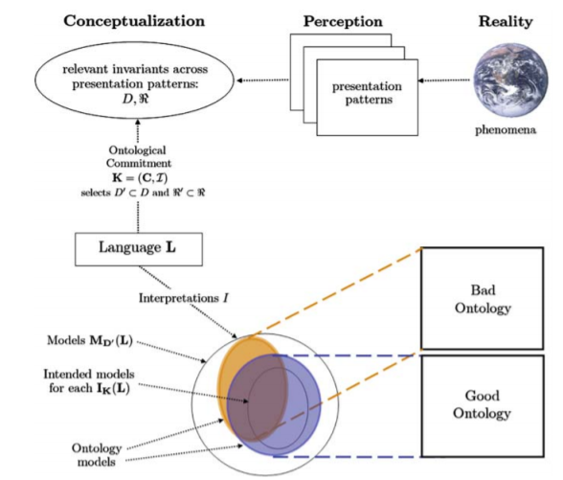
Gruber’s conceptualization re ontology
Modified from fig 2. in: What Is an Ontology? Nicola Guarino, Daniel Oberle, and Steffen Staab
S. Staab and R. Studer (eds.), Handbook on Ontologies, International Handbooks on Information Systems, DOI 10.1007/978-3-540-92673-3,
Springer-Verlag Berlin Heidelberg 2009

Slide 13
Realist conceptualization re ontology
Modified from fig 2. in: What Is an Ontology? Nicola Guarino, Daniel Oberle, and Steffen Staab
S. Staab and R. Studer (eds.), Handbook on Ontologies, International Handbooks on Information Systems, DOI 10.1007/978-3-540-92673-3,
Springer-Verlag Berlin Heidelberg 2009

Slide 14
Gruber’s ‘ontology’ Realism-based ontology
( continued point 4)
( continued point 4)
  ontological commitment should be minimal;
  the purpose is: ‘knowledge sharing and interoperation among programs’,
  shared conceptualizations must be ‘founded on the purpose of the resulting artifact rather than based on a priori notions of naturalness or Truth’;
  ‘knowledge’ does not belong in an ‘ontology’, but in a ‘knowledge base’ designed for the specific purpose the software program has to serve for a specific audience.
  ontological commitment should be based on justifiable true belief;
  the purpose is representation of the generic entities that exist and the relations among then
  shared conceptualizations must be founded in science on be based on truth interpreted as best scientific evidence;
  specific knowledge does not belong in an ontology, but in a data repository that together with the ontology can be used to perform reasoning, f.i. to advance science.

Slide 15
Stated goals and purposes of ontologies
Investigating a domain,
Representing a domain,
Enhancing collaboration,
Supporting data-related processing
  annotating, searching, indexing, merging, comparing, …,
Supporting ontology-related process
  comparing, merging, (re-)using, aligning, emulating, …,
Providing reasoning facilities for specific applications.
Towards modelling the intended purpose of ontologies: A case study in geography.
R Denaux, AG Cohn, V Dimitrova, G Hart
Proceedings of the Terra Cognita Workshop in conjunction with the 8th International Semantic Web Conference, CEUR-WS. Org. 2009. http://ceur-ws.org/Vol-518/terra09_submission_9.pdf

Slide 16
Stated goals and purposes of ontologies
Investigating a domain,
Representing a domain,
Enhancing collaboration,
Supporting data-related processing
  annotating, searching, indexing, merging, comparing, …,
Supporting ontology-related process
  comparing, merging, (re-)using, aligning, emulating, …,
Providing reasoning facilities for specific applications.
for people
for computers
Towards modelling the intended purpose of ontologies: A case study in geography.
R Denaux, AG Cohn, V Dimitrova, G Hart
Proceedings of the Terra Cognita Workshop in conjunction with the 8th International Semantic Web Conference, CEUR-WS. Org. 2009. http://ceur-ws.org/Vol-518/terra09_submission_9.pdf

Slide 17
Ontologies and ‘ontologies’
‘ontologies’
Direct
usefulness
for
people
Terminological
systems
Knowledge representation
systems
Realism-based
Ontologies
Direct usefulness for computers
Inspired by: Rector, A.. “Clinical terminology: why is it so hard?” Methods of information in medicine 38 4-5 (1999): 239-52 .

Slide 18
‘Ontology’ and representation (2)
fig 2. in: What Is an Ontology? Nicola Guarino, Daniel Oberle, and Steffen Staab
S. Staab and R. Studer (eds.), Handbook on Ontologies, International Handbooks on Information Systems, DOI 10.1007/978-3-540-92673-3,
Springer-Verlag Berlin Heidelberg 2009

Slide 19
‘Ontology’ and representation
Representation of
Real ism
Gruber
fig 2. in: What Is an Ontology? Nicola Guarino, Daniel Oberle, and Steffen Staab
S. Staab and R. Studer (eds.), Handbook on Ontologies, International Handbooks on Information Systems, DOI 10.1007/978-3-540-92673-3,
Springer-Verlag Berlin Heidelberg 2009

Slide 20
Further readings on the issue
Incoherencies and inconsistencies in how ‘concept’ is defined and in how concepts are used for representation:
Essential distinctions between concept-based and realism-based representations and how they might co-exist:
Differing views on what computational ontologies should be, how to be designed, and what determines their quality:
Barry Smith, Beyond Concepts, or: Ontology as Reality Representation. Achille Varzi and Laure Vieu (eds.), Formal Ontology and Information Systems. Proceedings of the Third International Conference (FOIS 2004), Amsterdam: IOS Press, 2004, 73–84. http://ontology.buffalo.edu/bfo/BeyondConcepts.pdf
Gunnar O. Klein and Barry Smith. Concept Systems and Ontologies: Recommendations for Basic Terminology. Trans Jpn Soc Artif Intell. 2010 Jan 1; 25(3): 433–441. https://www.ncbi.nlm.nih.gov/pmc/articles/PMC3034144/
M Brochhausen 1, A Burgun, W Ceusters, A Hasman, T Y Leong, M Musen, J L Oliveira, M Peleg, A Rector, S Schulz.
Discussion of "biomedical ontologies: toward scientific debate". Methods Inf Med. 2011;50(3):217-36..
https://ink.library.smu.edu.sg/cgi/viewcontent.cgi?article=4011&context=sis_research

Slide 21
Part 2
Ontologies and Logics

Slide 22
Ontology, principles, and language
Ontological principles (next session)
Logical principles
What Is an Ontology?
Nicola Guarino, Daniel Oberle, and Steffen Staab
S. Staab and R. Studer (eds.), Handbook on Ontologies, International Handbooks 1
on Information Systems, DOI 10.1007/978-3-540-92673-3,
Springer-Verlag Berlin Heidelberg 2009

Slide 23
What is ‘a logic’
A formal or informal language together with a deductive system and/or a (model-theoretic) semantics.
The language has components that correspond to a part of a natural language like English or Greek.
The deductive system is to capture, codify, or simply record arguments that are valid for the given language.
The semantics is to capture, codify, or record the meanings, or truth-conditions for at least part of the language.
Shapiro, Stewart and Teresa Kouri Kissel, "Classical Logic",
The Stanford Encyclopedia of Philosophy (Spring 2021 Edition), Edward N. Zalta (ed.).
https://plato.stanford.edu/archives/spr2021/entries/logic-classical/

Slide 24
Propositional Logic (PL) essentials

Slide 25
Language and semantics of PL
A well-formed formula is either atomic or composed following allowed composition rules.
Atomic formulae stand for propositions that must either be true or false:
  A: ‘John eats too much’.
  B: ‘John has a normal BMI’.
  C: ‘John is careful’.
Formula connectors:
  Negation (not): ¬ ~
  Conjunction (and): ∧ & ∙
  Disjunction (or): ∨
  Material implication (if...then): → ⇒ ⊃
  Biconditional (if and only if): ↔ ⬄ ≡ =

Slide 26
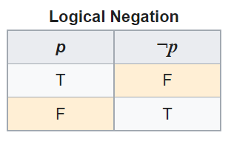
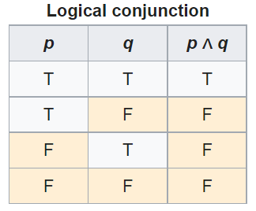
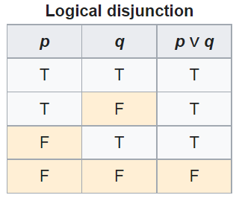
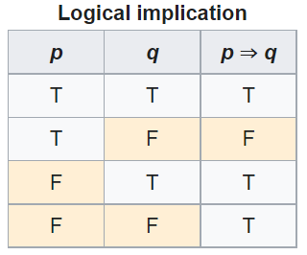
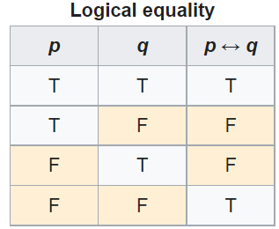
PL’s Deductive system: truth tables

Slide 27
Some PL laws
Truth tables can be used to prove laws, e.g.:
  a Λ (b V c) = (a Λ b) V (a Λ c)
  ¬ (a Λ b) = ¬ a V ¬b
  (a Λ (a → b)) → b
  (a→ b) Λ ¬b) → ¬a
  ((a V b) Λ ¬a) → b
  ((a → b) Λ (b → c)) → (a → c)
  …
  More examples:
    https://math.stackexchange.com/questions/1449866/catalogue-of-propositional-logic-laws
    http://mathonline.wikidot.com/the-laws-of-propositional-logic#toc0
Both truth tables and laws can be used to solve puzzles.

Slide 28
Exercise
Given:
  If John eats too much, then he does not have a normal BMI.
  If John is not careful, then he eats too much.
  John has a normal BMI.
Question
  Is John careful?

Slide 29
Translate sentences into PL
Propositions
John eats too much |  |  | a
John has a normal BMI |  |  | b
John is careful |  |  | c
Given
If John eats too much, then he does not have a normal BMI |  |  | a → ¬b
If John is not careful, then he eats too much. |  |  | ¬c → a
John has a normal BMI |  |  | b
Determine the truth value of: |  | (a → ¬b) ∧ (¬c → a) ∧ b

Slide 30
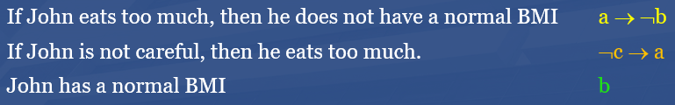

Method 1: Determine with tables

Slide 31
Method 2: Determine using laws
Propositions
John eats too much |  | a
John has a normal BMI |  | b
John is careful |  | c
Given
If John eats too much, then he does not have a normal BMI |  | a → ¬b | g1
If John is not careful, then he eats too much. |  | ¬c → a | g2
John has a normal BMI |  | b | g3
Rule application: | (x→ y) Λ ¬y) → ¬x | ¬a | g3/g1 | g4
 | (x→ y) Λ ¬y) → ¬x | c | g2/g4

Slide 32
Another exercise
Solve this puzzle:
  Given:
    Everybody who eats too much, does not have a normal BMI.
    Everybody who is not careful, eats too much.
    Everybody has a normal BMI.
  Question
    Is everybody careful?
Same as before: yes.

Slide 33
What about this one?
Solve this puzzle:
  Given:
    Everybody who eats too much, does not have a normal BMI.
    Everybody who is not careful, eats too much.
    John has a normal BMI.
  Question
    Is John careful?
Can not be done with propositional logic!
  There is no way to create propositions (within the syntax and semantics of propositional logic) so that ‘everybody’ and ‘John’ can be represented as related.

Slide 34
First Order Logic (FOL)
(Predicate Logic)

Slide 35
First-order logic
Propositional logic with predicates, variables and quantifiers.
Predicate: a proposition that some property holds for some entity, or a relation between entities.
  Prop.L. : A = ‘everybody eats too much’
  FOL: A = ‘eats too much’ A(x)
Quantifiers:
  ‘all’ ∀ ∀x.A(x) everything eats too much
  ‘some’ ∃ ∃x.A(x) something eats too much

Slide 36
First-order logic
Propositional logic with predicates, variables and quantifiers.
Predicate: a proposition that some property holds for some entity, or a relation between entities.
  Prop.L. : A = ‘everybody eats too much’
  FOL: A = ‘eats too much’ A(x)
Quantifiers:
  ‘all’ ∀ ∀x.A(x) everything eats too much
  ‘some’ ∃ ∃x.A(x) something eats too much
‘everybody eats too much’
  ∀x.(person(x) → A(x))

Slide 37
First-Order Logic (FOL) - Syntax
User defines these primitives:
  Constant symbols (i.e., the "individuals" in the world) e.g.: bfo, 3
  Function symbols (mapping individuals to individuals) e.g.: author-of(bfo) = barry_smith
  Predicate symbols (mapping from individuals to truth values)
e.g.: greater(5,3) = true,
smart(barry_smith) = true

Slide 38
First-Order Logic (FOL) - Syntax…
FOL supplies these primitives:
  Variable symbols. E.g., x,y
  Connectives.
    Same as in PL:
      not (~),
      and (^),
      or (v),
      implies (→),
      if and only if (<=>)
  Quantifiers: Universal (∀) and Existential (∃)

Slide 39
Truth values of quantified expressions
Statement | True when | False when
∀x.A(x) | A(x) is true for every x. | There is an x for which A(x) is false
∃x.A(x) | There is an x for which A(x) is true. | A(x) is false for every x.
Open World !!!
Reality
Represented Reality

Slide 40
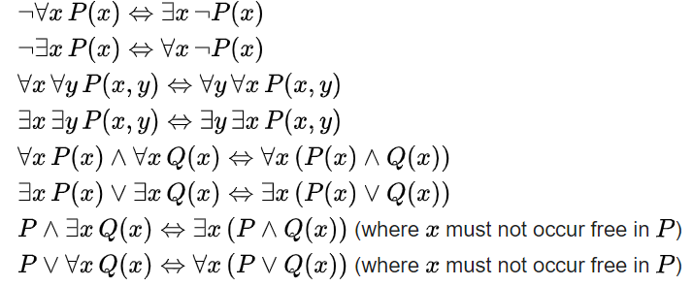
Some equivalences
A free variable is a variable not bound by a quantifier:
∀x.P(x) → Q(x) in contradistinction to ∀x.(P(x) → Q(x))

Slide 41

Flexibility in predicate formation
Some people eat too much:
  ∃x (person(x) Λ eats_too_much(x))
  ∃x (person(x) Λ eats(x, ‘too much’))
  ∃x ∃y (person(x) Λ eats(x, y) Λ quantity(y, ‘too much’))
However:
  Are not equivalent,
  Are based on a different ontology (in philosophical sense).
As a realist ontologist, make your choice on the basis of the ontological principles described in
https://genomebiology.biomedcentral.com/articles/10.1186/gb-2005-6-5-r46

Slide 42
Be aware of ambiguities in language
‘Every patient has some provider’
  Can mean:
    ∀x ∃y patientOf(x, y)
      For all x, there exist some y such that x is a patient of y
        Every patient has some provider.
    ∃y ∀x patientOf(x, y)
      There exist some y, such that for all x, x is a patient of y
        There is some provider that provides for all patients.

Slide 43
Description Logic(s)

Slide 44
Description Logic(s)
A DL is a fragment of FOL.
DLs come in many varieties, most of which are decidable.
  A logic is decidable if there is an effective method for determining whether arbitrary formulas of the logic are logically valid formulas.
  A FOL is not decidable if its signature (i.e. the list and description of non-logical symbols) includes equality and at least one other predicate with two or more arguments.
  Flavors: https://en.wikipedia.org/wiki/Description_logic .
Despite its limitations, but because of its use in the Web Ontology Language (OWL), it became the most popular one.

Slide 45
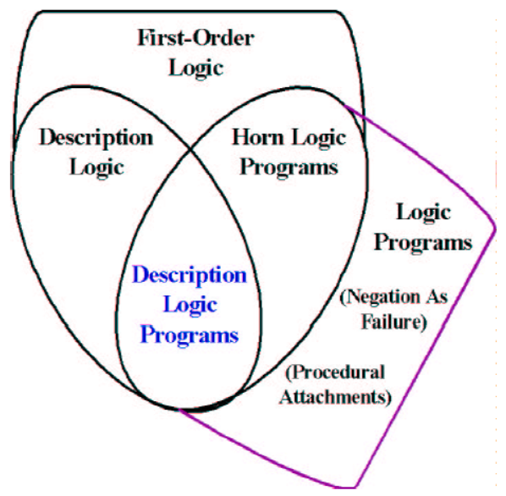
Relations between some logics
DL
Benjamin Grosof , Ian Horrocks, Raphael Volz, Stefan Decker.
Description Logic Programs: Combining Logic Programs with Description Logic. 2004 Research Papers in Economics.. http://www.cs.man.ac.uk/~horrocks/Publications/download/2003/p117-grosof.pdf

Slide 46
Description Logic(s)
Three essential components of a DL system:
  Abox: Father(john). concept assertion
  fatherOf(john, barry). role assertion
  john ≠ barry
  …
  Tbox: Father Parent concept inclusion
  Person ≡ Human concept equivalence
  …
  Rbox: fatherOf parentOf role inclusion
  disjoint(parentOf, childOf) disjointness of roles
  …
Assertions need to be interpreted as being about sets.

Slide 47
DL constructors
Male Parent intersection / conjunction
Male Female union / disjunction
¬ Male complement / negation
…
Can be used in Tbox axioms, e.g.
  Father ≡ Male Parent
  T Male Female everything is included in the set of males and females
  Male Female ⊥ the intersection of the set of males and the set of females is empty
  …
Markus Krötzsch, Frantisek Simancik, Ian Horrocks. A Description Logic Primer. https://arxiv.org/pdf/1201.4089.pdf

Slide 48
Role restrictions
Universal restriction:
  ∀parentOf.Female
    The set of individuals all of whose children are female including those that have no children at all.
Existential restriction:
  ∃parentOf.T
    The set of individuals that are parents of at least one individual.
Combinations:
  construct: ∃parentOf.T ∀parentOf.Female
    The set of all individuals with at least one child, all children being female.
  axiom: ∃sonOf.T male
    The set of individuals that are the son of at least one individual is a subset of the set of males.
Markus Krötzsch, Frantisek Simancik, Ian Horrocks. A Description Logic Primer. https://arxiv.org/pdf/1201.4089.pdf

Slide 49
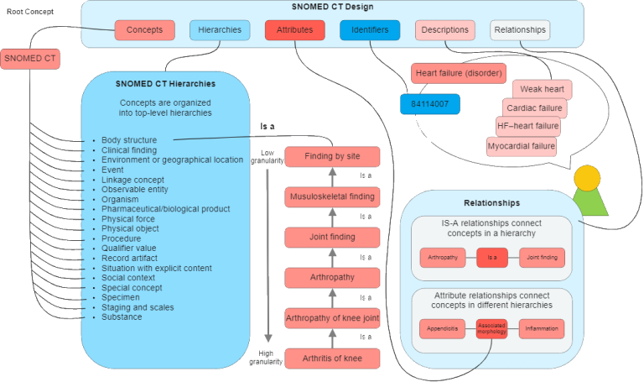
An example: Snomed CT
https://enonic.com/blog/what-is-snomed-ct

Slide 50
Snomed’s DL is EL++ (1)
The description logic EL++ allows the following concepts:
C, D → A | (atomic concept)
T | (universal concept)
⊥ | (bottom concept)
{a} | (singular enumeration)
C D | (intersection / conjunction)
∃R.C | (existential restriction)
With the following axioms:
  C D and C ≡ D for concept descriptions C and D.
  P Q and P ≡ Q for roles P, Q.
  C(a) and R(a, b) for concept C, role R and individuals a, b

Slide 51
Snomed’s DL is EL++ (2)
It lacks:
  negation, (only disjointness of classes: C D ⊥),
  disjunction,
  universal quantification,
  cardinalities,
  inverse roles,
  some role characteristics

Slide 52
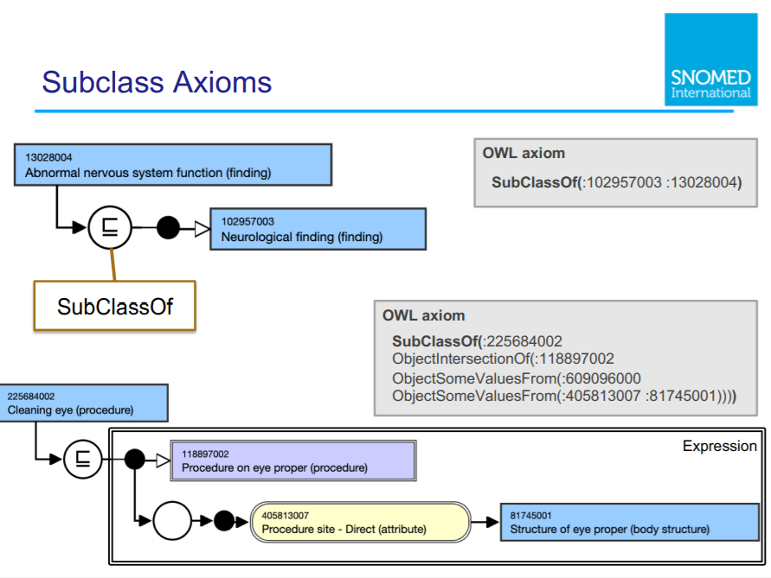

Slide 53
Existential restriction

Slide 54
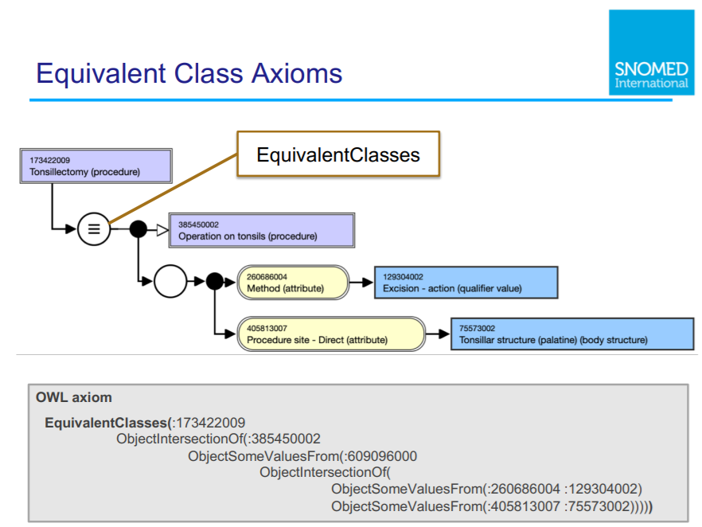

Slide 55
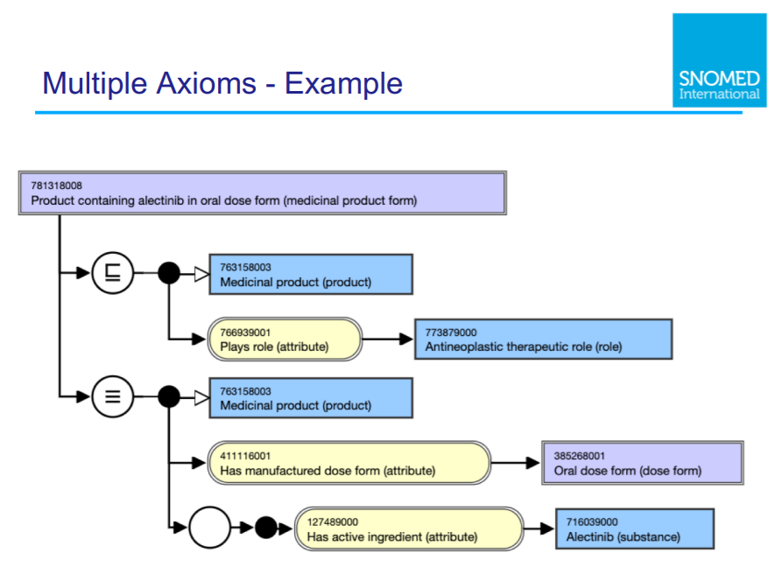

Slide 56
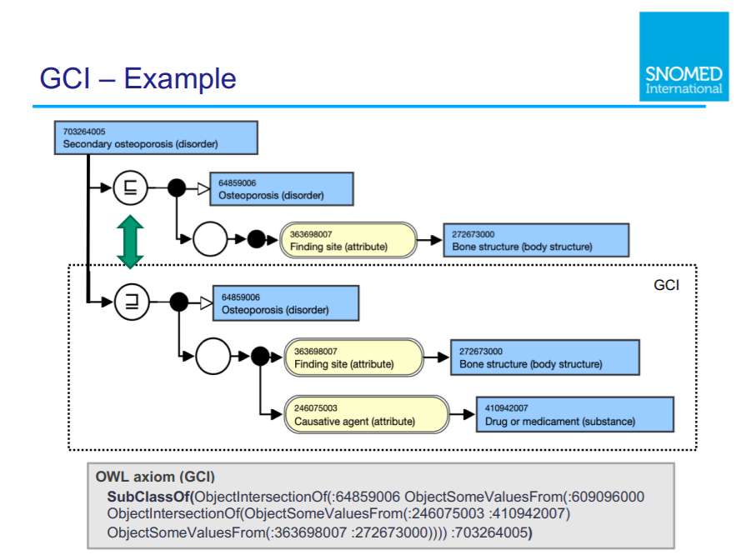

Slide 57
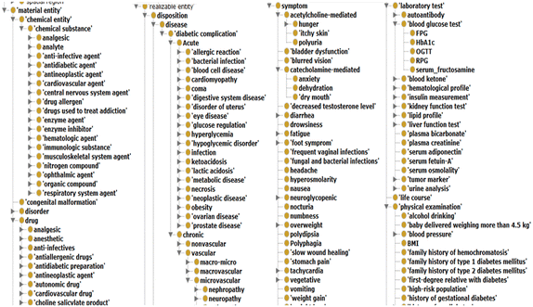
SubClassOf hierarchies = concept inclusion!
No reference provided due to vicarious embarrassment

Slide 58
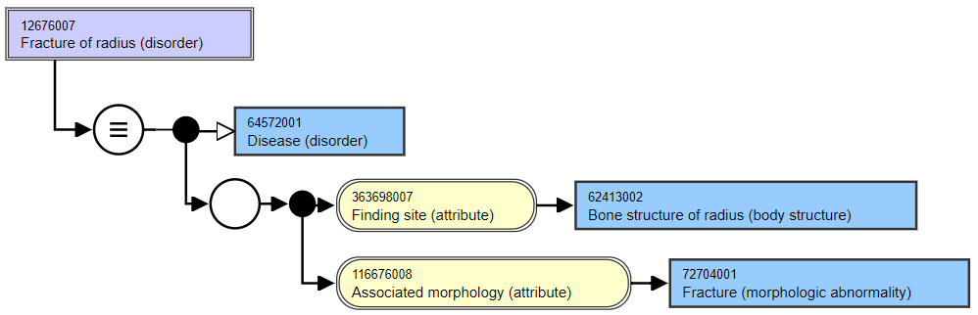
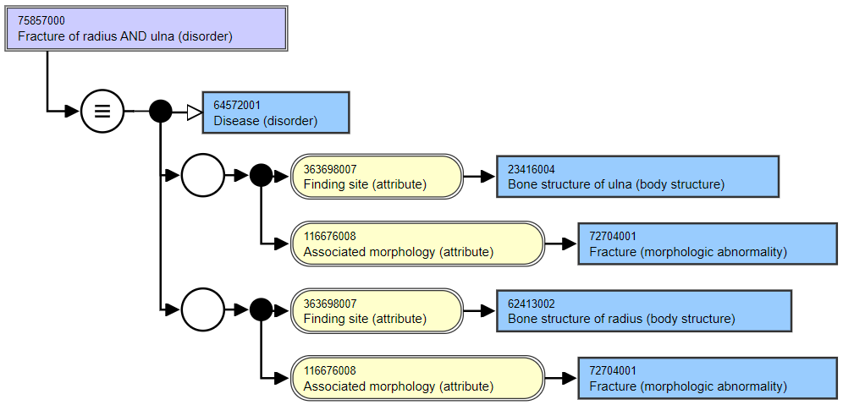
Asserted
Asserted

Slide 59
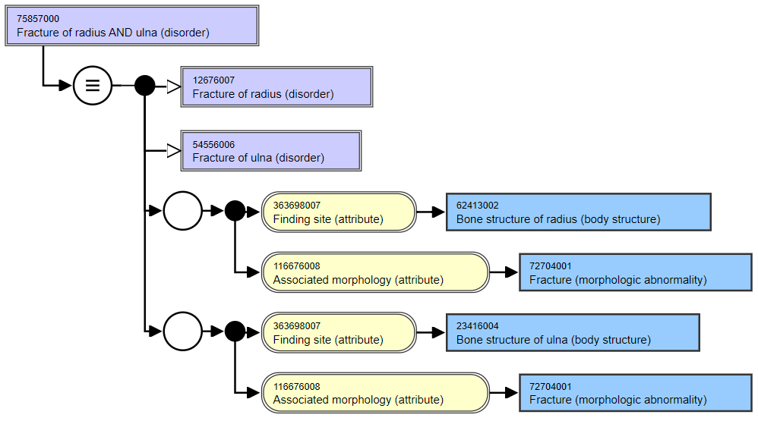
Role groups in
Snomed CT: odd
consequences by design

Slide 60
Characteristics of OWL-based DLs
Ideal for fixing the terminology of a domain
  → constructors
  DL-reasoners can detect contradicting definitions and classify terms automatically
    But only if axioms are used of a sort the reasoner can work with!

Slide 61
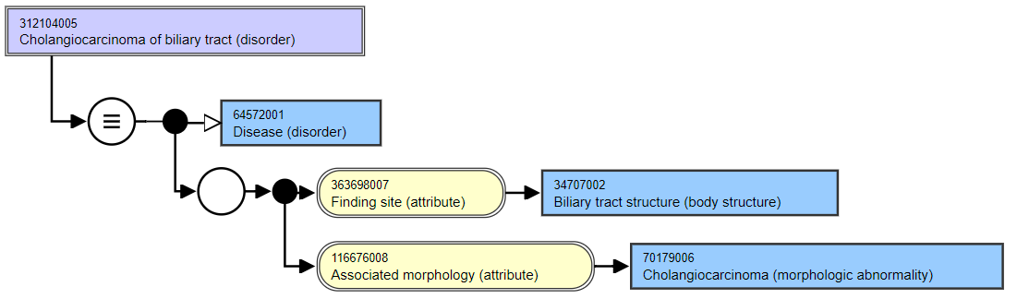
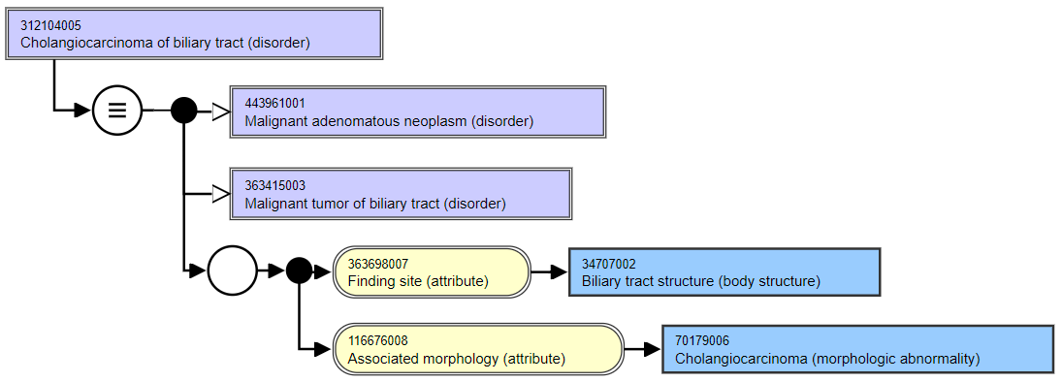
Asserted
Inferred

Slide 62
Characteristics of OWL-based DLs
Ideal for fixing the terminology of a domain
  → constructors
  DL-reasoners can detect contradicting definitions and classify terms automatically
Drawbacks:
  Based on non-defeasible logic, hence no exceptions are possible
  One cannot:
    represent classes of classes,
    make statements about classes
  Prone to ‘tweaking’ axioms for desired outcomes though ontologically nonsensical

Slide 63

A must read if you plan to use Protégé !

Slide 64
At least remember this forever!
‘ The words “ontology” and “ontological”, the Web Ontology Language, OWL, and the description logics on which OWL is based continue to cause confusion.
Description logics (DLs) and OWL are major advances for representing logical definitions for terminologies. However, they are severely limited in representing other kinds of statements. As a result, their standard semantics is often ignored or distorted with unintended consequences. ’
Rector A, Schulz S, Rodrigues JM, Chute CG, Solbrig H.
On beyond Gruber: "Ontologies" in today's biomedical information systems and the limits of OWL.
J Biomed Inform. 2019;100S:100002. doi: 10.1016/j.yjbinx.2019.100002. Epub 2019 Mar 9. PMID: 34384571.
https://www.sciencedirect.com/science/article/pii/S2590177X19300010

Slide 65
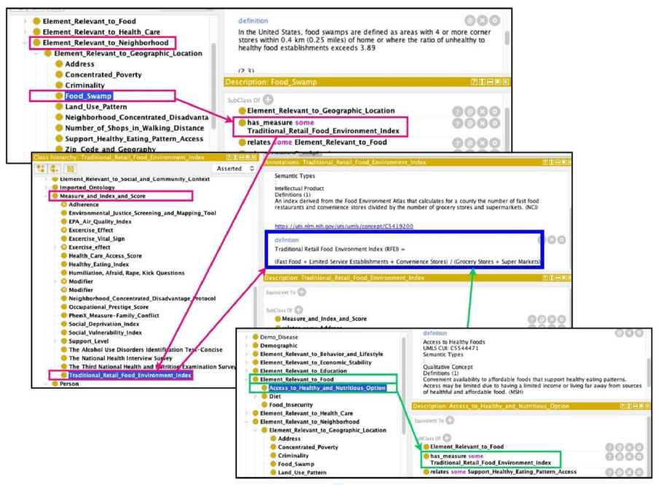
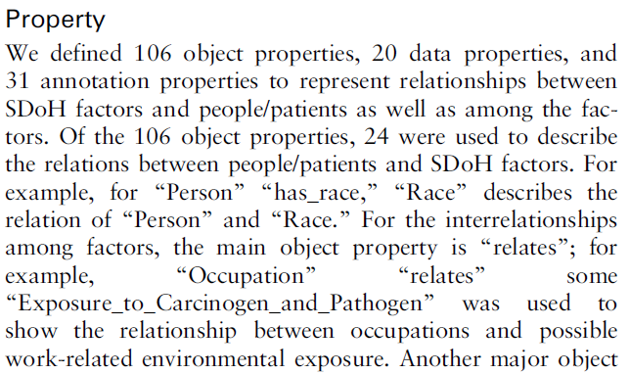
Abusing OWL
Dang Y, Li F, Hu X, Keloth VK, Zhang M, Fu S, Amith MF, Fan JW, Du J, Yu E, Liu H, Jiang X, Xu H, Tao C. Systematic design and data-driven evaluation of social determinants of health ontology (SDoHO). J Am Med Inform Assoc. 2023 Aug 18;30(9):1465-1473. doi: 10.1093/jamia/ocad096. PMID: 37301740; PMCID: PMC10436148.

Slide 66
Abusing Protégé, BFO and OGMS
No reference provided due to vicarious embarrassment

Slide 67
Common Logic

Slide 68
Common Logic (CL)
CL is a family of first-order logics which share a common abstract syntax and model theory, and an XML framework for encoding and transmitting them, or their content, on an open network.
CL syntax is very relaxed in the expressions it allows, in some ways going beyond classical FO logic.
ISO standard: https://standards.iso.org/ittf/PubliclyAvailableStandards/c066249_ISO_IEC_24707_2018.zip
https://www.w3.org/2004/12/rules-ws/slides/pathayes.pdf

Slide 69
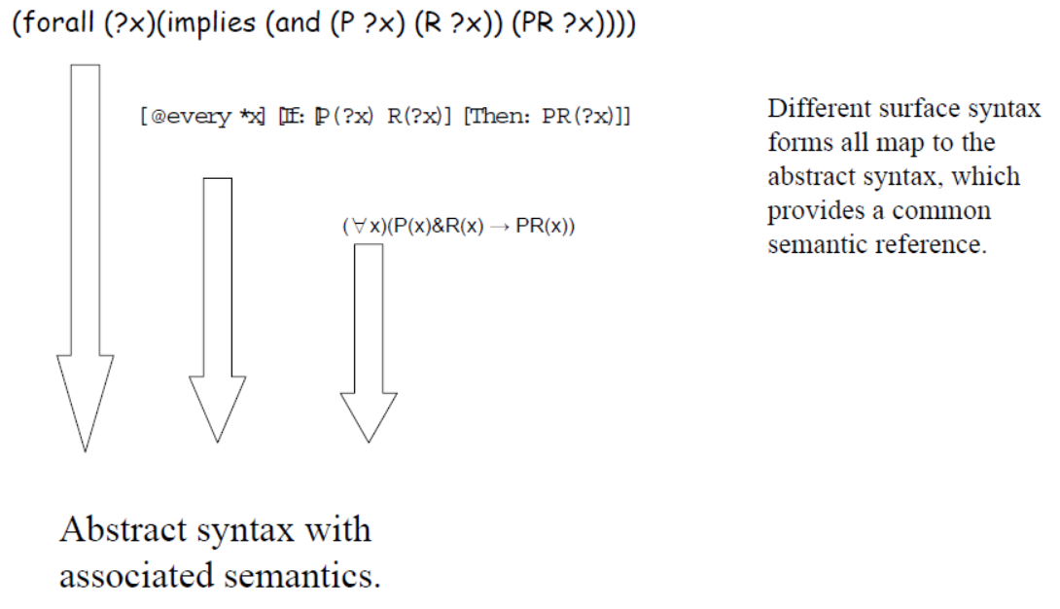
CL dialects
https://www.w3.org/2004/12/rules-ws/slides/pathayes.pdf

Slide 70
Common Logic Interchange Format
(CLIF)
John is going to Boston by bus
(exists (x y)
(and (Go x) (Person John) (City Boston)
(Bus y) (Agnt x John) (Dest x Boston) (Inst x y)))
https://standards.iso.org/ittf/PubliclyAvailableStandards/c066249_ISO_IEC_24707_2018.zip

Slide 71
Common Logic Interchange Format
(CLIF)
John is going to Boston by bus
(exists (x y)
(and (Go x) (Person John) (City Boston)
(Bus y) (Agnt x John) (Dest x Boston) (Inst x y)))
quantifier
variable
predicate
individuals
connective
https://standards.iso.org/ittf/PubliclyAvailableStandards/c066249_ISO_IEC_24707_2018.zip

Slide 72
BFO2020-style CLIF constructs for FOL (1)
Predicate: (predicate_name {arguments})
  where ‘{arguments}’ is a list of terms and/or variables.
  (universal human-being)
  (instance-of werner human-being year-2002)
  (inheres-in this-color that-ball)
Quantified construct: (quantifier ({vars}) <construct>)
  where ‘{vars}’ is a list of variables.
  (exists (t) (instance-of werner human-being t))
  (forall (t) (exists (x) (exists-at x t)))
Negation: (not <construct>)
  (not (= object history))
  (not (exists (t) (instance-of werner quality t)))

Slide 73
BFO2020-style CLIF constructs for FOL (2)
Construct-list: (and/or {constructs})
  (and (instance-of werner human-being year-2002)
  (instance-of werner human-being year-2003))
  (or (inheres-in this-color this-ball)
  (inheres-in this-color that-ball))
Implication: (if/iff <construct> <construct>)
  (iff (occurrent-part-of a b)
  (has-occurrent-part b a))
  (if (exists (t) (instance-of a occurrent t))
  (occurrent-part-of a a))

Slide 74
Examples from psychology
Textual representation | CLIF rendering
At any time at which x does not communicate accurate understanding of y’s perspectives and experiences, x does not have empathy for y. | (forall (x y t) (if (not (p-cau x y t)) (not (empathizes x y t))))
At any time at which x communicates accurate understanding of y’s perspectives and experiences, x has empathy for y. | (forall (x y t) (if (p-cau x y t) (empathizes x y t)))
At any time at which x vicariously experiences y’s feelings, perspectives, and thoughts, x has empathy for y. | (forall (x y t) (if (p-vef x y t) (empathizes x y t)))
Ceusters W & Dermen K. Developing ontologies for motivational interviewing to advance health behavior intervention research and practice.

Slide 75
Advantages of using FOL/CLIF (1)
Allows for precise, unambiguous and machine-processible descriptions of what one ontologically commits to;
  Example from BFO2020:
    (forall (t)
      (if (instance-of t temporal-region t)
      (exists (u i)
      (and (not (= i t))
      (universal u)
      (particular i)
      (instance-of i u t))))))
    At all times, there is at least one particular and one universal that is instantiated by that particular.
‘machine-processable’ → syntax can be checked by parser.

Slide 76
Advantages of using FOL/CLIF (2)
Allows for precise, unambiguous and machine-processible descriptions of what one ontologically commits to;
Allows for transformations to other formats such as Kowalski rules.

Slide 77
5 forms of Kowalski rules
‘if-then’-rules:
  ( A & B & … ) → P
  true → P
‘if-then-or’-rules:
  ( A & B & …) → ( P v Q v … )
  true → ( P v Q v … )
‘false-hood’-rules:
  ( A & B & … ) → false

Slide 78
Horn Logic
‘if-then’-rules:
  ( A & B & … ) → P
  true → P
‘if-then-or’-rules:
  ( A & B & …) → ( P v Q v … )
  true → ( P v Q v … )
‘false-hood’-rules:
  ( A & B & … ) → false
A, B, … may be true or false
P must be true

Slide 79
Example: simplification of axioms (1)
(cl:comment "No role changes type during its existence [bks-1]“
(forall (o)
(if (exists (t) (instance-of o role t))
(forall (u)
(if (exists (t) (instance-of o u t))
(forall (t) (iff (instance-of o role t) (instance-of o u t))))))))
Conversion to Kowalski-rules (in Prolog-readable syntax):
kow(if([['instance-of',E,D,A],
['instance-of',E,D,C],
['instance-of',E,role,B]]),
then(['instance-of',E,role,A]))).
Redundant literals can be removed
kow(if([['instance-of',E,role,A],
['instance-of',E,D,C],
['instance-of',E,role,B]]),
then(['instance-of',E,D,A]))).

Slide 80
Example: simplification of axioms (2)
kow(if([['instance-of',E,D,A],
['instance-of',E,role,B]]),
then(['instance-of',E,role,A]))).
Rename singular variable and re-order
kow(if([['instance-of',E,D,A],
['instance-of',E,role,B]]),
then(['instance-of',E,role,A]))).
Rename variables to match other formula
kow(if([['instance-of',E,D,A],
['instance-of',E,role,B]]),
then(['instance-of',E,role,A]))).
kow(if([['instance-of',E,role,A],
['instance-of',E,D,C],
then(['instance-of',E,D,A]))).
kow(if([['instance-of',E,D,B],
['instance-of',E,role,A],
then(['instance-of',E,D,A]))).
kow(if([['instance-of',E,D,A],
['instance-of',E,role,B],
then(['instance-of',E,D,B]))).

Slide 81
Example: simplification of axioms (3)
kow(if([['instance-of',E,D,A],
['instance-of',E,role,B]]),
then(['instance-of',E,role,A]))).
Back to CLIF:
(forall (e d b a)
(if (and (instance-of e d a) (instance-of e role b))
(and (instance-of e role a) (instance-of e d b))))
Compare with:
(forall (o)
(if (exists (t) (instance-of o role t))
(forall (u)
(if (exists (t) (instance-of o u t))
(forall (t) (iff (instance-of o role t)
(instance-of o u t))))))))
kow(if([['instance-of',E,D,A],
['instance-of',E,role,B],
then(['instance-of',E,D,B]))).

Slide 82
From FOL axioms to Kowalski rules
Eliminate the implications.
Move the negations down to the atomic formulas.
Eliminate the existential quantifiers.
Rename the variables, if necessary.
Move the universal quantifiers to the left.
Move the disjunctions down to the literals.
Eliminate the conjunctions.
Rename the variables, if necessary.
Eliminate the universal quantifiers.
For each disjunction obtained: move negations to the left and rewrite ‘not P or Q’ as ‘P → Q’.
https://www.cs.cornell.edu/courses/cs4700/2011fa/lectures/16_FirstOrderLogic.pdf
https://www.cs.miami.edu/home/geoff/Courses/COMP6210-10M/Content/FOFToCNF.shtml#:~:text=Clause%20Normal%20Form%20(CNF)%20is,%7C%2C%20e.g.%2C%20C%7C.

Slide 83
Example from BFO2020
    (forall (t)
      (if (instance-of t temporal-region t)
      (exists (u i)
      (and (not (= i t))
      (universal u)
      (particular i)
      (instance-of i u t))))))
    becomes:
      (instance-of t temporal-region t) → (instanceof sk9(t) sk8(t) t)
      (instance-of t temporal-region t) → (particular sk9(t))
      (instance-of t temporal-region t) → (universal sk8(t))
      (instance-of t temporal-region t) ∧ (= sk9(t) t) → false

Slide 84
Advantages of using FOL/CLIF (3)
Allows for precise, unambiguous and machine-processible descriptions of what one ontologically commits to;
Allows for transformations to other formats such as Kowalski rules;
Kowalski rules can be processed by relatively simple logic programs for satisfiability testing, model development, term expansion, rule-base optimization, data-integrity checking, ...
Practical examples and exercises will be given July 16.

