Slide 1
Biomedical Ontology for Biomedical Informaticists.
Lecture in BMI501: Survey of Biomedical Informatics – Sept 17, 2026
Department of Biomedical Informatics, University at Buffalo
Werner CEUSTERS, MD
^{wceusters@gmail.com}
Department of Biomedical Informatics
University at Buffalo, NY, USA

Slide 2
Two topics
How to distinguish between ontologies and related representations (25%)
How to assess the quality of an ‘ontology’ in function of its type and its appropriateness in function of your needs and goals? (75%)
    Various sorts of ontologies
    Various worldviews underlying different ontologies
    Faithfulness of the ontology to reality under a worldview
    Adequate use of natural language for human understanding
    Adequate use of a formal language for machine understanding
    Adherence to the formal semantics of a language if it has one
    Adherence to ontological principles
    Adherence to Basic Formal Ontology (BFO) principles

Slide 3
Part 1: Representations
Ontologies
Terminologies
Conceptualizations
Learning objectives: be able …
  to explain what they are,
  to motivate what makes them distinct.

Slide 4
Google exposes the ‘ontology zoo’
‘An ontology is’ …:
  ‘a vocabulary …’
  ‘a set of terms …’
  ‘a data structure …’
  ‘a description of data structure …’
  ‘a formal description of knowledge …’
  ‘a system for organizing information …’
  ‘a rulebook defining concepts …’
  ‘a formal, machine-readable model of a domain …’
  ‘a way of showing the properties of a subject area …’
  …

Slide 5
Most cited ‘ontology’ definition (1)
‘An ontology is an explicit specification of a conceptualization’
T. R. Gruber. A Translation Approach to Portable Ontologies.
Knowledge Acquisition, 5(2):199–220, 1993.
Quickly picked up by the medical terminology community → ‘formal terminology’
But: explaining and standardizing terminology is very different from explaining and formally representing the entities in reality denoted by terms!:
‘The term is borrowed from philosophy, where an ontology is a systematic account of Existence. For knowledge-based systems, what “exists” is exactly that which can be represented.’
T. R. Gruber. Ibidem

Slide 6
Most cited ‘ontology’ definition (2)
‘An ontology is an explicit specification of a conceptualization’
T. R. Gruber. A Translation Approach to Portable Ontologies.
Knowledge Acquisition, 5(2):199–220, 1993.
Quickly picked up by the medical terminology community → ‘formal terminology’
But: explaining and standardizing terminology is very different from explaining and formally representing the entities in reality denoted by terms!:
‘The term is borrowed from philosophy, where an ontology is a systematic account of Existence. For knowledge-based systems, what “exists” is exactly that which can be represented.’
→ Three key notions!
T. R. Gruber. Ibidem

Slide 7
K1. ‘Ontology borrowed from philosophy’
Ontology (no plural) is the study of what entities exist and how they relate to each other;
by some philosophers taken to be synonymous with ‘metaphysics’ while others draw distinctions in many distinct ways (the distinctions being irrelevant for this talk), but almost agreeing on the following classification:
  metaphysics → studies ‘how is the world?’
    general metaphysics → studies general principles and ‘laws’ about the world
      ontology → studies what type of entities exist in the world
    special metaphysics → focuses on specific principles and entities
distinct from ‘epistemology’ which is the study of how we can come to know about what exists.
distinct from ‘terminology’ which is the study of what terms mean and how to name things.

Slide 8
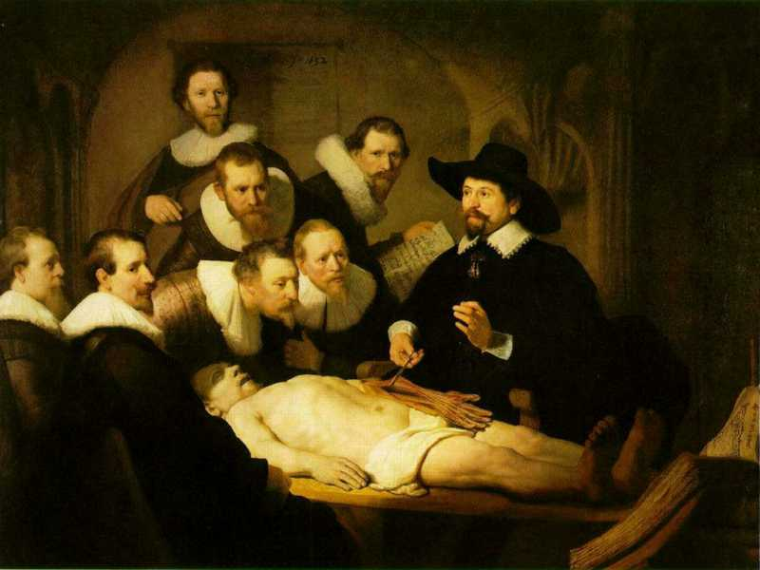
Three levels of reality
L1: what is the case
ontos
L2: what we believe
thought
logos
word / speech
L3: what we
communicate
Rembrandt van Rijn, The Anatomy Lesson of Dr. Nicolaes Tulp, 1632. Oil on canvas, 169.5cm x 216.5cm (Mauritshuis, The Hague)
8
Notes:
https://www.thewoventalepress.net/2018/02/12/an-anatomy-lesson/

Slide 9
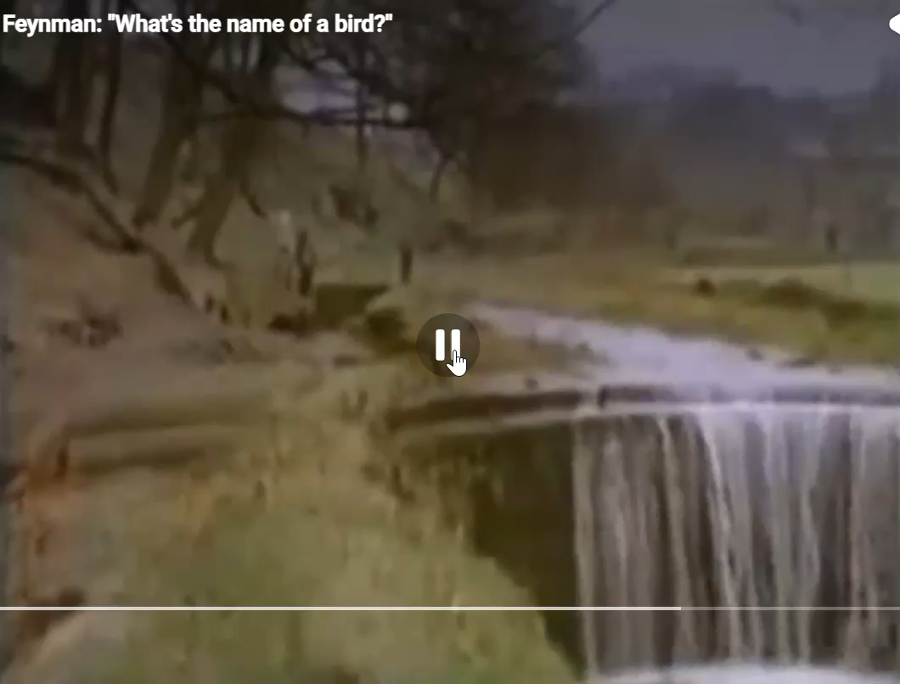
Knowing the name of a thing ≠ knowing what it is

Slide 10
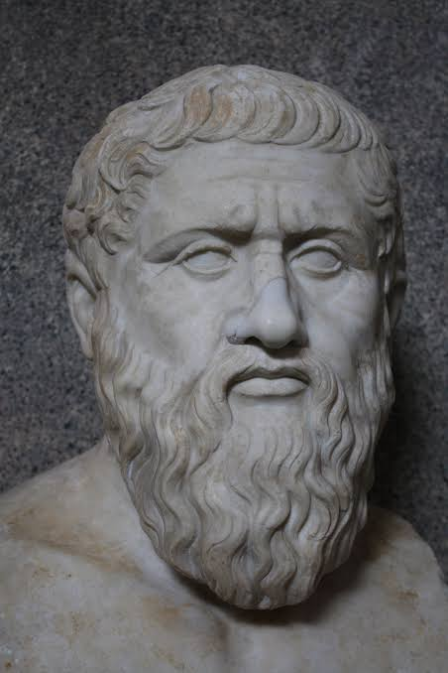
K2. ‘Knowledge’
‘True justified belief’ - requirements:
  It must be believed
    By whom?
  It must be about what is the case
  There must be evidence or sound argumentation for it.

Slide 11

‘Knowledge’ as justified true belief - problem
Requirements:
  It must be believed
    By whom?
  It must be about what is the case
  There must be evidence or sound argumentation for it.
The Gettier challenge (1963):
  Fooled by evidence
    Examples?

Slide 12
‘Knowledge’ as justified true belief - exceptions
Requirements:
  It must be believed
    By whom?
  It must be about what is the case
  There must be evidence or sound argumentation for it.
The Gettier challenge (1963):
  Fooled by evidence
    Clock case
    White paper in field

Slide 13
Is justified true belief (JTB) what Gruber denotes by ‘knowledge’?
‘knowledge does not belong in an ontology, but in a knowledge base designed for the specific purpose the software program has to serve for a specific audience’
T. R. Gruber. A Translation Approach to Portable Ontologies.
Knowledge Acquisition, 5(2):199–220, 1993.

Slide 14
Or is his thought clumsily formulated?
Which of the following JTB statements qualify as knowledge?
  Moles are disorders;
  The beauty spot above Cindy Crawford’s lip is a mole;
  Populations with fair skin naturally develop a higher average number of benign skin moles than populations of the same size with dark skin.

Slide 15
Or is his thought clumsily formulated? (2)
Which of the following JTB statements qualify as knowledge?
  Moles are disorders;
  The beauty spot above Cindy Crawford’s lip is a mole;
  Populations with fair skin naturally develop a higher average number of benign skin moles than populations of the same size with dark skin.
Possible interpretations:
  Instance data doesn’t belong in an ontology?
  Only the logic required to reason with instance data belongs in an ontology?

Slide 16
Clean separation of knowledge
Conceptual knowledge: the knowledge of sensible medical concepts;
Knowledge of clinical definitions and criteria: how to determine if a concept applies to a particular patient;
Surface linguistic knowledge: how to express the concepts in any given language;
Knowledge of classification and coding systems: how an expression has been classified by such a system;
Pragmatic knowledge: what doctors usually say or think, what they consider important, how to integrate in EHR.
Rector AL, Nowlan WA and Kay S. Conceptual Knowledge: the core of medical information systems. In:
Medinfo 92. Lun KC et al. (eds). North Holland: Elsevier Science Publishers BV, 1992: 1420 - 1426.

Slide 17
K3. ‘represent’ → ‘Representational artifact’
Roughly and broadly: something created to depict, represent, or be about something else.
Examples:
‘Werner Ceusters’
‘The Division Chief Biomedical Ontology of the UB BMI’
‘Celtic Bompa’

Slide 18
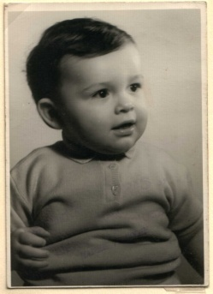

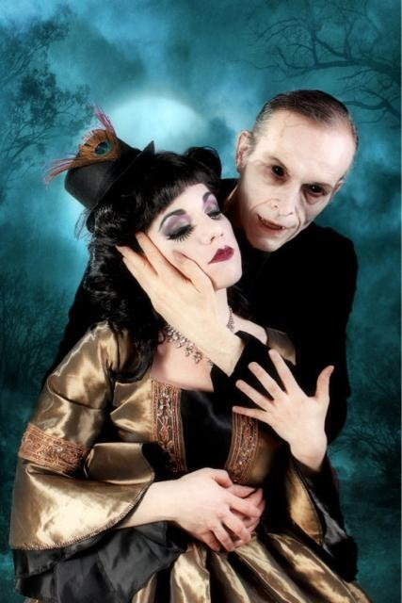

K3. ‘represent’ → ‘Representational artifact’
Roughly and broadly: something created to depict, represent, or be about something else.
Examples:
‘Werner Ceusters’
‘The Division Chief Biomedical Ontology of the UB BMI’
‘Celtic Bompa’
1960
2004 (by D.Boss)
2009 (by Laura Dark)
2013

Slide 19
Some rough definitions / elucidations (1)
REPRESENTATION: an entity, for example an idea, image, record, or description which refers to (is of or about), or is intended to refer to, some entity or entities external to the representation.
COMPOSITE REPRESENTATION: a representation built out of constituent sub-representations as their parts, in the way in which paragraphs are built out of sentences and sentences out of words.
REPRESENTATIONAL UNIT: the smallest constituent sub-representations such as icons, names, simple word forms, or the sorts of alphanumeric identifiers we might find in patient records.
Smith B, Kusnierczyk W, Schober D, Ceusters W. Towards a Reference Terminology for Ontology Research and Development in the Biomedical Domain. Proceedings of KR-MED 2006, Biomedical Ontology in Action, November 8, 2006, Baltimore MD, USA (draft)

Slide 20
Some rough definitions / elucidations (2)
COGNITIVE REPRESENTATION: a representation whose representational units are ideas, thoughts, or beliefs in the mind of some cognitive subject – for example a clinician engaged in applying theoretical (and practical) knowledge to the task of establishing a diagnosis.
REPRESENTATIONAL ARTIFACT: a representation that is fixed in some medium in such a way that it can serve to make the cognitive representations existing in the minds of separate subjects publicly accessible in some enduring fashion. Examples are: a text, a diagram, a map legend, a list, a clinical record, or a controlled vocabulary.
Smith B, Kusnierczyk W, Schober D, Ceusters W. Towards a Reference Terminology for Ontology Research and Development in the Biomedical Domain. Proceedings of KR-MED 2006, Biomedical Ontology in Action, November 8, 2006, Baltimore MD, USA (draft)

Slide 21
Note: Gruber did not intend to describe reality !
Working on AI, at that time focused on closed-world reasoning, he argued that:
  ontological commitment should be minimal;
  that the shared conceptualizations must be ‘founded on the purpose of the resulting artifact rather than based on a priori notions of naturalness or Truth’;
  for a purpose which is: ‘knowledge sharing and interoperation among programs’, and
  that ‘knowledge’ does not belong in his conception of ‘ontology’, but in a ‘knowledge base’ designed for the specific purpose the software program has to serve for a specific audience.
      Gruber TR. Toward principles for the design of ontologies used for knowledge sharing. International Journal of Human-Computer Studies. 1995;43(5-6):907-28.

Slide 22
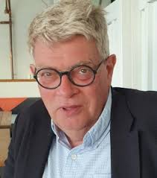
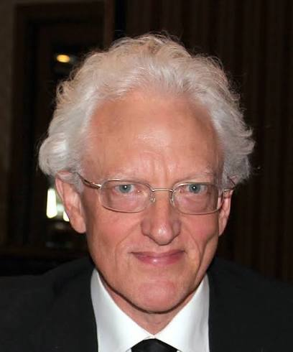
‘Conceptualization’ → ‘Concept’
Definition: meaning of a term as agreed upon by a group of responsible persons.
  there can be agreed meanings for terms like “unicorn” which do not correspond to any unit of knowledge;
  ‘concepts’ as common understandings of the meaning of a term distinguishes concepts from ideas in the minds of individual cognitive subjects;
  the term refers to this meaning itself and not to any specification of this meaning in some natural or artificial language or in some formal model.
Concept systems and ontologies: Recommendations for basic terminology
Gunnar O. Klein & Barry Smith
Transactions of the Japanese Society for Artificial Intelligence 25 (3):433-441 (2010)

Slide 23
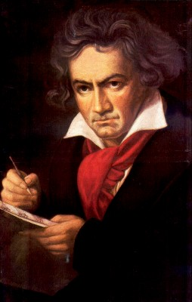
The semantic triangle
Ludwig van Beethoven
that great German composer that became deaf
…
concept
term
referent
‘Beethoven’
Ogden, C. K. and I.A. Richards. 1989[1923]. The Meaning of Meaning.
San Diego: Harcourt Brace Jovanovich. (Original published London: Kegan Paul.)

Slide 24
Gruber’s ‘ontology’ Realism-based ontology
  ontological commitment should be minimal;
  ontological commitment should be based on justifiable true belief;

Slide 25
Gruber’s ‘ontology’ Realism-based ontology
( continued point 2 )
( continued point 2 )
  ontological commitment should be minimal;
  the purpose is: ‘knowledge sharing and interoperation among programs’,
  ontological commitment should be based on justifiable true belief;
  the purpose is representation of the generic entities that exist and the relations among then

Slide 26
Commitment to generic entities (1)
Three distinct positions in analytical philosophy:
Nominalism:
  there are no generic entities in reality: there is no personhood, there are only individual persons.
Conceptualism:
  generalizations are in our ‘minds’. Personhood is a concept construed in our ‘mind’ that allows us to reason about persons without any particular person in mind.
Realism:
  generic entities do exist and are called ‘universals’. Each particular person is an instance of the universal we call ‘person’.

Slide 27
Commitment to generic entities (2)
Three distinct positions in analytical philosophy:
Nominalism:
  there are no generic entities in reality: there is no personhood, there are only individual persons.
Conceptualism: ← the mainstream approach to ontology design
  generalizations are in our ‘minds’. Personhood is a concept construed in our ‘mind’ that allows us to reason about persons without any particular person in mind.
Realism: ← the realism-based approach
  generic entities do exist and are called ‘universals’. Each particular person is an instance of the universal we call ‘person’.

Slide 28
Gruber’s ‘ontology’ Realism-based ontology
( continued point 3 )
( continued point 3)
  ontological commitment should be minimal;
  the purpose is: ‘knowledge sharing and interoperation among programs’,
  shared conceptualizations must be ‘founded on the purpose of the resulting artifact rather than based on a priori notions of naturalness or Truth’;
  ontological commitment should be based on justifiable true belief;
  the purpose is representation of the generic entities that exist and the relations among then
  shared conceptualizations must be founded on science and be based on ‘truth’ interpreted as best scientific evidence;

Slide 29
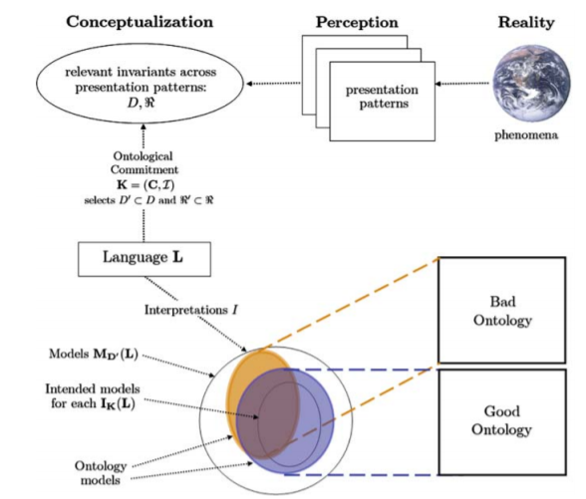
Gruber’s conceptualization re ontology
Modified from fig 2. in: What Is an Ontology? Nicola Guarino, Daniel Oberle, and Steffen Staab
S. Staab and R. Studer (eds.), Handbook on Ontologies, International Handbooks on Information Systems, DOI 10.1007/978-3-540-92673-3,
Springer-Verlag Berlin Heidelberg 2009

Slide 30
Realist conceptualization re ontology
Modified from fig 2. in: What Is an Ontology? Nicola Guarino, Daniel Oberle, and Steffen Staab
S. Staab and R. Studer (eds.), Handbook on Ontologies, International Handbooks on Information Systems, DOI 10.1007/978-3-540-92673-3,
Springer-Verlag Berlin Heidelberg 2009

Slide 31
Gruber’s ‘ontology’ Realism-based ontology
( continued point 4)
( continued point 4)
  ontological commitment should be minimal;
  the purpose is: ‘knowledge sharing and interoperation among programs’,
  shared conceptualizations must be ‘founded on the purpose of the resulting artifact rather than based on a priori notions of naturalness or Truth’;
  ‘knowledge’ does not belong in an ‘ontology’, but in a ‘knowledge base’ designed for the specific purpose the software program has to serve for a specific audience.
  ontological commitment should be based on justifiable true belief;
  the purpose is representation of the generic entities that exist and the relations among then
  shared conceptualizations must be founded in science on be based on truth interpreted as best scientific evidence;
  knowledge about specific entities does not belong in an ontology, but in a data repository that together with the ontology can be used to perform reasoning, f.i. to advance science.

Slide 32
Key elements of Gruber’s perspective
shared conceptualizations must be ‘founded on the purpose of the resulting artifact rather than based on a priori notions of naturalness or Truth’;
‘for knowledge-based systems, what “exists” is exactly that which can be represented’;
‘knowledge does not belong in an ontology, but in a knowledge base designed for the specific purpose the software program has to serve for a specific audience’, e.g. ‘knowledge sharing and interoperation among programs’.

Slide 33
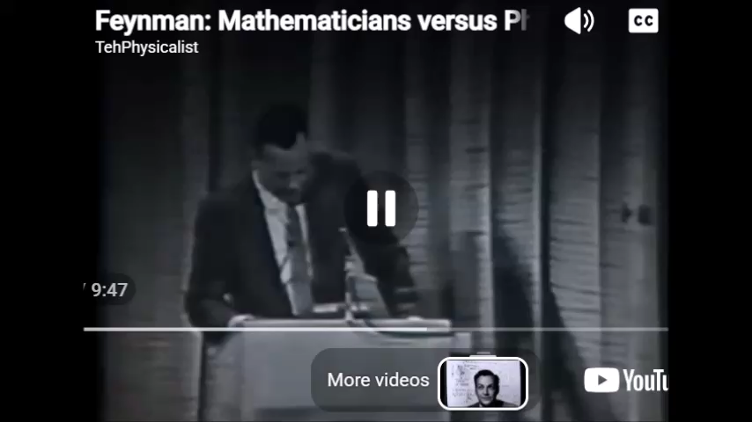
Computation vs. Ontology

Slide 34
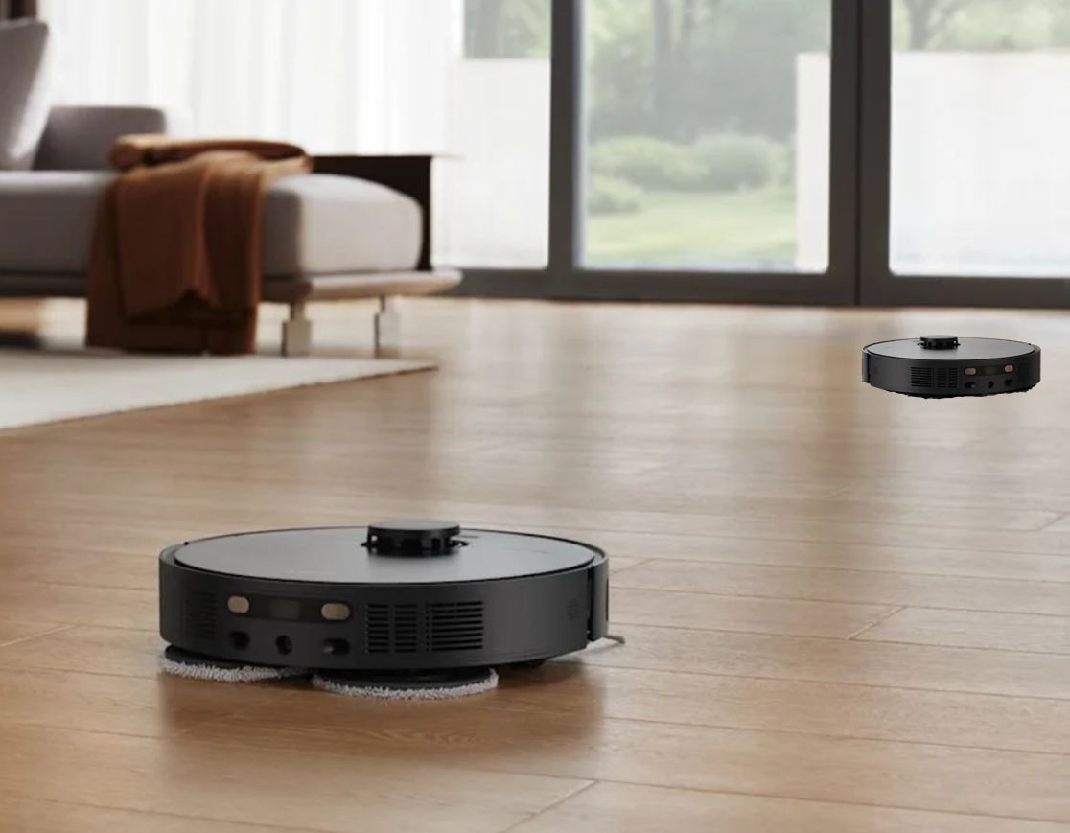
Ontologies for Roombas
RB1: represents locations by a cellular grid where ‘1’ in a cell means ‘occupied’ and ‘0’ ‘free’.
RB2: represents locations using angles and distance from a reference point, ‘occupation’ by ‘o’ or ‘f’.
Under Gruber’s perspective:
  What must be minimally in either Roomba’s ontology?
  What is their minimal knowledge-related requirement to be able to successfully communicate about locations?
  What would be in their knowledge base?
  Impact of presence or absence of a priori room map?
  Are they capable of detecting displacements of objects (e.g. bumping into a small toy vs. a table) ?

Slide 35
Stated goals and purposes of ontologies
Investigating a domain,
Representing a domain,
Enhancing collaboration,
Supporting data-related processing
  annotating, searching, indexing, merging, comparing, …,
Supporting ontology-related process
  comparing, merging, (re-)using, aligning, emulating, …,
Providing reasoning facilities for specific applications.
Towards modelling the intended purpose of ontologies: A case study in geography.
R Denaux, AG Cohn, V Dimitrova, G Hart
Proceedings of the Terra Cognita Workshop in conjunction with the 8th International Semantic Web Conference, CEUR-WS. Org. 2009. http://ceur-ws.org/Vol-518/terra09_submission_9.pdf

Slide 36
Stated goals and purposes of ontologies
Investigating a domain,
Representing a domain,
Enhancing collaboration,
Supporting data-related processing
  annotating, searching, indexing, merging, comparing, …,
Supporting ontology-related process
  comparing, merging, (re-)using, aligning, emulating, …,
Providing reasoning facilities for specific applications.
for people
for computers
Towards modelling the intended purpose of ontologies: A case study in geography.
R Denaux, AG Cohn, V Dimitrova, G Hart
Proceedings of the Terra Cognita Workshop in conjunction with the 8th International Semantic Web Conference, CEUR-WS. Org. 2009. http://ceur-ws.org/Vol-518/terra09_submission_9.pdf

Slide 37
Ontologies and ‘ontologies’
‘ontologies’
Direct
usefulness
for
people
Terminological
systems
Knowledge representation
systems
Realism-based
Ontologies
Direct usefulness for computers
Inspired by: Rector, A.. “Clinical terminology: why is it so hard?” Methods of information in medicine 38 4-5 (1999): 239-52 .

Slide 38
In what tend ‘ontologies’ to differ
What it is in reality that exists;
What it is that is/should be represented;
The degree to which the representation is faithful to reality according to the chosen worldview;
Choice of representation language;
Extent to which they are developed using an environment that checks for consistency;
Whether all allowed (consistent) models are indeed desired models;
What the purpose/functionality is;
…

Slide 39
Definitions adhered to in this talk
Ontology: a representational artifact, comprising a taxonomy as proper part, whose representational units are intended to designate some combination of types, classes, and certain relations between them.
Realism-based Ontology: an ontology built out of terms which are intended to refer exclusively to types and which correspond to that part of the content of a scientific theory that is captured by its constituent general terms and their interrelations.
Concept systems and ontologies: Recommendations for basic terminology
Gunnar O. Klein & Barry Smith
Transactions of the Japanese Society for Artificial Intelligence 25 (3):433-441 (2010)

Slide 40
Take away message from part 1
Never take somebody’s definition of ‘ontology’ from a paper and write:
  ‘an ontology is … [1]’;
Rather write something along the lines:
‘In [1], an ontology is defined as …, a view which we adhere to in this paper.’
Part 2 is intended to give you the tools to make an informed decision on what to pick for what purpose.

Slide 41
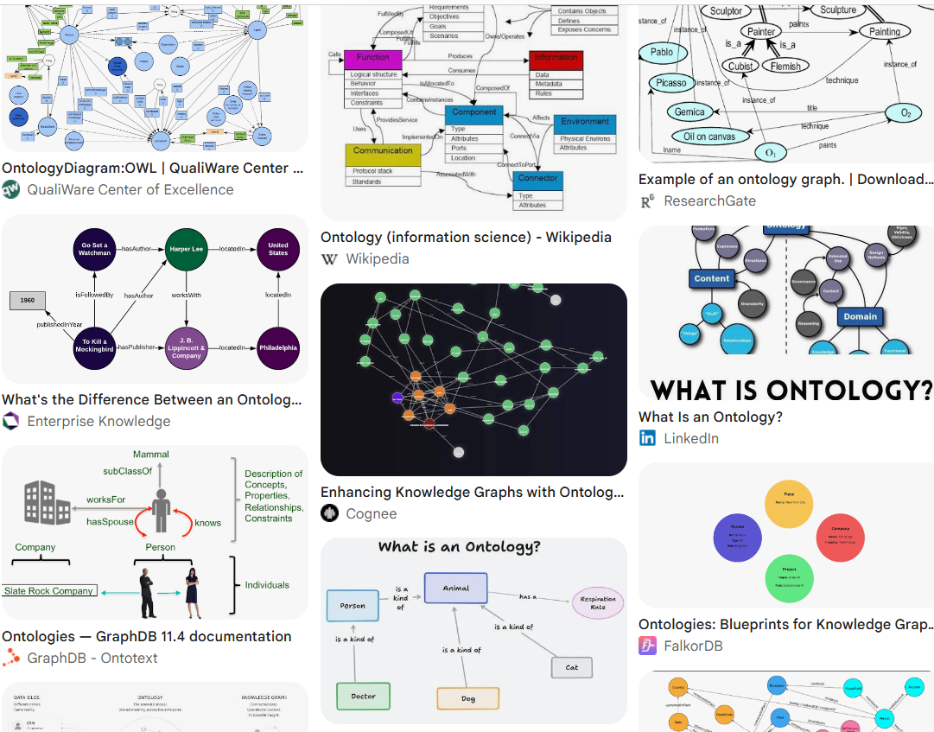

Slide 42
Part 2
How to assess the quality of an ontology in function of its type and its appropriateness in function of your needs and goals?
Learning objectives: be able …
  to specify what criteria are relevant, sufficient and necessary for specific needs and goals,
  to understand how they might be relevant to different degrees depending on the type of ontology,
  to know for each one of them what the impact is when they are not or poorly satisfied,
  to assess whether a specific ontology of a specific type satisfies the criteria.

Slide 43
C1. Clear and unambiguous specification of the sort of ontology under assessment.

Slide 44
Ontology types and dichotomies (1)
Reference (1) vs. application (2) ontology:
  (1) Canonical representation of entities salient to the science underlying the covered domain;
  (2) created to accomplish a precise, local goal.

Slide 45
Ontology types and dichotomies (2)
Reference (1) vs. application (2) ontology:
  (1) Canonical representation of entities salient to the science underlying the covered domain;
  (2) created to accomplish a precise, local goal.
Formal (3) vs. domain (4) ontology:
  (3) Representation of the categories of entities and of the relationships within and between them;
  (4) Representation of the non-formal universals that are instantiated in some specific domain.

Slide 46
Ontology types and dichotomies (3)
Reference (1) vs. application (2) ontology:
  (1) Canonical representation of entities salient to the science underlying the covered domain;
  (2) created to accomplish a precise, local goal.
Formal (3) vs. domain (4) ontology:
  (3) Representation of the categories of entities and of the relationships within and between them;
  (4) Representation of the non-formal universals that are instantiated in some specific domain.
Top-level (5) vs. mid-level (6) ontology:
  (5) A highly general representation of categories and relations common to all specific domains;
  (6) Representation of all domain categories and relations common to all subdomains the ontology serves.

Slide 47
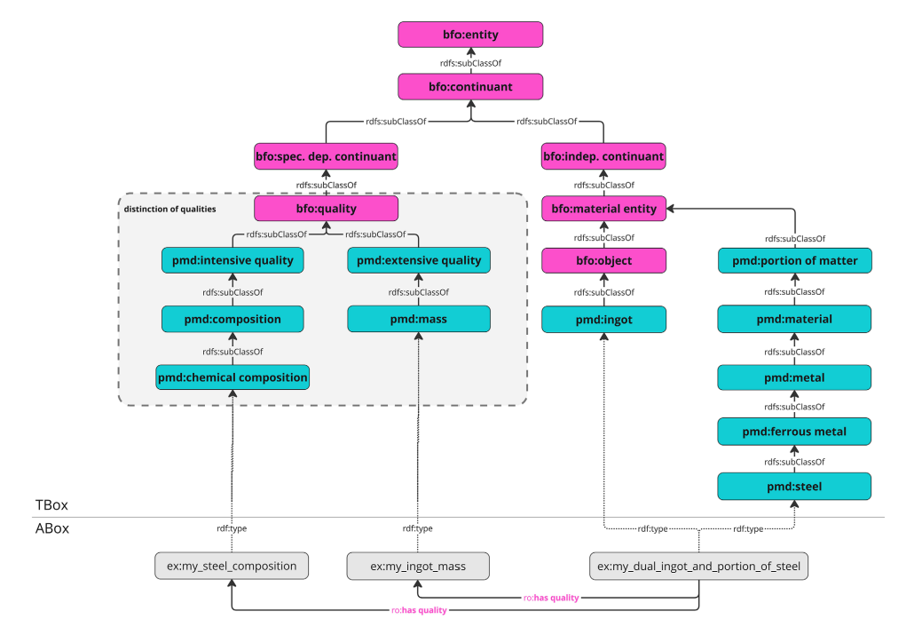
Fig3, p11.
M. Schilling e.a.

Slide 48
C2. The worldview of the ontology is consistent with a) your worldview, b) the ontologies it imports from, and c) its intended purposes.

Slide 49
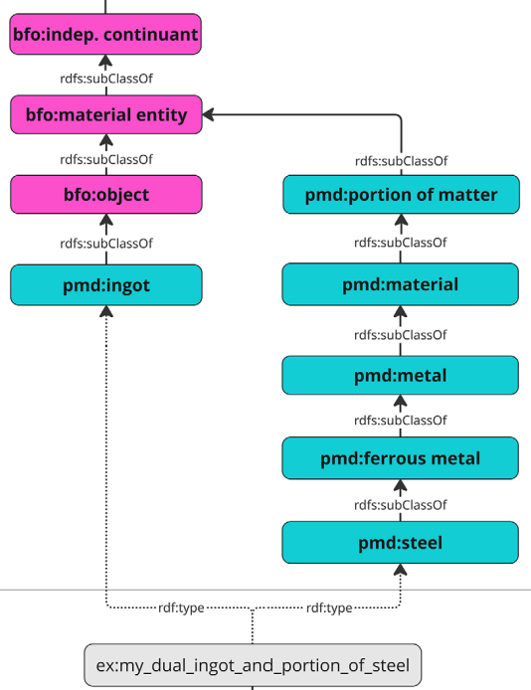
The BFO and the PMDco
Is a steel ingot:
  an object AND a portion of steel, or
  An object made-out-of / composed-of a portion of steel?
Compare:
  Ice cube / water
  cloud / water
Change over time

Slide 50
Cave ‘isa-overloading’ (MeSH)
All MeSH Categories
Diseases Category
Female Urogenital Diseases
and Pregnancy Complications
Eye Diseases
Nervous System Diseases
Male Urogenital
Diseases
Cranial Nerve
Diseases
Female Urogenital Diseases
Neurodegenerative
Diseases
Optic Nerve
Diseases
Optic Nerve
Diseases
Eye Diseases,
Hereditary
Heredodegenerative
Disorders,
Nervous System
Urologic Diseases
Optic Atrophy
Kidney Diseases
Optic Atrophies,
Hereditary
Diabetes Insipidus
Wolfram Syndrome

Slide 51
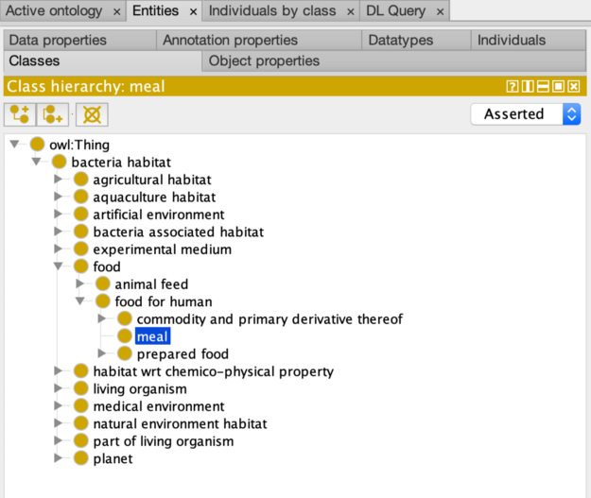

Slide 52
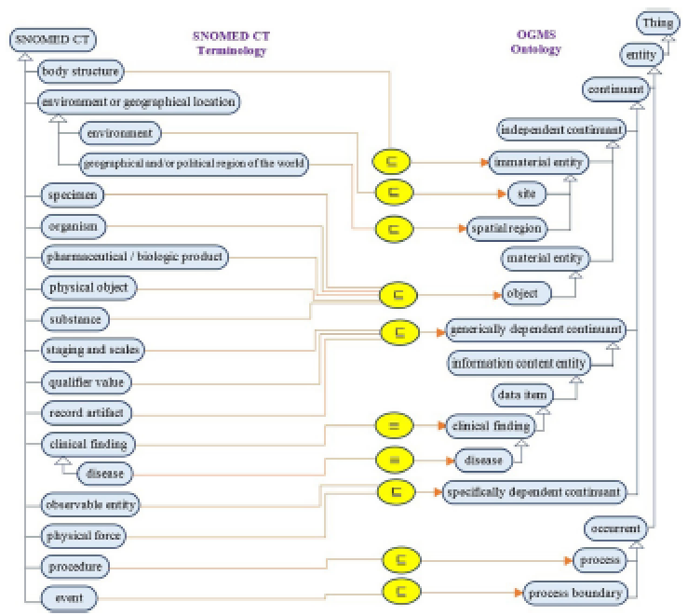
Naive mapping between upper-levels of Snomed and OGMS

Slide 53
C3. Faithfulness to reality (within the worldview)

Slide 54
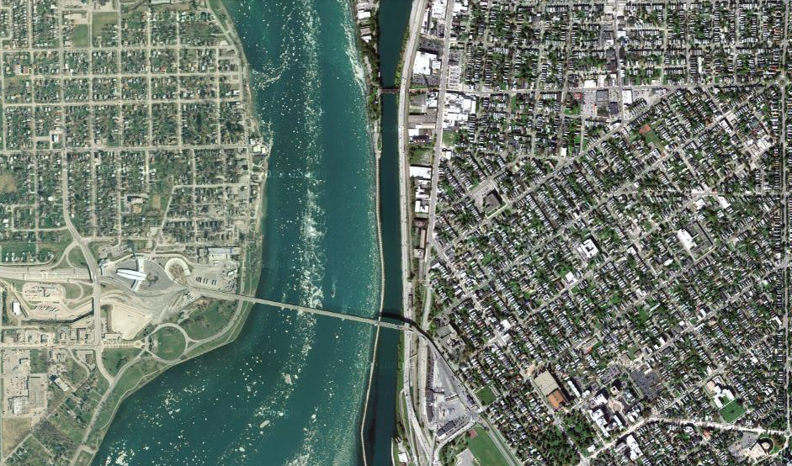
Satellite view of region around Peace Bridge

Slide 55
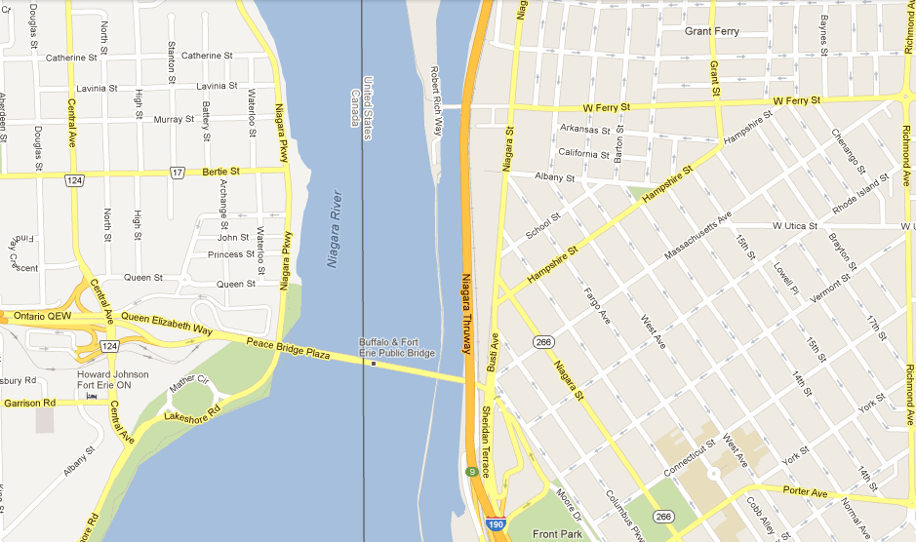
Google map of region around Peace Bridge

Slide 56
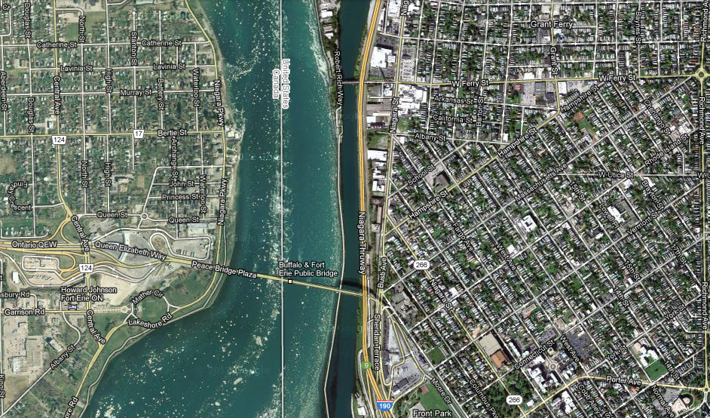
A quasi perfect overlap: the map is ‘faithful to reality’

Slide 57
Caveats
If a representation is faithful to reality is then part of the representation also faithful to reality ?

Slide 58
Caveats
If a representation is faithful to reality is then part of the representation also faithful to reality ?
  Pictures: yes
  Text: not always
    ‘A rabbit is not a bird’ / ‘it is not the case that a rabbit is a bird’
    ‘A rabbit is a bird’ / ‘ a rabbit is a bird’

Slide 59
Caveats
If a representation is faithful to reality is then part of the representation also faithful to reality ?
  Pictures: yes
  Text: not always
    ‘A rabbit is not a bird’ / ‘it is not the case that a rabbit is a bird’
    ‘A rabbit is a bird’ / ‘ a rabbit is a bird’
Some representations don’t stay, or become, faithful when reality changes.

Slide 60
Caveats
If a representation is faithful to reality is then part of the representation also faithful to reality ?
  Pictures: yes
  Text: not always
    ‘A rabbit is not a bird’ / ‘it is not the case that a rabbit is a bird’
    ‘A rabbit is a bird’ / ‘ a rabbit is a bird’
Representations that are not time-indexed don’t stay, or become, faithful when reality changes.
  A patient’s benign tumor becomes malignant →
    An earlier correct diagnosis ‘this patient’s tumor is benign’ would become false;
    An earlier incorrect diagnosis ‘this patient’s tumor is malignant’ would become true.
  Need for medication reconciliation in EHRs.

Slide 61
C4. Adequate use of natural language as representational elements.

Slide 62
Natural language as knowledge representation (1)
Examples:
  moles are skin disorders;
  the beauty spot above Cindy Crawford’s lip is a mole;
  populations with fair skin naturally develop a higher average number of skin moles than populations of the same size with dark skin.

Slide 63
Natural language as knowledge representation (2)
Examples:
  moles are skin disorders;
  the beauty spot above Cindy Crawford’s lip is a mole;
  populations with fair skin naturally develop a higher average number of skin moles than populations of the same size with dark skin;
  moles are mammals;
  there are at least 6.022*10²³ moles in 1 mole of moles;
  …
  Lots of issues !

Slide 64
If on the surface of Earth there would be 1 mole of moles, i.e. the animals, how thick would the layer of stacked moles be when uniformly distributed over Earth’s surface?’

Slide 65
Gemini prompt: If on the surface of Earth there would be 1 mole of moles, i.e. the animals, how thick would the layer of stacked moles be when uniformly distributed over Earth’s surface?’
Total Mass: An average mole weighs about 75 grams. Multiplying this by Avogadro's number gives a total mass of roughly 4.52*10²² kg.
Total Volume: mammals are mostly water, we can assume a density of roughly 1,000 kg/m³, giving a volume of 4.52* 10¹⁹ m³ for the entire population.
Surface Area of the Earth: 5.1*10¹⁴ m².
The Result: dividing the total volume by Earth's surface area yields a thickness of roughly 87 kilometers. Accounting for the geometric expansion of a sphere as the layer grows thicker, the final depth settles right around 80 kilometers (50 miles).

Slide 66
Principle of Separation of Concerns (1) maintain clear distinctions!

Slide 67
Principle of Separation of Concerns (2) maintain clear distinctions!
Representations
Reality

Slide 68
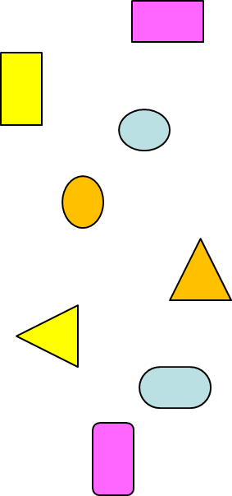
Principle of Separation of Concerns (3) maintain clear distinctions!
Representations
Ontology
Entity names: internal names used in an ontology to uniquely denote an intended entity;
Entity descriptions: definitions or elucidations that convey what entity is intended by an entity name;
Relation names: internal names for formal relations that obtain between entities;
Axioms: descriptions about how certain entities relate to each other;
Reality

Slide 69
Principle of Separation of Concerns (4) maintain clear distinctions!
Representations
Ontology
Entity names: internal names used in an ontology to uniquely denote an intended entity;
Entity descriptions: definitions or elucidations that convey what entity is intended by an entity name;
Relation names: internal names for formal relations that obtain between entities;
Axioms: descriptions about how certain entities relate to each other;
Terminology
Terms: names for entities as used in natural language;
Term usages: descriptions about the conditions, prescriptive or descriptive, under which a term is used.
Reality

Slide 70
Principle of Separation of Concerns (5) maintain clear distinctions!
Representations
Ontology
Entity names: internal names used in an ontology to uniquely denote an intended entity;
Entity descriptions: definitions or elucidations that convey what entity is intended by an entity name;
Relation names: internal names for formal relations that obtain between entities;
Axioms: descriptions about how certain entities relate to each other;
Terminology
Terms: names for entities as used in natural language;
Term usages: descriptions about the conditions, prescriptive or descriptive, under which a term is used.
Reality

Slide 71
C5. Adequate use of a formal language.

Slide 72
Formal Language
A language defined by an alphabet and formation rules.
The alphabet is a set of symbols, some of which may have a special meaning or belong to a certain type:
  a , b , c , …
  and, or, ‘ ’, …
The formation rules specify which strings of symbols count as well-formed:
  rules postulating that such and such expressions belong to the language in question.
  rules establishing how to build well-formed expressions from other expressions belonging to the language,
  …

Slide 73
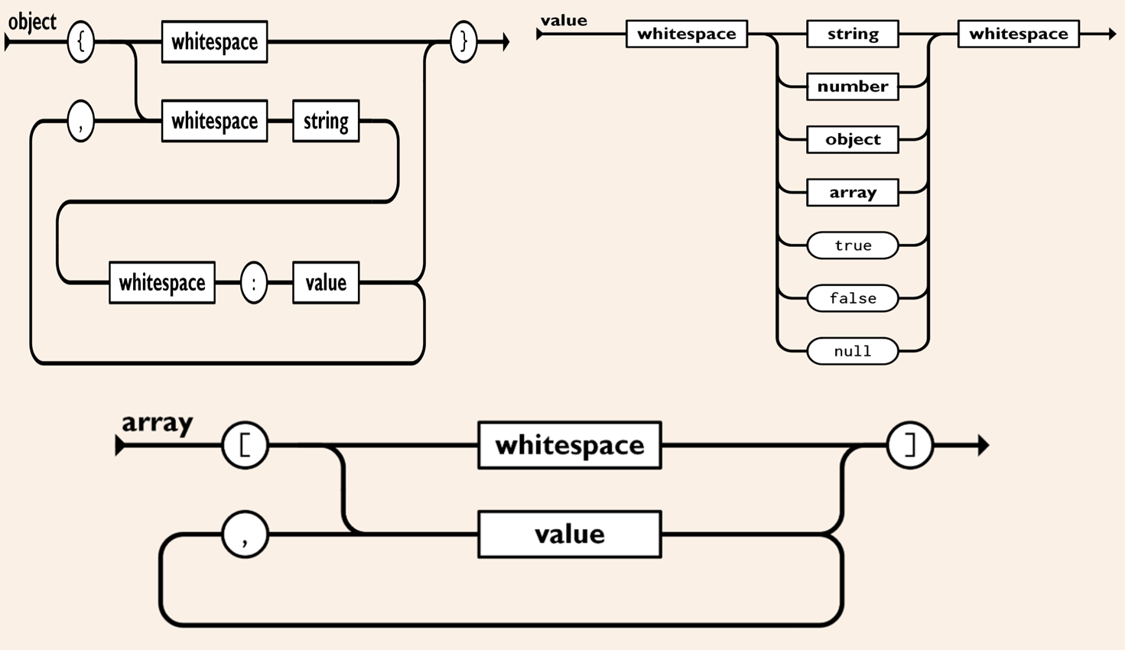
Some JSON formation rules and symbols

Slide 74
JSON data example
{ "first_name": "John",
"last_name": "Smith",
"is_alive": true,
"age": 27,
"address": { "street_address": "21 2nd Street",
"city": "New York",
"state": "NY",
"postal_code": "10021-3100" },
"phone_numbers":
[ { "type": "home",
"number": "212 555-1234" },
{ "type": "office",
"number": "646 555-4567" } ],
"children": [ "Catherine", "Thomas", "Trevor" ],
"spouse": null }

Slide 75
JSON data example
{ "first_name": "John",
"last_name": "Smith",
"is_alive": true,
"age": 27,
"address": { "street_address": "21 2nd Street",
"city": "New York",
"state": "NY",
"postal_code": "10021-3100" },
"phone_numbers":
[ { "type": "home",
"number": "212 555-1234" },
{ "type": "office",
"number": "646 555-4567" } ],
"children": [ "Catherine", "Thomas", "Trevor" ],
"spouse": null }
JSON does not have a formal semantics !!!

Slide 76
People and GenAI use intuitive semantics
Gemini AI prompt: What would be a relational database representation for the following JSON object:
{ "first_name": "John",
"last_name": "Smith",
"is_alive": true,
"age": 27,
"address": { "street_address": "21 2nd Street",
"city": "New York",
"state": "NY",
"postal_code": "10021-3100" },
"phone_numbers":
[ { "type": "home",
"number": "212 555-1234" },
{ "type": "office",
"number": "646 555-4567" } ],
"children": [ "Catherine", "Thomas", "Trevor" ],
"spouse": null }

Slide 77
Gemini output in SQL (1)
-- ============================================================================
-- RELATIONAL DATABASE REPRESENTATION FOR THE JSON OBJECT
-- ============================================================================
-- Target Design: Fully Normalized (3NF) Relational Schema
-- This schema splits multi-valued attributes (arrays like phone_numbers and children)
-- and nested objects (address) into standard relational tables linked via Foreign Keys.
-- ============================================================================
-- 1. Main Person / Profile Table
CREATE TABLE users (
user_id INT AUTO_INCREMENT PRIMARY KEY,
first_name VARCHAR(50) NOT NULL,
last_name VARCHAR(50) NOT NULL,
is_alive BOOLEAN NOT NULL DEFAULT TRUE,
age INT,
spouse_id INT NULL, -- Can self-reference the users table if a spouse profile exists
created_at TIMESTAMP DEFAULT CURRENT_TIMESTAMP
);

Slide 78
Gemini output in SQL (2)
-- 2. Address Table (1:1 Relationship or 1:Many shared addresses)
-- Maps the nested "address" object.
CREATE TABLE addresses (
address_id INT AUTO_INCREMENT PRIMARY KEY,
user_id INT NOT NULL UNIQUE, -- Ensures a 1:1 structure for this user profile profile
street_address VARCHAR(255) NOT NULL,
city VARCHAR(100) NOT NULL,
state CHAR(2) NOT NULL, -- Specifically for US state abbreviations like 'NY'
postal_code VARCHAR(20) NOT NULL,
FOREIGN KEY (user_id) REFERENCES users(user_id) ON DELETE CASCADE
);
-- 3. Phone Numbers Table (1:Many Relationship)
***
-- 4. Children Table (1:Many Relationship)
***

Slide 79
Gemini output in SQL (3)
--==========================================================================
-- SAMPLE DATA INSERTION (Populating from the provided JSON values)
--==========================================================================
-- Step 1: Insert core user entity
INSERT INTO users (user_id, first_name, last_name, is_alive, age, spouse_id)
VALUES (1, 'John', 'Smith', TRUE, 27, NULL);
-- Step 2: Insert nested address components
INSERT INTO addresses (user_id, street_address, city, state, postal_code)
VALUES (1, '21 2nd Street', 'New York', 'NY', '10021-3100');
-- Step 3: Insert items from the phone numbers sub-array
INSERT INTO phone_numbers (user_id, type, number) VALUES
(1, 'home', '212 555-1234'),
(1, 'office', '646 555-4567');
-- Step 4: Insert items from the children scalar array
INSERT INTO children (user_id, child_name) VALUES
(1, 'Catherine'),
(1, 'Thomas'),
(1, 'Trevor');

Slide 80
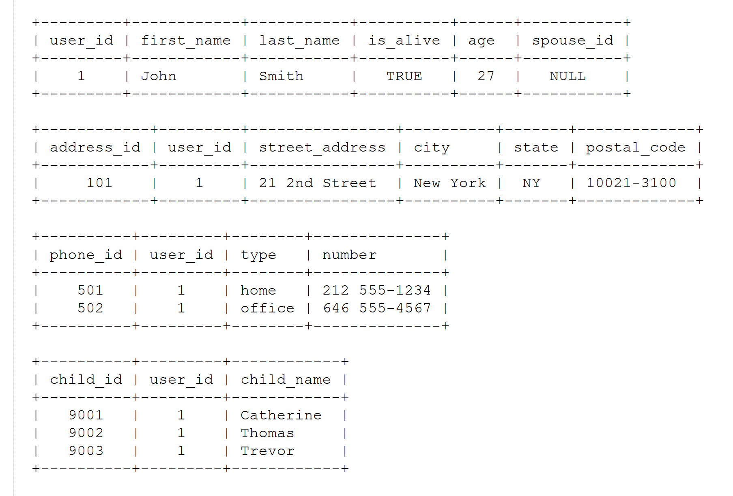
Continued prompt: render as tables

Slide 81
Formal semantics of a language
Core components:
Truth Conditions:
  meaning is defined by knowing what the world must look like for a statement to be true.
Compositionality:
  the meaning of a whole sentence is calculated directly from the meanings of its smaller parts and how they connect.
Model Theory:
  the language maps to a simplified, mathematical model of reality containing specific objects, properties, and sets.
Symbolic Logic:
  replaces ambiguous words and sentences with precise logical formulas.

Slide 82
C6. Adherence to the formal semantics of the formal language used.

Slide 83
Ontology, principles, and language
Ontological principles
Logical principles
What Is an Ontology?
Nicola Guarino, Daniel Oberle, and Steffen Staab
S. Staab and R. Studer (eds.), Handbook on Ontologies, International Handbooks 1
on Information Systems, DOI 10.1007/978-3-540-92673-3,
Springer-Verlag Berlin Heidelberg 2009

Slide 84
What is ‘a logic’
A formal or informal language together with a deductive system and/or a (model-theoretic) semantics.
The language has components that correspond to a part of a natural language like English or Greek.
The deductive system is to capture, codify, or simply record arguments that are valid for the given language.
The semantics is to capture, codify, or record the meanings, or truth-conditions for at least part of the language.
Shapiro, Stewart and Teresa Kouri Kissel, "Classical Logic",
The Stanford Encyclopedia of Philosophy (Spring 2021 Edition), Edward N. Zalta (ed.).
https://plato.stanford.edu/archives/spr2021/entries/logic-classical/

Slide 85
Propositional Logic (PL) essentials

Slide 86
Language and semantics of PL
A well-formed formula is either atomic or composed following allowed composition rules.
Atomic formulae stand for propositions that must either be true or false:
  A: ‘John eats too much’.
  B: ‘John has a normal BMI’.
  C: ‘John is careful’.
Formula connectors:
  Negation (not): ¬ ~
  Conjunction (and): ∧ & ∙
  Disjunction (or): ∨
  Material implication (if...then): → ⇒ ⊃
  Biconditional (if and only if): ↔ ⬄ ≡ =

Slide 87
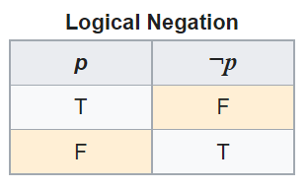
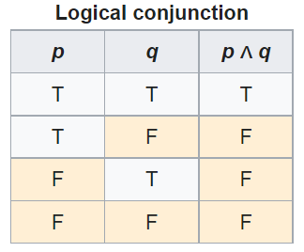
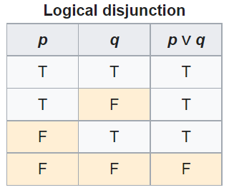
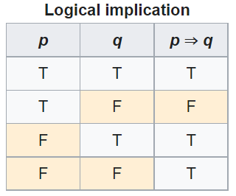
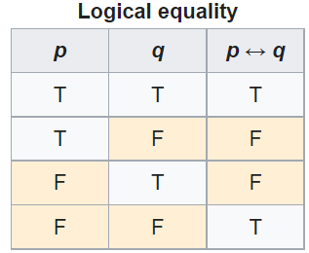
PL’s Deductive system: truth tables

Slide 88
Some PL laws
Truth tables can be used to prove laws, e.g.:
  a Λ (b V c) = (a Λ b) V (a Λ c)
  ¬ (a Λ b) = ¬ a V ¬b
  (a Λ (a → b)) → b
  (a→ b) Λ ¬b) → ¬a
  ((a V b) Λ ¬a) → b
  ((a → b) Λ (b → c)) → (a → c)
  …
  More examples:
    https://math.stackexchange.com/questions/1449866/catalogue-of-propositional-logic-laws
    http://mathonline.wikidot.com/the-laws-of-propositional-logic#toc0
Both truth tables and laws can be used to solve puzzles.

Slide 89
Exercise
Given:
  If John eats too much, then he does not have a normal BMI.
  If John is not careful, then he eats too much.
  John has a normal BMI.
Question
  Is John careful?

Slide 90
Translate sentences into PL
Propositions
John eats too much |  |  | a
John has a normal BMI |  |  | b
John is careful |  |  | c
Given
If John eats too much, then he does not have a normal BMI |  |  | a → ¬b
If John is not careful, then he eats too much. |  |  | ¬c → a
John has a normal BMI |  |  | b
Determine the truth value of: |  | (a → ¬b) ∧ (¬c → a) ∧ b

Slide 91
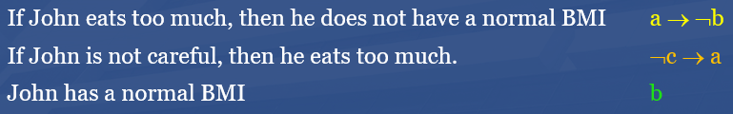


Method 1: Determine with tables

Slide 92
Method 2: Determine using laws
Propositions
John eats too much |  | a
John has a normal BMI |  | b
John is careful |  | c
Given
If John eats too much, then he does not have a normal BMI |  | a → ¬b | g1
If John is not careful, then he eats too much. |  | ¬c → a | g2
John has a normal BMI |  | b | g3
Rule application: | (x→ y) Λ ¬y) → ¬x | ¬a | g3/g1 | g4
 | (x→ y) Λ ¬y) → ¬x | c | g2/g4

Slide 93
Another exercise
Solve this puzzle:
  Given:
    Everybody who eats too much, does not have a normal BMI.
    Everybody who is not careful, eats too much.
    Everybody has a normal BMI.
  Question
    Is everybody careful?
Same as before: yes.

Slide 94
What about this one?
Solve this puzzle:
  Given:
    Everybody who eats too much, does not have a normal BMI.
    Everybody who is not careful, eats too much.
    John has a normal BMI.
  Question
    Is John careful?
Can not be done with propositional logic!
  There is no way to create propositions (within the syntax and semantics of propositional logic) so that ‘everybody’ and ‘John’ can be represented as related.

Slide 95
First Order Logic (FOL)
(Predicate Logic)

Slide 96
First-order logic
Propositional logic with predicates, variables and quantifiers.
Predicate: a proposition that some property holds for some entity, or a relation between entities.
  Prop.L. : A = ‘everybody eats too much’
  FOL: A = ‘eats too much’ A(x)
Quantifiers:
  ‘all’ ∀ ∀x.A(x) everything eats too much
  ‘some’ ∃ ∃x.A(x) something eats too much

Slide 97
First-order logic
Propositional logic with predicates, variables and quantifiers.
Predicate: a proposition that some property holds for some entity, or a relation between entities.
  Prop.L. : A = ‘everybody eats too much’
  FOL: A = ‘eats too much’ A(x)
Quantifiers:
  ‘all’ ∀ ∀x.A(x) everything eats too much
  ‘some’ ∃ ∃x.A(x) something eats too much
‘everybody eats too much’
  ∀x.(person(x) → A(x))

Slide 98
First-Order Logic (FOL) - Syntax
User defines these primitives:
  Constant symbols (i.e., the "individuals" in the world) e.g.: bfo, 3
  Function symbols (mapping individuals to individuals) e.g.: author-of(bfo) = barry_smith
  Predicate symbols (mapping from individuals to truth values)
e.g.: greater(5,3) = true,
smart(barry_smith) = true

Slide 99
First-Order Logic (FOL) - Syntax…
FOL supplies these primitives:
  Variable symbols. E.g., x,y
  Connectives.
    Same as in PL:
      not (~),
      and (^),
      or (v),
      implies (→),
      if and only if (<=>)
  Quantifiers: Universal (∀) and Existential (∃)

Slide 100
‘Ontology’ and representation (1)
fig 2. in: What Is an Ontology? Nicola Guarino, Daniel Oberle, and Steffen Staab
S. Staab and R. Studer (eds.), Handbook on Ontologies, International Handbooks on Information Systems, DOI 10.1007/978-3-540-92673-3,
Springer-Verlag Berlin Heidelberg 2009

Slide 101
Truth values of quantified expressions
Statement | True when | False when
∀x.A(x) | A(x) is true for every x. | There is an x for which A(x) is false
∃x.A(x) | There is an x for which A(x) is true. | A(x) is false for every x.
Open World !!!
Reality
Represented Reality

Slide 102
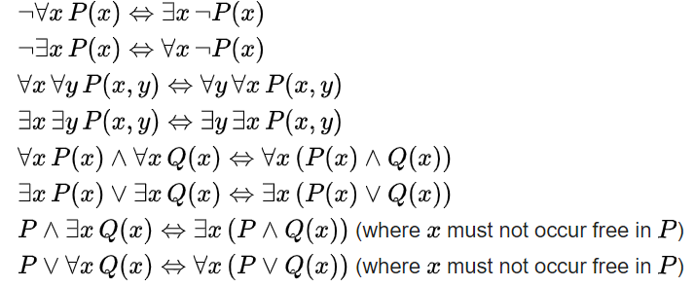
Some equivalences
A free variable is a variable not bound by a quantifier:
∀x.P(x) → Q(x) in contradistinction to ∀x.(P(x) → Q(x))

Slide 103

Flexibility in predicate formation
Some people eat too much:
  ∃x (person(x) Λ eats_too_much(x))
  ∃x (person(x) Λ eats(x, ‘too much’))
  ∃x ∃y (person(x) Λ eats(x, y) Λ quantity(y, ‘too much’))
However:
  Are not equivalent,
  Are based on a different ontology (in philosophical sense).
As a realist ontologist, make your choice on the basis of the ontological principles described in
https://genomebiology.biomedcentral.com/articles/10.1186/gb-2005-6-5-r46

Slide 104
Be aware of ambiguities in language
‘Every patient has some provider’
  Can mean:
    ∀x ∃y patientOf(x, y)
      For all x, there exist some y such that x is a patient of y
        Every patient has some provider.
    ∃y ∀x patientOf(x, y)
      There exist some y, such that for all x, x is a patient of y
        There is some provider that provides for all patients.

Slide 105
Common Logic

Slide 106
Common Logic (CL)
CL is a family of first-order logics which share a common abstract syntax and model theory, and an XML framework for encoding and transmitting them, or their content, on an open network.
CL syntax is very relaxed in the expressions it allows, in some ways going beyond classical FO logic.
ISO standard: https://standards.iso.org/ittf/PubliclyAvailableStandards/c066249_ISO_IEC_24707_2018.zip
https://www.w3.org/2004/12/rules-ws/slides/pathayes.pdf

Slide 107
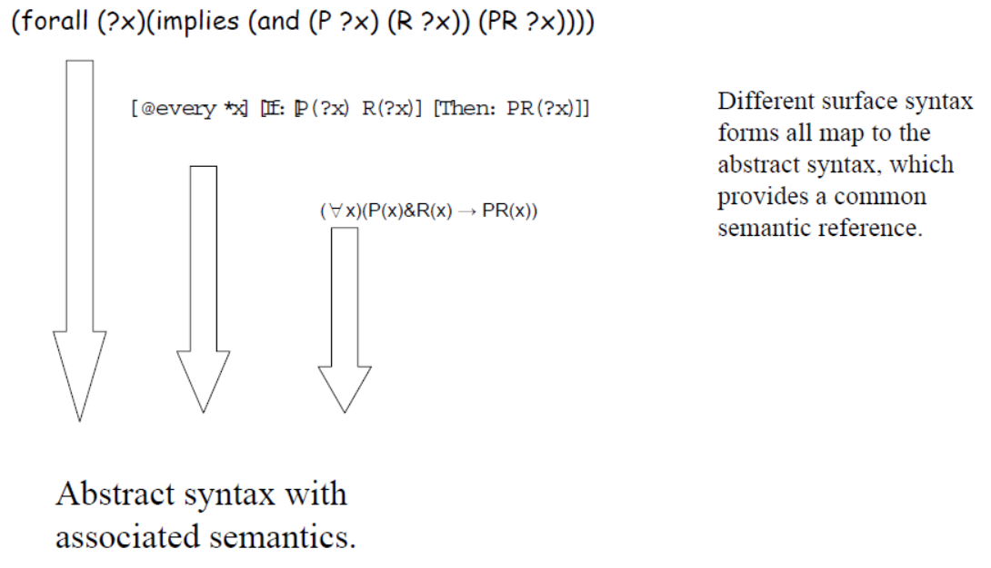
CL dialects
https://www.w3.org/2004/12/rules-ws/slides/pathayes.pdf

Slide 108
Using the Common Logic Interchange Format (CLIF) for FOL
John is going to Boston by bus
(exists (x y)
(and (Go x) (Person John) (City Boston)
(Bus y) (Agnt x John) (Dest x Boston) (Inst x y)))
https://standards.iso.org/ittf/PubliclyAvailableStandards/c066249_ISO_IEC_24707_2018.zip

Slide 109
Common Logic Interchange Format
(CLIF)
John is going to Boston by bus
(exists (x y)
(and (Go x) (Person John) (City Boston)
(Bus y) (Agnt x John) (Dest x Boston) (Inst x y)))
quantifier
variable
predicate
individuals
connective
https://standards.iso.org/ittf/PubliclyAvailableStandards/c066249_ISO_IEC_24707_2018.zip

Slide 110
BFO2020-style CLIF constructs for FOL (1)
Predicate: (predicate_name {arguments})
  where ‘{arguments}’ is a list of terms and/or variables.
  (universal human-being)
  (instance-of werner human-being year-2002)
  (inheres-in this-color that-ball)
Quantified construct: (quantifier ({vars}) <construct>)
  where ‘{vars}’ is a list of variables.
  (exists (t) (instance-of werner human-being t))
  (forall (t) (exists (x) (exists-at x t)))
Negation: (not <construct>)
  (not (= object history))
  (not (exists (t) (instance-of werner quality t)))

Slide 111
BFO2020-style CLIF constructs for FOL (2)
Construct-list: (and/or {constructs})
  (and (instance-of werner human-being year-2002)
  (instance-of werner human-being year-2003))
  (or (inheres-in this-color this-ball)
  (inheres-in this-color that-ball))
Implication: (if/iff <construct> <construct>)
  (iff (occurrent-part-of a b)
  (has-occurrent-part b a))
  (if (exists (t) (instance-of a occurrent t))
  (occurrent-part-of a a))

Slide 112
Examples from psychology
Textual representation | CLIF rendering
At any time at which x does not communicate accurate understanding of y’s perspectives and experiences, x does not have empathy for y. | (forall (x y t) (if (not (p-cau x y t)) (not (empathizes x y t))))
At any time at which x communicates accurate understanding of y’s perspectives and experiences, x has empathy for y. | (forall (x y t) (if (p-cau x y t) (empathizes x y t)))
At any time at which x vicariously experiences y’s feelings, perspectives, and thoughts, x has empathy for y. | (forall (x y t) (if (p-vef x y t) (empathizes x y t)))
Ceusters W & Dermen K. Developing ontologies for motivational interviewing to advance health behavior intervention research and practice.

Slide 113
BFO uses the CLIF syntax for FOL
Allows for precise, unambiguous and machine-processible descriptions of what one ontologically commits to;
  Example from BFO2020:
    (forall (t)
      (if (instance-of t temporal-region t)
      (exists (u i)
      (and (not (= i t))
      (universal u)
      (particular i)
      (instance-of i u t))))))
    At all times, there is at least one particular and one universal that is instantiated by that particular.
‘machine-processable’ → syntax can be checked by parser.

Slide 114
More advantages of using FOL/CLIF
Allows for precise, unambiguous and machine-processible descriptions of what one ontologically commits to;
Allows for transformations to other formats such as Kowalski rules.

Slide 115
5 forms of Kowalski rules
‘if-then’-rules:
  ( A & B & … ) → P
  true → P
‘if-then-or’-rules:
  ( A & B & …) → ( P v Q v … )
  true → ( P v Q v … )
‘false-hood’-rules:
  ( A & B & … ) → false

Slide 116
Horn Logic
‘if-then’-rules:
  ( A & B & … ) → P
  true → P
‘if-then-or’-rules:
  ( A & B & …) → ( P v Q v … )
  true → ( P v Q v … )
‘false-hood’-rules:
  ( A & B & … ) → false
A, B, … may be true or false
P must be true

Slide 117
More advantages of using FOL/CLIF (2)
Allows for precise, unambiguous and machine-processible descriptions of what one ontologically commits to;
Allows for transformations to other formats such as Kowalski rules;
Kowalski rules can be processed by relatively simple logic programs for satisfiability testing, model development, term expansion, rule-base optimization, data-integrity checking, ...

Slide 118
Equivalence of axioms
(cl:comment "No role changes type during its existence [bks-1]“
(forall (o)
(if (exists (t) (instance-of o role t))
(forall (u)
(if (exists (t) (instance-of o u t))
(forall (t) (iff (instance-of o role t) (instance-of o u t))))))))
Is equivalent with:
(forall (e d b a)
(if (and (instance-of e d a) (instance-of e role b))
(and (instance-of e role a) (instance-of e d b))))

Slide 119
From FOL axioms to Kowalski rules
Eliminate the implications.
Move the negations down to the atomic formulas.
Eliminate the existential quantifiers.
Rename the variables, if necessary.
Move the universal quantifiers to the left.
Move the disjunctions down to the literals.
Eliminate the conjunctions.
Rename the variables, if necessary.
Eliminate the universal quantifiers.
For each disjunction obtained: move negations to the left and rewrite ‘not P or Q’ as ‘P → Q’.
https://www.cs.cornell.edu/courses/cs4700/2011fa/lectures/16_FirstOrderLogic.pdf
https://www.cs.miami.edu/home/geoff/Courses/COMP6210-10M/Content/FOFToCNF.shtml#:~:text=Clause%20Normal%20Form%20(CNF)%20is,%7C%2C%20e.g.%2C%20C%7C.

Slide 120
Example from BFO2020
    (forall (t)
      (if (instance-of t temporal-region t)
      (exists (u i)
      (and (not (= i t))
      (universal u)
      (particular i)
      (instance-of i u t))))))
    becomes:
      (instance-of t temporal-region t) → (instanceof sk9(t) sk8(t) t)
      (instance-of t temporal-region t) → (particular sk9(t))
      (instance-of t temporal-region t) → (universal sk8(t))
      (instance-of t temporal-region t) ∧ (= sk9(t) t) → false

Slide 121
Description Logic(s)

Slide 122
Description Logic(s)
A DL is a fragment of FOL.
DLs come in many varieties, most of which are decidable.
  A logic is decidable if there is an effective method for determining whether arbitrary formulas of the logic are logically valid formulas.
  A FOL is not decidable if its signature (i.e. the list and description of non-logical symbols) includes equality and at least one other predicate with two or more arguments.
  Flavors: https://en.wikipedia.org/wiki/Description_logic .
Despite its limitations, but because of its use in the Web Ontology Language (OWL), it became the most popular one.

Slide 123
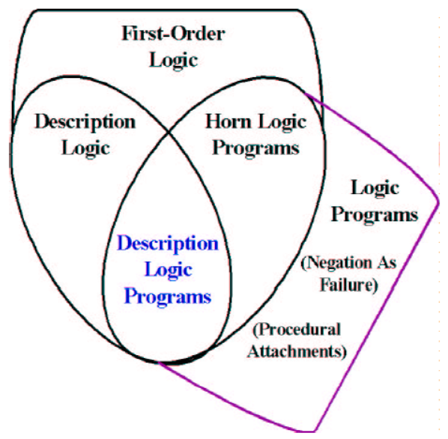
Relations between some logics
DL
Benjamin Grosof , Ian Horrocks, Raphael Volz, Stefan Decker.
Description Logic Programs: Combining Logic Programs with Description Logic. 2004 Research Papers in Economics.. http://www.cs.man.ac.uk/~horrocks/Publications/download/2003/p117-grosof.pdf

Slide 124
Description Logic(s) (2)
Three essential components of a DL system:
  Abox: Father(john). concept assertion
  fatherOf(john, barry). role assertion
  john ≠ barry
  …
  Tbox: Father Parent concept inclusion
  Person ≡ Human concept equivalence
  …
  Rbox: fatherOf parentOf role inclusion
  disjoint(parentOf, childOf) disjointness of roles
  …
Assertions need to be interpreted as being about sets.

Slide 125
DL constructors
Male Parent intersection / conjunction
Male Female union / disjunction
¬ Male complement / negation
…
Can be used in Tbox axioms, e.g.
  Father ≡ Male Parent
  T Male Female everything is included in the set of males and females
  Male Female ⊥ the intersection of the set of males and the set of females is empty
  …
Markus Krötzsch, Frantisek Simancik, Ian Horrocks. A Description Logic Primer. https://arxiv.org/pdf/1201.4089.pdf

Slide 126
Role restrictions
Universal restriction:
  ∀parentOf.Female
    The set of individuals all of whose children are female including those that have no children at all.
Existential restriction:
  ∃parentOf.T
    The set of individuals that are parents of at least one individual.
Combinations:
  construct: ∃parentOf.T ∀parentOf.Female
    The set of all individuals with at least one child, all children being female.
  axiom: ∃sonOf.T male
    The set of individuals that are the son of at least one individual is a subset of the set of males.
Markus Krötzsch, Frantisek Simancik, Ian Horrocks. A Description Logic Primer. https://arxiv.org/pdf/1201.4089.pdf

Slide 127
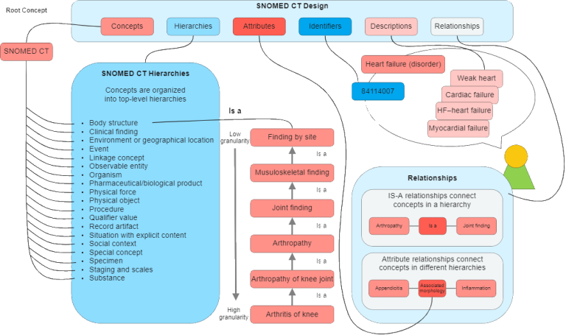
An example: Snomed CT
https://enonic.com/blog/what-is-snomed-ct

Slide 128
Snomed’s DL is EL++ (1)
The description logic EL++ allows the following concepts:
C, D → A | (atomic concept)
T | (universal concept)
⊥ | (bottom concept)
{a} | (singular enumeration)
C D | (intersection / conjunction)
∃R.C | (existential restriction)
With the following axioms:
  C D and C ≡ D for concept descriptions C and D.
  P Q and P ≡ Q for roles P, Q.
  C(a) and R(a, b) for concept C, role R and individuals a, b

Slide 129
Snomed’s DL is EL++ (2)
It lacks:
  negation, (only disjointness of classes: C D ⊥),
  disjunction,
  universal quantification,
  cardinalities,
  inverse roles,
  some role characteristics

Slide 130
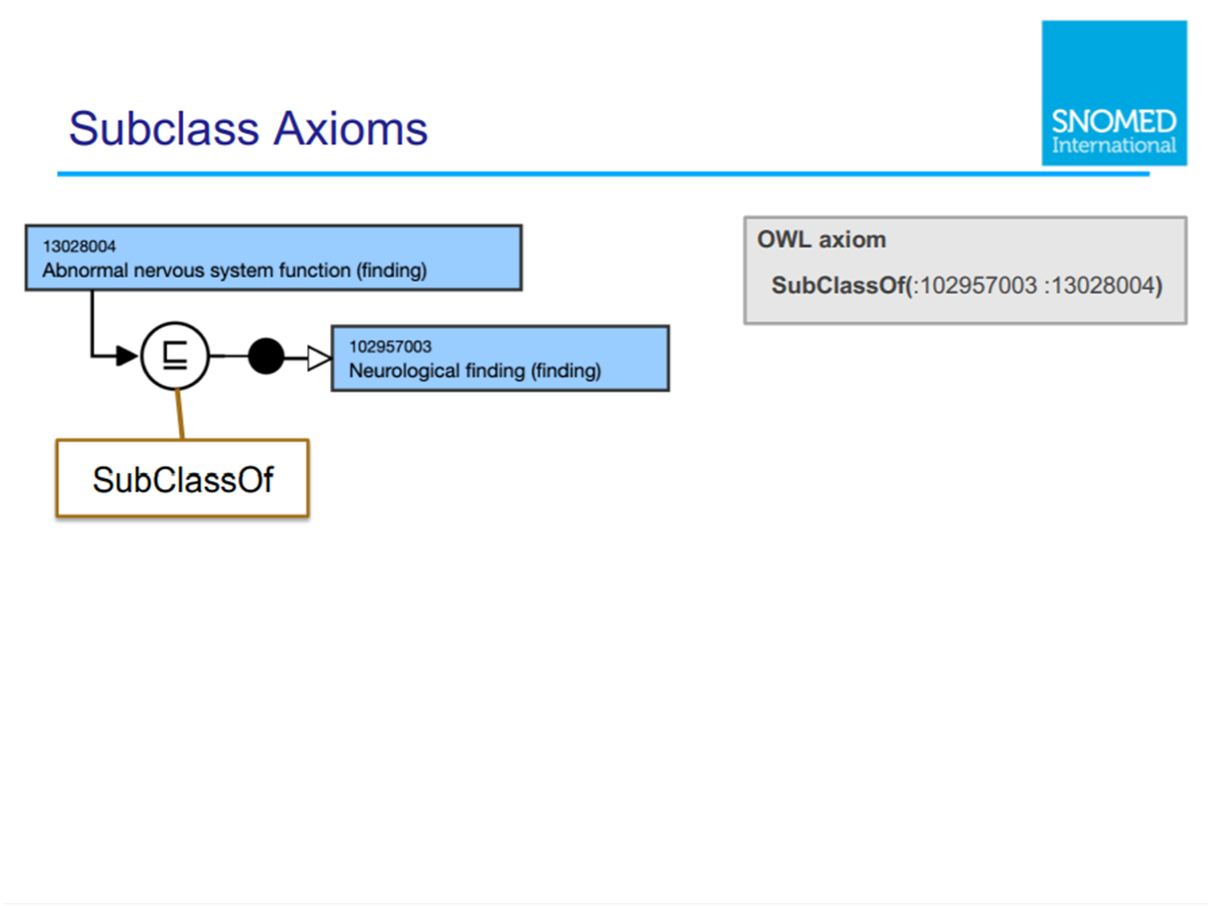

Slide 131
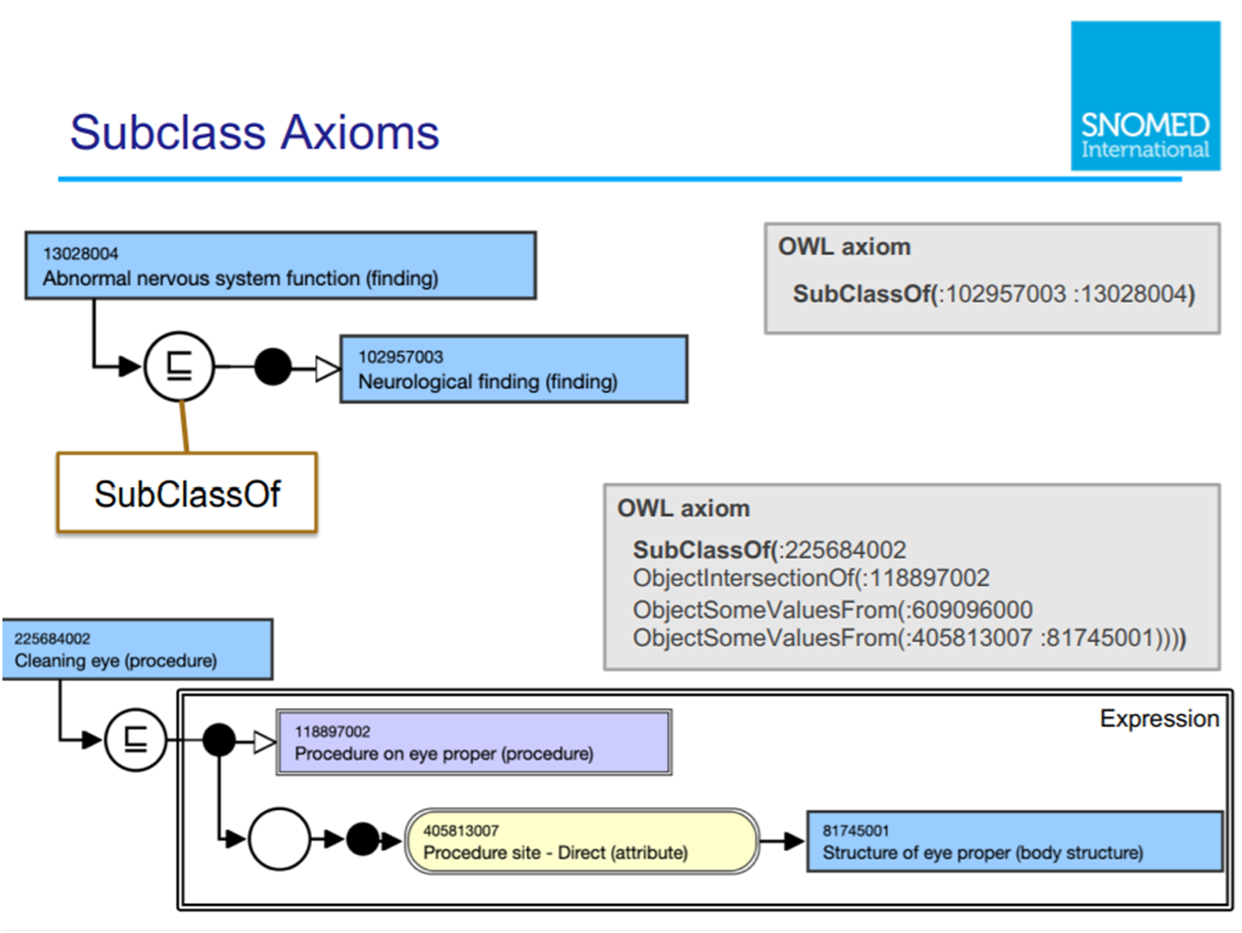

Slide 132
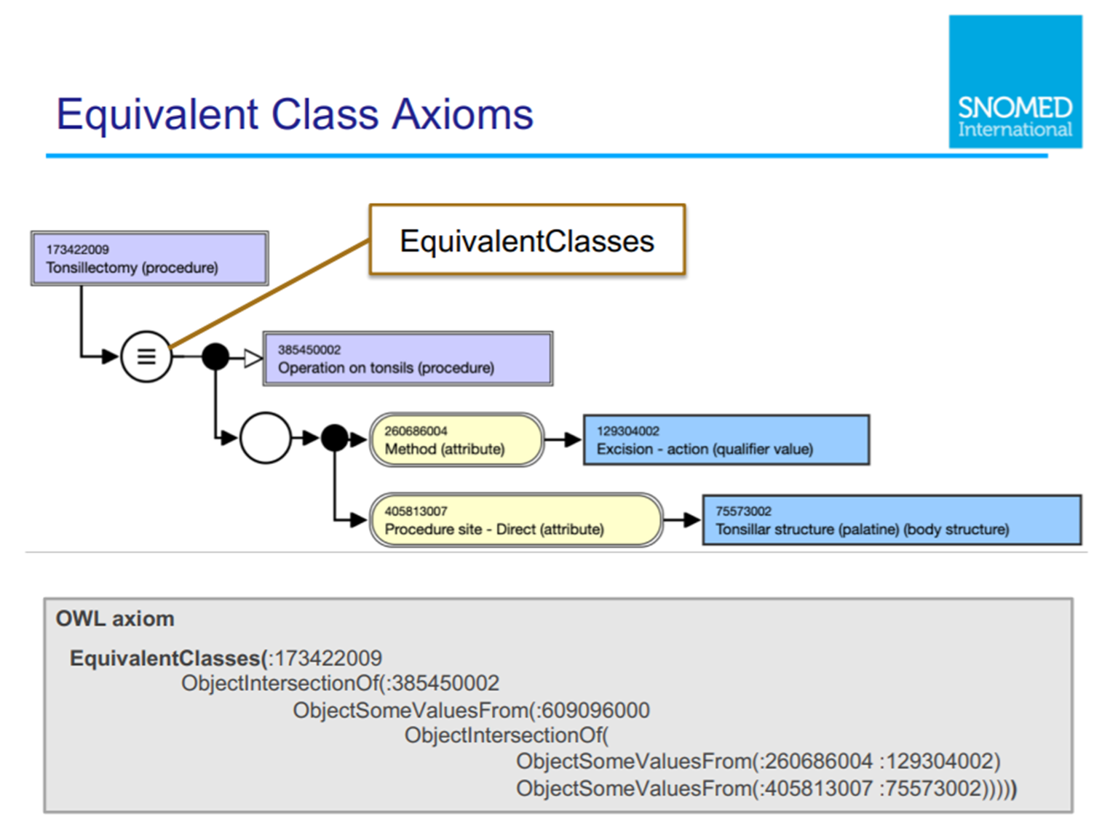

Slide 133
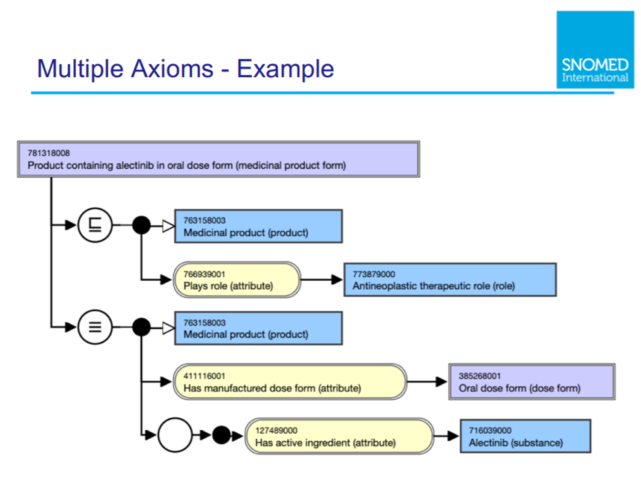

Slide 134
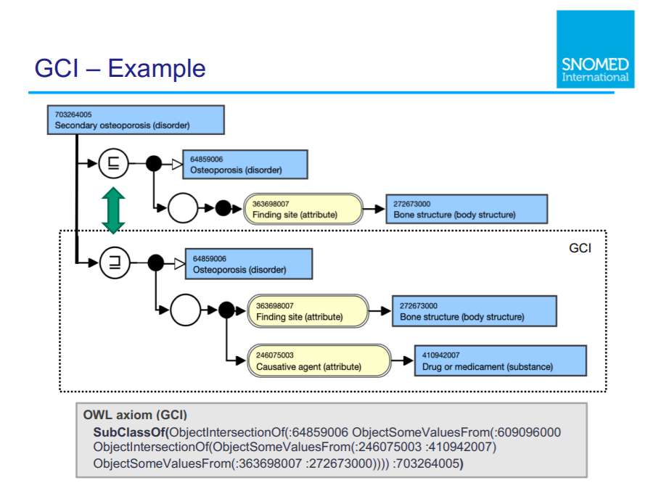

Slide 135
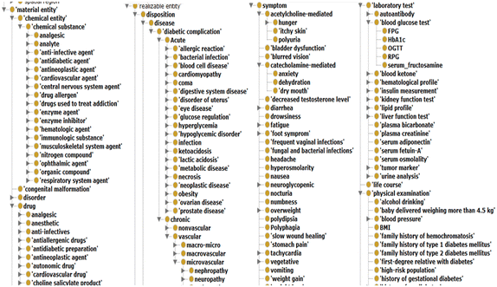
SubClassOf hierarchies = concept inclusion!
No reference provided due to vicarious embarrassment

Slide 136
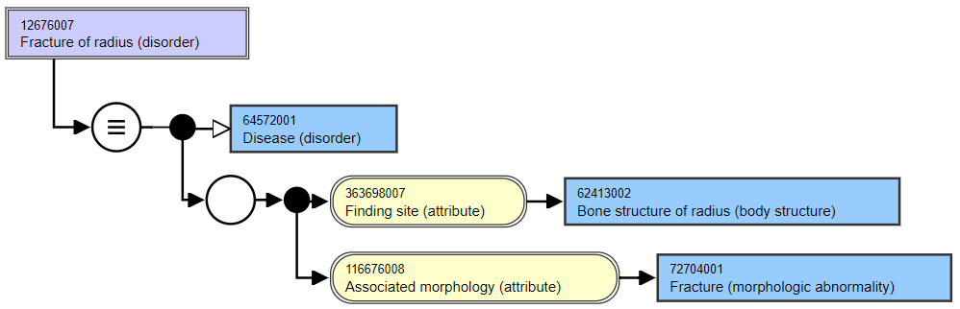
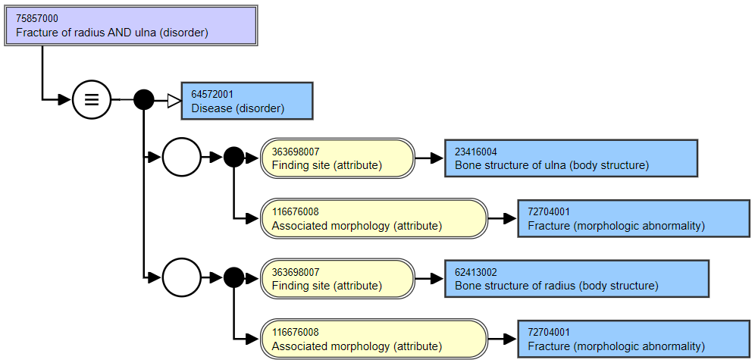
Asserted
Asserted

Slide 137
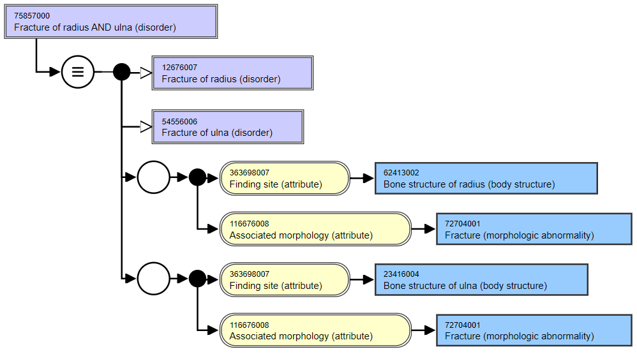
Role groups in
Snomed CT: odd
consequences by design

Slide 138
Characteristics of OWL-based DLs
Ideal for fixing the terminology of a domain
  → constructors
  DL-reasoners can detect contradicting definitions and classify terms automatically
    But only if axioms are used of a sort the reasoner can work with!

Slide 139
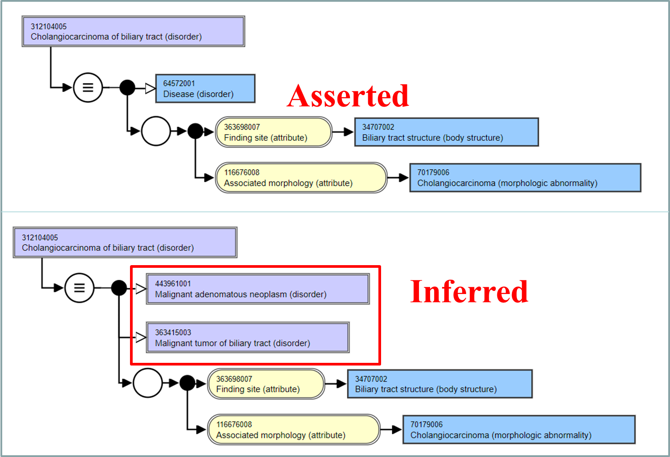

Slide 140
Characteristics of OWL-based DLs
Ideal for fixing the terminology of a domain
  → constructors
  DL-reasoners can detect contradicting definitions and classify terms automatically
Drawbacks:
  Based on non-defeasible logic, hence no exceptions are possible
  One cannot:
    represent classes of classes,
    make statements about classes
  Prone to ‘tweaking’ axioms for desired outcomes though ontologically nonsensical

Slide 141

A must read if you plan to use Protégé !

Slide 142
At least remember this forever!
‘ The words “ontology” and “ontological”, the Web Ontology Language, OWL, and the description logics on which OWL is based continue to cause confusion.
Description logics (DLs) and OWL are major advances for representing logical definitions for terminologies. However, they are severely limited in representing other kinds of statements. As a result, their standard semantics is often ignored or distorted with unintended consequences. ’
Rector A, Schulz S, Rodrigues JM, Chute CG, Solbrig H.
On beyond Gruber: "Ontologies" in today's biomedical information systems and the limits of OWL.
J Biomed Inform. 2019;100S:100002. doi: 10.1016/j.yjbinx.2019.100002. Epub 2019 Mar 9. PMID: 34384571.
https://www.sciencedirect.com/science/article/pii/S2590177X19300010

Slide 143
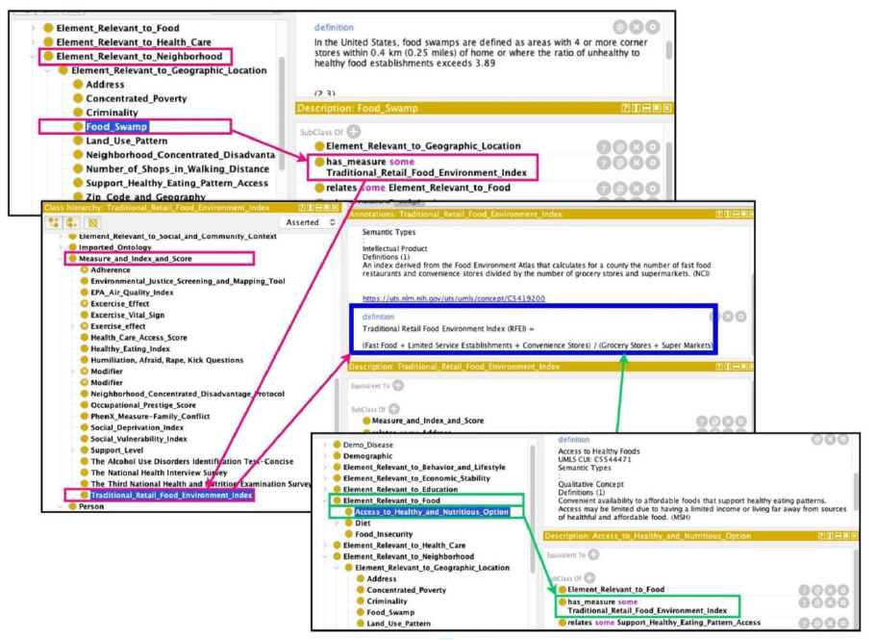
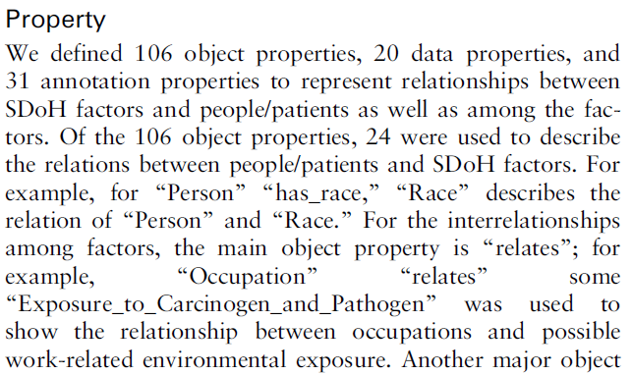
Abusing OWL
Dang Y, Li F, Hu X, Keloth VK, Zhang M, Fu S, Amith MF, Fan JW, Du J, Yu E, Liu H, Jiang X, Xu H, Tao C. Systematic design and data-driven evaluation of social determinants of health ontology (SDoHO). J Am Med Inform Assoc. 2023 Aug 18;30(9):1465-1473. doi: 10.1093/jamia/ocad096. PMID: 37301740; PMCID: PMC10436148.

Slide 144
Abusing Protégé, BFO and OGMS
No reference provided due to vicarious embarrassment

Slide 145
C7. Adherence to ontological principles.
Our preference: applying the principles of ontological realism to design realism-based ontologies.

Slide 146
Realism-based ontology
General principles:
  What to represent
    → ‘ontology’: philosophical discipline,
    Basic principles to classify what exists
  How to represent
    → ‘ontology’: formal representation.

Slide 147
Ontology is much more than classification!
Classification: based on ‘properties’ ‘in common’
  being human, being pregnant, being poisonous,
  having cancer, having a parent, having mass,
  …
Ontology:
  Mainstream ‘ontology’: merely classification
  Realism-based ontology:
    Analyzing the ‘properties’ in relation to their bearers:
      If x has property p, can x exist without p?
      If x acquired property p, can x ever lose p?
      Can x and y share property p?
      …

Slide 148
Mimicking the nature of things in the representation of these things !
‘Some berries are red’:
(exists (x) (and( berry(x) red(x)))
(exists (x) (and( berry(x) has-color(x, red)))
(exists (x y) (and ( berry(x) red(y) has-color(x, y)))
(exists (x y) (and ( instance-of(x, berry) instance-of(y, red) has-color(x, y)))
(exists (x y t) (and instance-of(x, berry, t) instance-of(y, red, t)
instance-of(t, temporal-interval, t) ∧ inheres-in(y, x)))
Realism-based

Slide 149
Essential distinctions made in Realism-based ontologies
Reality versus representations
Particulars versus types

Slide 150
Portions of reality versus representations thereof

Slide 151
We’ve seen this. Explain!

Slide 152


Reality ←→ Representation (videos)

Slide 153
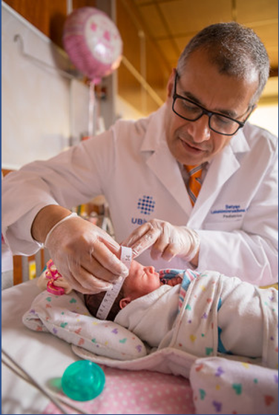
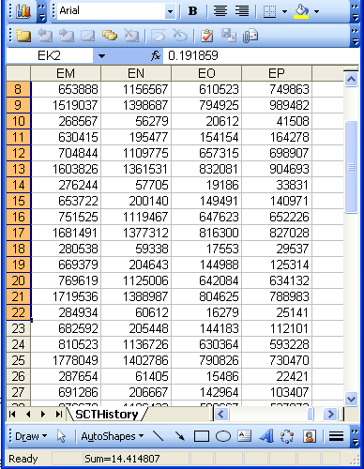
Reality ←→ Representation (data)
(research) domain
(research) data
Referents
References

Slide 154


Realism-based Ontology (RBO)
Referents
  are (meta-) physically the way they are,
  relate to each other in an objective way,
  follow ‘laws of nature’.
Window on reality
  restricted by:
  what is physically and technically observable,
  fit between what is measured and what we think is measured,
  fit between established knowledge and ‘laws of nature’.
References
  follow, ideally, the syntactic-semantic conventions of some representation language,
  are restricted by the expressivity of that language,
  reference collections need to come, for correct interpretation, with documentation outside the representation.

Slide 155
particulars versus types
(universals and defined classes)

Slide 156
‘Type’
Names for something generic in main-stream ontology:
  ‘concept’
  ‘kind’
  ‘category’
  ‘class’
  ‘prototype’
  …
In realism-based ontology:
  ‘Type’:
    ‘Universal’: human being
    ‘Defined class’: human being in Buffalo
  ‘Class’: all human beings

Slide 157
Realism-based terminology for referents
Particular (individual, instance):
  individual entity that exist(ed) in space and time, that exist(ed) only once and carries identity.
Type:
  counterpart in reality of some non-empty general term used in the formulation of some scientific theory.
Universal: type which has particulars as instances (= is instantiated by particulars).
Class: extension (=maximal collection) of a non-empty general term.
Defined class: collection of particulars defined by selection or combination of terms denoting particulars or types.
Smith B, Ceusters W. Ontological Realism as a Methodology for Coordinated Evolution of Scientific Ontologies. Applied Ontology, 2010;5(3-4):139-188.
https://www.ncbi.nlm.nih.gov/pmc/articles/PMC3104413/

Slide 158
Universals versus particulars
for every universal there is or has been at least one instance
some universal
instance-of at t
entities on either site cannot ‘cross’ this boundary
every particular is an instance of at least one universal
some particular

Slide 159
Universal/particular declaration in BFO2020
At all times, there is at least one particular and one universal that is instantiated by that particular.
(forall (t)
  (if (instance-of t temporal-region t)
  (exists (u i)
  (and (not (= i t))
  (universal u)
  (particular i)
  (instance-of i u t))))))

Slide 160




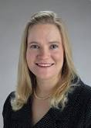
Types versus particulars
Human being
instance of at t
particulars

Slide 161
Types versus particulars
Reality versus representation !
Photograph
instance of at t
particulars

Slide 162
Instances are the objects of classification …
Organism
Vertebrate
Mammal
Human being
instance of at t
particulars

Slide 163
Formal BFO definition for is_a
(aka subClassOf)
The is_a relation is the subtype or subuniversal relation between universals or types.
  C is_a C1 =def.:
    C and C1 are universals, and
    for all c, t, if c instance_of C at t then c instance_of C1 at t

Slide 164
Some BFO2020-FOL ‘subclass’ axioms
(cl:comment "specifically-dependent-continuant is subclass of continuant [dhv-1]"
(forall (t x)
(if (instance-of x specifically-dependent-continuant t)
(instance-of x continuant t))))
(cl:comment "quality is subclass of specifically-dependent-continuant [nbm-1]"
(forall (t x)
(if (instance-of x quality t)
(instance-of x specifically-dependent-continuant t))))
(cl:comment "relational-quality is subclass of quality [taj-1]"
(forall (t x)
(if (instance-of x relational-quality t)
(instance-of x quality t))))

Slide 165
BFO-isa interpretation
(cl:comment "specifically-dependent-continuant is subclass of continuant [dhv-1]"
(forall (t x)
(if (instance-of x specifically-dependent-continuant t)
(instance-of x continuant t))))
(cl:comment "quality is subclass of specifically-dependent-continuant [nbm-1]"
(forall (t x)
(if (instance-of x quality t)
(instance-of x specifically-dependent-continuant t))))
(cl:comment "relational-quality is subclass of quality [taj-1]"
(forall (t x)
(if (instance-of x relational-quality t)
(instance-of x quality t))))
BFO-isa
BFO-isa
BFO-isa

Slide 166
Instances are the objects of classification …
isa
Organism
isa
Vertebrate
isa
Mammal
Human being
instance of at t
particulars

Slide 167
Compare with RDFS / OWL
If the class description C1 is defined as a subclass of class description C2, then the set of individuals in the class extension of C1 should be a subset of the set of individuals in the class extension of C2.
Differences with BFO:
  subClassOf is primitive, being a subset is a consequence
  You just have to declare it
    → how you want the domain to be,
      not how the domain is!
  No time indexing.

Slide 168
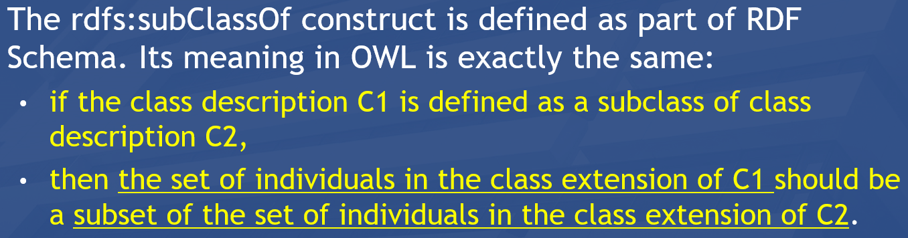
Instances are the objects of classification …
isa
Organism
isa
Vertebrate
isa
Mammal
Human being
instance of at t
particulars

Slide 169
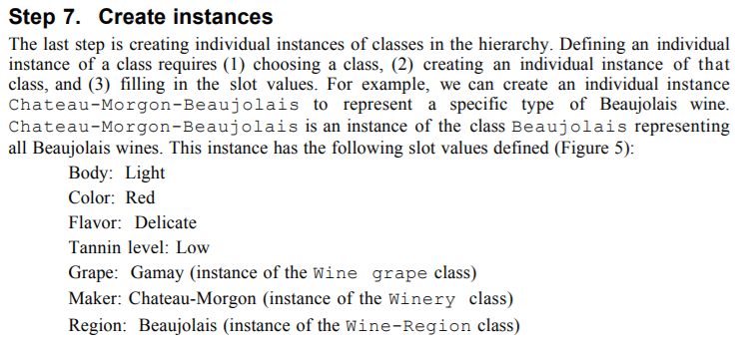
Whether something is a particular or a type is NOT a matter of choice, but a matter of reality!!!
Logically ok.
Ontologically wrong!
https://protege.stanford.edu/publications/ontology_development/ontology101.pdf, p11

Slide 170
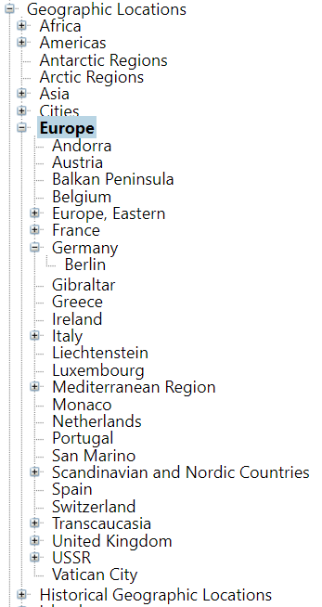
MeSH: several mistakes per RBO rules !!!
Particulars are represented as types;
    Lame excuse: ‘we mean that this type has only one instance’.
Particulars have other particulars as instances;
    The lame excuse breaks down: a class with one instance cannot have a subclass.
How did we call this earlier ?
  Isa / subClassOf overload.

Slide 171
Importance of the particular/universal distinction (1)
Ignoring the distinction may lead to assertions in which
  Different interpretations are possible depending on which terms intend particulars and which universals,

Slide 172
Importance of being clear
The International Classification of Headache Disorders has
‘Persistent idiopathic facial pain (PIFP)’
  = ‘persistent facial pain with varying presentations …’
  Imagine three patients:
  all three have continuously facial pain,
  the first one has always pain which presents itself in the same way,
  the second one has also always pain which presents itself in the same way, but in a different way than in the first patient,
  the third one’s pain presents itself sometimes like in the first patient, sometimes like in the second patient, and sometimes different from those.
  Which patients satisfy the definition for PIFP ?

Slide 173
Do you see the ambiguity ?
‘Persistent idiopathic facial pain (PIFP)’
  = ‘persistent facial pain with varying presentations …’
persistent
facial pain
presentation
type1
presentation
type2
presentation
type3
types
t₂
t₃
t₁
t₁
t₁
t₂
t₂
t₃
t₁
t₃
parti-
culars
t₁
t₂
t₂
t₁
t₃
t₂
t₃
t₃
my pain
her pain
his pain

Slide 174

Make it clear whether assertions are about particulars or types
‘Persistent idiopathic facial pain (PIFP)’
  = ‘persistent facial pain with varying presentations …’
  if the description is about types, then the three particular pains fall under PIFP.
  if the description is about (arbitrary) particulars, then only her pain falls under PIFP.

Slide 175
Importance of the particular/universal distinction (2)
Ignoring the distinction may lead to assertions in which
  Different interpretations are possible depending on which terms intend particulars and which universals,
  the authors run together forms of speech governed by different logical rules.

Slide 176
How to analyze these assertions?
Examples:
  ‘Stating that (sleep) bruxism is a behavior in no way precludes the possibility (at some to-be-specified and validated cut point) of it being more than a behavior, either a risk factor or disorder’.
  ‘Bruxism is a continuously distributed behavior’
        Raphael KG, Santiago V, Lobbezoo F. Bruxism is a continuously distributed behaviour, but disorder decisions are dichotomous (Response to letter by Manfredini, De Laat, Winocur, & Ahlberg (2016)). J Oral Rehabil. 2016 Oct;43(10):802-3. https://www.ncbi.nlm.nih.gov/pmc/articles/PMC5538380/

Slide 177
  ‘ … bruxism is a behavior …’
This is a statement about universals:
Bruxism
isa
Behavior
Ceusters W, Smith B. On Defining Bruxism.
Medical Informatics Europe (MIE2018), Goteborg, Sweden, April 24-26, 2018.
Stud Health Technol Inform. 2018;247:551-555.
https://ebooks.iospress.nl/publication/48852

Slide 178
  ‘ … bruxism is a behavior …’
This is a statement about universals:
here is an instance
Bruxism
isa
Behavior
Instance of at t
John’s repetitive jaw muscle activity of last night

Slide 179
  ‘ … bruxism is a behavior …’
This is a statement about universals:
here is an instance
Bruxism
isa
Behavior
Instance of at t
Instance of at t
John’s repetitive jaw muscle activity of last night

Slide 180
  ‘ … bruxism is a behavior …’
  ‘Bruxism is a continuously distributed behavior’
Are these statements about universals ?
continuously distributed behavior
isa
Bruxism
isa
Behavior
???
Instance of at t
Instance of at t
John’s repetitive jaw muscle activity of last night

Slide 181
  ‘ … bruxism is a behavior …’
  ‘Bruxism is a continuously distributed behavior’
Are these statements about universals ?
continuously distributed behavior
isa
Bruxism
isa
Behavior
???
Instance of at t
Instance of ???
Instance of at t
John’s repetitive jaw muscle activity of last night

Slide 182
  ‘ … bruxism is a behavior …’
  ‘Bruxism is a continuously distributed behavior’
Are these statements about universals ?
continuously distributed behavior
isa
Bruxism
isa
Behavior
???
Instance of at t
Instance of ???
Instance of at t
This is ‘in’ all particulars that are instances of bruxism
John’s repetitive jaw muscle activity of last night

Slide 183
  ‘ … bruxism is a behavior …’
  ‘Bruxism is a continuously distributed behavior’
Are these statements about universals ?
continuously distributed behavior
isa
Bruxism
isa
Behavior
???
Instance of at t
Instance of ???
Instance of at t
This is ‘in’ no particular at all!!!
This is rather a ‘type of universal’, a construct outside the particular/universal realm.
John’s repetitive jaw muscle activity of last night

Slide 184
C8. Adequate adherence to the ontological principles used in the Basic Formal Ontology (BFO).

Slide 185


BFO’s major references
https://mitpress.mit.edu/books/building-ontologies-basic-formal-ontology
https://github.com/BFO-ontology/BFO-2020

Slide 186
The many faces of ‘BFO’
BFO text definitions:
Object is a Material Entity =Def.
for all x, t, if x is an instance of Object at t then x is an instance of Material Entity at t
BFO-OWL:
  <owl:Class rdf:about="http://purl.obolibrary.org/obo/BFO_0000030">
  <rdfs:label xml:lang="en">object</rdfs:label>
  <rdfs:subClassOf rdf:resource="http://purl.obolibrary.org/obo/BFO_0000040"/>
  </owl:Class>
BFO2020 axiomatization:
(not (exists (x) (and (universal x) (particular x))))
(forall (i u t) (if (instance-of i u t)
(and (particular i) (universal u) (instance-of t temporal-region t)))
(universal object)
(forall (t x) (if (instance-of x object t) (instance-of x material-entity t)))
186
Fabian Neuhaus: BFO-FOL for Domain Ontologies. https://ncorwiki.buffalo.edu/index.php/Basic_Formal_Ontology_Summit_Meeting/abstracts

Slide 187
BFO 2.0 top
Entity
Elucidation:
An entity is anything that exists or has existed (or will exist).

Slide 188
Continuants versus
Occurrents

Slide 189
BFO 2.0 top
Entity
Continuant
Occurrent
me my life
my intelligence my reasoning
my heart function the functioning of my heart
my instructor role my teaching
… …

Slide 190
BFO 2020
universal
particular all three are unary relations !
entity
Examples in predicate logic notation:
  universal(a)
  particular(b)
  instanceOf(b, a, t)

Slide 191
Continuants ←→ Occurrents
 | Continuant | Occurrent
Entities that at any time they exist,
exist
in total
Entities that at any time they exist,
exist only
partially
Smith B, Ceusters W. Ontological Realism as a Methodology for Coordinated Evolution of Scientific Ontologies. Applied Ontology, 2010;5(3-4):139-188.

Slide 192
An ontological square
 | Continuant | Occurrent
Types | Tooth | Teeth grinding
Particulars | My left maxillary first molar | My teeth grinding

Slide 193
An ontological square
 | Continuant | Occurrent
Types | Tooth | Teeth grinding
Particulars | My left maxillary first molar | My teeth grinding
Instance
of at t
Instance
of at t
(Instance of
prior to BFO2020)

Slide 194




Continuants preserve identity while changing
human
being
me
me
t
Instance-of
in 1960
child
Instance-of
since 1980
adult
living
creature
animal
caterpillar
butterfly

Slide 195
The importance of temporal indexing
(note: this is totally ignored in mainstream ontologies!)
benign
tumor
malignant
tumor
stomach
instanceOf at t₂
instanceOf at t₁
instanceOf at t₂
instanceOf at t₁
continuant-part-of at t₁
John’s tumor
John’s stomach
continuant-part-of at t₂

Slide 196
The importance of temporal indexing
benign
tumor
malignant
tumor
stomach
instanceOf at t₂
instanceOf at t₁
instanceOf at t₂
instanceOf at t₁
John’s
tumor
continuant-part-of at t₁
John’s stomach
continuant-part-of at t₂
John’s carcinoma

Slide 197

Continuants in BFO

Slide 198
Three major continuant types in BFO
Continuant
Independent
Continuant
IC
Specifically
dependent
continuant
Generically
dependent
continuant
SDC
GDC

Slide 199
Generically Dependent Continuants
Generically
Dependent
Continuant
if one bearer ceases to exist, then the entity can survive, because there are other bearers
(copyability)
the pdf file on my laptop
the DNA (sequence) in this chromosome
A diagnosis
Information
Content
Entity
Gene
Sequence

Slide 200
Specifically Dependent Continuant
Specifically Dependent Continuant
Quality
Realizable
Entity
Relational
Quality
Disposition
Role
Function
Arp, R., B. Smith, and A.D. Spear,
Building ontologies with basic formal ontology. 2015,
The MIT Press,: Cambridge, Massachusetts. p. 1 online resource (245 p).

Slide 201
Specifically Dependent Continuant
Specifically Dependent Continuant
Quality
Realizable
Entity
Elucidation: a quality is a specifically dependent continuant that, in contrast to roles and dispositions, does not require any further process in order to be realized.
Elucidation: b is a realizable entity means: b is a specifically dependent continuant that inheres in some independent continuant which is not a spatial region and is of a type some instances of which are realized in processes of a correlated type.
  ISO/IEC PRF 21838-2:2020(E)

Slide 202
Realizables and realizations
Continuant
Occurrent
Realizable entity
Process
Fragility of a glass
Skill of a craftsman
Role of a student
Function of a heart
Breaking
Constructing
Studying
Beating

Slide 203
Realizables: dispositions versus roles
Disposition:
  if it ceases to exist, then its bearer and/or its immediate surrounding environment is physically changed;
  its realization occurs when its bearer is in some special physical circumstances;
  its realization is what it is in virtue of the bearer’s physical make-up.
Role:
  exists because the bearer is in some special physical, social, or institutional set of circumstances in which the bearer does not have to be, and
  is not such that, if it ceases to exist, then the physical make-up of the bearer is thereby changed.

Slide 204
Occurrent
Occurrent
Process
Temporal Region
unfolds itself in time
Process
Boundary
Spatiotemporal
Region
start or end of process

Slide 205
Relational entities versus formal relations

Slide 206

Not to be confused with what is currently called the ‘OBO Relation Ontology’ !
https://genomebiology.biomedcentral.com/articles/10.1186/gb-2005-6-5-r46

Slide 207
Essentials
Distinguishing what is denoted by ‘relation’ in technical sense (‘formal relations’) from what is denoted by ‘relation’ in non-formal language (‘material relations’);
Differences between type-level formal relations, particular-level formal relations and particular-type-level formal relations;
Arity and other properties of formal relations and differences thereof between particular-type formal relations and their corresponding type-level formal relations;
Elucidation versus definition of formal relations;
‘Basic’ formal relations versus ‘shortcut’ formal relations;
Axiomatic characterization of formal relations.

Slide 208
‘Relations’
(mainstream view)
Relations:
  ‘entities that glue together other entities’
  Formal relations:
    ‘hold between two or more entities directly, without any further intervening individual’.
  Material relations:
    ‘have material structure on their own’.
        = are entities
    Guizzardi & Wagner. What’s in a Relationship: An Ontological Analysis. In: Qing Li, Stefano Spaccapietra, Eric Yu, Antoni Olivé (Eds.), Conceptual Modeling - ER 2008. Lecture Notes in Computer Science, Vol. 5231, 83-97, 2008 https://doi.org/10.1007/978-3-540-87877-3_8↗

Slide 209
Material relation
‘John is friends with Mary’
isAbout at t
J&M’s
friendship
John
Mary

Slide 210
Material relation
‘John is friends with Mary’
isAbout at t
J&M’s
friendship
John
Mary
instanceOf at t
BFO:Object
BFO:Relational Quality

Slide 211
Material relation
‘John is friends with Mary’
isAbout at t
inheres-in
J&M’s
friendship
inheres-in
John
Mary
instanceOf at t
BFO:Object
BFO:Relational Quality

Slide 212
Material relation
‘John is friends with Mary’
isAbout at t
inheres-in
J&M’s
friendship
inheres-in
John
Mary
instanceOf at t
BFO:Object
BFO:Relational Quality

Slide 213
Material relations
‘have material structure on their own’
Are entities in their own right.
Relate other entities to each other by means of formal relations.
Examples: what might by some be denoted by:
  ‘patient’,
  ‘treatment’,
  ‘driver’.
Examples in BFO:
  relational qualities
      Have independent continuants as their bearers.
  relational processes: kissing, buying, …

Slide 214
Formal relations
‘John is friends with Mary’
isAbout at t
inheres-in
J&M’s
friendship
inheres-in
John
Mary
instanceOf at t
BFO:Object
BFO:Relational Quality

Slide 215
Formal relations
‘hold between two or more entities directly, without any further intervening individual’
Basic formal relations:
  ontological dependence, inherence, subtype-of, part-of, subset-of, instantiation, …
Domain formal relations:
  ‘relations that exhibit similar characteristics, i.e., those relations of comparison such as is taller than, is older than, knows more Greek than’.
    Guizzardi & Wagner. What’s in a Relationship: An Ontological Analysis. In: Qing Li, Stefano Spaccapietra, Eric Yu, Antoni Olivé (Eds.), Conceptual Modeling - ER 2008. Lecture Notes in Computer Science, Vol. 5231, 83-97, 2008 https://doi.org/10.1007/978-3-540-87877-3_8↗

Slide 216
Arity of a relation
Binary:
  My youth partOf my life
1 2
Ternary:
  My hand partOf me now
1 2 3
Quaternary:
  My left middle finger between my left index finger
    1 2
  and my left ring finger now
  3 4
…

Slide 217

Properties of binary relations
http://en.ndncdc.org/page/symmetric-binary-relation-on-set/

Slide 218
Relations in Ontological Realism
Instance-level relations
  Your heart (instance-level) continuant_part_of your body at t
  Your heart beating (instance-level) has_participant your heart at t
Instance-type relations
  John’s heart instantiates human heart at t
  John’s heart beating instantiates human heart beating at t
Type-level relations
  human heart continuant_part­_of human body
  human heart beating process has_occurrent_part beat profile

Slide 219
Features of relations on the level of instances may not hold on the level of universals
nucleus adjacent_to cytoplasm
  Not: cytoplasm adjacent_to nucleus
    Red blood cells don’t have a nucleus
seminal vesicle adjacent_to urinary bladder
  Not: urinary bladder adjacent_to seminal vesicle
    Women don’t have seminal vesicles
Adjacency as a relation between universals is not symmetric while it is symmetric at particular level.

Slide 220
the all-some form
A continuant_part_of B =def.
  for all particulars a and times t,
  If a is an instance of the universal A at t,
  then there is some instance b of the universal B
  such that
  a is an instance-level part_of b at t
Domain: Continuant
Range: Continuant

Slide 221
Remember !!!
Formal relations expressed in the BFO are all type-type relations.
    IC isa Continuant
    SDC specifically depends on IC
However !!!!: BFO’s type-type relations don’t express anything about types, but only what is the case for all particulars in the domain position of the relation.
BFO’s type-type relations are defined / elucidated on the basis of instance-level relations.

Slide 222
Elucidation versus definition
x is_about y means:
  x refers to or is cognitively directed towards y. Domain: representations; Range: portions of reality. Axiom: if x is_about y then y exists (veridicality).
‘A means B’:
    If A is the case, you can conclude that B holds.
    If B is the case, you cannot conclude anything re A.
x is_a_representation_of y =def.
  x is a representa­tion & x is_about y (where y is a portion of reality). Note that not all representations are about something.
‘A =def. B’ :
    If A is the case, you can conclude that B holds.
    If B is the case, you can conclude that A holds.
    If one doesn’t hold, the other one doesn’t hold.

Slide 223
Avoid at all cost!!!
‘X hasY Y’
Disease hasSymptom Symptom
Object hasTemperature Temperature
…
(unless you define such relations explicitly as ‘shortcut’ relations)

