Slide 1
Statistical data analysis and research methods BMI504 Course 16556 – Spring 2024
Class 1 – Jan 25, 2024
Course Introduction
Introduction to research and research proposals
Werner CEUSTERS, MD

Slide 2
Class structure (C1)
Participant and instructor introduction.
Course introduction:
course overview,
course project work and assessment,
housekeeping rules and expectations.
Introduction to research proposals.
Discussion on research proposal topics.

Slide 3
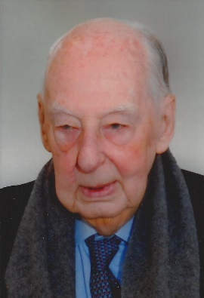
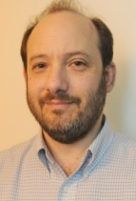
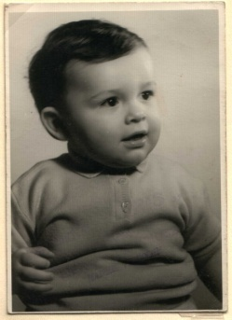
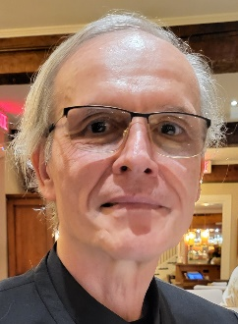
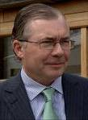
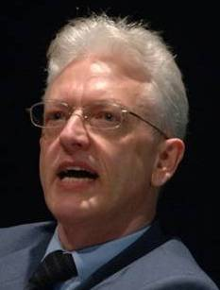
Educational & professional environments
Paul
Kluyskens
Alan
Ruttenberg
1977
2014
1959 -
2012
2006
1989
1992
2004
2002
1993
1995
1998
Georges
Demoor
Barry
Smith

Slide 4
Research and applications covered
Informatics
Knowledge Representation
Linguistics
Computational Linguistics
Ontology
Philosophy
Medical Natural
Language Understanding
Realism-Based
Ontology
Electronic
Health Records
Translational
Research
Referent
Tracking
Medicine
Pharmacogenomics
Performing
Arts
Defense &
Intelligence
Biology
Pharmacology

Slide 5
Student Introductions
Name.
What did you do prior and relevant to starting your current curriculum?
What is your current curriculum / program?
Why did you pick the current program?
What are your career objectives?
For non-BMI-students: why did you pick this course?
What are you expecting from this course?

Slide 6
Course end goal: a research proposal!
You need to write a research proposal for a narrow topic:
that is of interest to you,
that, for BMI students, fits the learning objectives of the BMI program,
BMI504-Spring2024-topic-requirements.pdf
for which you propose a mixed method design.
Time line:
A0 Feb 1: Suggestions for research topic
A1 Feb 23: Outline of the proposal
A2 Mar 5: Mixed method approach included
A3 Mar 26: PICOTT research question, hypotheses, detailed variables, operational linkage
A4 Apr 3: Statistical requirements outlined (3% FS)
A5 Apr 25: Relevant statistical exercise (5% FS)
A7 May 1: Powerpoints for final presentation (5% FS)
A6 May 6: Research proposal complete (34% FS)
A8 May 2: Public oral presentation (15% FS)

Slide 7
Why: research requirements BMI / PhD
All PhD students:
Must write a thesis about original and novel research advancing the state of the art in their domain.
BMI PhD students:
Must write a thesis proposal as their qualifying exam for PhD candidacy.
Funded students, or students hoping to be funded should do this in the form of a NIH F-award.
BMI MSc students: must write a MSc thesis (T) or perform research in a Final Practicum Project (P) depending on their concentration:
General BMI: T or P | Public Health Informatics: P
Clinical Informatics/Decision Support: T or P | Biomedical Ontology: T
Bioinformatics/Translational Informatics: T | Sociotechnical & HCD: P

Slide 8
Housekeeping
The syllabus is the go-to document for all that needs to be done:
Assignments, in-class tests, required readings, …
Any dispute that might arise during the course will be arbitrated by what is in the syllabus or in slides presented during the course, including what was recorded on video:
Read the syllabus through THIS WEEK and provide comments about any unclarity by email PRIOR TO CLASS C2!
Links to required readings are provided in the syllabus.
Slides of presentations will be made available after the class in UB Box
Be present and on time.
Some classes have in-class tests which contribute to final score.

Slide 9
Course scoring
Types:
Three tests: 8%
Statistics preparation 3% (A4)
Statistics assignment: 5% (A5)
Final research proposal: 34% (A6)
Presentation (slides, talk, discussion) 20%
Final exam: 30%
Penalties for late submission of A4, A5, A6, A7.
A1, A2, A3: voluntary with benefits.
Missing A4: may lead to irrelevant exercise for A5.

Slide 10
Assignments
All assignments need to be completed prior to the deadline specified in the course schedule and submitted to UB Box as a Microsoft Word document. No Google doc links or any other link to a cloud server.
The filename should be formatted as this: BMI504-[number of the assignment]-[your UBIT name].
For example, if the course director were a student:
“BMI504-A1-ceusters.docx”.
The first line in the document should always be your full name (first and last name).
Whenever you send me an email in relation to the class, the subject line must start with “BMI504:”.

Slide 11
Homework for next week !!!
a) Required reading
R2 Wagensberg, J., On the Existence and Uniqueness of the Scientific Method. Biol Theory, 2014. 9(3): p. 331-346.
https://www.ncbi.nlm.nih.gov/pmc/articles/PMC4131153/pdf/13752_2014_Article_166.pdf
b) A0: Prepare for proposal:
Reflect about your research interests concerning your future MSc or PhD thesis and formulate a number of research topics.
These topics should for BMI students fit at least three of the detailed learning objectives for biomedical informaticists described in the document ‘BMI504-Spring2024-topic-requirements.doc’.
For students outside the BMI department, any topic will do.
Be prepared to present and discuss this informally in class C2. No prior submission needed.

Slide 12
Writing a research proposal for this course

Slide 13
Mandatory layout and style conventions
Submit as Word .docx document
Letter size, ‘normal margins’, portrait, no columns.
Times Roman font 10-12p, single line spacing, text justified.
Use numbered heading styles, not indented. Change defaults to sample document.
I don’t need literary masterpieces, but concise, unambiguous, well-documented and to the point descriptions.
Content: see template.

Slide 14
Quality assessment of research proposals
Valid for:
Real life
My assessment about your work (A6, A8)

Slide 15
Relevant readings for proposal
R1. Shortliffe, E.H., The organization and content of informatics doctoral dissertations. J Am Med Inform Assoc, 2016. 23(4): p. 840-3.
R3. Ioannidis, J.P., Why most published research findings are false. PLoS Med, 2005. 2(8): p. e124.
R4. Abbasi, K., Covid-19: politicisation, “corruption,” and suppression of science. BMJ, 2020. 371: p. m4425.
R5. Ioannidis, J.P., Why Most Clinical Research Is Not Useful. PLoS Med, 2016. 13(6): p. e1002049.
R7. Sudheesh, K., D.R. Duggappa, and S.S. Nethra, How to write a research proposal? Indian journal of anaesthesia, 2016. 60(9): p. 631-634.
R11. Mårtensson, P., et al., Evaluating research: A multidisciplinary approach to assessing research practice and quality. Research Policy, 2016. 45(3): p. 593-603.

Slide 16
Strongly suggested
Tracy, S. J. (2010). Qualitative quality: Eight “big-tent” criteria for excellent qualitative research. Qualitative Inquiry, 16, 837–851. doi:10.1177/1077800410383121
Recent update: https://www.sarahjtracy.com/wp-content/uploads/2020/08/Tracy-Hinrichs_Big_Tent-Criteria-Encyc-17.pdf

Slide 17
Worthy topic
Relevant
Timely
Significant
Conceptually/theoretically
Practically
Morally
Methodologically
Heuristically
Interesting

Slide 18
Rich rigor
Will there be enough data to support significant claims?
Did the researcher describe how he is going to gather interesting and significant data?
Are the context or samples appropriate given the goals of the study?
Will the researcher use appropriate procedures in terms of field note style, interviewing practices, and analysis procedures?

Slide 19
Meaningful coherence
Will the study achieve what it purports to be about?
Are methods and procedures proposed that fit the stated goals?
Does the proposal meaningfully connects literature, research questions, findings, and interpretations?

Slide 20
Sincerity
Does the proposal demonstrate self-reflexivity about subjective values, biases and inclinations of the researcher?
Is there transparency in the methods and challenges?

Slide 21
Credibility
Description, concrete RELEVANT detail, knowledge
Triangulation or crystallization
Multiple sources
Anticipates reflections from researchers, subjects, target audience

Slide 22
Resonance
Does the proposal demonstrates aesthetic evocative representation?
Are generalizations naturalistic and logical?
Efforts towards transferable findings?

Slide 23
Ethics
Does the proposal consider:
procedural ethics?
situational and culturally specific ethics?
Relational ethics?
Re-use ethics (sharing the research)?

Slide 24
Discussion on possible research topics

