Slide 1
Statistical data analysis and research methods
BMI504
Course 16249 – Spring 2025
Class 1 – Jan 23, 2025
Course Introduction
Introduction to research and research proposals
Werner CEUSTERS, MD

Slide 2
Class structure (C1)
Participant and instructor introduction.
Course introduction:
  course overview,
  course project work and assessment,
  housekeeping rules and expectations.
Introduction to research proposals.
Discussion on research proposal topics.

Slide 3


















Educational & professional environments
Paul
Kluyskens
Alan
Ruttenberg
1977
2014
1959 -
2012
2006
1989
1992
2004
2002
1993
1995
1998
Georges
Demoor
Barry
Smith

Slide 4
Research and applications covered
Informatics
Knowledge Representation
Linguistics
Computational Linguistics
Ontology
Philosophy
Medical Natural
Language Understanding
Realism-Based
Ontology
Electronic
Health Records
Translational
Research
Referent
Tracking
Medicine
Pharmacogenomics
Performing
Arts
Defense &
Intelligence
Biology
Pharmacology

Slide 5
Student Introductions
Name.
What did you do prior and relevant to starting your current curriculum?
What is your current curriculum / program?
Why did you pick the current program?
What are your career objectives?
For non-BMI-students: why did you pick this course?
What are you expecting from this course?

Slide 6
Course end goal: a research proposal!
You need to write a research proposal for a narrow topic:
  that is of interest to you,
  that, for BMI students, fits the learning objectives of the BMI program,
      BMI504-Spring2025-topic-requirements.pdf
  for which you propose a mixed method design.
Time line:
  A0 Jan 30: Suggestions for research topic
  A1 (Feb 17): A1-section (problem, objective, purpose…) (2.5% A6)
  A2 (Mar 2): Mixed method, significance, PICOTT, … (6.5% A6)
  A3 (Mar 24): hypotheses, detailed methods, variables, … (23% A6)
  A4 (Apr 6)!!!: Data tables, cohorts, bias, stats, … (18% A6)
  A5 Apr 25: Relevant statistical exercise (5% FS)
  A7 Apr 28: Powerpoint for final presentation (5% FS)
  A8 May 1: Oral presentation (10% FS)
  A6 May 6: Research proposal complete (50% FS)
  May 8: Final Exam (30% FS)

Slide 7
Why: research requirements BMI / PhD
All PhD students:
  Must write a thesis about original and novel research advancing the state of the art in their domain.
BMI PhD students:
  Must write a thesis proposal as their qualifying exam for PhD candidacy.
  Funded students, or students hoping to be funded should do this in the form of a NIH F-award.
BMI MSc students: must write a MSc thesis (T) or perform research in a Final Practicum Project (P) depending on their concentration:
General BMI: T or P | Public Health Informatics: P
Clinical Informatics/Decision Support: T or P | Biomedical Ontology: T
Bioinformatics/Translational Informatics: T | Sociotechnical & HCD: P

Slide 8
Housekeeping
The syllabus is the go-to document for all that needs to be done:
    Assignments, (in-class tests), required readings, …
Any dispute that might arise during the course will be arbitrated by what is in the syllabus or in slides presented during the course, including what was recorded on video:
    Read the syllabus through THIS WEEK and provide comments about any unclarity by email PRIOR TO CLASS C2!
Links to required readings are provided in the syllabus.
Slides of presentations will be made available after the class in UB Box
Be present and on time.

Slide 9
Assignments
A1 … A4: voluntary, floating deadline but not later than April 6, commented ones each!
All assignments need to be completed prior to the deadline specified in the course schedule and submitted to UB Box as a Microsoft Word document. No Google doc links or any other link to a cloud server.
The filename should be formatted as this: BMI504-[number of the assignment]-[your UBIT name].
  For example, if the course director were a student:
  “BMI504-A1-ceusters.docx”.
The first line in the document should always be your full name (first and last name).
Whenever you send me an email in relation to the class, the subject line must start with “BMI504:”.

Slide 10
Homework for next week !!!
a) Required reading
R2 Wagensberg, J., On the Existence and Uniqueness of the Scientific Method. Biol Theory, 2014. 9(3): p. 331-346.
https://www.ncbi.nlm.nih.gov/pmc/articles/PMC4131153/pdf/13752_2014_Article_166.pdf
b) A0: Prepare for proposal:
  Reflect about your research interests concerning your future MSc or PhD thesis and formulate a number of research topics.
  These topics should for BMI students fit at least one of the detailed learning objectives for biomedical informaticists described in the document ‘BMI504-Spring2025-topic-requirements.pdf’.
  For students outside the BMI department, any topic will do.
  Be prepared to present and discuss this informally in class C2. No prior submission needed.

Slide 11
Writing a research proposal for this course

Slide 12
Mandatory layout and style conventions
The provided template must be used and strictly followed. This means font, font size, headings, single line spacing, justified, …
Use numbered heading styles, not indented. Change defaults to sample document.
Adhere to all criteria in the skeleton.
Sections deviating from template or skeleton in any way will be scored 0.
Submit as Word .docx document
I don’t need literary masterpieces, but concise, unambiguous, well-documented and to the point descriptions.

Slide 13
Framing the research question
A1/1.1.
Two general strategies:
hypothesis testing:
  researchers construct a null hypothesis (“no effect” or “no difference”) and an alternative hypothesis;
  evidence is sought to disprove the null and/or support the alternative hypothesis.
Estimation:
  Compute differences in some outcome for two different events with appropriate precision;
  Appropriate precision is measured by the width of a confidence interval of the difference between the outcomes in the two groups.
Required for your proposal
Evans SR. Fundamentals of clinical trial design. Journal of experimental stroke & translational medicine. 2010;3(1):19-27.

Slide 14
Evidence Based Research Question Types
A1/1.1.
Intervention/Therapy:
  Does introducing system s leads to less p in z ?
Etiology:
  What causes z’s to have p’s when using s ?
Diagnosis:
  Is s1 better than s2 to improve p by z’s ?
Prognosis/Prediction:
  What f’s will make z’s be more efficient with s ?
Meaning:
  Why do z’s prefer s1 over s2 to do x?
https://www.aaacn.org/sites/default/files/documents/misc-docs/1e_PICOT_Questions_template.pdf

Slide 15
Specific strategy: PICO(TT) Framework
A2/1.1.
P | Patient Population of patients Problem | What is the best way to briefly describe this patient population or situation? E.g. pregnant women over 40 with preeclampsia, adolescent boys 13-15, etc.
I | Intervention (therapy or test) | What is the intervention? E.g. a drug, a questionnaire, a test, a procedure, etc.
C | Comparison | Is there an alternative intervention to compare to? E.g. placebo, current standard of care, another therapy, etc.
O | Outcome | Include specific patient-oriented outcomes E.g. morbidity, quality of life, etc.
T | Time for completion | Used to identify the time/duration for your data collection or for assessing your outcome. I.e. how long before you are to see that the intervention is having a positive impact OR the time in which the intervention will be delivered
T | Type of study | What is the ideal study design to answer this question? What type of study design do you realistically anticipate finding? E.g. randomized-controlled trial, systematic reviews, etc.
For the proposal: a BMI application or process!!!

Slide 16
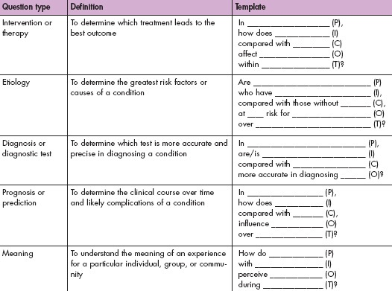
A2/1.1.
https://www.aaacn.org/sites/default/files/documents/misc-docs/1e_PICOT_Questions_template.pdf

Slide 17
Be aware
A2/1.1.
Your research question(s) must EXACTLY follow the format of one of these 5 types !!!
Your hypothes(i)(e)s must reflect your research question(s)
All your variables must be motivated and described in relation to the research questions, including ‘intermediate variables’ specified in your theory (theoretical linkage)
The set of your variables is the minimal set required to be able to accept/reject the null hypothesis.

Slide 18
Research design types
A2/1.4.
Quantitative | Qualitative | Mixed Methods
Experimental designs Nonexperimental designs, such as surveys | Narrative research Phenomenology Grounded theory Ethnographies Case study | Convergent Explanatory sequential Exploratory sequential Transformative, embedded, or multiphase
Be explicit in your proposal !
Creswell JW. Research design : qualitative, quantitative, and mixed methods approaches— 4th ed. Sage Publications, 2014, p12.

Slide 19
Some purposes of mixed methods
A2/1.4.
Convergence: using both types to answer the same question, through comparison of results to see if they reach the same conclusion (triangulation) or by converting a data set from one type into another.
Complementarity: using each method to answer a related question or series of questions for purposes of evaluation or elaboration.
Expansion: using one type to answer questions raised by the other type.
Development: using one type to answer questions that will enable use of the other method to answer other questions.
Sampling: using one type to define or identify the participant sample for collection and analysis of data representing the other type.
Palinkas et. al. Mixed Method Designs in Implementation Research.
Adm Policy Ment Health (2011) 38:44–53

Slide 20
Criteria for choosing an MM design
A2/1.4.
Reasons | Expected Outcomes | Design
Comparing different perspectives drawn from quantitative and qualitative data Explaining quantitative results with qualitative data Developing better measurement instruments Understanding experimental results by incorporating perspectives of individuals Developing an understanding of needed changes for a marginalized group Understanding the need for an impact of an intervention | Merging the two databases to show how the data converge or diverge An in-depth understanding of the quantitative results (often cultural relevance) A test of better measures for a sample of a population An understanding of participant views within the context of an experimental intervention A call for action program A formative and summative evaluation | Convergent parallel Explanatory sequential Exploratory sequential Embedded Transformative Multiphase
Creswell JW. Research design : qualitative, quantitative, and mixed methods approaches— 4th ed. Sage Publications, 2014.

Slide 21
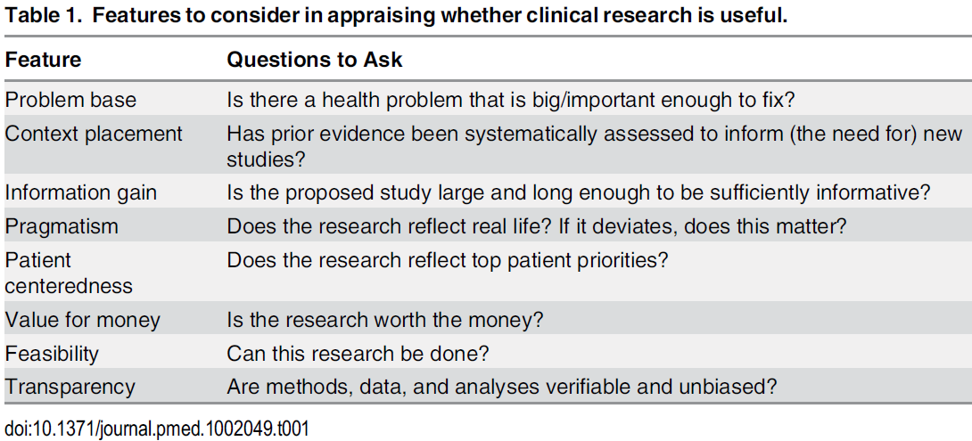
Usefulness features per Ioannidis
A2/2.3.
Features Outline

Slide 22
Quantitative research (QNR)
A3/3.1.
In natural sciences and social sciences, quantitative research is the systematic empirical investigation of observable phenomena via statistical, mathematical or computational techniques.
https://en.wikipedia.org/wiki/Quantitative_research
Qualitative research (QLR)
Qualitative Research is primarily exploratory research used to gain an understanding of underlying reasons, opinions, and motivations. It provides insights into the problem or helps to develop ideas or hypotheses for potential quantitative research.
http://www.snapsurveys.com/blog/what-is-the-difference-between-qualitative-research-and-quantitative-research/

Slide 23
Quantitative, qualitative and mixed methods
A3/3.1.
Required for
your proposal
Quantitative methods | Qualitative methods | Mixed methods
Predetermined methods | Emerging methods | Both predetermined and emerging methods
Instrument based questions | Open-ended questions | Both open- and closed-ended questions
Observational data, performance data, attitude data, and census data | Interview data, observation data, document data, and audiovisual data | Multiple forms of data drawing on all possibilities
Statistical analysis | Text and image analysis | Statistical and text analysis
Statistical interpretation | Themes, patterns interpretation | Integration of multiple interpretations

Slide 24
Mixed methods research
A3/3.1.
Goal:
  Obtain a deeper and more complete understanding of a research problem than either approach alone.
Process of research:
  collecting both quantitative and qualitative data,
  integrating the two forms of data, and
  using distinct designs that may involve different philosophical assumptions and theoretical frameworks.
Creswell JW. Research design : qualitative, quantitative, and mixed methods approaches— 4th ed. Sage Publications, 2014.

Slide 25
Good Reporting of A Mixed Methods Study (GRAMMS)
A3/3.1.
Describe:
  the justification for using a mixed methods approach to the research question;
  the design in terms of the purpose, priority, and sequence of methods;
  each method in terms of sampling, data collection and analysis;
  where integration has occurred, how it has occurred, and who has participated in it;
  any limitation of one method associated with the presence of the other method; and
  any insights gained from mixing or integrating methods.
O’Cathain, A., Murphy, E., & Nicholl, J. (2008). The quality of mixed methods studies in health services research. Journal of Health Services Research Policy, 13(2), 92-98.

Slide 26
Steps in data analysis (1.4)
A3/3.2.a)
Specify the question you are asking.
  Does doing physical exercise influences heart rate while doing the exercise?
Put the question in the form of a null hypothesis and alternate hypothesis.
  Null hypothesis: Physical exercise does not influence heart rate while doing the exercise.
Put the question in the form of a statistical null hypothesis and alternative hypothesis.
  Statistical null hypothesis: the average heart rate observed in a sample of individuals working out is the same as in a sample of individuals being at rest.
Determine which variables are relevant to the question.

Slide 27
Statistical hypothesis
A3/3.2.b)
A statistical hypothesis is an assumption about a ‘population parameter’, i.e. a measurable characteristic of a population, such as a mean or a standard deviation.
This assumption may or may not be true.
Hypothesis testing refers to the formal procedures used by statisticians to accept or reject statistical hypotheses.
The best way to determine whether a statistical hypothesis is true:
  Examine the entire population, or
  Examine a random sample from the population.
    If sample data are not consistent with the statistical hypothesis, the hypothesis is rejected.
http://stattrek.com/hypothesis-test/hypothesis-testing.aspx

Slide 28
Two types of statistical hypotheses
A3/3.2.b)
Statistical null hypothesis.
  the hypothesis that sample observations result purely from chance;
  notation: H₀
Statistical alternative hypothesis.
  the hypothesis that sample observations are influenced by some non-random cause;
  notation: H₁ or H_{a}.
http://stattrek.com/hypothesis-test/hypothesis-testing.aspx

Slide 29
Theoretical linkage
A3/3.2.c)
Should explain WHY you believe your alternate hypothesis is correct and the null to be rejected.
Should describe how your independent variables, dependent variables and bias variables used in your theory are related to each other, so that the dependent variables corollate with the independent variables in the way claimed by your alternative hypothesis. Therefore, all these variables need to be described in your variable description section.

Slide 30
Operational linkage
A3/3.2.d)
should describe WHY you believe that the way you measure your variables will lead to observing the effect in the way that you predicted as described and motivated in the theoretical linkage.

Slide 31
‘Operational Linkage’
A3/3.2.d)
The operational linkage provides the means of testing the probable truth or falsity of the corresponding relationship between variables.
This distinguishes a scientific relationship, which must be shown to be true in the “measurement world” of observations, from an “a priori” relationship.
The operational linkage allows us to determine objectively if two concepts/constructs covary, by telling us how measured changes in one variable should be associated with measured changes in the other.
By determining if the two variables covary in the way described by the operational linkage, we can test the probable truth of the scientific relationship.
Adapted from: James H. Watt and Sjef van den Berg. Research Methods For Communication Science. 2002
http://www.cios.org/readbook/rmcs/rmcs.htm

Slide 32
Types of Data Collection in QLRM
A3/3.3.e)
Questionnaire
Interviews
Focus groups
Observation
(Data) extraction
Secondary data sources
Ethnography
MC. Harrell & MA. Bradley. Data Collection Methods: Semi-Structured Interviews and Focus Groups. RAND Corporation 2009. http://www.rand.org/pubs/technical_reports/TR718.html

Slide 33
COREQ (COnsolidated criteria for REporting Qualitative research) Checklist
A3/3.3.e)
Covers:
  Research team and reflexivity
  Study design
  Analysis and findings
Origine:
    Tong A, Sainsbury P, Craig J.
    Consolidated criteria for reporting qualitative research (COREQ): a 32-item checklist for interviews and focus groups.
    International Journal for Quality in Health Care. 2007. Volume 19, Number 6: pp. 349 – 357.
Required for publishing papers in certain journals.
https://content.sph.harvard.edu/wwwhsph/sites/2448/2021/02/Consolidated-criteria-for-reporting-qualitative-research-COREQ.pdf

Slide 34
Pre-defined perspectives
A3/3.4.c)
Perspective label:
  Short term that functions as a name to identify the perspective in communications about the research.
Theoretical definition:
  Description that specifies what sort of PoR the defining researcher carved out through the perspective.
Operational definition:
  Description intended to allow other researchers
    (a) to observe (in case of concepts) the intended PoRs from the very same perspective objectively or,
    (b) to build (in case of constructs) the perspective in exactly the same way as intended.
Adapted from: James H. Watt and Sjef van den Berg. Research Methods For Communication Science. 2002
http://www.cios.org/readbook/rmcs/rmcs.htm

Slide 35
‘Theoretical definition’ and
‘Theoretical linkage’
A3/3.4.c)
The ‘theoretical definition’:
  is a … description that specifies what sort of PoR the defining researcher carved out through the perspective.
  explains the nature of a PoR observed through a perspective.
The ‘theoretical linkage’:
  provides the justification for the posited causation within the theory;
  explains, as the product of a rational process, the nature of a relationship between two concepts/ constructs.

Slide 36
Requirements for operational definitions
A3/3.4.d)
Must contain instructions as precisely as possible for observations/calculations to be done repeatably and objectively;
Must specify:
  how observations are to be done, and calculations or logical combinations to be performed,
  units of measurements,
  level of measurement:
    categorical , … ?
Correspondence between theoretical and operational definition establishes the validity of the measurements.
Adapted from: James H. Watt and Sjef van den Berg. Research Methods For Communication Science. 2002
http://www.cios.org/readbook/rmcs/rmcs.htm

Slide 37
Variables & level of measurement
A3/3.4.e)
Nominal (=categorical):
    e.g.: shape = round, square, oval, …
    Only comparison is (in)equality,
    Special type: binary.
Ordinal (=rank):
    Ranking order between values,
    e.g.: like most, like somewhat, neutral, dislike somewhat, …
Interval:
    Ranked with equal distance between values,
    Null-point is arbitrary.
    e.g.: temperature in Celsius or Fahrenheit.
Ratio:
    Ratios between pairs of values are meaningful,
    Absolute null-point.
    e.g.: temperature in Kelvin.

Slide 38
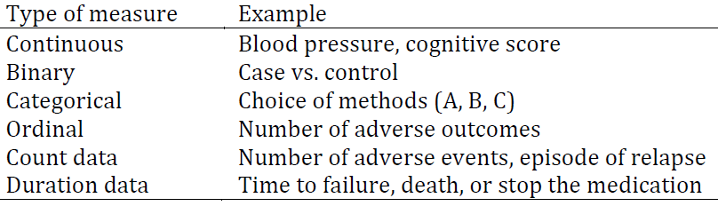
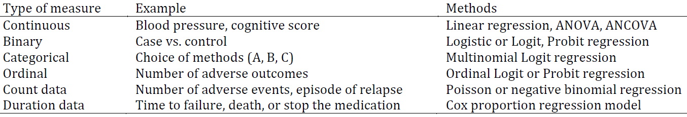
Data types and statistical analysis (preview)
A3/3.4.e)
Zhang F and Hughes C. Reporting standards for clinical and translational research. Glob Clin Transl Res. 2019; 1(2): 69-73

Slide 39
Mainstream classification of bias types
A4/3.5.f)
Selection bias:
  distortion that results from the method by which referents are selected into the study population,
Information bias (also called misclassification bias):
  distortion that results from
    inaccuracies in the representation of referent characteristics,
    incorrect classification therefrom,
Confounding bias:
  distortion in the interpretation of representations due to failure to take into account the effect of non-represented portions of reality other than the represented referent(s).
Adapted from: Kleinbaum DG, Kupper LL, Morgenstern H. Epidemiologic research. Belmont, CA: Lifetime Learning Publications, 1982.

Slide 40
Fight bias through management plans
A4/3.5.g)
Essential elements of your method’s section:
  explain the procedures or extras steps to be taken to minimize the risk of bias.
    The procedures or protections put into place to reduce the risk of bias are often called “controls.”
  Explain how they are tailored to your specific study and/or sponsor and/or your financial interests.
J. Moore, C. McGoff, MA. Conflicts of Interest in Human Subjects. Research. https://about.citiprogram.org/en/homepage/.

Slide 41
Baseline determination
A4/3.5.h)
Consider all important baseline variables to be measured and how they are to be measured before research starts:
  Demographic characteristics (age, sex, height, weight, etc),
  Known factors that predict the outcome (potential confounders),
  Factors that predict or alter the risk of adverse reactions,
  Stratification factors,
  Pre-specified subgroups.
Burgess DC, Gebski VJ, Keech AC. Baseline data in clinical trials.
Med J Aust. 2003 Jul 21;179(2):105-7.

Slide 42
Table of Baseline Data
A4/3.5.h)
Table describing the characteristics of the intervention and control groups before the trial begins
Variables
  Demographics (age, gender, race, ethnicity, etc.)
  Lab Values
  Diagnoses
  Severity of illness scores (any risk factors for the primary outcome)
  Abnormal cut offs for values
  Combined values as needed for composite measures
  Comparison of the intervention and control groups

Slide 43
Data tables
A3/3.6
Each row should contain one or more results of observations, each result expressed as an individual value for the corresponding variable.
Each row should refer to at least:
  an individual subject from your cohorts
  a specific time or time-period at or over which the observations have been made.
The operational definition of the variable should explain:
  how values for observations are obtained,
  be consistent with the overall methodology.

Slide 44
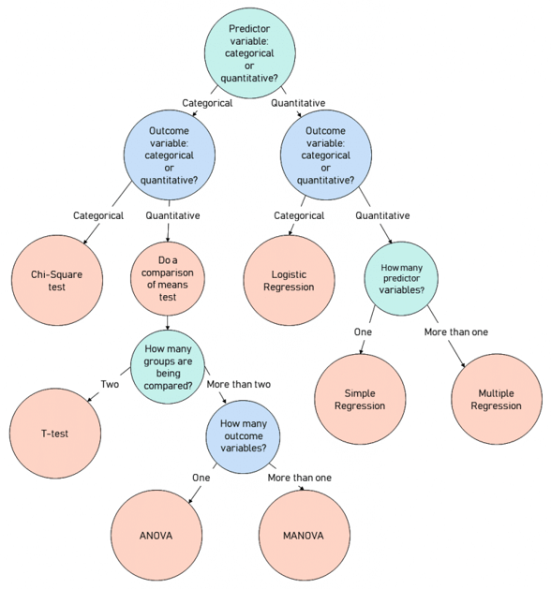
Variable types and hypothesis testing
A4/3.7
https://stats.idre.ucla.edu/other/mult-pkg/whatstat/
https://www.scribbr.com/statistics/statistical-tests/

Slide 45
Population
A4/4.
The total group of interest to be studied:
  All instances of type X which …
    All students registered in BMI504 Spring 2025
    All students registered at UB Spring 2020
  Instances of any types, including ‘events’
What is of interest: ‘variables’
  = measurable characteristic that (1) describes some entity and (2) can vary from one entity to another, or within one entity over time.
  E.g. gender, IQ, country of origin, BMI, …
Populations are described by quantities called ‘parameters’
  The population’s mean length, the population’s variance in country of origin, …

Slide 46
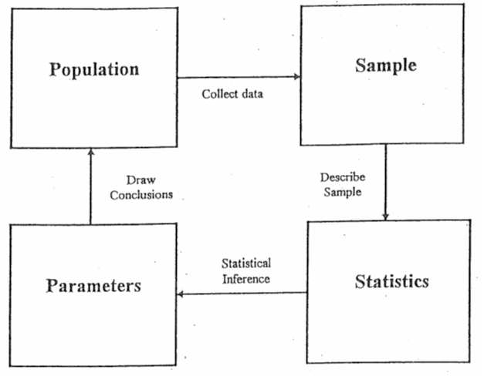
‘Statistics’
A4/4.
As mass noun:
    a branch of mathematics dealing with the collection, analysis, interpretation, and presentation of masses of numerical data.
Diane Kiernan. Natural Resources Biometrics. https://textbooks.opensuny.org/natural-resources-biometrics/.

Slide 47
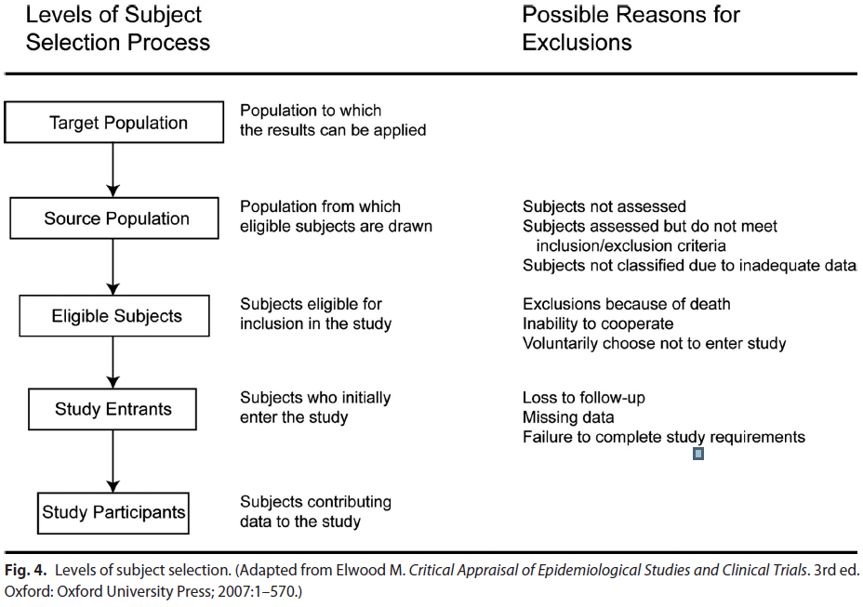
Selection of study participants
A4/4.
Song JW, Chung KC. Observational studies: Cohort and case-control studies. Plast Reconstr Surg 2010;126:2234-42

Slide 48
Cohort selection criteria
A4/4.1
Inclusion criteria:
  necessary conditions to participate.
Exclusion criteria:
  conditions sufficient to reject subjects that satisfy the inclusion criteria
  they are NOT the negation of the inclusion criteria

Slide 49
Sample
A4/4.3.a)
Subsets of data drawn from a population
Descriptive statistics (sample mean, sample variance, …) describe the samples.
Only the statistics of completely representative samples provide for accurate parameters (population mean, …).
  Statistics → parameter estimates
  How good are the estimates?
  If the statistics about the same variables in distinct samples are distinct, are then the parameters for these variables distinct in the populations the samples are drawn from?

Slide 50
Sampling methods
A4/4.3.a)
Random (in combination with others)
Stratified:
  the population is partitioned into non-overlapping groups (‘strata’) and a sample is selected by some design within each stratum.
      https://onlinecourses.science.psu.edu/stat506/node/27
Clustered: focus on a specific subpopulation;
Judgment-based: focus on subpopulations with specific knowledge or perspective.
Convenience-based.
Opportunity-based.
Snowball: e.g. suggestions by other interviewees.
MC. Harrell & MA. Bradley. Data Collection Methods: Semi-Structured Interviews and Focus Groups. RAND Corporation 2009. http://www.rand.org/pubs/technical_reports/TR718.html

Slide 51
Randomization
A4/4.3.b)
Goal: minimizing treatment selection bias;
    assignment to treated group not based on prognostic factors;
    prevents confounding of the treatment effects with other prognostic variables.
Strategies:
  Simple: flip a coin for each subject.
  Constrained: subjects pick token (T or nT) from a bag.
  Adaptive, several schemas, e.g.:
    pick token from bag to determine group, put it back, add one token from opposite category, or,
    pick from bag, give selected treatment, if treatment successful add two tokens of same treatment to bag, otherwise, one of each.
  Stratified: create treatment groups that are balanced with respect to confounding (prognostic) variables.

Slide 52
Blinding
A4/4.3.c)
Of who:
  single: study subjects;
  double: subjects plus investigators;
  triple: subjects, investigators, evaluators, sponsors.
Not often possible:
  Ethical (no fake surgery)
  Different side effects of two compared treatments
  Different routes of administration
    Can be canceled out by ‘double dummy’ approach
Requires evaluation of the success of the blinding.
Evans SR. Fundamentals of clinical trial design. Journal of experimental stroke & translational medicine. 2010;3(1):19-27.

Slide 53
Control group selection
A4/4.3.d)
Goal: discriminate the effects caused by the study intervention from effects due to other factors.
      natural history of the disease, patient or clinician expectations, the effects of other interventions, …
Types:
  historical controls: data from previous studies
    Randomization not possible → more bias risk
  placebo/sham controls
  active controls: comparison to intervention with known outcomes
    ‘non-inferiority’ studies.
Evans SR. Fundamentals of clinical trial design. Journal of experimental stroke & translational medicine. 2010;3(1):19-27.

Slide 54
Steps in sample size determination
A4/4.4.
Formulate null and alternative hypotheses.
    ‘minimum clinically relevant difference’.
Select type I and type II errors.
Obtain estimates of quantities that may be needed (e.g., estimates of variation or a control group response rate), through:
    searching the literature for prior data
    running pilot studies.
Select the minimum sample size such that two conditions hold:
    if the null hypothesis is true then the probability of incorrectly rejecting is no more than the selected Type I error rate, and
    if the alternative hypothesis is true then the probability of incorrectly failing to reject is no more than the selected Type II error.
Evans SR. Fundamentals of clinical trial design. Journal of experimental stroke & translational medicine. 2010;3(1):19-27.

Slide 55
Discussion on possible research topics

