Slide 1
Statistical data analysis and research methods
BMI504
Course 16249 – Spring 2025
Class 11 – April 10, 2025
Descriptive and elementary statistics
Werner CEUSTERS

Slide 2
What you should know by now about research conducted following the scientific method (1)
You must observe in reality (= ‘in the real world’) that
  some entities (P) exhibit characteristics (C) that make them be/behave/react different(ly) than other entities (E),
  these entities P are facing a problem that needs to be solved. → worthwhile research?
You must ask yourself:
  Are these differences real? → research question
  Why is it like that? → theory
  What can I do about it? → worthwhile research?

Slide 3
What you should know by now about research conducted following the scientific method (2)
You must describe the characteristics C in terms of variables that can be divided in two groups I and D such that
  changes in I-type variables (independent variables) seem to induce changes in D-type variables (dependent variables),
  values for some I-type variables can be manipulated,
  some I-type variables tend to have different values in E entities than in P entities, and/or
  manipulable I-type variables induce changes in D-type variables differently in E entities than in P entities.
→ Research questions in PICOT format

Slide 4
What you should know by now about research conducted following the scientific method (3)
From the I-group variables you pick/combine variables that you use to formulate null and alternative hypotheses about how they influence one or a combination of D-type variables and do so differently in E and P entities.
For each variable (D/I) selected, you provide:
  What the variable exactly describes in reality
    → theoretical definition
  How you exactly measure it and at what level(s)
    → operational definition

Slide 5
What you should know by now about research conducted following the scientific method (4)
For each hypothesis, you formulate over your samples a statistical hypothesis in which the variables are replaced by appropriate population parameters as allowed by the level of measurement you use.
You explain by resorting to your theory-variables and selected I- and D variables why you believe you can reject your null hypotheses in the sense formulated in the alternative hypotheses. → theoretical linkage
You explain why your method to measure the variables will be such that if the null hypothesis is to be rejected, this will be reflected in the population parameters used to describe the statistical null hypothesis. → operational linkage

Slide 6
What you should know by now about research conducted following the scientific method (5)
To be sure that you will measure only the characteristics you intend to measure, and that only the selected I-variables are responsible for changes in D-variables, you take measures to eliminate confounding bias.
To be sure you can reliably compare E and P entities,
  You avoid selection bias when sampling from E and P,
  You ensure E-sample and P-sample are comparable for all characteristics you do not measure
→ Need to be described non-redundantly in dedicated subsections of the proposal.

Slide 7
Most incomplete elements thus far
Experimental component:
  Describe in more detail (flow chart to visualize)
    how subjects are ‘navigated’ through the study,
    paths they can follow depending on circumstances,
    what is done to them at steps in the paths
Data collection plan:
  What data collected when in which paths
  What route is followed by the data
How your statistics tables are computed from the raw data tables.
How the statistics tables express what you claim in your hypotheses.

Slide 8
Today’s class relevance
To add more detail to the operational linkage:
Your motivated assumptions about the distribution of your dependent and independent variables
The way you will verify the distribution once you would have the data
Your motivation for why the chosen population parameters in your statistical hypotheses are appropriate
Which statistical tests you will use if your distribution assumptions are correct

Slide 9
‘Statistics’
Goal:
  Demonstrate that if your D-type population parameters show differences for your E-sample and P-sample, these differences are significant!
Determinants:
  Sample sizes and power
  Measurement levels of variables
  Conditions under which significance tests may be applied
  …

Slide 10
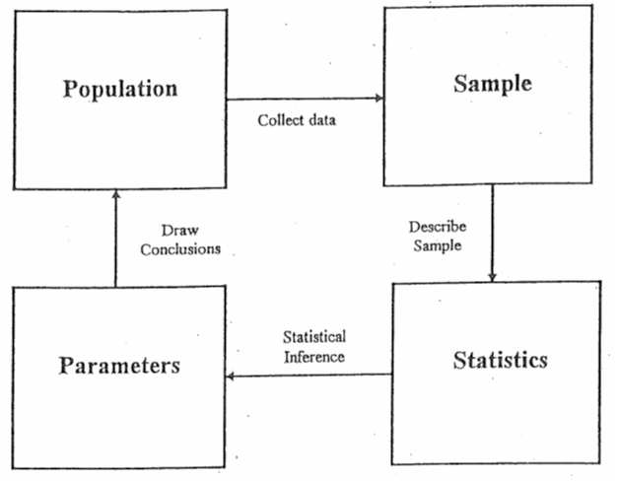
‘Statistics’
As mass noun:
    a branch of mathematics dealing with the collection, analysis, interpretation, and presentation of masses of numerical data.
Diane Kiernan. Natural Resources Biometrics. https://textbooks.opensuny.org/natural-resources-biometrics/.

Slide 11
‘Statistics’
As mass noun:
    a branch of mathematics dealing with the collection, analysis, interpretation, and presentation of masses of numerical data.
As count noun:
    a collection of quantitative data.
The singular ‘statistic’:
    a single term or datum in a collection of statistics;
    a quantity (as the mean of a sample) that is computed from a sample; specifically an estimate;
    a random variable that takes on the possible values of a statistic.
        https://www.merriam-webster.com/dictionary/statistic

Slide 12
Descriptive vs. inferential statistics
Descriptive statistics:
  mathematical quantities that summarize and interpret some of the properties of a sample (set of data);
    More used as plural count noun
Inferential statistics:
  Research on a sample to infer the properties of the population from which the sample was drawn;
    More used as mass noun.
  Elementary inferential statistics:
    use hypothesis tests to weigh inferences concerning means and proportions;
    use a confidence interval to estimate and measure the accuracy of means and proportions; and
    use a scatter plot of bivariate data to visualize the relationship between variables, use the correlation coefficient to measure the strength and direction of the relationship.

Slide 13
Population
The total group of interest to be studied:
  All instances of type X which …
    All students registered in BMI504 Spring 2023
    All students registered at UB Spring 2020
  Instances of any types, including ‘events’
What is of interest: ‘variables’
  = measurable characteristic that (1) describes some entity and (2) can vary from one entity to another, or within one entity over time.
  E.g. gender, IQ, country of origin, BMI, …
Populations are described by quantities called ‘parameters’
  The population’s mean length, the population’s variance in country of origin, …

Slide 14
Same population, distinct variables, values
Students at UB Spring 2023
Students at UB Spring 2023
Students at UB Spring 2023
undergraduate
graduate
master
PhD
Intelligence
Level
Age

Slide 15
Distinct populations, same variable
Students at UB Spring 1905
Students at UB Spring 1960
Students at UB Spring 2021
Intelligence
Intelligence
Intelligence

Slide 16
Overlapping populations
Students at UB Spring 2016
Students at UB Spring 2017
Students at UB Spring 2018
Students at UB Spring 2019
Students at UB Spring 2020
t

Slide 17
Subpopulations and overlap
‘Distinct’ populations: a matter of defining populations in terms of variables.
Appropriate definitions allow to find out how variables covary.

Slide 18
Sample
Subsets of data drawn from a population
Descriptive statistics (sample mean, sample variance, …) describe the samples.
Only the statistics of completely representative samples provide for accurate parameters (population mean, …).
  Statistics → parameter estimates
  How good are the estimates?
  If the statistics about the same variables in distinct samples are distinct, are then the parameters for these variables distinct in the populations the samples are drawn from?

Slide 19
Distinct notations for statistics and parameters
 | Sample statistic | Population parameter
Proportion | p̂ (called “p-hat”) | P
Mean | x̄ (called “x-bar”) | μ (Greek letter “mu”)
Standard deviation | s (Latin letter “s”) | σ (Greek letter “sigma”)
Variance | s² | σ²
…
https://www.scribbr.com/statistics/parameter-vs-statistic/

Slide 20
Sampling needs to be as accurate as possible
From distinct but comparable populations
Random (= probability sampling)
Sampling error is unavoidable

Slide 21
Dependent versus independent samples (1)
Independent samples:
  subjects in one group do not provide information about subjects in other groups.
  Each group contains different subjects and there is no meaningful way to pair them.
  Studies that use independent samples estimate between-subject effects. These effects are the differences between groups, such as the mean difference.
  Independent groups are more common in hypothesis testing.
https://statisticsbyjim.com/basics/independent-dependent-samples/

Slide 22
Dependent versus independent samples (2)
Dependent samples:
  subjects in one group do provide information about subjects in other groups.
  the groups contain either the same set of subjects or different subjects that the analysts have paired meaningfully.
https://statisticsbyjim.com/basics/independent-dependent-samples/

Slide 23
Central Limit Theorem
→ the sampling distribution of the sample means will approach a normal distribution as the sample size increases.
So if we do not have a normal distribution, or know nothing about our distribution, the CLT tells us that the distribution of the sample means (x̄) will become normal distributed as n (sample size) increases.
How large does n have to be?
  A general rule of thumb tells us that n ≥ 30.

Slide 24
Providing descriptive statistics (1)
Method: organize the data
  Tables
  Graphs

Slide 25
A table with results of some measurement procedure carried out 35 times on some variable.
72.8
71
76.5
83.9
78.4
83.9
76.5
80.9
91.2
85.9
92.5
85.9
83.9
84.6
84.6
88.1
86.6
95.2
86.6
95.2
95.2
83.6
88.2
90
92.5
86.5
90.7
93.2
73.8
76.8
81.9
78.1
74.3
84.3
81.9

Slide 26
Plots of the results of these measurements
← in order as presented
(down columns)
sorted by result
→

Slide 27
Temporally ordered: one series

Slide 28
Temporally ordered: five series

Slide 29
Ordered per magnitude

Slide 30
Which plot is best?
Depends on:
  what the event exactly is,
  what exactly the event is measured on,
  how exactly it is measured.
Possibilities?

Slide 31
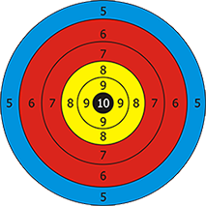
Shooting results
What kind of settings can you think of?

Slide 32

These two setups produced the same results
Same shooter different gun

Slide 33
These four setups also
Same shooter
different gun
Different shooter
same gun

Slide 34
Further possible scenarios
1, 5 or 7 different shooters
1, 5 or 7 different guns
1, 5 or 7 different distances to bull’s eye
1, 5 or 7 different personal or environmental conditions under which the shooting happened
…

Slide 35
What are the results measurements of?
Group | Student | T1 | T2 | T3 | T4 | T5
 | S1 | 72.8 | 80.9 | 84.6 | 83.6 | 73.8
G1 | S2 | 71 | 91.2 | 88.1 | 88.2 | 76.8
 | S3 | 76.5 | 85.9 | 86.6 | 90 | 81.9
 | S4 | 83.9 | 92.5 | 95.2 | 92.5 | 78.1
G2 | S5 | 78.4 | 85.9 | 86.6 | 86.5 | 74.3
 | S6 | 83.9 | 83.9 | 95.2 | 90.7 | 84.3
 | S7 | 76.5 | 84.6 | 95.2 | 93.2 | 81.9
7 students divided in two groups passed 5 tests.
Which group is doing better?

Slide 36
Descriptive statistics - before you even start
Adequate description of:
  Population(s) you draw from
  Sample(s) you take: how and how many
  Variables you use:
    What they are
    Measurement levels
    Measurement procedures
  What you intend to find out:
    Exploratory
    Differences in populations
    Correlation between variables
    Hypothesis testing
    …

Slide 37
Providing descriptive statistics (2)
Method: organize the data
  Tables
  Graphs
Goal: summarize the data
  What is always possible AND required is describing:
    The distribution: concerns the frequency of each value.
    The central tendency: concerns the averages of the values.
    The variability: concerns how spread out the values are.

Slide 38
Descriptive measures
Mostly computable for samples, rarely known for populations.
Measures of center (central tendency, or groups’ “Middle Values”):
  Mean
  Median
  Mode
Measures of variability (dispersion, or summary of differences within groups):
  Range
  Percentiles and interquartile range (IQR)
  Variance
  Standard deviation
  Standard error of the means (SEM)

Slide 39
However !!!
(1) How to report distribution, central tendency and variability, and (2) whether you can and/or are useful, depends on several factors some of which depend on each other:
  What the measurements are measurements of
  Number and (in)dependence of variables that are measured
  Level of measurement of the variables
  The precise distribution
  …

Slide 40
Important distinctions
variable
Categorical
variable
Quantitative
variable
Discrete
variable
Continuous
variable
Finite number of
possible values
Infinite number of
possible values

Slide 41
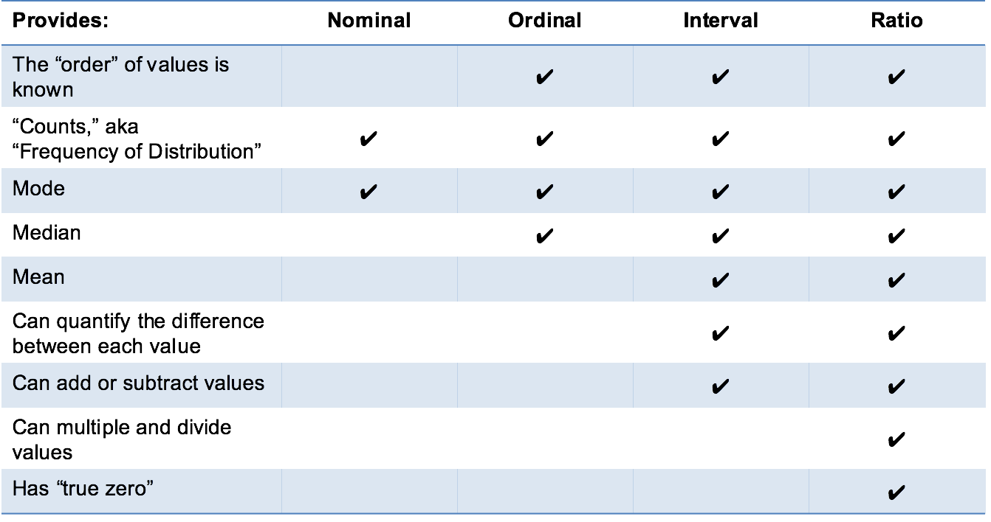
E.g. variable types and central tendency
http://www.mymarketresearchmethods.com/types-of-data-nominal-ordinal-interval-ratio/

Slide 42
Measurement levels and Descriptive Statistics
Data type | Mathematical operations | Measures of central tendency | Measures of variability
Nominal | Equality (=, ≠) | Mode | None
Ordinal | Equality (=, ≠) Comparison (>, <) | Mode Median | Range Interquartile range
Interval | Equality (=, ≠) Comparison (>, <) Addition, subtraction (+,−) | Mode Median Arithmetic mean | Range Interquartile range Standard deviation Variance
Ratio | Equality (=, ≠) Comparison (>, <) Addition, subtraction (+,−) Multiplication, division (×, ÷) | Mode Median Arithmetic mean Geometric mean | Range Interquartile range Standard deviation Variance Relative standard deviation
https://www.scribbr.com/statistics/levels-of-measurement/

Slide 43
Variable types and distributions
Discrete variables → Discrete probability distributions
  Binomial distribution: binary data
    E.g. answers to yes/no questions.
  Poisson distribution: count data
    E.g. the count of patient admins per day.
  Uniform distribution: multiple possible events with the same probability
    E.g. rolling a dice.
Continuous variables → Probability density functions

Slide 44
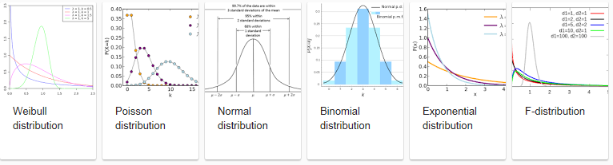
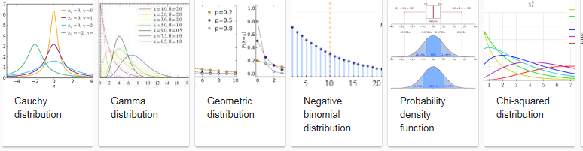
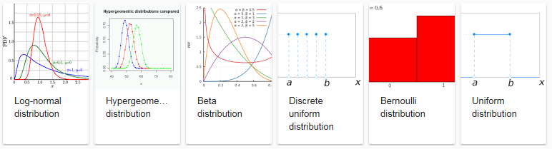
Distinct types of distribution functions

Slide 45
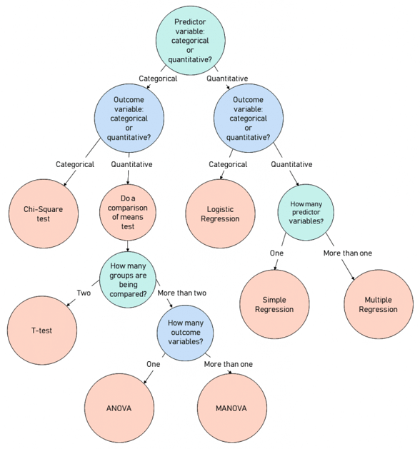
Variable types and hypothesis testing
https://stats.idre.ucla.edu/other/mult-pkg/whatstat/
https://www.scribbr.com/statistics/statistical-tests/

Slide 46
Parametric versus Non-parametric tests
Parametric tests:
  make assumptions about the parameters of the population distribution (whatever which one) from which the samples are drawn
  can analyze only continuous data
  the findings can be overly affected by outliers.
Non-parametric tests:
  no assumptions about the distribution
  the data can be collected from a sample that does not follow a specific distribution
  can deal with ordinal data
Parametric tests usually have more statistical power than nonparametric tests

Slide 47
‘Distribution’

Slide 48
Central notion: distribution
A distribution describes the possible values for a variable and how often these values occur.
Frequency distribution:
  Visualized through a table or graph that displays the frequency of various events (outcomes) in a sample,

Slide 49
Frequency distribution of our data
71 | 1
72.8 | 1
73.8 | 1
74.3 | 1
76.5 | 2
76.8 | 1
78.1 | 1
78.4 | 1
80.9 | 1
81.9 | 2
83.6 | 1
83.9 | 3
84.3 | 1
84.6 | 2
85.9 | 2
86.5 | 1
86.6 | 2
88.1 | 1
88.2 | 1
90 | 1
90.7 | 1
91.2 | 1
92.5 | 2
93.2 | 1
95.2 | 3

Slide 50
Central notion: distribution
A distribution describes the possible values for a variable and how often these values occur.
Frequency distribution:
  Visualized through a table or graph that displays the frequency of various events (outcomes) in a sample,
Probability distribution:
  Visualized through a graph describing the likelihood of occurrence of every possible event (outcome).
  A "normalized frequency distribution table“ is where all possible occurrences of outcomes sum to 1.

Slide 51
Probability distribution of our data
 | Bin | Frequency | Prob distrib | Cumulative %
1 | 71 | 1 | 0.029 | 2.86%
2 | 72.8 | 1 | 0.029 | 5.71%
3 | 73.8 | 1 | 0.029 | 8.57%
4 | 74.3 | 1 | 0.029 | 11.43%
5 | 76.5 | 2 | 0.057 | 17.14%
6 | 76.8 | 1 | 0.029 | 20.00%
7 | 78.1 | 1 | 0.029 | 22.86%
8 | 78.4 | 1 | 0.029 | 25.71%
9 | 80.9 | 1 | 0.029 | 28.57%
10 | 81.9 | 2 | 0.057 | 34.29%
11 | 83.6 | 1 | 0.029 | 37.14%
12 | 83.9 | 3 | 0.086 | 45.71%
13 | 84.3 | 1 | 0.029 | 48.57%
14 | 84.6 | 2 | 0.057 | 54.29%
15 | 85.9 | 2 | 0.057 | 60.00%
16 | 86.5 | 1 | 0.029 | 62.86%
17 | 86.6 | 2 | 0.057 | 68.57%
18 | 88.1 | 1 | 0.029 | 71.43%
19 | 88.2 | 1 | 0.029 | 74.29%
20 | 90 | 1 | 0.029 | 77.14%
21 | 90.7 | 1 | 0.029 | 80.00%
22 | 91.2 | 1 | 0.029 | 82.86%
23 | 92.5 | 2 | 0.057 | 88.57%
24 | 93.2 | 1 | 0.029 | 91.43%
25 | 95.2 | 3 | 0.086 | 100.00%
 | More | 0 | 0.000 | 100.00%
 |  | 35 | 1
Cumulative
probability distribution
of our data

Slide 52
Important difference
‘Our data’:
  Gives the outcome of a variable
  Exhibits a particular frequency distribution
  Exhibits a particular probability distribution
  Must for reliable interpretation be compared with the probability distribution of a random variable.
Random variable:
  variable whose values depend on outcomes of a random phenomenon.
  a measurable function defined on a probability space that maps from the sample space to the real numbers.

Slide 53
Probability distribution function
a mathematical function that indicates the values a random variable may have.
that random variable is the result of a function that associates a real number (the probability value) to an outcome of an experiment.
Cumulative probability distribution function (CDF): the probability that the random variable X takes on a value less than or equal to x.
Notes:
CHANGED

Slide 54
Essential for statistical analysis
Find out whether ‘our data’ suggest that the variable that is described by it, is a random variable.
i.e.: to what extent is the probability distribution of ‘our data’ the result of a probability distribution function.
Only then one can:
  calculate confidence intervals for parameters, and
  calculate critical regions for hypothesis tests.
    ‘critical region’: the region of values that corresponds to the rejection of the null hypothesis at some chosen probability level.

Slide 55
Need for distribution determination (1)
Parameter estimation within a population.
Determining the extent to which the parameters of distinct populations but concerning the same variable are distinct.

Slide 56
Need for distribution determination (2)
3. Determining which statistical test to use for correlation between two variables P and Q in a sample.
E.g.: the relation looks linear on a plot, then
  If P is normally distributed and Q is normally distributed:
    Calculate the Pearson correlation coefficient
  Otherwise
    Calculate the Spearman correlation coefficient or the Kendall correlation coefficient.

Slide 57
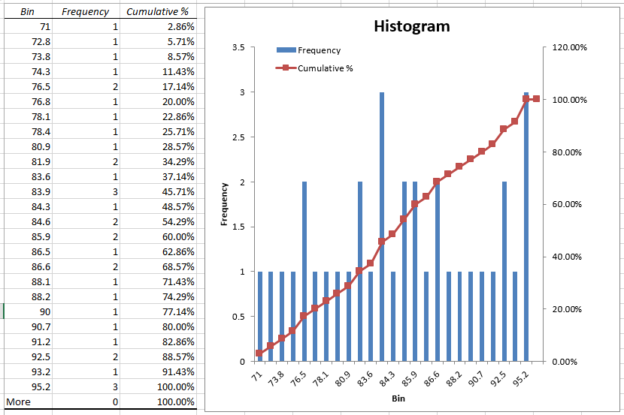
Our data’s freq./prob. distribution

Slide 58
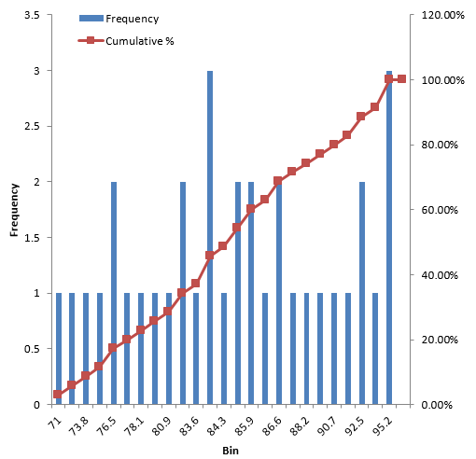
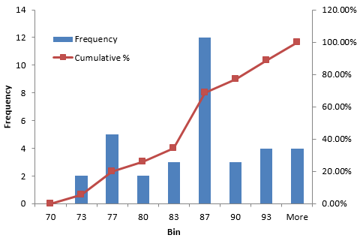
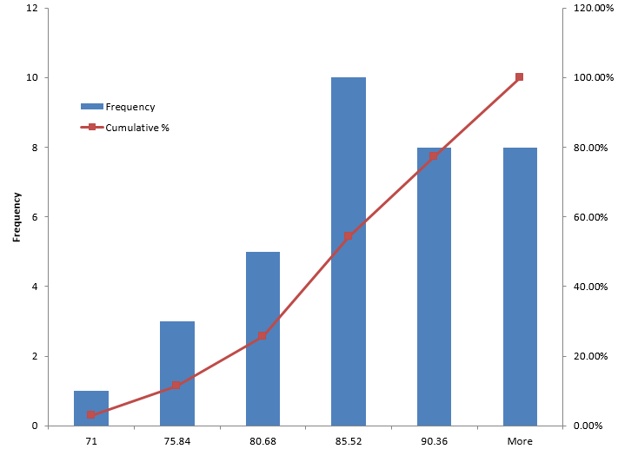
One can be creative (1)
Different ways of constructing the bins

Slide 59
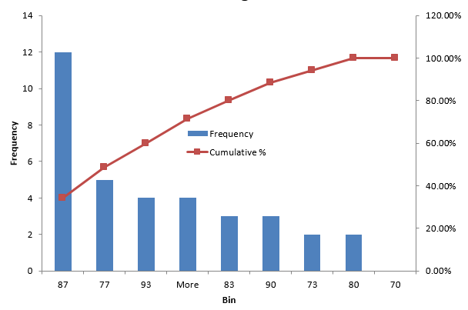
One can be creative (2)
Sorting the bins

Slide 60
Best way: ‘distribution fitting’
Offered by several statistical software programs and add-ons for programming languages (python, R, …)
Some online tools:
  https://www.socscistatistics.com/tests/kolmogorov/
  https://www.socscistatistics.com/utilities/normaldistribution/default.aspx
Example in Excel
Notes:
71.00
72.80
73.80
74.30
76.50
76.50
76.80
78.10
78.40
80.90
81.90
81.90
83.60
83.90
83.90
83.90
84.30
84.60
84.60
85.90
85.90
86.50
86.60
86.60
88.10
88.20
90.00
90.70
91.20
92.50
92.50
93.20
95.20
95.20
95.20

Slide 61
Some descriptive statistics on the results
Mean | 84.43429
Standard Error | 1.135944
Median | 84.6
Mode | 83.9
Standard Deviation | 6.720335
Sample Variance | 45.16291
Kurtosis | -0.73002
Skewness | -0.19589
Range | 24.2
Minimum | 71
Maximum | 95.2
Sum | 2955.2
Count | 35
Largest(1) | 95.2
Smallest(1) | 71
Confidence Level(95.0%) | 2.308516
Depending on what distribution you are dealing with, and what the results are measurements of, these statistics can make sense ranging from not all to extremely well!

Slide 62
Measures of Central Tendency

Slide 63


The arithmetic mean
= arithmetic average of at least interval or ratio scores.
computed by adding all the scores (X1, X2, …) and dividing by the total number N of scores.
Population mean
Sample mean
Difference?

Slide 64
Inner mean
Also called ‘trimmed mean’.
Inner mean of N numbers is calculated by removing the x lowest values and the x highest value and calculating the arithmetic mean of the remaining N – 2x ‘inner’ values.
If x = N/2, inner mean = median.
Reduces the effect of outliers on the arithmetic mean.

Slide 65


Harmonic mean
Defined as the reciprocal of the arithmetic mean of the reciprocals
or
is f.i. used in population genetics, when calculating the effects of fluctuations in generation size on the effective breeding population.
    takes into account the fact that a very small generation is like a bottleneck and means that a very small number of individuals are contributing disproportionately to the gene pool, which can result in higher levels of inbreeding.

Slide 66
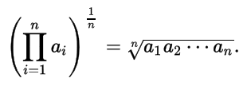
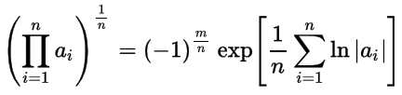
Geometric mean
is defined as the n^{th} root of the product of n numbers
Alternative calculation:
      where m = number of negative numbers in n
is the only correct mean when averaging normalized results, i.e. results that are presented as ratios to reference values.
often used when summarizing skewed data, especially if there is reason to believe that the data might be log-normally distributed.

Slide 67
Position of the arithmetic mean
Mean | 84.43429
17 | 84.3
18 | 84.6

Slide 68
Position of the arithmetic mean
Mean | 84.43429
17 | 84.3
18 | 84.6
Confidence Level(95.0%)
2.308516

Slide 69
Comparing means (for normal distributions)
Independent Samples T-Test: to compare means for two data sets that are independent from each other. (how).
One sample T-Test: to compare means between one data set and a specified constant (e.g. the mean from a hypothetical normal distribution). (how).
Paired Samples T-Test: when one group is tested at two different times. The groups are “paired” because there intrinsic connections between them (i.e. they are not independent). This comparison of means is often used for groups of patients before treatment and after treatment, or for students tested before remediation and after remediation. (how).
One way Analysis of Variance (ANOVA): Use this test when you have a group of individuals randomly split into smaller groups and completing different tasks. (how).
…

Slide 70
Assumptions for t-tests
One sample t-test:
  requires that the data have an approximately Normal distribution,
Paired t-test:
  requires that the distribution of the differences are approximately Normal.
Unpaired t-test:
  the data from the two samples are both Normally distributed,
  the SDs from the two samples are approximately equal.

Slide 71
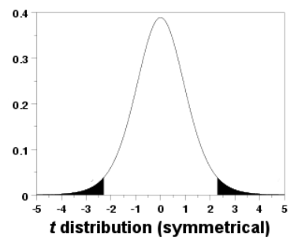
One-tailed or two-tailed t-test?
Two-tailed test: to determine if there is any difference between two groups, e.g. whether Group A scored higher or lower than Group B.
One-tailed test: to determine if there is a difference between groups in a specific direction, e.g. whether Group A scored higher than Group B, while uninterested whether Group A scoring lower than Group B.
Results are more likely to be significant for a one-tailed test if there truly is a difference between the groups in the direction that you have predicted.
→ Use 1-tailed only when you predict the direction before collecting or analyzing the data!
https://stats.idre.ucla.edu/other/mult-pkg/faq/general/faq-what-are-the-differences-between-one-tailed-and-two-tailed-tests/

Slide 72
Median
The central data element when all of the data are arranged (ranked) in numerical order.
It is a literal measure of central tendency.
Usable for at least ordinal data.
Use instead of mean for non-normal data; less sensitive for outliers.
When there are an even number of data, the mean of the two central data points is taken as the median.

Slide 73
Mean and median
Mean | 84.43429
Median | 84.6
17 | 84.3
18 | 84.6

Slide 74
Non-parametric tests for ordinal data
Non-parametric test | Aim | Samples or variables | Example
Mood’s median test | Compare the medians | 2 or more samples | How different are the median income levels of people in 2 neighbouring cities?
Mann-Whitney U test (Wilcoxon rank sum test) | Compare sum of rankings of scores | 2 independent samples | How does perceived social status in one city differ from that in another?
Wilcoxon matched-pairs signed-rank test | Compare magnitude and direction of difference between distributions of scores | 2 dependent samples | How similar are the distributions of income levels of Democrats and Republicans in the same city?
Kruskal–Wallis H test | Compare mean rankings of scores | 3 or more samples | How does perceived social status differ between Democrats, Republicans and Independents?
Spearman’s rho or rank correlation coefficient | Correlate 2 variables | 2 ordinal variables | Does income level correlate with perceived social status?
https://www.scribbr.com/statistics/ordinal-data/

Slide 75
Mode
The most frequent value in a dataset
Often not a particularly good indicator of central tendency.
Despite its limitations, the mode is the only means of measuring central tendency in a dataset containing nominal values.

Slide 76
What is the mode here?
71 | 1
72.8 | 1
73.8 | 1
74.3 | 1
76.5 | 2
76.8 | 1
78.1 | 1
78.4 | 1
80.9 | 1
81.9 | 2
83.6 | 1
83.9 | 3
84.3 | 1
84.6 | 2
85.9 | 2
86.5 | 1
86.6 | 2
88.1 | 1
88.2 | 1
90 | 1
90.7 | 1
91.2 | 1
92.5 | 2
93.2 | 1
95.2 | 3

Slide 77
Bimodal data set
71 | 1
72.8 | 1
73.8 | 1
74.3 | 1
76.5 | 2
76.8 | 1
78.1 | 1
78.4 | 1
80.9 | 1
81.9 | 2
83.6 | 1
83.9 | 3
84.3 | 1
84.6 | 2
85.9 | 2
86.5 | 1
86.6 | 2
88.1 | 1
88.2 | 1
90 | 1
90.7 | 1
91.2 | 1
92.5 | 2
93.2 | 1
95.2 | 3

Slide 78
Modes for color preference in I.P. and E.P?
(Observed counts) | Colours
 | Red | Yellow | Green | Blue | Totals
Introvert personality | 20 | 6 | 30 | 44 | 100
Extrovert personality | 180 | 34 | 50 | 36 | 300
Totals | 200 | 40 | 80 | 80 | 400

Slide 79
Comparing is possible: Chi²
(Observed counts) | Colours
 | Red | Yellow | Green | Blue | Totals
Introvert personality | 20 | 6 | 30 | 44 | 100
Extrovert personality | 180 | 34 | 50 | 36 | 300
Totals | 200 | 40 | 80 | 80 | 400
(Expected counts) | Colours
 | Red | Yellow | Green | Blue | Totals
Introvert personality | 50 | 10 | 20 | 20 | 100
Extrovert personality | 150 | 30 | 60 | 60 | 300
Totals | 200 | 40 | 80 | 80 | 400
Expected counts:

Slide 80

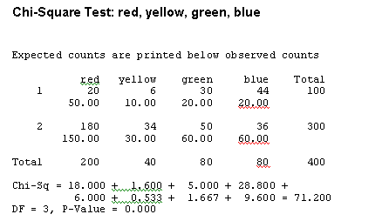
Chi-square
http://learntech.uwe.ac.uk/da/Default.aspx?pageid=1440

Slide 81
Chi-square assumptions
The data in the cells may only be counts.
The categories are mutually exclusive.
Each subject may contribute data to one and only one cell in the Chi². If the same subjects are tested over time such that the comparisons are of the same subjects at Time 1, Time 2, Time 3, etc., then χ² may not be used.
The study groups must be independent. Thus it cannot be used for paired samples.
The 2 variables are measured as categories, usually nominal, but collapsing into ordinal categories of other types is allowed.
No limit in the number of cells but a very large number of cells (over 20) can make it difficult to meet assumption #7, and to interpret the meaning of the results.
The values of the expected cells should be >=5 in at least 80% of the cells, and no cell should have an expected of less than 1. This assumption is most likely to be met if the sample size equals at least the number of cells multiplied by 5.
https://www.ncbi.nlm.nih.gov/pmc/articles/PMC3900058/

Slide 82
Chi-square assumptions
The data in the cells may only be counts.
The categories are mutually exclusive.
Each subject may contribute data to one and only one cell in the Chi². If the same subjects are tested over time such that the comparisons are of the same subjects at Time 1, Time 2, Time 3, etc., then χ² may not be used.
The study groups must be independent. Thus it cannot be used for paired samples.
The 2 variables are measured as categories, usually nominal, but collapsing into ordinal categories of other types is allowed.
No limit in the number of cells but a very large number of cells (over 20) can make it difficult to meet assumption #7, and to interpret the meaning of the results.
The values of the expected cells should be >=5 in at least 80% of the cells, and no cell should have an expected of less than 1. This assumption is most likely to be met if the sample size equals at least the number of cells multiplied by 5.
https://www.ncbi.nlm.nih.gov/pmc/articles/PMC3900058/

Slide 83
Mean, median and modes
Mean | 84.43429
Median | 84.6
17 | 84.3
18 | 84.6

Slide 84
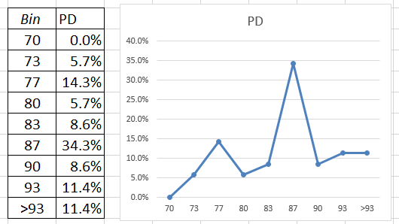
Mean, median and modes on distribution
Mean
Median
mode

Slide 85
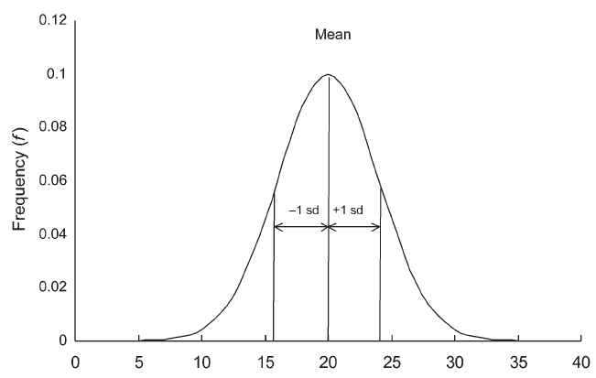
Mean, median and mode in the normal distribution
all three!

Slide 86
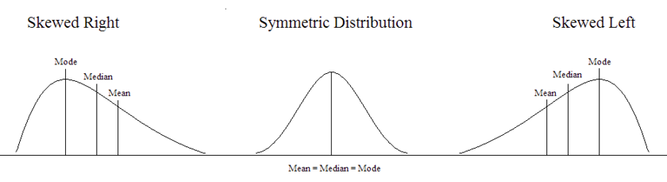
With skewed data
https://courses.lumenlearning.com/suny-natural-resources-biometrics/chapter/chapter-1-descriptive-statistics-and-the-normal-distribution/

Slide 87
Measures of Dispersion

Slide 88
Range
= interval between highest and lowest values
Range = 24.2

Slide 89
Range
Does not change (much) depending on the ways of constructing bins

Slide 90
Percentiles / Quartiles
25th
50th
75th

Slide 91
Interquartile range
88.2-78.1=10.1
25th
50th
75th

Slide 92
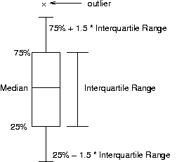
Box and whisker plot

Slide 93
Skewness and kurtosis
Skewness:
  is a measure of lack of symmetry.
  a distribution, or data set, is symmetric if it looks the same to the left and right of the center point.

Slide 94
Skewness and kurtosis
Skewness:
  is a measure of lack of symmetry.
  a distribution, or data set, is symmetric if it looks the same to the left and right of the center point.

Slide 95
Skewness and kurtosis
Skewness:
  is a measure of lack of symmetry.
  a distribution, or data set, is symmetric if it looks the same to the left and right of the center point.
Kurtosis:
  is a measure of whether the data are heavy-tailed or light-tailed relative to a normal distribution;
  data sets with high kurtosis tend to have heavy tails, or outliers. Data sets with low kurtosis tend to have light tails, or lack of outliers.

Slide 96
Skewness and kurtosis
Kurtosis | -0.73002
Skewness | -0.19589

Slide 97
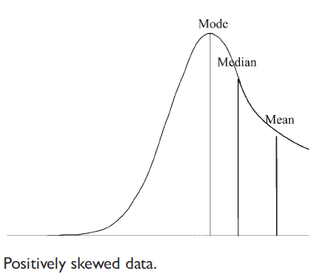
Skewness and kurtosis
Mean
Median
mode

Slide 98
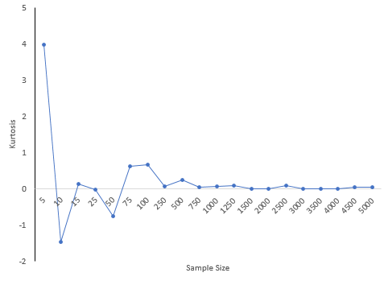
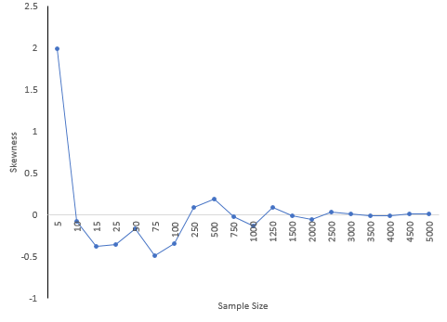
However !
The skewness and kurtosis are very dependent on the sample size. Smaller sample sizes can give results that are very misleading.
"In short, skewness and kurtosis are practically worthless. Shewhart made this observation in his first book. The statistics for skewness and kurtosis simply do not provide any useful information beyond that already given by the measures of location and dispersion."
https://www.spcforexcel.com/knowledge/basic-statistics/are-skewness-and-kurtosis-useful-statistics#:~:text=Skewness%20essentially%20measures%20the%20relative,which%20is%20equal%20to%203.

Slide 99
Variance
A measure of the spread of the recorded values on a variable. A measure of dispersion.
The larger the variance, the further the individual cases are from the mean.
The smaller the variance, the closer the individual scores are to the mean.

Slide 100


Variance
The variance uses the difference between each value and its arithmetic mean. The differences are squared to deal with positive and negative differences.
The sample variance (s2) is an unbiased estimator of the population variance (σ2), with n-1 degrees of freedom.
Degrees of freedom: In general, the degrees of freedom for an estimate is equal to the number of values minus the number of parameters estimated en route to the estimate in question.
Population variance
Sample variance
https://stats.libretexts.org/Bookshelves/Introductory_Statistics/Introductory_Statistics_(Lane)/10%3A_Estimation/10.02%3A_Degrees_of_Freedom

Slide 101
Variance
Sample Variance 45.16291

Slide 102
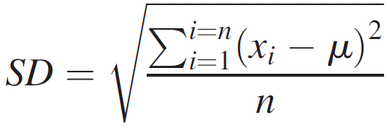
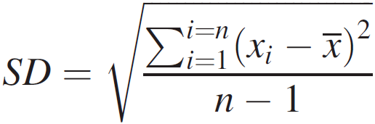
Standard deviation
Standard deviation for a population
Standard deviation for a sample:
Population
Mean
Size
Sample
Mean
Size

Slide 103
Standard deviation
Standard Deviation 6.720335
mean
sd
sd
sd
sd

Slide 104
IQV—Index of Qualitative Variation
For nominal variables
Statistic for determining the dispersion of cases across categories of a variable.
Ranges from 0 (no dispersion or variety) to 1 (maximum dispersion or variety)
1 refers to even numbers of cases in all categories, NOT that cases are distributed like population proportions
IQV is affected by the number of categories
www.sjsu.edu/people/james.lee/courses/102/s1/asDescriptive_Statistics2.ppt

Slide 105
IQV—Index of Qualitative Variation
To calculate:
K(100² – Σ cat.%²)
IQV = 100²(K – 1)
K=# of categories
Cat.% = percentage in each category
www.sjsu.edu/people/james.lee/courses/102/s1/asDescriptive_Statistics2.ppt

Slide 106
IQV—Index of Qualitative Variation
Problem: Is SJSU more diverse than UC Berkeley?
Solution: Calculate IQV for each campus to determine which is higher.
SJSU: UC Berkeley:
Percent Category Percent Category
00.6 Native American 00.6 Native American
06.1 Black 03.9 Black
39.3 Asian/PI 47.0 Asian/PI
19.5 Latino 13.0 Latino
34.5 White 35.5 White
What can we say before calculating? Which campus is more evenly distributed?
K (100² – Σ cat.%²)
IQV = 100²(K – 1)
www.sjsu.edu/people/james.lee/courses/102/s1/asDescriptive_Statistics2.ppt

Slide 107
IQV—Index of Qualitative Variation
Problem: Is SJSU more diverse than UC Berkeley? YES
Solution: Calculate IQV for each campus to determine which is higher.
SJSU: UC Berkeley:
Percent Category %² Percent Category %²
00.6 Native American 0.36 00.6 Native American 0.36
06.1 Black 37.21 03.9 Black 15.21
39.3 Asian/PI 1544.49 47.0 Asian/PI 2209.00
19.5 Latino 380.25 13.0 Latino 169.00
34.5 White 1190.25 35.5 White 1260.25
K = 5 Σ cat.%² = 3152.56 k = 5 Σ cat.%² = 3653.82
100² = 10000
K (100² – Σ cat.%²)
IQV = 100²(K – 1)
5(10000 – 3152.56) = 34237.2 5(10000 – 3653.82) = 31730.9
10000(5 – 1) = 40000 SJSU IQV = .856 10000(5 – 1) = 40000 UCB IQV =.793
www.sjsu.edu/people/james.lee/courses/102/s1/asDescriptive_Statistics2.ppt

Slide 108
What is appropriate?
For parametric (normally distributed, symmetrical) data, the mean and SD are the appropriate measures of central tendency and variability of the data.
For non-parametric data, the median is the appropriate central tendency measure and the IQR is the appropriate measure of the variability of the data.

Slide 109
Excellent on-line resources
(focusing on principles, not mathematics)
https://statisticsbyjim.com/
https://courses.lumenlearning.com/suny-natural-resources-biometrics/front-matter/about-this-textbook/

Slide 110
For your proposals (A6)
Make sure that your population parameters used in the statistical hypotheses correspond with what the level of measurement of the variables allows.
Describe how you are going to assess significant difference if any difference at all.
Provide sample size calculation.
  https://www.statisticshowto.com/probability-and-statistics/find-sample-size/
Due date: May 1, noon!

