Slide 1
Statistical data analysis and research methods
BMI504
Course 16249 – Spring 2025
Class 2 – Jan 30, 2025
Fundamentals of Science and Research
Werner CEUSTERS, MD

Slide 2
Pre-class assignment
a) Required reading
R2 Wagensberg, J., On the Existence and Uniqueness of the Scientific Method. Biol Theory, 2014. 9(3): p. 331-346.
https://www.ncbi.nlm.nih.gov/pmc/articles/PMC4131153/pdf/13752_2014_Article_166.pdf
Questions ?

Slide 3
Ok, you tell me:
?????????????
Three concepts:
  (1) reality, (2) observation (of that reality), and (3) understanding (of that observation of that reality).
Three hypotheses:
  (1) reality is observable, (2) observation is understandable, and (3) understanding is falsifiable.
Three principles:
  (1) Observation is Maximally Objective, (2) Understanding is Maximally Intelligible, (3) Understanding is Coherent (Without Paradoxes of Contradiction) and Complete (Without Paradoxes of Incompleteness)
Three benefits:
  (1) universality, (2) anticipatability, and (3) progress.
Three intellectual joys:
  (1) through stimulus, (2) through conversation, and (3) through understanding
??????????????????????????????????????????????????????????
?????????????
??????????????????????????????????????????????????????????
?????????????
??????????????????????????????????????????????????????????
?????????????
??????????????????????????????????????????????????????????
?????????????
??????????????????????????????????????????????????????????
Wagensberg, J., On the Existence and Uniqueness of the Scientific Method. Biol Theory, 2014. 9(3): p. 331-346.

Slide 4
Pre-class assignment
a) Required reading
R2 Wagensberg, J., On the Existence and Uniqueness of the Scientific Method. Biol Theory, 2014. 9(3): p. 331-346.
https://www.ncbi.nlm.nih.gov/pmc/articles/PMC4131153/pdf/13752_2014_Article_166.pdf
b) A0: Prepare for proposal:
  Reflect about your research interests concerning your future MSc or PhD thesis and formulate a number of research topics.
  These topics should for BMI students fit at least one of the detailed learning objectives for biomedical informaticists described in the document ‘BMI504-Spring2025-topic-requirements.pdf’.
  For students outside the BMI department, any topic will do.
  Be prepared to present and discuss this informally in class C2. No prior submission needed.

Slide 5
Today’s topics
Philosophy of science
Ontology
Research
Presentation of proposal topic ideas

Slide 6
Elements of Philosophy of Science

Slide 7
Philosophy of Science
‘Philosophy of science is about as useful to scientists as ornithology is to birds’.

Slide 8


Philosophy of science
‘Philosophy of science is about as useful to scientists as ornithology is to birds’.
    Attributed to Richard Feynman in Donald E. Simanek and John C. Holden, Science Askew: A Light-Hearted Look at the Scientific World (Philadelphia: Institute of Physics Publishing, 2002) , 215.
Feynman photo © Richard Hartt/Caltech archives

Slide 9

Two takeaways, one question
Takeaways:
Science is about finding ‘laws’ → what is generic in reality.
If a putative law (= hypothesis (‘guess’ ?) ) does not agree with experiment, the hypothesis is wrong!
Question:
If the outcome of an experiment does agree with a hypothesis, is the hypothesis then correct?

Slide 10
Confusion matrix
 |  | Experiment
 |  | Positive | Negative
Hypothesis | Correct | True positive | False negative
 | Wrong | False positive | True negative
‘agrees with experiment’ = repeated experiments !!!
 |  |  | hundred-fold experiment
 |  |  | Positive | Negative
Hypothesis 1 | Probably correct | ← | 95 | 5
Hypothesis 2 | Probably wrong | ← | 5 | 95

Slide 11
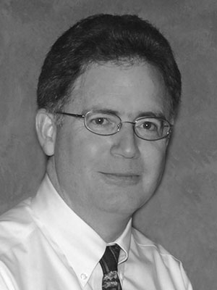
Philosophy of science: use(ful/less)?
‘Philosophy of science is about as useful to scientists as ornithology is to birds’.
    Attributed to Richard Feynman in Donald E. Simanek and John C. Holden, Science Askew: A Light-Hearted Look at the Scientific World (Philadelphia: Institute of Physics Publishing, 2002) , 215.
Feynman photo © Richard Hartt/Caltech archives
‘Science can't be free of philosophy any more than baseball can be free of physics’.
    Jeffrey L. Kasser, Ph.D. http://www.thegreatcourses.com/courses/philosophy-of-science.html#BVRRWidgetID

Slide 12
Philosophy of Science (PhyS) ?
a rigorous academic study that deals specifically with what science is, how it works, and the logic through which we build scientific knowledge.
    http://undsci.berkeley.edu/article/philosophy
a general philosophy of science seeks to describe and understand how science works within a wide range of sciences.
    Malcolm Forster. An Introduction to Philosophy of Science, 2004.
philosophy of science should help us look at claims made within science, and claims made about science, and should help us make informed judgments about how and what we are to think about each case.
    http://www.thegreatcourses.com/professors/jeffrey-l-kasser/

Slide 13
Philosophy of Science (PhyS) ?
a rigorous academic study that deals specifically with what science is, how it works, and the logic through which we build scientific knowledge.
    http://undsci.berkeley.edu/article/philosophy
a general philosophy of science seeks to describe and understand how science works within a wide range of sciences.
    Malcolm Forster. An Introduction to Philosophy of Science, 2004.
philosophy of science should help us look at claims made within science, and claims made about science, and should help us make informed judgments about how and what we are to think about each case.
    http://www.thegreatcourses.com/professors/jeffrey-l-kasser/

Slide 14

Topics in PhyS
http://www.thegreatcourses.com/courses/philosophy-of-science.html#BVRRWidgetID
Science and Philosophy
Popper and the Problem of Demarcation
Further Thoughts on Demarcation
Einstein, Measurement, and Meaning
Classical Empiricism
Logical Positivism and Verifiability
Logical Positivism, Science, and Meaning
Holism
Discovery and Justification
Induction as Illegitimate
Some Solutions and a New Riddle
Instances and Consequences
Kuhn and the Challenge of History
Revolutions and Rationality
Assessment of Kuhn
For and Against Method
Sociology, Postmodernism, and Science Wars
(How) Does Science Explain?
Putting the Cause Back in "Because"
Probability, Pragmatics, and Unification
Laws and Regularities
Laws and Necessity
Reduction and Progress
Reduction and Physicalism
New Views of Meaning and Reference
Scientific Realism
Success, Experience, and Explanation
Realism and Naturalism
Values and Objectivity
Probability
Bayesianism
Problems with Bayesianism
Entropy and Explanation
Species and Reality
The Elimination of Persons?
Philosophy and Science
Notes:
I found the chapter selections very useful. I did not purchase the course and have no idea about its quality.

Slide 15
Questions addressed in PhyS (1)
• What exactly is science?
www.hu.mtu.edu/~tlockha/h3700qst.doc

Slide 16
Definitions of ‘science’ (1)
3a : knowledge or a system of knowledge covering general truths or the operation of general laws especially as obtained and tested through scientific method
3b : such knowledge or such a system of knowledge concerned with the physical world and its phenomena: natural science
http://www.merriam-webster.com/dictionary/science

Slide 17
Definitions of ‘science’ (2)
Science is a systematic search for knowledge whose validity does not depend on the particular individual but is open for anyone to check or rediscover.
Hansson, Sven Ove, "Science and Pseudo-Science", The Stanford Encyclopedia of Philosophy (Spring 2015 Edition), Edward N. Zalta (ed.). https://plato.stanford.edu/archives/spr2015/entries/pseudo-science/.

Slide 18
Definitions of ‘science’ (3)
Science is the pursuit and application of knowledge and understanding of the natural and social world following a systematic methodology based on evidence.
http://sciencecouncil.org/about-us/our-definition-of-science/

Slide 19
What question is asked for which these keywords are part of adequate answers?
Science and Philosophy
Popper and the Problem of Demarcation
Further Thoughts on Demarcation
Einstein, Measurement, and Meaning
Classical Empiricism
Logical Positivism and Verifiability
Logical Positivism, Science, and Meaning
Holism
Discovery and Justification
Induction as Illegitimate
Some Solutions and a New Riddle
Instances and Consequences
Kuhn and the Challenge of History
Revolutions and Rationality
Assessment of Kuhn
For and Against Method
Sociology, Postmodernism, and Science Wars
(How) Does Science Explain?
Putting the Cause Back in "Because"
Probability, Pragmatics, and Unification
Laws and Regularities
Laws and Necessity
Reduction and Progress
Reduction and Physicalism
New Views of Meaning and Reference
Scientific Realism
Success, Experience, and Explanation
Realism and Naturalism
Values and Objectivity
Probability
Bayesianism
Problems with Bayesianism
Entropy and Explanation
Species and Reality
The Elimination of Persons?
Philosophy and Science
Notes:
I found the chapter selections very useful. I did not purchase the course and have no idea about its quality.

Slide 20
Questions addressed in PhyS (2)
• What exactly is science? How to differentiate from pseudo-science?
www.hu.mtu.edu/~tlockha/h3700qst.doc

Slide 21
Some key principles in how to do science
Objective observation: measurement and data (possibly although not necessarily using mathematics as a tool),
Evidence,
Experiment and/or observation as benchmarks for testing hypotheses,
Induction: reasoning to establish general rules or conclusions drawn from facts or examples,
Repetition,
Critical analysis,
Verification and testing: critical exposure to scrutiny, peer review and assessment.
http://sciencecouncil.org/about-us/our-definition-of-science/

Slide 22
Identifying pseudoscience
Belief in authority: It is contended that some have a special ability to determine what is true or false. Others must accept their judgments.
Unrepeatable experiments: Reliance is put on experiments that cannot be repeated by others with the same outcome.
Handpicked examples: are used although they are not representative of the general category that the investigation refers to.
Unwillingness to test: A theory is not tested although it can be.
Disregard of refuting information: Observations or experiments that conflict with a theory are neglected.
Built-in subterfuge: The testing of a theory is so arranged that the theory can only be confirmed, never disconfirmed, by the outcome.
Explanations are abandoned without replacement. Tenable explanations are given up without being replaced, so that the new theory leaves much more unexplained than the previous one.
Hansson, Sven Ove, "Science and Pseudo-Science", The Stanford Encyclopedia of Philosophy (Spring 2015 Edition), Edward N. Zalta (ed.). https://plato.stanford.edu/archives/spr2015/entries/pseudo-science/.

Slide 23
A List Of Fallacious Arguments
http://www.don-lindsay-archive.org/skeptic/arguments.html
E.g.: False Compromise:
if one does not understand a debate, it must be "fair" to split the difference, and agree on a compromise between the opinions. (But one side is very possibly wrong, and in any case one could simply suspend judgment.) Journalists often invoke this fallacy in the name of "balanced" coverage.
"Some say the sun rises in the east, some say it rises in the west; the truth lies probably somewhere in between."
Television reporters like balanced coverage so much that they may give half of their report to a view held by a small minority of the people in question. There are many possible reasons for this, some of them good. However, viewers need to be aware of this tendency.

Slide 24
What question is asked for which these keywords are part of adequate answers?
Science and Philosophy
Popper and the Problem of Demarcation
Further Thoughts on Demarcation
Einstein, Measurement, and Meaning
Classical Empiricism
Logical Positivism and Verifiability
Logical Positivism, Science, and Meaning
Holism
Discovery and Justification
Induction as Illegitimate
Some Solutions and a New Riddle
Instances and Consequences
Kuhn and the Challenge of History
Revolutions and Rationality
Assessment of Kuhn
For and Against Method
Sociology, Postmodernism, and Science Wars
(How) Does Science Explain?
Putting the Cause Back in "Because"
Probability, Pragmatics, and Unification
Laws and Regularities
Laws and Necessity
Reduction and Progress
Reduction and Physicalism
New Views of Meaning and Reference
Scientific Realism
Success, Experience, and Explanation
Realism and Naturalism
Values and Objectivity
Probability
Bayesianism
Problems with Bayesianism
Entropy and Explanation
Species and Reality
The Elimination of Persons?
Philosophy and Science
Notes:
I found the chapter selections very useful. I did not purchase the course and have no idea about its quality.

Slide 25
Questions addressed in PhyS (3)
• What exactly is science? How to differentiate from pseudo-science?
• Is there a single basic method of science? If there are several, what makes them all "scientific"?
•
www.hu.mtu.edu/~tlockha/h3700qst.doc

Slide 26
One or more?
Philosophy of Science (PhyS)
versus
Philosophies of Science (PhieS)

Slide 27
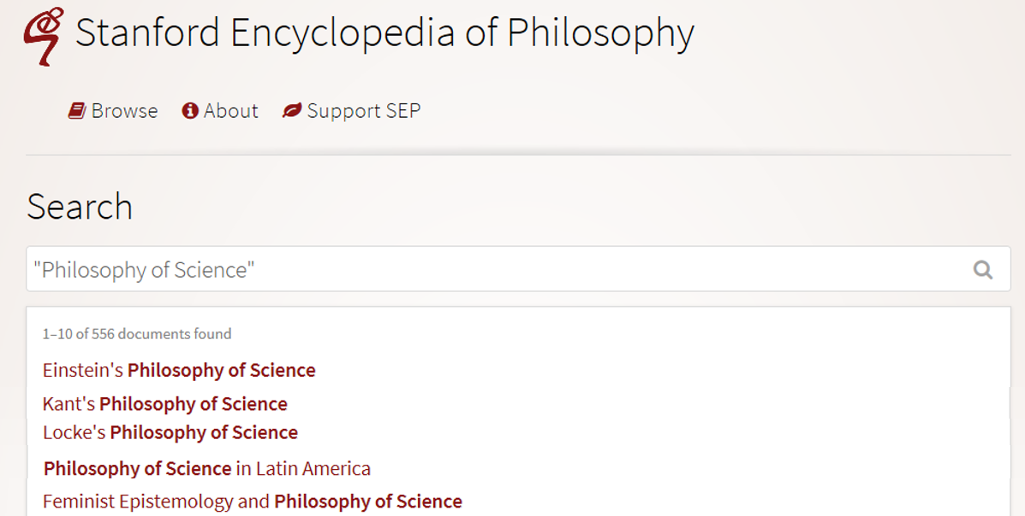
Many philosophies of science
https://plato.stanford.edu/search/search?query=%22Philosophy+of+Science%22

Slide 28
Questions addressed in PhyS (4)
• What exactly is science? How to differentiate from pseudo-science?
• Is there a single basic method of science? If there are several, what makes them all "scientific"?
• Is science the best way to know about the world?
• Is science compatible with religion, or do they conflict? If they conflict, which one should we believe?
www.hu.mtu.edu/~tlockha/h3700qst.doc

Slide 29
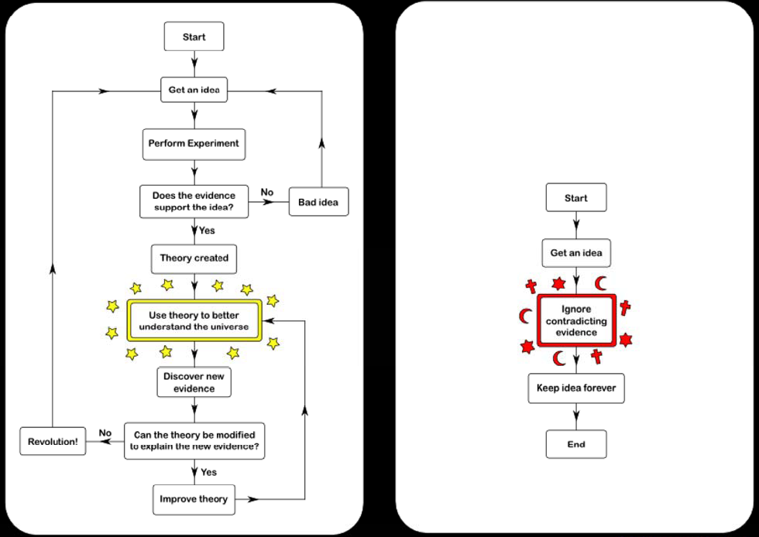
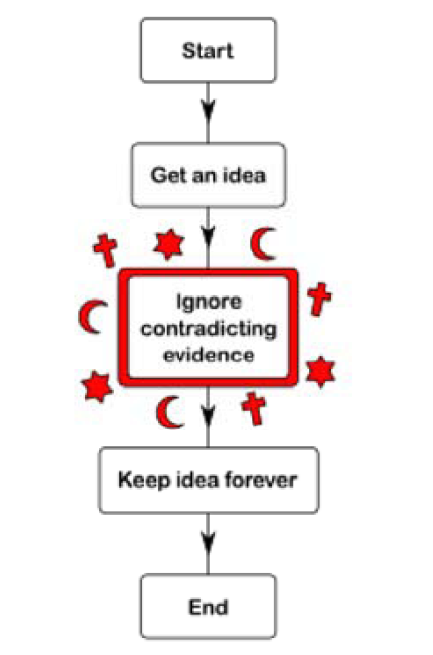
Science
Argument
Faith
Opinion
https://rationalwiki.org/wiki/Scientific_method

Slide 30
Questions addressed in PhyS (5)
• What exactly is science? How to differentiate from pseudo-science?
• Is there a single basic method of science? If there are several, what makes them all "scientific"?
• Is science the best way to know about the world?
• Is science compatible with religion, or do they conflict? If they conflict, which one should we believe?
• What is a scientific theory? How should scientists decide which among competing theories to accept?
www.hu.mtu.edu/~tlockha/h3700qst.doc

Slide 31

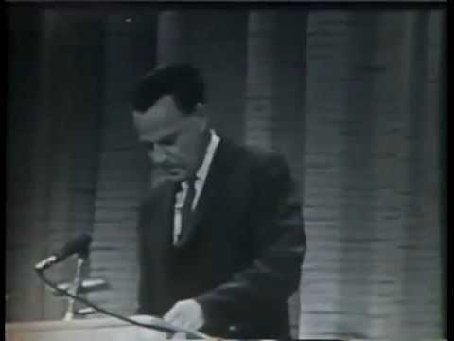
Feynman’s answer

Slide 32
Questions addressed in PhyS (6)
• What exactly is science? How to differentiate from pseudo-science?
• Is there a single basic method of science? If there are several, what makes them all "scientific"?
• Is science the best way to know about the world?
• Is science compatible with religion, or do they conflict? If they conflict, which one should we believe?
• What is a scientific theory? How should scientists decide which among competing theories to accept?
• Why do scientists sometimes disagree with each other, even when they have the same data? Could fully rational scientists have such disagreements?
• What is scientific progress? Does it really exist? Is science getting us closer and closer to the truth?
www.hu.mtu.edu/~tlockha/h3700qst.doc

Slide 33
Which questions addressed in PhyS should scientists deeply care about?
• What exactly is science?
• Is there a single basic method of science? If there are several, what makes them all "scientific"?
• Is science the best way to know about the world?
• Is science compatible with religion, or do they conflict? If they conflict, which one should we believe?
• What is a scientific theory? How should scientists decide which among competing theories to accept?
• Why do scientists sometimes disagree with each other, even when they have the same data? Could fully rational scientists have such disagreements?
• What is scientific progress? Does it really exist? Is science getting us closer and closer to the truth?
www.hu.mtu.edu/~tlockha/h3700qst.doc

Slide 34
Which questions addressed in PhyS should scientists deeply care about?
• What exactly is science? How to differentiate from pseudo-science?
• Is there a single basic method of science? If there are several, what makes them all "scientific"? → What makes your approach scientific?
• Is science the best way to know about the world?
• Is science compatible with religion, or do they conflict? If they conflict, which one should we believe?
• What is a scientific theory? How should scientists decide which among competing theories to accept?
• Why do scientists sometimes disagree with each other, even when they have the same data? Could fully rational scientists have such disagreements?
• What is scientific progress? Does it really exist? Is science getting us closer and closer to the truth?
www.hu.mtu.edu/~tlockha/h3700qst.doc

Slide 35
‘Ontology’
Helps scientists to determine and describe what sorts of entities their research is intended to be directed at.

Slide 36
Four notions of ‘ontology’ as a study
(O1) the study of ontological commitment, i.e. what we or others are committed to,
(O2) the study of what there is,
(O3) the study of the most general features of what there is, and how the things there are relate to each other in the metaphysically most general ways,
(O4) the study of meta-ontology, i.e. saying what task it is that the discipline of ontology should aim to accomplish, if any, how the questions it aims to answer should be understood, and with what methodology they can be answered.
http://plato.stanford.edu/entries/logic-ontology/#DifConOnt

Slide 37
Realism
Generic Realism (on some subject matter):
a, b, and c and so on exist,
and the fact that they exist and have properties such as F-ness, G-ness, and H-ness is (apart from mundane empirical dependencies of the sort sometimes encountered in everyday life) independent of anyone's beliefs, linguistic practices, conceptual schemes, and so on.
http://plato.stanford.edu/entries/realism/

Slide 38
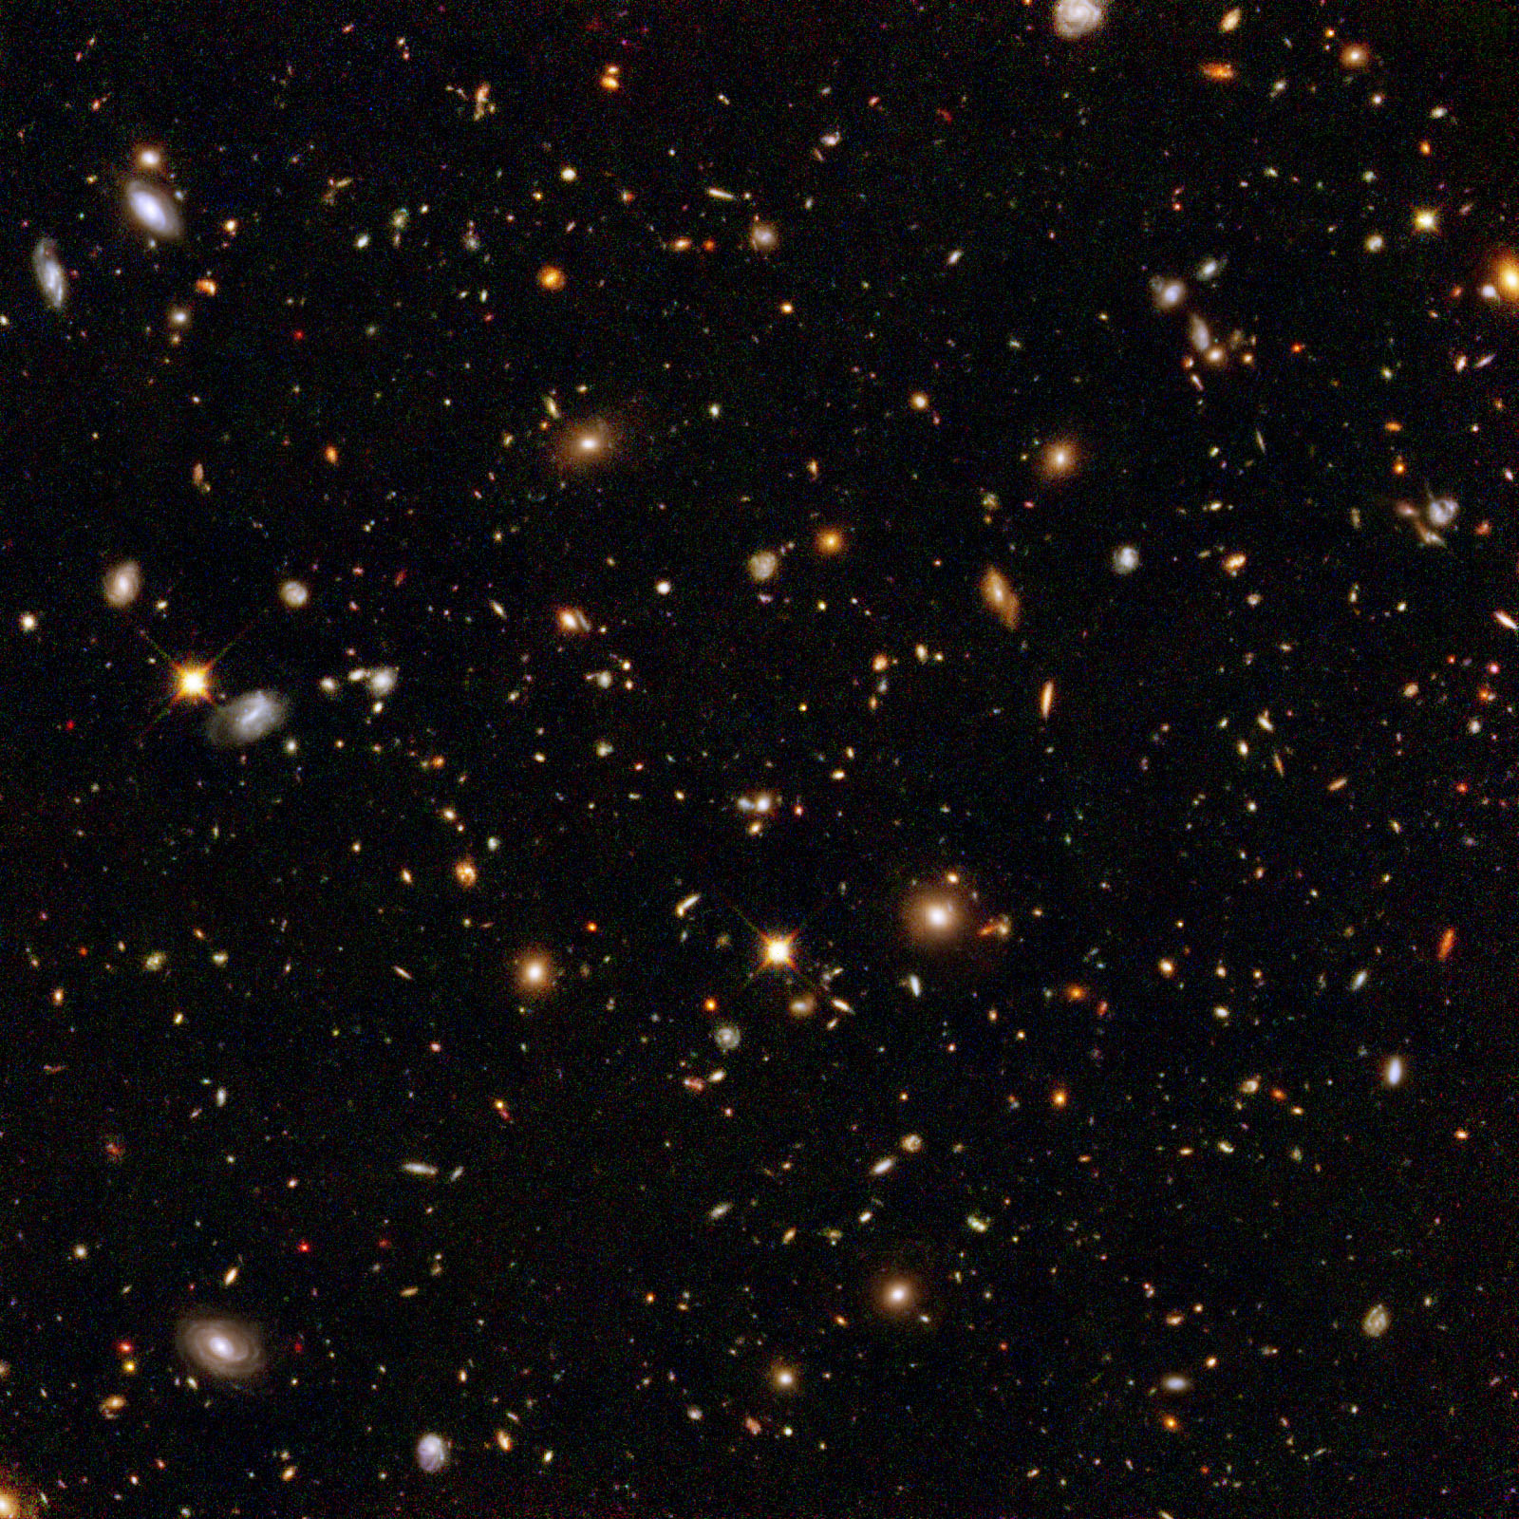

The basis of Ontological Realism (O.R.)
There is one external reality which is ‘objectively’ the way it is;
That reality is accessible to us;
We build in our brains cognitive representations of reality;
We communicate with others about what is there, and what we believe there is there.
This sounds familiar?
Smith B, Kusnierczyk W, Schober D, Ceusters W. Towards a Reference Terminology for Ontology Research and Development in the Biomedical Domain. Proceedings of KR-MED 2006, Biomedical Ontology in Action, November 8, 2006, Baltimore MD, USA

Slide 39
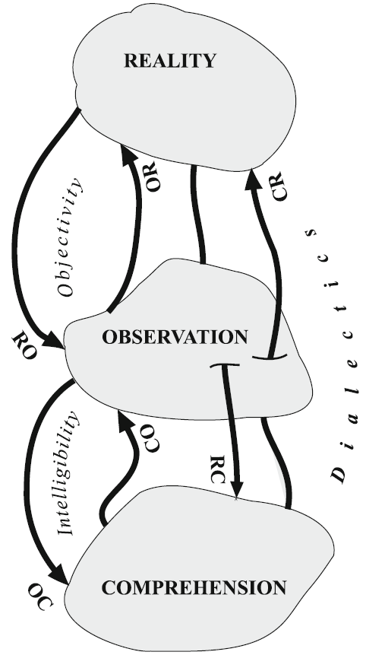
This sounds familiar?
There is one external reality which is ‘objectively’ the way it is;
That reality is accessible to us;
We build in our brains cognitive representations of reality;
We communicate with others about what is there, and what we believe there is there.
Wagensberg, J., On the Existence and Uniqueness of the Scientific Method. Biological theory, 2014. 9(3): p. 335.
Smith B, Kusnierczyk W, Schober D, Ceusters W. Towards a Reference Terminology for Ontology Research and Development in the Biomedical Domain. Proceedings of KR-MED 2006, Biomedical Ontology in Action, November 8, 2006, Baltimore MD, USA

Slide 40
However …
‘The concept of observation can be summed up as a construction achieved by means of differences between similar realities’.
‘Understanding can be defined as a construction achieved by similarities between different realities’.
‘The SM that we are trying to design should be applied to observable realities, understandable observations, and understanding not shielded in advance against what may occur in reality.’
Does Wagensberg believe in the existence of multiple realities rather than the one postulated for in Ontological Realism?
Wagensberg, J., On the Existence and Uniqueness of the Scientific Method. Biological theory, 2014. 9(3): p. 335.

Slide 41
Perception / Observation
‘To perceive reality implies a kind of conversation between a mind and a slice of reality. The mind devises a representation of a slice of reality by using some kind of language. When the perceptions are programmed in accordance with preconceived criteria, the perception is called observation.’
‘What we call a mystical experience can be perceived, but it is very difficult to observe.’
Wagensberg, J., On the Existence and Uniqueness of the Scientific Method. Biological theory, 2014. 9(3): p. 333.

Slide 42
Interplay of reality, sensing perceiving and interpreting
 | Reality | Sensing | Perceiving | Interpreting
Canonical case | Dog | Dog-stimulus | Dog | Dog
Illusion | Dog | Cat-like stimuli | Cat | Cat / Cat? / x?
Hallucination | - | - | Dog | Dog
Belief in inaccurate perception | - | - | Dog | No dog
Delusion | - | - | - | Dog
Sensory loss | Dog | - | - | -
(visual) anosognosia | Dog | Dog-stimulus | - | Dog
Denial | Dog | Dog-stimulus | Dog | -

Slide 43
Relevant disciplines and theories
Ontology
by some philosophers taken to be synonymous with ‘metaphysics’ while others draw distinctions in many distinct ways but almost agreeing on the following classification:
  metaphysics
    general metaphysics
      ontology
    special metaphysics
‘epistemology’:
‘terminology’ (as part of ‘semantics’):

Slide 44
Relevant disciplines and theories
Ontology (no plural) is the study of what entities exist and how they relate to each other;
by some philosophers taken to be synonymous with ‘metaphysics’ while others draw distinctions in many distinct ways but almost agreeing on the following classification:
  metaphysics → studies ‘how is the world?’
    general metaphysics → studies general principles and ‘laws’ about the world
      ontology → studies what type of entities exist in the world
    special metaphysics → focuses on specific principles and entities
‘epistemology’: the study of how we can come to know about what exists.
‘terminology’ (as part of ‘semantics’): the study of what terms mean and how to name things.

Slide 45
Distinct questions. What type are they of?
Terminological:
  what does ‘pain’ mean ?
Metaphysical:
  what have all pains in common in virtue of which they are pains?
Ontological:
  what type of entity is pain?
Onto-terminological:
  what, if anything at all, does ‘pain’ denote?
Epistemological:
  how can we find out whether something is pain?

Slide 46
Scientific Realism
Three dimensions:
Metaphysically: commits to the mind-independent existence of the world investigated by the sciences.
Semantically: commits to a literal interpretation of scientific claims about the world. Claims about scientific entities, processes, properties, and relations, whether they be observable or unobservable, should be construed literally as having truth values, whether true or false.
Epistemologically: commits to the idea that theoretical claims (interpreted literally as describing a mind-independent reality) constitute knowledge of the world.
http://plato.stanford.edu/entries/scientific-realism/#WhaSciRea

Slide 47
Scientific Realism
Our best scientific theories give true or approximately true descriptions of observable and unobservable aspects of a mind-independent world.
http://plato.stanford.edu/entries/scientific-realism/#WhaSciRea

Slide 48
Never forget:
What are the four essential distinctions made in realism-based ontology?

Slide 49
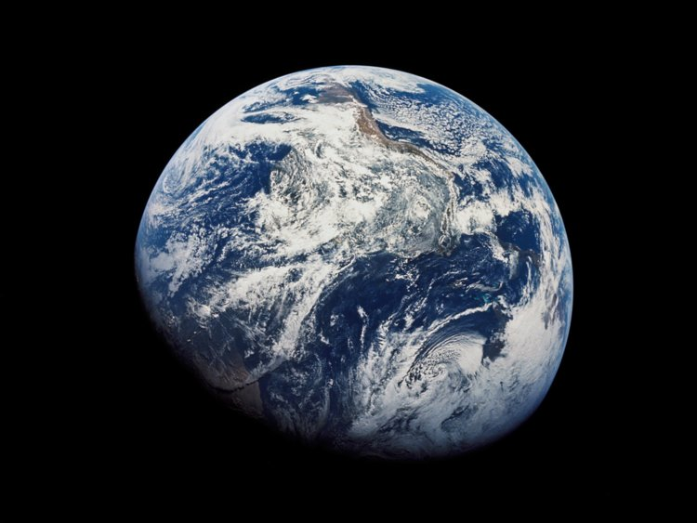
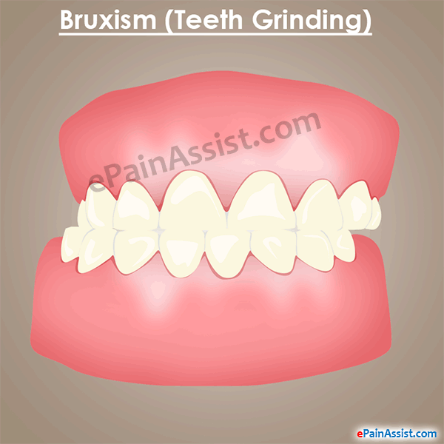
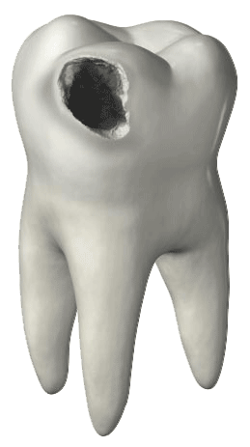
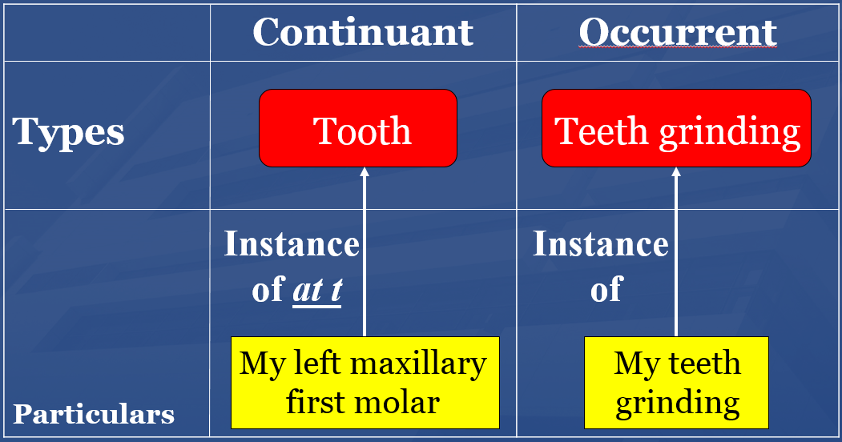
Four distinctions in realism-based ontology
1
Reality ←→ representation

Slide 50
Explain in light of the previous
‘However, some things are not scientifically understandable. In the case of a mystical experience, scientific comprehension seems unattainable. The experience in itself is perceivable, yet planning an observation is practically impossible—how can one define a universe of observation with an unrepeatable slice of reality?’
‘Perception’ for Wagensberg is ‘in some language of the brain’, thus representation. Representations are not always accurate.
Wagensberg, J., On the Existence and Uniqueness of the Scientific Method. Biological theory, 2014. 9(3): p. 334.

Slide 51
Four distinctions in realism-based ontology
Ontology ←→ an ontology
2

Slide 52
Four distinctions in realism-based ontology
3

Slide 53
Four distinctions in realism-based ontology
4

Slide 54
‘Research’

Slide 55
Definition of ‘research’
careful or diligent search.
studious inquiry or examination; especially :
investigation or experimentation
aimed at
- the discovery and interpretation of facts,
- revision of accepted theories or laws in the light of new facts,
- or practical application of such new or revised theories or laws.
the collecting of information about a particular subject.
http://www.merriam-webster.com/dictionary/research

Slide 56
Definition of ‘research’
Keywords?
careful or diligent search
studious inquiry or examination; especially :
investigation or experimentation
aimed at
- the discovery and interpretation of facts,
- revision of accepted theories or laws in the light of new facts,
- or practical application of such new or revised theories or laws
the collecting of information about a particular subject
http://www.merriam-webster.com/dictionary/research

Slide 57
Definition of ‘research’
keywords
careful or diligent search
studious inquiry or examination; especially :
investigation or experimentation
aimed at
- the discovery and interpretation of facts,
- revision of accepted theories or laws in the light of new facts,
- or practical application of such new or revised theories or laws
the collecting of information about a particular subject
http://www.merriam-webster.com/dictionary/research

Slide 58
Definition of ‘research’
keywords
careful or diligent search
studious inquiry or examination; especially :
investigation or experimentation
aimed at
- the discovery and interpretation of facts,
- revision of accepted theories or laws in the light of new facts,
- or practical application of such new or revised theories or laws
the collecting of information about a particular subject
http://www.merriam-webster.com/dictionary/research

Slide 59
Research viewpoints
Positivism
The natural and social world are governed by principles, which may take the form of law-like regularities.
Beuving and de Vries, Doing Qualitative Research, Amsterdam, 2015

Slide 60
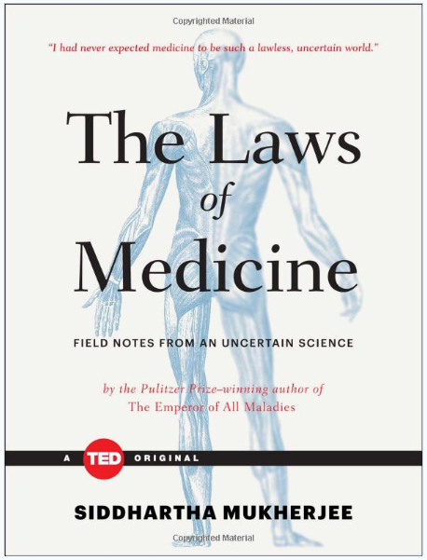
Laws of Medicine
I had never expected medicine to be such a lawless, uncertain world.

Slide 61
Research viewpoints
Positivism
The natural and social world are governed by principles, which may take the form of law-like regularities.
Interpretivism
Order of the social world follows from how humans understand their situation and act upon it.
Beuving and de Vries, Doing Qualitative Research, Amsterdam, 2015

Slide 62
Research worldviews
Positivism | Constructivism
Determination Reductionism Empirical observation and measurement Theory verification | Understanding Multiple participant meanings Social and historical construction Theory generation
Transformative | Pragmatism
Political agenda Change-oriented | Consequences of actions Problem-centered Real-world practice oriented
Creswell, Research Design, Los Angeles, 2014

Slide 63

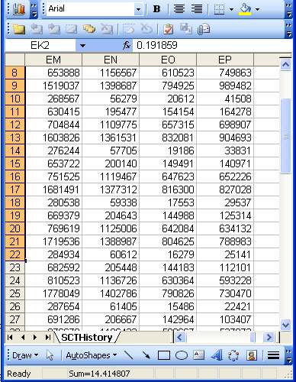
A non-trivial relation
Referents
References

Slide 64
Current mainstream informatics thinking
knowledge
information
data

Slide 65
Current mainstream informatics thinking
?
knowledge
information
data

Slide 66
Current mainstream informatics thinking
wisdom
knowledge
information
data

Slide 67
Where do data come from?
knowledge
information
data
Reality
What is there on the side of the patient

Slide 68
Where do data come from?
knowledge
information
data
Questions not often enough asked:
What parts of our data correspond with something out there in reality ?
What parts of reality are not captured by our data, but should because they are relevant ?
Reality
What is there on the side of the patient

Slide 69
Where do data come from?
knowledge
information
data
Questions not often enough asked:
What parts of our data correspond with something out there in reality ?
What parts of reality are not captured by our data, but should because they are relevant ?
Ontology
Reality
What is there on the side of the patient

Slide 70
Generalization: data generation and use
data
organization
model development
observation &
measurement
further R&D
(instrument and
study optimization)
add
verify
use
Δ = outcome
Generic
beliefs
application

Slide 71
Generalization: data generation and use
Science
Research
data
organization
model development
observation &
measurement
further R&D
(instrument and
study optimization)
add
verify
use
Δ = outcome
Generic
beliefs
application

Slide 72
‘The Scientific Method’
A name for a quite generally accepted research method

Slide 73
Fifteen common mistakes encountered in clinical research. Failure to …
carefully examine the literature for similar, prior research
critically assess the prior literature
specify the inclusion and exclusion criteria for your subjects
determine and report the error of your measurement methods
specify the exact statistical assumptions made in the analysis
perform sample size analysis before the study begins
implement adequate bias control measures
write and stick to a detailed time line
vigorously recruit and retain subjects
have a detailed, written and vetted protocol
examine for normality of the data
report missing data, dropped subjects and use of an intention to treat analysis
perform and report power calculations
point out the weaknesses of your own study
understand and use correct scientific language
Journal of Prosthodontic Research 55 (2011) 1–6

Slide 74
The Scientific Method
principles and procedures for the systematic pursuit of knowledge involving:
  the recognition and formulation of a problem,
  the collection of data through observation and experiment, and
  the formulation and testing of hypotheses.
http://www.merriam-webster.com/dictionary/scientific%20method

Slide 75
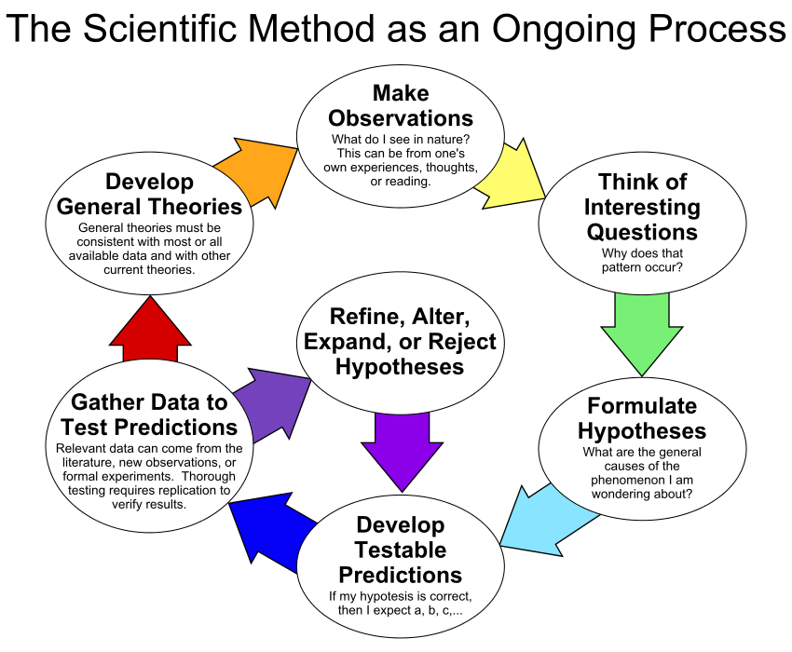
By ArchonMagnus - Own work, CC BY-SA 4.0, https://commons.wikimedia.org/w/index.php?curid=42164616

Slide 76
Scientific Objectivity (1)
Objectivity as Faithfulness to Facts
Objectivity as Absence of Normative Commitments and the Value-Free Ideal
Objectivity as Freedom from Personal Biases
  Measurement and Quantification
  Inductive and Statistical Inference

Slide 77
Scientific Objectivity (2)
Science is objective in that, or to the extent that:
its products—theories, laws, experimental results and observations—constitute accurate representations of the external world. The products of science are not tainted by human desires, goals, capabilities or experience.
  product objectivity
the processes and methods that characterize it neither depend on contingent social and ethical values, nor on the individual bias of a scientist
  → process objectivity.
http://plato.stanford.edu/entries/scientific-objectivity

Slide 78
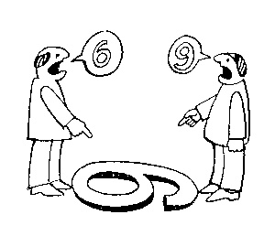
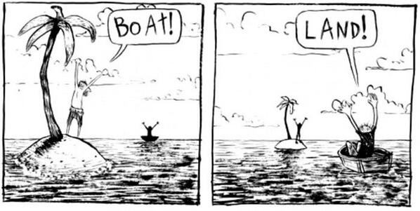
The view from nowhere
There are two kinds of qualities: ones that vary with the perspective one has or takes, and ones that remain constant through changes of perspective. The latter are the objective properties.
http://plato.stanford.edu/entries/scientific-objectivity

Slide 79
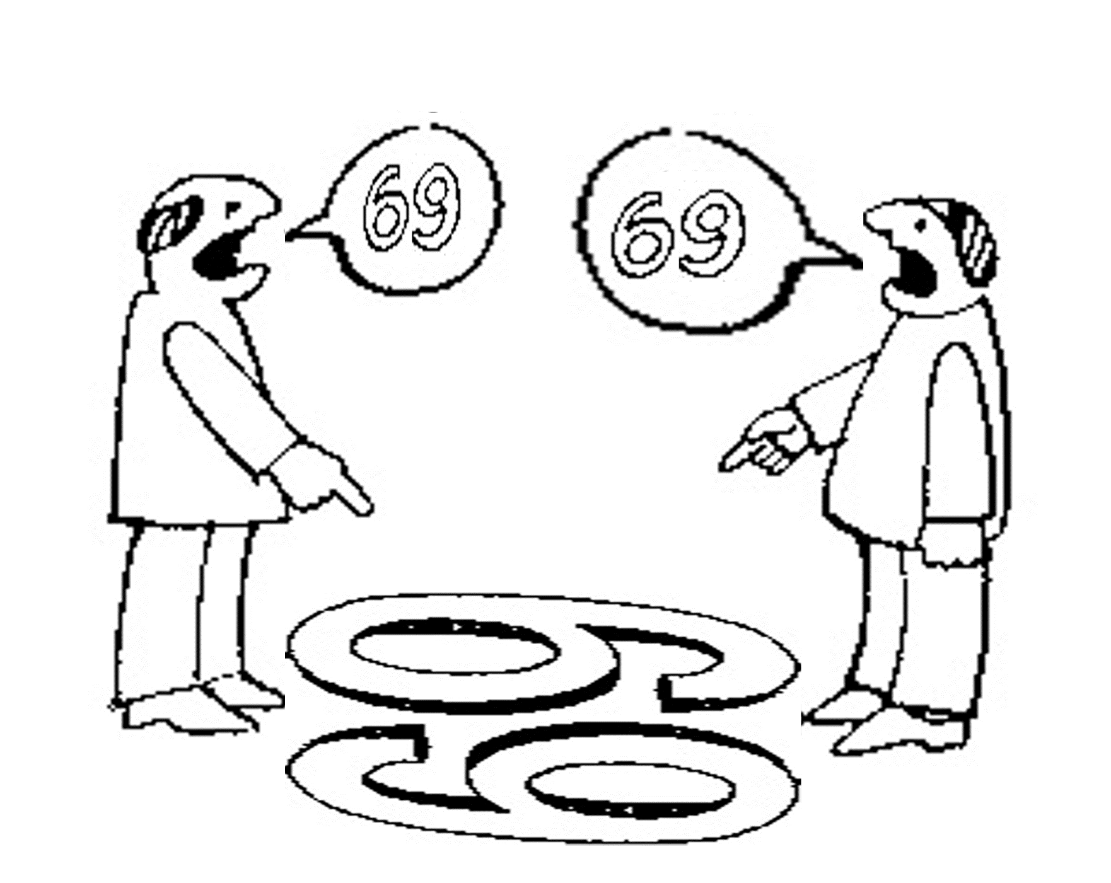
Is there scientific objectivity here?
sixty
nine
sixty
nine

Slide 80
The view from nowhere
Nagel’s 3-step conception:
realize (or postulate) that our perceptions are caused by the actions of things on us, through their effects on our bodies.
realize (or postulate) that since the same properties that cause perceptions in us also have effects on other things and can exist without causing any perceptions at all, their true nature must be detachable from their perspectival appearance and need not resemble it.
form a conception of that “true nature” independently of any perspective.
http://plato.stanford.edu/entries/scientific-objectivity
Nagel, T., 1986, The View From Nowhere, New York, NY: Oxford University Press.

Slide 81
Impact of value(s) on science
the choice of a scientific research problem;
the gathering of evidence in relation to the problem;
the acceptance of a scientific hypothesis or theory as an adequate answer to the problem on the basis of the evidence;
the proliferation and application of scientific research results.
(Weber 1917 [1988]).
http://plato.stanford.edu/entries/scientific-objectivity

Slide 82
Value types
Scientific values:
  Accuracy, simplicity, …
Epistemic (or cognitive) values:
  predictive accuracy, scope, unification, explanatory power, coherence with other accepted theories, …
Contextual (non-cognitive) values:
  moral, personal, social, political and cultural values such as pleasure, justice and equality, conservation of the natural environment, diversity, …
http://plato.stanford.edu/entries/scientific-objectivity

Slide 83
Three theses
Value-Free Ideal (VFI):
    Scientists should strive to minimize the influence of contextual values on scientific reasoning, e.g., in gathering evidence and assessing/accepting scientific theories.
    scientific objectivity is characterized by absence of contextual values and by exclusive commitment to epistemic values in scientific reasoning.
Value-Neutrality Thesis (VNT):
    Scientists can—at least in principle—gather evidence and assess/accept theories without making contextual value judgments.
Value-Laden Thesis (VLT):
    Scientists cannot gather evidence and assess/accept theories without making contextual value judgments.
http://plato.stanford.edu/entries/scientific-objectivity

Slide 84
Evidence-based medicine
Evidence-based medicine de-emphasizes intuition, unsystematic clinical experience, and pathophysiological rationale as sufficient grounds for clinical decision making and stresses the examination of evidence from clinical research.
‘Evidence’ = analyses of the results of randomized controlled trials (RCTs) which attempt to eliminate selection bias.
Judgment still required to assess the extent to which a patient is similar to the study subjects!
http://plato.stanford.edu/entries/scientific-objectivity

Slide 85
Questions?

Slide 86
!!! Assignment for next week !!!
Required reading:
  R3 Ioannidis, J.P., Why most published research findings are false. PLoS Med, 2005. 2(8): p. e124.
  https://www.ncbi.nlm.nih.gov/pubmed/16060722

Slide 87
Students will report on their pre-class assignment and explain their ideas, each presentation followed by discussion.

