Slide 1
Statistical data analysis and research methods
BMI504
Course 16249 – Spring 2025
Class 3 – Feb 6, 2025
Parameters for research designs
Werner CEUSTERS, MD

Slide 2
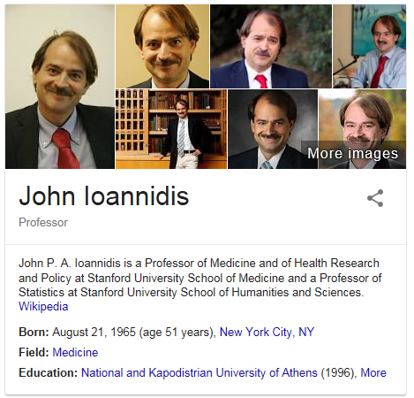
Pre-lecture reading test
John P. A. Ioannidis.
Why Most Published Research Findings Are False.
PLOS Medicine 2005;2(8):e124
http://robotics.cs.tamu.edu/RSS2015NegativeResults/pmed.0020124.pdf

Slide 3
Useful references re Ioannidis 2005
Reconstruction of the analysis:
    https://matthew-brett.github.io/teaching/ioannidis_2005.html
Use and assessment of prior probabilities:
    https://psychology.wikia.org/wiki/Prior_probability
    http://doingbayesiandataanalysis.blogspot.com/2013/01/bayesian-disease-diagnosis-with.html

Slide 4
Assignments for next week
Required readings:
  R4. Ioannidis, J.P., Why Most Clinical Research Is Not Useful. PLoS Med, 2016. 13(6): p. e1002049.
    http://journals.plos.org/plosmedicine/article?id=10.1371/journal.pmed.1002049
  R5. Ozonoff, D.M. and P. Grandjean, What is useful research? The good, the bad, and the stable. Environ Health, 2020. 19(1): p. 2.
    https://ehjournal.biomedcentral.com/articles/10.1186/s12940-019-0556-5
On the basis of the lectures thus far and papers R4 and R5 reflect further on concrete topics for your research proposal, and pick one for presentation and detailed discussion during C4.

Slide 5
Lecture
Parameters for research designs

Slide 6
Goal of Research Design
to ensure that the data obtained enables the researcher to effectively address the research problem logically and as unambiguously as possible.

Slide 7
Distinct research purpose → distinct design
to describe and understand some phenomenon in its natural context
  → Descriptive Study
to look for an association among variables by studying the situation without managing any intervention
  → Observational or Epidemiological Study
to determine the effect of a specified intervention (e.g., protocol, method, or treatment) managed by the investigator
  → Experimental Trial
to validate a test, tool or diagnostic method
  → Diagnostic, Validity or Reliability Study
Adapted from: Research Design Algorithm developed by the American Dietetic Association, 2010

Slide 8
Biomedical Informatics Examples
Systematic comparison of the protein-protein interaction databases from a user's perspective
Inter-observer agreement and reliability assessment for observational studies of clinical work
Sex, obesity, diabetes, and exposure to particulate matter among patients with severe asthma: Scientific insights from a comparative analysis of open clinical data sources during a five-day hackathon
An empirical study on prediction of population health through social media
Comparing information extraction techniques for low-prevalence concepts: The case of insulin rejection by patients
Tracking a moving user in indoor environments using Bluetooth low energy beacons
Creating synthetic patient data to support the design and evaluation of novel health information technology

Slide 9
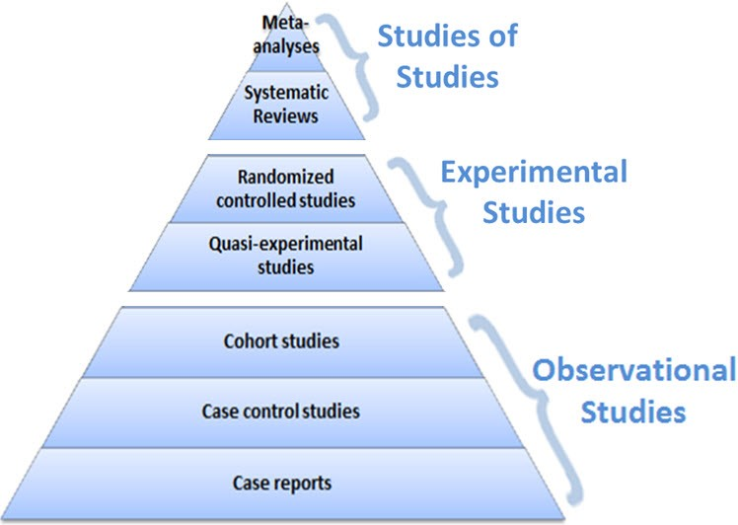
Design partially determines level of evidence
Evidence
level
https://guides.library.vcu.edu/humphrey/journal-club

Slide 10
Research Design: what and what parts
The plans and procedures for research that span the steps from broad assumptions to detailed methods of data collection, analysis, and interpretation.
Decision to select a design must be informed by:
  research problem, esp. its nature,
  worldviews: the philosophical assumptions the researcher brings to the study;
  methodology: procedures of inquiry (quantitative / qualitative / mixed)
  research methods: how to conduct data collection, analysis, and interpretation.
Adapted from: Creswell, Research Design, Los Angeles, 2014

Slide 11
Design versus methodology
Research design | Research methodology
Focuses on the end-product: What kind of study is being planned and what kind of results are aimed at. E.g. Historical - comparative study, interpretive approach OR exploratory study, inductive and deductive etc.
Dr Brian van Wyk. Research design and methods; Part I.
https://www.uwc.ac.za/Students/Postgraduate/Documents/Research_and_Design_I.pdf

Slide 12
Design versus methodology
Research design | Research methodology
Focuses on the end-product: What kind of study is being planned and what kind of results are aimed at. E.g. Historical - comparative study, interpretive approach OR exploratory study, inductive and deductive etc. | Focuses on the research process and the kind of tools and procedures to be used. E.g. Document analysis, survey methods, analysis of existing (secondary) data/statistics etc.)
Dr Brian van Wyk. Research design and methods; Part I.
https://www.uwc.ac.za/Students/Postgraduate/Documents/Research_and_Design_I.pdf

Slide 13
Design versus methodology
Research design | Research methodology
Focuses on the end-product: What kind of study is being planned and what kind of results are aimed at. E.g. Historical - comparative study, interpretive approach OR exploratory study, inductive and deductive etc. | Focuses on the research process and the kind of tools and procedures to be used. E.g. Document analysis, survey methods, analysis of existing (secondary) data/statistics etc.)
Point of departure (driven by) = Research problem or question.
Dr Brian van Wyk. Research design and methods; Part I.
https://www.uwc.ac.za/Students/Postgraduate/Documents/Research_and_Design_I.pdf

Slide 14
Design versus methodology
Research design | Research methodology
Focuses on the end-product: What kind of study is being planned and what kind of results are aimed at. E.g. Historical - comparative study, interpretive approach OR exploratory study, inductive and deductive etc. | Focuses on the research process and the kind of tools and procedures to be used. E.g. Document analysis, survey methods, analysis of existing (secondary) data/statistics etc.)
Point of departure (driven by) = Research problem or question. | Point of departure (driven by) = Specific tasks (data collection or sampling) at hand.
Dr Brian van Wyk. Research design and methods; Part I.
https://www.uwc.ac.za/Students/Postgraduate/Documents/Research_and_Design_I.pdf

Slide 15
Design versus methodology
Research design | Research methodology
Focuses on the end-product: What kind of study is being planned and what kind of results are aimed at. E.g. Historical - comparative study, interpretive approach OR exploratory study, inductive and deductive etc. | Focuses on the research process and the kind of tools and procedures to be used. E.g. Document analysis, survey methods, analysis of existing (secondary) data/statistics etc.)
Point of departure (driven by) = Research problem or question. | Point of departure (driven by) = Specific tasks (data collection or sampling) at hand.
Focuses on the logic of research: What evidence is required to address the question adequately?
Dr Brian van Wyk. Research design and methods; Part I.
https://www.uwc.ac.za/Students/Postgraduate/Documents/Research_and_Design_I.pdf

Slide 16
Design versus methodology
Research design | Research methodology
Focuses on the end-product: What kind of study is being planned and what kind of results are aimed at. E.g. Historical - comparative study, interpretive approach OR exploratory study, inductive and deductive etc. | Focuses on the research process and the kind of tools and procedures to be used. E.g. Document analysis, survey methods, analysis of existing (secondary) data/statistics etc.)
Point of departure (driven by) = Research problem or question. | Point of departure (driven by) = Specific tasks (data collection or sampling) at hand.
Focuses on the logic of research: What evidence is required to address the question adequately? | Focuses on the individual (not linear) steps in the research process and the most ‘objective’ (unbiased) procedures to be employed.
Dr Brian van Wyk. Research design and methods; Part I.
https://www.uwc.ac.za/Students/Postgraduate/Documents/Research_and_Design_I.pdf

Slide 17
Research Design: what and why
Specifies:
  required data,
  methods to be used to collect and analyze this data, and how this contributes to answering the research question.
Different design logics are used for different types of study, e.g. based on purpose of the inquiry:
    Exploration
    Description
    Explanation
    Prediction
    Evaluation
    History

Slide 18
Steps in scientific research
Specify the question you are asking.
Put the question in the form of a null hypothesis and alternative hypothesis.
Put the question in the form of a statistical null hypothesis and alternative hypothesis.
Determine which variables are relevant to the question.
Determine what kind of variable each one is.
Design an experiment that controls or randomizes the confounding variables.
Based on the number of variables, the kinds of variables, the expected fit to the parametric assumptions, and the hypothesis to be tested, choose the best statistical test to use.
Do a power analysis to determine a good sample size for the experiment.
Do the experiment.
Examine the data to see if it meets the assumptions of the statistical test you chose. If it doesn't, choose a more appropriate test.
Apply the statistical test you chose, and interpret the results.
Communicate your results effectively, usually with a graph or table.
John H. McDonald. The Handbook of Biological Statistics ©. 2014. http://www.biostathandbook.com/

Slide 19
Exploratory versus conclusive research
Research project components | Exploratory research | Conclusive research
Research purpose | General: to generate insights about a situation | Specific: to verify insights and aid in selecting a course of action
Data needs | Vague | Clear
Data sources | Ill defined | Well defined
Data collection form | Open-ended, rough | Usually structured
Sample | Relatively small; subjectively selected to maximize generalization of insights | Relatively large; objectively selected to permit generalization of findings
Data collection | Flexible; no set procedure | Rigid; well-laid-out procedure
Data analysis | Informal; typically non-quantitative | Formal; typically quantitative
Inferences/ Recommendations | More tentative than final | More final than tentative
Not acceptable for this course !
https://research-methodology.net/research-methodology/research-design/

Slide 20
Data orientation
Generating primary data
  surveys, experiments, case studies, program evaluation, ethnographic studies
Analyzing existing data
  text data: discourse analysis, content analysis, textual criticism, historical studies, or
  numeric data: secondary data analysis, statistical modelling.

Slide 21
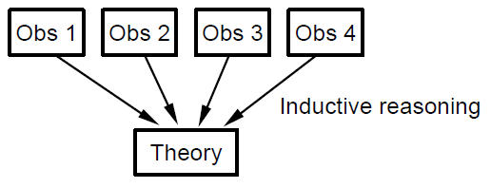
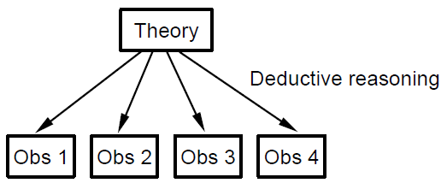
Theory building versus testing
Theory building
Theory testing

Slide 22
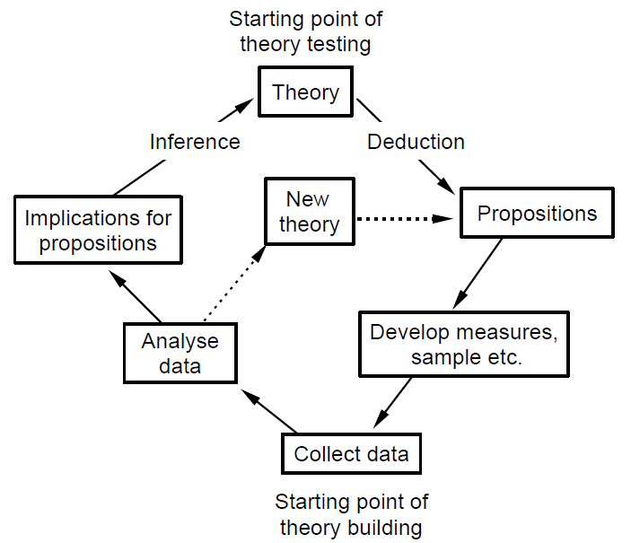
Logic of scientific research
https://www.nyu.edu/classes/bkg/methods/005847ch1.pdf

Slide 23
Time perspective of what is studied
Past
Present
Future

Slide 24
Major methodologies

Slide 25
Quantitative research
In natural sciences and social sciences, quantitative research is the systematic empirical investigation of observable phenomena via statistical, mathematical or computational techniques.
https://en.wikipedia.org/wiki/Quantitative_research
Qualitative research

Slide 26
Quantitative research
In natural sciences and social sciences, quantitative research is the systematic empirical investigation of observable phenomena via statistical, mathematical or computational techniques.
https://en.wikipedia.org/wiki/Quantitative_research
Qualitative research
Qualitative Research is primarily exploratory research used to gain an understanding of underlying reasons, opinions, and motivations. It provides insights into the problem or helps to develop ideas or hypotheses for potential quantitative research.
http://www.snapsurveys.com/blog/what-is-the-difference-between-qualitative-research-and-quantitative-research/

Slide 27
Qualitative vs. quantitative research
Qualitative research emphasizes the importance of looking at variables in the natural setting in which they are found. Interaction between variables is important.
http://www.okstate.edu/ag/agedcm4h/academic/aged5980a/5980/newpage21.htm

Slide 28
‘Variable’

Slide 29
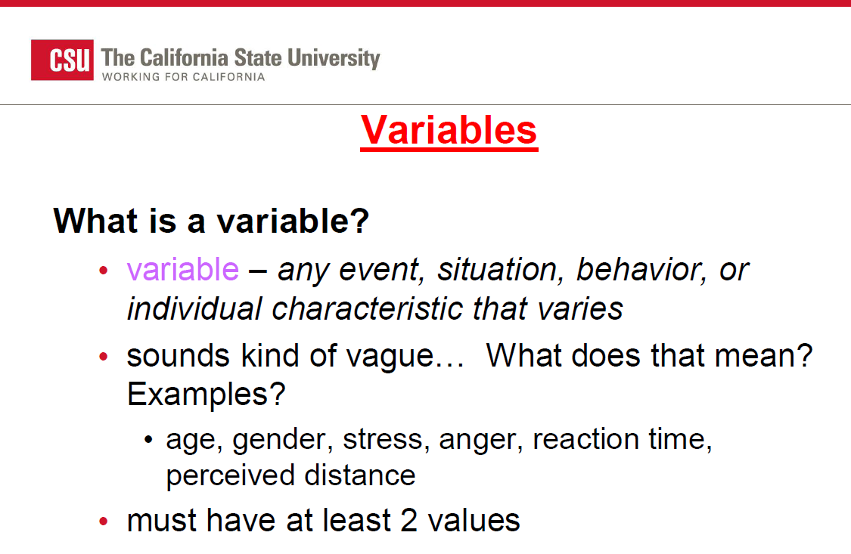
How about this?
http://www.sjsu.edu/people/mark.vanselst/courses/psyc120/s2/Cosby-c4-Research-Fundamentals.pdf

Slide 30
Why do I not agree with this?
http://www.sjsu.edu/people/mark.vanselst/courses/psyc120/s2/Cosby-c4-Research-Fundamentals.pdf

Slide 31
‘Variable’
(in research, not in logic)
How the word should be used (my tentative definition grounded in realism-based ontology):
Symbol used by an author to denote
some pre-defined perspective P on portions of reality (PoR)
whereby P allows these PoRs to be described
in a comparable and standardized way.

Slide 32
‘Variable’
(in research, not in logic)
How the word should be used (my tentative definition grounded in realism-based ontology):
Symbol used by an author to denote
some pre-defined perspective P on portions of reality (PoR)
whereby P allows these PoRs to be described
in a comparable and standardized way.

Slide 33
‘Pre-defined perspectives’: concept
‘Concept’
  A perspective drawn from observing a number of PoRs in a relatively similar, comparable and standardized way.

Slide 34
‘Pre-defined perspectives’: concept
‘Concept’
  A perspective drawn from observing a number of PoRs in a relatively similar, comparable and standardized way.
‘The critical term here is “observed”, because it means that there is a direct link between the concept (the abstraction) and its referents (the reality).
For instance, we can observe a number of particular instances where individuals receive varying amounts of money for the work they have done over a given period of time. From these particulars we distill an abstraction and label it “income”.
Similarly, we observe individuals and find some of them short, some tall and more of them in between; from these observations we generate the concept “height”.’
James H. Watt and Sjef van den Berg. Research Methods For Communication Science. 2002
http://www.cios.org/readbook/rmcs/rmcs.htm

Slide 35
‘Pre-defined perspectives’: construct
‘Construct’
  A perspective built from the logical combination of a number of concepts.

Slide 36
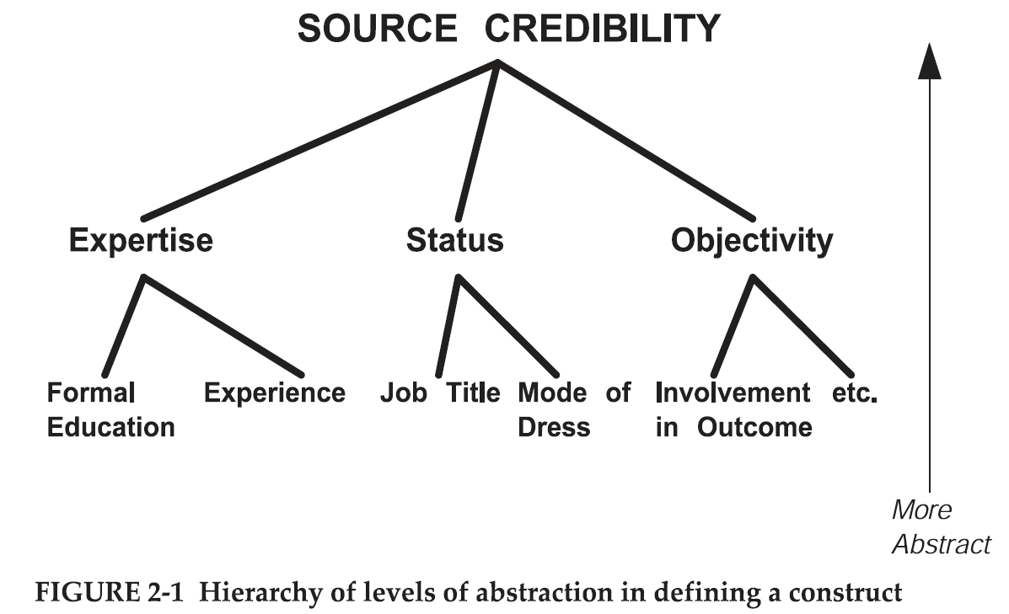
‘Pre-defined perspectives’: construct
A3/3.4 //A4/3.5
‘Construct’
  A perspective built from the logical combination of a number of concepts.
James H. Watt and Sjef van den Berg. Research Methods For Communication Science. 2002.
Part 1, Chapter 2, Elements of Scientific Theories: Concepts and Definitions. P12.
http://www.cios.org/readbook/rmcs/rmcs.htm

Slide 37
‘Perspective’
‘Construct’
  A perspective built from the logical combination of a number of concepts.
‘Concept’
  A perspective drawn from observing a number of PoRs in a relatively similar, comparable and standardized way.
‘Perspective’
  A Cognitive Representation resulting from an interpretive process driven by relatively systematic observations of a PoR.

Slide 38
Cognitive Representation
INFORMATION CONTENT ENTITY | An ENTITY which is (1) GENERICALLY DEPENDENT on (2) some MATERIAL ENTITY and which is (3) concretized by a QUALITY (a) inhering in the MATERIAL ENTITY and (b) that is_about some PORTION OF REALITY
INFORMATION QUALITY ENTITY | A REPRESENTATION that is the concretization of some INFORMATION CONTENT ENTITY
REPRESENTATION | A QUALITY which is_about or is intended to be about a PORTION OF REALITY
MENTAL QUALITY | A QUALITY which specifically depends on an ANATOMICAL STRUCTURE in the cognitive system of an organism
COGNITIVE REPRESENTATION | A REPRESENTATION which is a MENTAL QUALITY
Smith B, Ceusters W. Aboutness: Towards Foundations for the Information Artifact Ontology. In: Proceedings of the Sixth International Conference on Biomedical Ontology: July 27-30, 2015; Lisboa, Portugal. 2015. Available at: http://ceur-ws.org/Vol-1515/regular10.pdf. Accessed 24 Aug 2016.

Slide 39
Pre-defined perspectives
Perspective label:
  Short term that functions as a name to identify the perspective in communications about the research.
Theoretical definition:
  Description that specifies what sort of PoR the defining researcher carved out through the perspective.
Operational definition:
  Description intended to allow other researchers
    (a) to observe (in case of concepts) the intended PoRs from the very same perspective objectively or,
    (b) to build (in case of constructs) the perspective in exactly the same way as intended.
Adapted from: James H. Watt and Sjef van den Berg. Research Methods For Communication Science. 2002
http://www.cios.org/readbook/rmcs/rmcs.htm

Slide 40
Construct/concept appropriateness (1)
Caroline Stone. A Defense and Definition of Construct Validity in Psychology
Philosophy of Science, vol 86:5, 11 December 2019.

Slide 41
Construct/concept appropriateness (2)
A3/3.4 //A4/3.5
Construct validity:
  A measure, m, of some construct, C, is construct valid if and only if we are sufficiently justified in believing m tracks C.
Construct legitimacy:
  A construct, C, is legitimate if and only if the theory that posits C is sufficiently justified.
Such justifications MUST be in the proposal!
Caroline Stone. A Defense and Definition of Construct Validity in Psychology
Philosophy of Science, vol 86:5, 11 December 2019.

Slide 42
‘Variable’
‘Variable’ is an ambiguous term:
  Above, in ‘looking at variables in the natural setting’, it is used to denote observable entities in reality.

Slide 43
‘Observable’
‘Observable’ is an ambiguous term:
  ‘a property or object is observable (in the philosopher’s sense) if it can be perceived directly, where directness of observation precludes the use of technical artifacts and inferences’.
  ‘the physicist, by contrast, would also count quantitative magnitudes that can be measured in a ‘relatively simple, direct way’ as observable. Hence, the physicist views such quantities as temperature, pressure and intensity of electric current as observable.’
Andreas, Holger, "Theoretical Terms in Science", The Stanford Encyclopedia of Philosophy (Fall 2017 Edition),
Edward N. Zalta (ed.), https://plato.stanford.edu/archives/fall2017/entries/theoretical-terms-science/.

Slide 44
‘Variable’
‘Variable’ is an ambiguous term:
  Above, in ‘looking at variables in the natural setting in which they are found’, the term is used to denote observable entities in reality.
  More often, it is used to denote a syntactic element in one or other formal language, e.g.
    E = mc²
      ‘E’ and ‘m’ are variables,
      ‘c’ is a constant.

Slide 45
Qualitative vs. quantitative research
Qualitative research emphasizes the importance of looking at variables in the natural setting in which they are found. Interaction between variables is important.
Detailed data is gathered through open ended questions that provide direct quotations. The interviewer is an integral part of the investigation (Jacob, 1988).
This differs from quantitative research which attempts to gather data by objective methods to provide information about relations, comparisons, and predictions and attempts to remove the investigator from the investigation (Smith, 1983).
http://www.okstate.edu/ag/agedcm4h/academic/aged5980a/5980/newpage21.htm

Slide 46
Characteristics of qualitative research
A3/3.3
Purpose | Understanding - Seeks to understand people’s interpretations.
Reality | Dynamic [in an odd sense] – ‘Reality changes with changes in people’s perceptions’.
Viewpoint | Insider - Reality is what people perceive it to be.
Values | Value bound - Values will have an impact and should be understood and taken into account when conducting and reporting research.
Focus | Holistic - A total or complete picture is sought.
Orientation | Discovery - Theories and hypotheses are evolved from data as collected.
Data | Subjective - Data are perceptions of the people in the environment.
Instrumentation | Human - The human person is the primary collection instrument.
Conditions | Naturalistic - Investigations are conducted under natural conditions.
Results | Valid [if done lege artis] - The focus is on design and procedures to gain "real," "rich," and "deep" data.
http://www.okstate.edu/ag/agedcm4h/academic/aged5980a/5980/newpage21.htm ‘[…]’: my comments

Slide 47
Qualitative Research Foundations
A3/3.3
Although reality is objectively the way it is, it is/should not be observed or experienced in one single agreed upon way.
Interpretations are socially constructed by individuals in their interaction with their local reality.
Therefore, there are multiple interpretations of reality that are in flux and that change over time.
Qualitative researchers are interested in understanding what those interpretations are at a particular point in time and in a particular context.
The purpose is NOT to predict.

Slide 48
Different types of qualitative study design
A3/3.1
Ethnography:
  Portrait of people-study of the story and culture of a group usually to develop cultural awareness and sensitivity;
Phenomenology:
  Study of individual’s lived experiences of events-e.g. the experience of AIDS care;
Grounded Theory:
  Going beyond adding to the existing body of knowledge-developing a new theory about a phenomenon-theory grounded on data;
Participatory action research:
  Individuals & groups researching their own personal beings, socio-cultural settings and experiences;
Case study:
  In-depth investigation of a single or small number of units at a point (over a period) in time.
Joan LaFrance. Fundamentals of Qualitative Research. AIHEC NARCH Meeting DinѐCollege. June 25, 2015

Slide 49
Field notes are crucial
Field notes:
    are transcribed notes or the written account derived from data collected during observations.
Generally consist of two parts:
    descriptive in which the observer attempts to capture a word-picture of the setting, actions and conversations; and
    reflective in which the observer records thoughts, ideas, questions and concerns based on the observations and interviews.
Should be written as soon as possible after the observation and/or interviews.
Joan LaFrance. Fundamentals of Qualitative Research. AIHEC NARCH Meeting DinѐCollege. June 25, 2015

Slide 50
Data Reduction becomes a need
Qualitative studies produce a wealth of data but not all of it is meaningful. Identify and focus in on what is meaningful.
Transform the data into a simplified format that can be understood in the context of the research questions.
When trying to discern what is meaningful data always refer back to the research questions and use them as a framework.
Hone in on specific patterns and themes of interest while not focusing on other aspects of the data.
Joan LaFrance. Fundamentals of Qualitative Research. AIHEC NARCH Meeting DinѐCollege. June 25, 2015

Slide 51
Types of Data Collection in QLRM
Survey
Interviews
Focus groups
Observation
(Data) extraction
Secondary data sources
Ethnography
→ Covered in detail in C6
MC. Harrell & MA. Bradley. Data Collection Methods: Semi-Structured Interviews and Focus Groups. RAND Corporation 2009. http://www.rand.org/pubs/technical_reports/TR718.html

Slide 52
Quantitative, qualitative and mixed methods
Required for
your proposal
Quantitative methods | Qualitative methods | Mixed methods
Predetermined methods | Emerging methods | Both predetermined and emerging methods
Instrument based questions | Open-ended questions | Both open- and closed-ended questions
Observational data, performance data, attitude data, and census data | Interview data, observation data, document data, and audiovisual data | Multiple forms of data drawing on all possibilities
Statistical analysis | Text and image analysis | Statistical and text analysis
Statistical interpretation | Themes, patterns interpretation | Integration of multiple interpretations

Slide 53
Some methods in research design

Slide 54
The Scientific Method
H ypothesize
O perationalize
M easure
E valuate
R eplicate, revise, report.
JL. Lakin, RB Giesler, KA. Morris, JR. Vosmik.
HOMER as an Acronym for the Scientific Method
April 1, 2007. https://doi.org/10.1080/00986280701291317

Slide 55
(Relatively) Common Strategies
Research question formulation
Standardization
Randomization and stratification
Blinding
Use of placebos/shams
Control group selection
Population selection
Endpoint selection
Protocol adherence
Sample size determination
Evans SR. Fundamentals of clinical trial design. Journal of experimental stroke & translational medicine. 2010;3(1):19-27.

Slide 56
S1. Question formulation
A1/1.1
Precise formulation of the purpose of the study.
Strategies for framing the question.

Slide 57
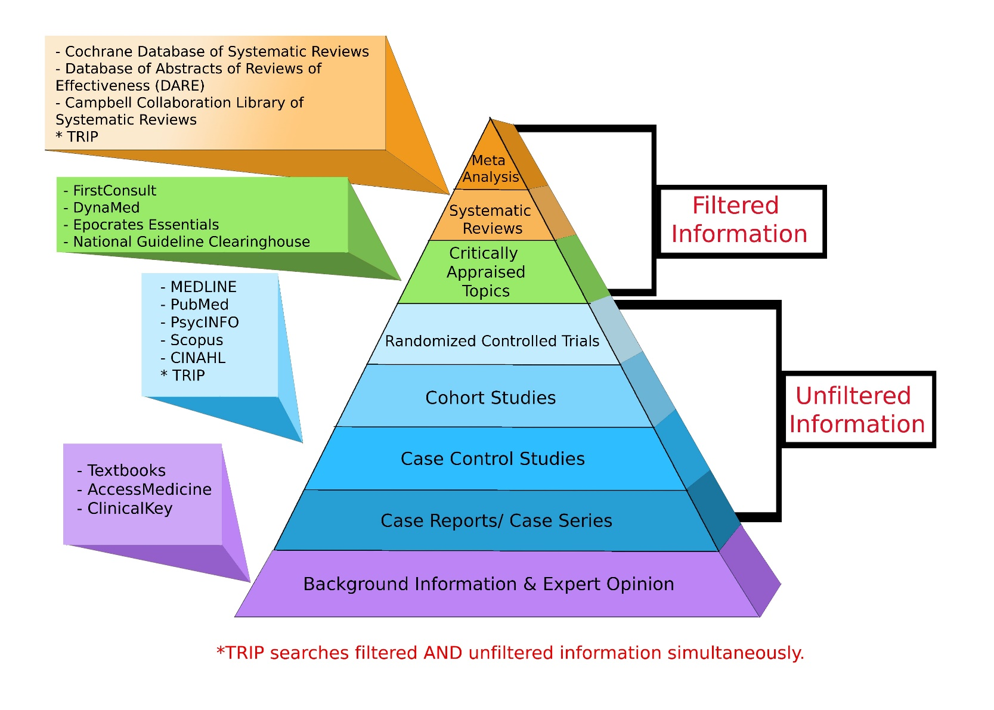
Where to search
A2/2.4
http://libguides.gwumc.edu/ebm/studytypes

Slide 58

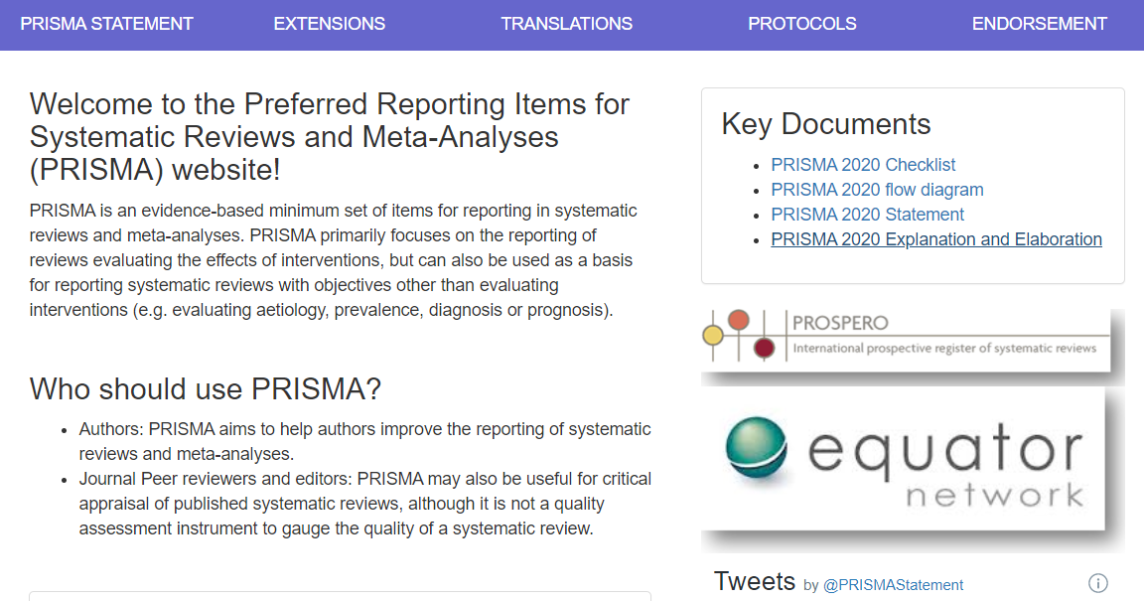
A2/2.4
How to search and report on it
http://www.prisma-statement.org/

Slide 59
Framing the research question
Two general strategies:
hypothesis testing:
  researchers construct a null hypothesis (“no effect” or “no difference”) and an alternative hypothesis;
  evidence is sought to disprove the null and/or support the alternative hypothesis.
Estimation:
  Compute differences in some outcome for two different events with appropriate precision;
  Appropriate precision is measured by the width of a confidence interval of the difference between the outcomes in the two groups.
Required for your proposal
Evans SR. Fundamentals of clinical trial design. Journal of experimental stroke & translational medicine. 2010;3(1):19-27.

Slide 60
Specific strategy: PICO(TT) Framework
A1/1.1
P | Patient Population of patients Problem | What is the best way to briefly describe this patient population or situation? E.g. pregnant women over 40 with preeclampsia, adolescent boys 13-15, etc.
I | Intervention (therapy or test) | What is the intervention? E.g. a drug, a questionnaire, a test, a procedure, etc.
C | Comparison | Is there an alternative intervention to compare to? E.g. placebo, current standard of care, another therapy, etc.
O | Outcome | Include specific patient-oriented outcomes E.g. morbidity, quality of life, etc.
T | Time for completion | Used to identify the time/duration for your data collection or for assessing your outcome. I.e. how long before you are to see that the intervention is having a positive impact OR the time in which the intervention will be delivered
T | Type of study | What is the ideal study design to answer this question? What type of study design do you realistically anticipate finding? E.g. randomized-controlled trial, systematic reviews, etc.
For the proposal: a BMI application or process!!!

Slide 61
Evidence Based Medicine question types
A1/1.1
Intervention/Therapy
Etiology
Diagnosis
Prognosis/Prediction
Meaning
https://www.aaacn.org/sites/default/files/documents/misc-docs/1e_PICOT_Questions_template.pdf

Slide 62
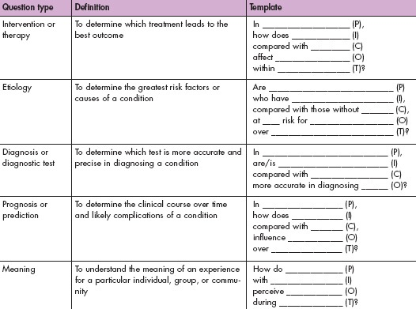
A1/1.1
https://www.aaacn.org/sites/default/files/documents/misc-docs/1e_PICOT_Questions_template.pdf

Slide 63
Some examples in BMI research
A1/1.1
Do user satisfaction scores among clinicians using EHR systems improve more when they receive training from an experienced clinician-user than from a vendor trainer?
Do patients whose providers use extensive narrative clinical notes in addition to structured clinical reporting have better outcomes than with structured clinical reporting alone?
Does managing a problem list using SNOMED CT offers better perspectives for clinical decision support than managing it by means of ICD-9-CM?
For nurses working in acute care settings, what is the effect of using an EHR for documentation on time spent at the bedside providing patient care?

Slide 64
Special case for comparison
‘A/B’ testing
  a way to compare two versions of something to figure out which performs better.
    https://hbr.org/2017/06/a-refresher-on-ab-testing
  Example in BMI:
    https://pubmed.ncbi.nlm.nih.gov/33835035/
      a revised CDS influenza alert was tested against usual care CDS
      test 3 versions (financial, quality, regulatory) of text supporting tobacco cessation alerts.

Slide 65
S2. Standardization
A4/4.3
Goal: minimize variation.
Strategies:
  construct consistent and uniform endpoint definitions which are as much as possible objectively measurable;
  use central labs/evaluators to eliminate between-lab/ between-evaluator variation;
  Use very precise evaluation manuals;
  Training of evaluators.
Evans SR. Fundamentals of clinical trial design. Journal of experimental stroke & translational medicine. 2010;3(1):19-27.

Slide 66
S3. Randomization
A4/4.3.b)
Goal: minimizing treatment selection bias;
    assignment to treated group not based on prognostic factors;
    prevents confounding of the treatment effects with other prognostic variables.
Strategies:
  Simple: flip a coin for each subject.
  Constrained: subjects pick token (T or nT) from a bag.
  Adaptive, several schemas, e.g.:
    pick token from bag to determine group, put it back, add one token from opposite category, or,
    pick from bag, give selected treatment, if treatment successful add two tokens of same treatment to bag, otherwise, one of each.
  Stratified: create treatment groups that are balanced with respect to confounding (prognostic) variables.

Slide 67
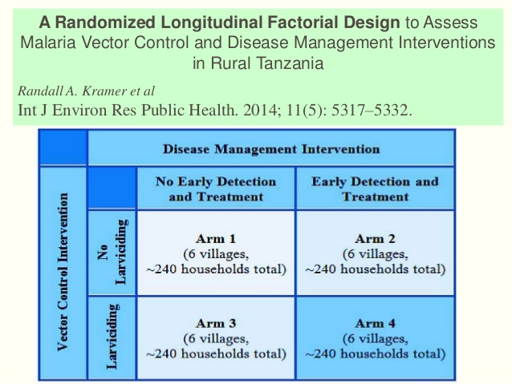
A4/4

Slide 68
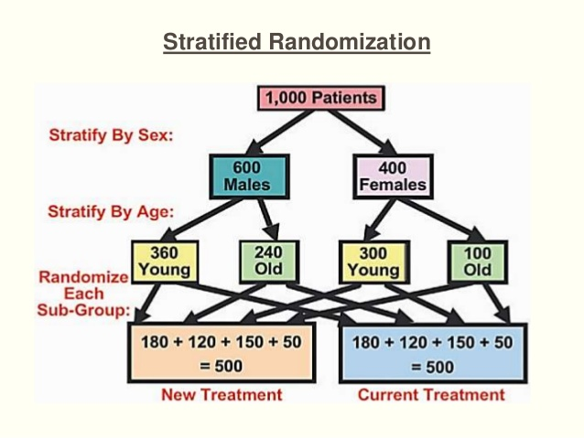
A4/4

Slide 69
S4. Blinding
A4/4.3.c)
Of who:
  single: study subjects;
  double: subjects plus investigators;
  triple: subjects, investigators, evaluators, sponsors.
Not often possible:
  Ethical (no fake surgery)
  Different side effects of two compared treatments
  Different routes of administration
    Can be canceled out by ‘double dummy’ approach
Requires evaluation of the success of the blinding.
Evans SR. Fundamentals of clinical trial design. Journal of experimental stroke & translational medicine. 2010;3(1):19-27.

Slide 70
S5. Use of placebos
Sometimes costly
Sometimes impossible
  surgery
  device testing
May have treatment effects, most often with patient-reported outcomes.
Evans SR. Fundamentals of clinical trial design. Journal of experimental stroke & translational medicine. 2010;3(1):19-27.

Slide 71
S6. Control group selection
A4/4.3.d)
Goal: discriminate the effects caused by the study intervention from effects due to other factors.
      natural history of the disease, patient or clinician expectations, the effects of other interventions, …
Types:
  historical controls: data from previous studies
    Randomization not possible → more bias risk
  placebo/sham controls
  active controls: comparison to intervention with known outcomes
    ‘non-inferiority’ studies.
Evans SR. Fundamentals of clinical trial design. Journal of experimental stroke & translational medicine. 2010;3(1):19-27.

Slide 72
Control groups
A4/4.3.d)
The selection of a control group depends on:
  the research question,
  ethical constraints,
  the feasibility of blinding,
  the availability of quality data, and
  the ability to recruit participants.
Evans SR. Fundamentals of clinical trial design. Journal of experimental stroke & translational medicine. 2010;3(1):19-27.

Slide 73
Parallel and cross-over
A4/4.3.d)
Parallel A
B
Cross-over A A
B B

Slide 74
No control → Quasi-experimental design
A form of experimental research used extensively in the social sciences and psychology.
Mainly useful for measuring social variables.
The inherent weaknesses in the methodology do not undermine the validity of the data, as long as they are recognized and allowed for during the whole experimental process.
Quasi experiments resemble quantitative and qualitative experiments, but lack random allocation of groups or proper controls, so firm statistical analysis can be very difficult.
Not allowed
for this course
https://explorable.com/quasi-experimental-design

Slide 75
S7. Population selection
A4/4
Determined by the study objective
Homogenous and small versus diverse and large
Response variation and effect isolation versus impact of intervention on society
Entry criteria considerations:
  Participant safety
  Reduction of variation
  Prevention of bias
    Eliminate confounding comorbidities
Evans SR. Fundamentals of clinical trial design. Journal of experimental stroke & translational medicine. 2010;3(1):19-27.

Slide 76
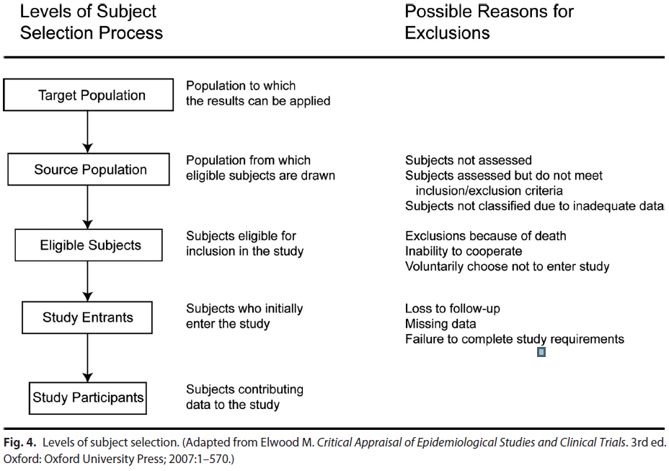
Selection of study participants
A4/4.1-2
Song JW, Chung KC. Observational studies: Cohort and case-control studies. Plast Reconstr Surg 2010;126:2234-42

Slide 77
Sampling methods
A4/4.3.a)
Random (in combination with others)
Stratified:
  the population is partitioned into non-overlapping groups (‘strata’) and a sample is selected by some design within each stratum.
      https://onlinecourses.science.psu.edu/stat506/node/27
Clustered: focus on a specific subpopulation;
Judgment-based: focus on subpopulations with specific knowledge or perspective.
Convenience-based.
Opportunity-based.
Snowball: e.g. suggestions by other interviewees.
MC. Harrell & MA. Bradley. Data Collection Methods: Semi-Structured Interviews and Focus Groups. RAND Corporation 2009. http://www.rand.org/pubs/technical_reports/TR718.html

Slide 78
S8. Endpoint selection
Desiderata for endpoints:
  (clinically) relevant,
  interpretable,
  sensitive to the effects of intervention,
  practical and affordable to measure in an unbiased manner,
    Objective endpoints better than subjective endpoints .
Characterized as one of the variable types (nominal, …)
Evans SR. Fundamentals of clinical trial design. Journal of experimental stroke & translational medicine. 2010;3(1):19-27.

Slide 79
S8. Composite endpoints
An intervention can have effects on several important endpoints. Composite endpoints combine a number of endpoints into a single measure.
Possible advantages:
  more completed characterization of intervention effects higher power and resulting smaller sample sizes
  may reduce the bias due to competing risks and informative censoring.
  avoid the multiplicity issue of evaluating endpoints individually.
Possible disadvantages:
  significance of composite does not imply significance of components
  significance of components does not imply significance of the composite.
  interpretation can be challenging
  Intervention effects for different components can go in different directions.
Evans SR. Fundamentals of clinical trial design. Journal of experimental stroke & translational medicine. 2010;3(1):19-27.

Slide 80
S8. Surrogate endpoints
A surrogate endpoint is a measure that is predictive of the event but takes a shorter time to observe.
The definitive endpoint often measures some benefit whereas the surrogate endpoint tracks the progress or extent of some phenomenon.
Surrogate endpoints could also be used when the definitive end-point is too expensive or difficult to measure, or not ethical to measure.
Criteria:
  the marker is predictive of the event,
  the intervention effect on the outcome manifests itself entirely through its effect on the marker.
significant correlation does not necessarily imply that a marker will be an acceptable surrogate.
Evans SR. Fundamentals of clinical trial design. Journal of experimental stroke & translational medicine. 2010;3(1):19-27.

Slide 81
Advantages of surrogate endpoints
Typically increase statistical power compared to clinical outcomes
Surrogate outcomes
  often continuous
  measured repeatedly
  less contamination by competing comorbidities if the study duration is short
Clinical outcomes
  often categorical
  surveillance till outcome occurs

Slide 82
Disadvantages of surrogate endpoints
Can involve complex, technical procedures
  procedures sometimes new
  procedures become obsolete
  many technical and analytic issues, often unapparent
Missing values are commonplace.
Potential for bias
  missing values occur in the sickest people,
  informative censoring, that is, loss of follow up data potentially related to treatment assignment.

Slide 83
S9. Protocol adherence
Goal: limit missing data
Strategies:
  Create simple trial;
  Use Intension to treat (ITT) model;
  Training of investigators;
  Explanation and motivation for patients.
Evans SR. Fundamentals of clinical trial design. Journal of experimental stroke & translational medicine. 2010;3(1):19-27.

Slide 84
S10. Steps in sample size determination
A4/4.4
Formulate null and alternative hypotheses.
    ‘minimum relevant difference’.
Select type I and type II errors.

Slide 85
Probabilities w.r.t. null hypothesis
A4/4.3.d)
Null Hypothesis | Claim that an investigator desires to disprove.
Power | The probability of rejecting a null hypothesis when it should be rejected.
Type I Error | The probability of rejecting the null hypothesis when it should not be rejected (i.e., a false positive).
Type II Error | The probability of failing to reject the null hypothesis when it should be rejected (i.e., a false negative). Type II error is the compliment of “power”.
Evans SR. Fundamentals of clinical trial design. Journal of experimental stroke & translational medicine. 2010;3(1):19-27.

Slide 86
Example: superiority trial
A4/4.3.d)
Superiority trial: trial designed to show that a new treatment is superior to another one, typically a placebo.
Power:
  The probability of identifying a treatment effect when indeed a true treatment effect exists.
Type I Error:
  The probability of (incorrectly) identifying a treatment effect when indeed a true treatment effect does not exist.
Type II Error:
  The probability of failing to identifying a treatment effect when indeed a true treatment effect exists.
Evans SR. Fundamentals of clinical trial design. Journal of experimental stroke & translational medicine. 2010;3(1):19-27.

Slide 87
Type I and type II errors
A4/4.3.d)
 | Reality
Observation | Treatment has no effect | Treatment has effect
Treatment is effective H₀ is rejected | Type I (or α) error (falsely reject H₀) α | Correct conclusion (reject H₀) 1-β (= study power)
Treatment has no effect H₀ is accepted | Correct conclusion (accept H₀) 1-α | Type II (or β) error (falsely accept H₀) β
Jerrold Lerman. Study design in clinical research: sample size estimation and power analysis

Slide 88
Sample size
A4/4.3.d)
Depends on four critical quantities:
  The type I and type II error rates (α and β)
  the population variance (σ²), and
  the effect size (ES),
    i.e. the amount by which we would expect two treatments to differ, or the difference that would be clinically worthwhile.
      ‘minimum clinically relevant difference’.

Slide 89
S10. Steps in sample size determination
A4/4.3.d)
Formulate null and alternative hypotheses.
    ‘minimum clinically relevant difference’.
Select type I and type II errors.

Slide 90
Select type I error
A4/4.3.d)
Typically set at 5%
Consider using a smaller Type I error (e.g. 1%)
  when a safe and effective intervention already exists, or
  when the new intervention appears to be “risky”.
Use a larger Type I error (e.g. 10%)
  when a safe and effective intervention does not exist and,
  when the new intervention appears to have low risk.
Evans SR. Fundamentals of clinical trial design. Journal of experimental stroke & translational medicine. 2010;3(1):19-27.

Slide 91
Select type II error
A4/4.3.d)
Typically Type II error is set at 10–20%.
Use of lower Type II error (e.g. 10%):
  When evaluating a new intervention for a serious disease that has no effective treatment.
Use of higher Type II error (e.g. 20%)
  when effective alternative interventions are available.
Evans SR. Fundamentals of clinical trial design. Journal of experimental stroke & translational medicine. 2010;3(1):19-27.

Slide 92
S10. Steps in sample size determination
A4/4.3.d)
Formulate null and alternative hypotheses.
    ‘minimum clinically relevant difference’.
Select type I and type II errors.
Obtain estimates of quantities that may be needed (e.g., estimates of variation or a control group response rate), through:
    searching the literature for prior data
    running pilot studies.
Select the minimum sample size such that two conditions hold:
    if the null hypothesis is true then the probability of incorrectly rejecting is no more than the selected Type I error rate, and
    if the alternative hypothesis is true then the probability of incorrectly failing to reject is no more than the selected Type II error.
Evans SR. Fundamentals of clinical trial design. Journal of experimental stroke & translational medicine. 2010;3(1):19-27.

Slide 93
S10. Alternative sample size method
A4/4.3.d)
Identify a primary quantity to be estimated (e.g. between-group difference in the mean response);
Estimate it with acceptable precision;
Compute the sample size so that there is a high probability that this quantity is estimated with acceptable precision as measured by, e.g. the width of the confidence interval for the between-group difference in means.
Evans SR. Fundamentals of clinical trial design. Journal of experimental stroke & translational medicine. 2010;3(1):19-27.

Slide 94
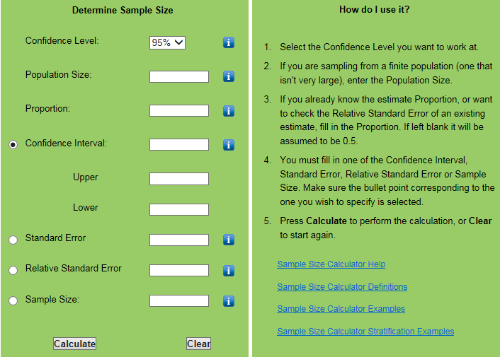
http://www.nss.gov.au/nss/home.nsf/pages/Sample+size+calculator
Notes:
http://www.nss.gov.au/nss/home.nsf/pages/Sample+size+calculator

Slide 95


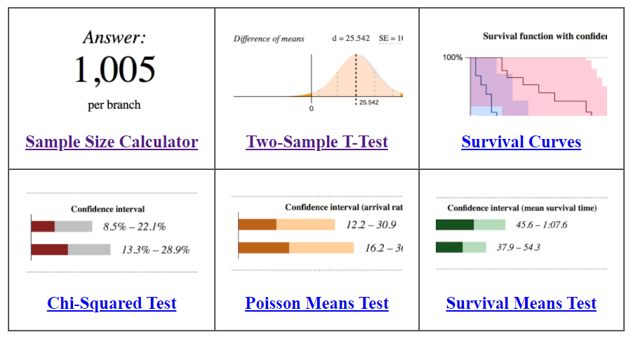
https://www.evanmiller.org/ab-testing/

Slide 96
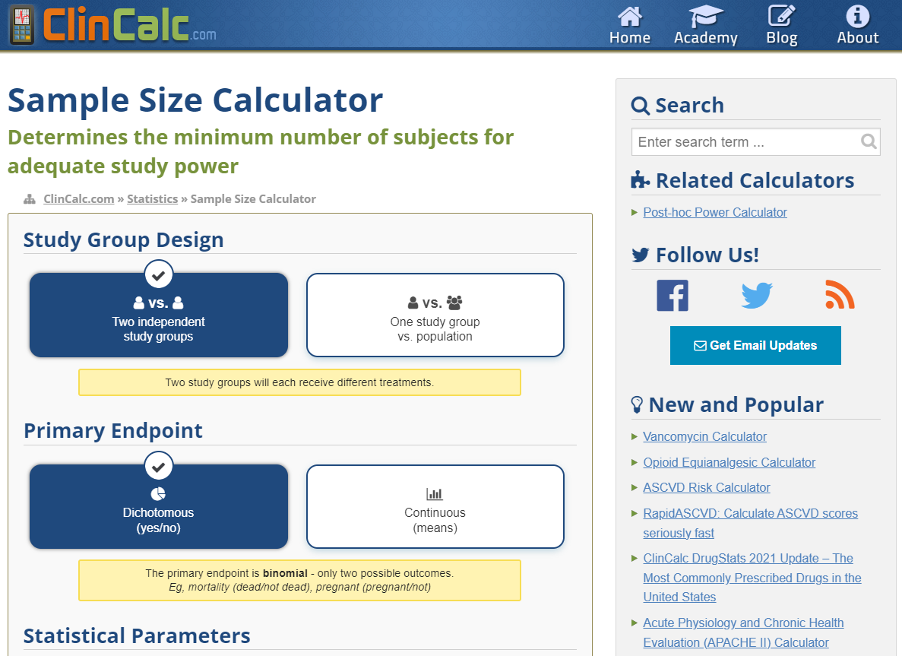
https://clincalc.com/stats/samplesize.aspx

Slide 97
Baseline determination
A4/3.5
Consider all important baseline variables to be measured and how they are to be measured before treatment starts:
  Demographic characteristics (age, sex, height, weight, etc),
  Known factors that predict the outcome (potential confounders),
  Factors that predict or alter the risk of adverse reactions,
  Stratification factors,
  Pre-specified subgroups.
Burgess DC, Gebski VJ, Keech AC. Baseline data in clinical trials.
Med J Aust. 2003 Jul 21;179(2):105-7.

Slide 98
Table of Baseline Data
A4/3.5
Table describing the characteristics of the intervention and control groups before the trial begins
Variables
  Demographics (age, gender, race, ethnicity, etc.)
  Lab Values
  Diagnoses
  Severity of illness scores (any risk factors for the primary outcome)
  Abnormal cut offs for values
  Combined values as needed for composite measures
  Comparison of the intervention and control groups

Slide 99
Any last questions?

