Slide 1
Statistical data analysis and research methods
BMI504
Course 16249 – Spring 2025
Class 6 – February 27, 2025
Introduction to data analysis of
quantitative and qualitative variables
Werner CEUSTERS

Slide 2
Keep in mind
Introduction: one page maximum!
Be specific:
  No “may”, “can”, “would”, …, but … I WILL DO …

Slide 3

https://plaingeets.medium.com/pet-peeves-1-the-usage-of-would-in-indian-english-e43c0c9594d

Slide 4
Steps in data analysis: this class
Specify the question you are asking.
Put the question in the form of a null hypothesis and alternative hypothesis.
Put the question in the form of a statistical null hypothesis and alternative hypothesis.
Determine which variables are relevant to the question.
Determine what kind of variable each one is.
Design an experiment that controls or randomizes the confounding variables.
Based on the number of variables, the kinds of variables, the expected fit to the parametric assumptions, and the hypothesis to be tested, choose the best statistical test to use.
If possible, do a power analysis to determine a good sample size for the experiment.
Do the experiment.
Examine the data to see if it meets the assumptions of the statistical test you chose. If it doesn't, choose a more appropriate test.
Apply the statistical test you chose, and interpret the results.
Communicate your results effectively, usually with a graph or table.
John H. McDonald. The Handbook of Biological Statistics ©. 2014. http://www.biostathandbook.com/

Slide 5
Steps in data analysis (1.1)
Specify the question you are asking:
  e.g.: Does physical exercise influences heart rate ?
  or ?

Slide 6
Steps in data analysis (1.1)
Specify the question you are asking:
  e.g.: Does physical exercise influences heart rate ?
  or ?
  Does physical exercise increases heart rate ?
  Does doing physical exercise influences heart rate while doing the exercise?
  Does doing regular physical exercise influences heart rate at rest?

Slide 7
Steps in data analysis (1.2)
Specify the question you are asking.
  Does doing physical exercise influences heart rate while doing the exercise?
Put the question in the form of a null hypothesis and alternative hypothesis:
  Null hypothesis:
  Alternative hypothesis:

Slide 8
Steps in data analysis (1.2)
Specify the question you are asking.
  Does doing physical exercise influences heart rate while doing the exercise?
Put the question in the form of a null hypothesis and alternative hypothesis:
  Null hypothesis:
    Physical exercise does not influence heart rate while doing the exercise.
  Alternative hypothesis:
    Physical exercise does influence heart rate while doing the exercise.

Slide 9
Steps in data analysis (1.3)
Specify the question you are asking.
  Does doing physical exercise influences heart rate while doing the exercise?
Put the question in the form of a null hypothesis and alternate hypothesis.
  Null hypothesis: Physical exercise does not influence heart rate while doing the exercise.
Put the question in the form of a statistical null hypothesis and alternative hypothesis.

Slide 10
Statistical hypothesis
A statistical hypothesis is an assumption about a ‘population parameter’, i.e. a measurable characteristic of a population, such as a mean or a standard deviation.
This assumption may or may not be true.
Hypothesis testing refers to the formal procedures used by statisticians to accept or reject statistical hypotheses.
The best way to determine whether a statistical hypothesis is true:
  Examine the entire population, or
  Examine a random sample from the population.
    If sample data are not consistent with the statistical hypothesis, the hypothesis is rejected.
http://stattrek.com/hypothesis-test/hypothesis-testing.aspx

Slide 11
Two types of statistical hypotheses
A3/3.2-3.3
Statistical null hypothesis.
  the hypothesis that sample observations result purely from chance;
  notation: H₀
Statistical alternative hypothesis.
  the hypothesis that sample observations are influenced by some non-random cause;
  notation: H₁ or H_{a}.
http://stattrek.com/hypothesis-test/hypothesis-testing.aspx

Slide 12
Steps in data analysis (1.3)
Specify the question you are asking.
  Does doing physical exercise influences heart rate while doing the exercise?
Put the question in the form of a null hypothesis and alternate hypothesis.
  Null hypothesis: Physical exercise does not influence heart rate while doing the exercise.
Put the question in the form of a statistical null hypothesis and alternative hypothesis.
  Statistical null hypothesis:

Slide 13
Steps in data analysis (1.3)
Specify the question you are asking.
  Does doing physical exercise influences heart rate while doing the exercise?
Put the question in the form of a null hypothesis and alternate hypothesis.
  Null hypothesis: Physical exercise does not influence heart rate while doing the exercise.
Put the question in the form of a statistical null hypothesis and alternative hypothesis.
  Statistical null hypothesis: the average heart rate observed in a sample of individuals working out is the same as in a sample of individuals being at rest.
→ PICOTT population and comparison facets !!!

Slide 14
Steps in data analysis (1.3)
Specify the question you are asking.
  Does doing physical exercise influences heart rate while doing the exercise?
Put the question in the form of a null hypothesis and alternate hypothesis.
  Null hypothesis: Physical exercise does not influence heart rate while doing the exercise.
Put the question in the form of a statistical null hypothesis and alternative hypothesis.
  Statistical null hypothesis: the average heart rate observed in … ?
increases
increase

Slide 15
Steps in data analysis (1.3)
Specify the question you are asking.
  Does doing physical exercise influences heart rate while doing the exercise?
Put the question in the form of a null hypothesis and alternate hypothesis.
  Null hypothesis: Physical exercise does not influence heart rate while doing the exercise.
Put the question in the form of a statistical null hypothesis and alternative hypothesis.
  Statistical null hypothesis: the average heart rate observed in a sample of individuals working out is the same as in a sample of individuals being at rest.
?

Slide 16
Remember ontology: what is out there ?
portions of reality
relations
configurations
participation
me participating in my life
universals
entities
particulars
continuants
occurrents
me
my life
organism

Slide 17

Data and Reality
Referents
Window on reality
References
?
?
?
  ‘Average heart rate’

Slide 18
Steps in data analysis (1.4)
Specify the question you are asking.
  Does doing physical exercise influences heart rate while doing the exercise?
Put the question in the form of a null hypothesis and alternate hypothesis.
  Null hypothesis: Physical exercise does not influence heart rate while doing the exercise.
Put the question in the form of a statistical null hypothesis and alternative hypothesis.
  Statistical null hypothesis: the average heart rate observed in a sample of individuals working out is the same as in a sample of individuals being at rest.
Determine which variables are relevant to the question.

Slide 19
Remember …
‘Perspective’
  A Cognitive Representation resulting from an interpretive process driven by relatively systematic observations of a Portion of Reality (PoR).
‘Concept’
  A perspective drawn from observing a number of PoRs in a relatively similar, comparable and standardized way.
‘Construct’
  A perspective built from the logical combination of a number of concepts.

Slide 20
Pre-defined perspectives
Perspective label:
  Short term that functions as a name to identify the perspective in communications about the research.
Theoretical definition:
  Description that specifies what sort of PoR the defining researcher carved out through the perspective.
Operational definition:
  Description intended to allow other researchers
    (a) to observe (in case of concepts) the intended PoRs from the very same perspective objectively or,
    (b) to build (in case of constructs) the perspective in exactly the same way as intended.
Adapted from: James H. Watt and Sjef van den Berg. Research Methods For Communication Science. 2002
http://www.cios.org/readbook/rmcs/rmcs.htm

Slide 21
Steps in data analysis (1.4)
Research question: Does doing physical exercise influences heart rate while doing the exercise?
Null hypothesis: Physical exercise does not influence heart rate while doing the exercise.
Statistical null hypothesis: the average heart rate observed in a sample of individuals working out is the same as in a sample of individuals being at rest.
Relevant variables:

Slide 22
Steps in data analysis (1.4)
Research question: Does doing physical exercise influences heart rate while doing the exercise?
Null hypothesis: Physical exercise does not influence heart rate while doing the exercise.
Statistical null hypothesis: the average heart rate observed in a sample of individuals working out is the same as in a sample of individuals being at rest.
Relevant variables: ‘heart rate’, ‘physical exercise’

Slide 23
Steps in data analysis (1.5)
Research question: Does doing physical exercise influences heart rate while doing the exercise?
Null hypothesis: Physical exercise does not influence heart rate while doing the exercise.
Statistical null hypothesis: the average heart rate observed in a sample of individuals working out is the same as in a sample of individuals being at rest.
Relevant variables: ‘heart rate’, ‘physical exercise’.
Determine what kind of variable each one is.

Slide 24
Kinds of variables
A3/3.4-A4/3.5
Can be classified along several axes, but most importantly:
  Dependent versus independent,
  Level of measurement,
  Discrete or continuous.

Slide 25
Variables & level of measurement
A3/3.4-A4/3.5
Nominal (=categorical):
    e.g.: shape = round, square, oval, …
    Only comparison is (in)equality,
    Special type: binary.
Ordinal (=rank):
    Ranking order between values,
    e.g.: like most, like somewhat, neutral, dislike somewhat, …
Interval:
    Ranked with equal distance between values,
    Null-point is arbitrary.
    e.g.: temperature in Celsius or Fahrenheit.
Ratio:
    Ratios between pairs of values are meaningful,
    Absolute null-point.
    e.g.: temperature in Kelvin.

Slide 26
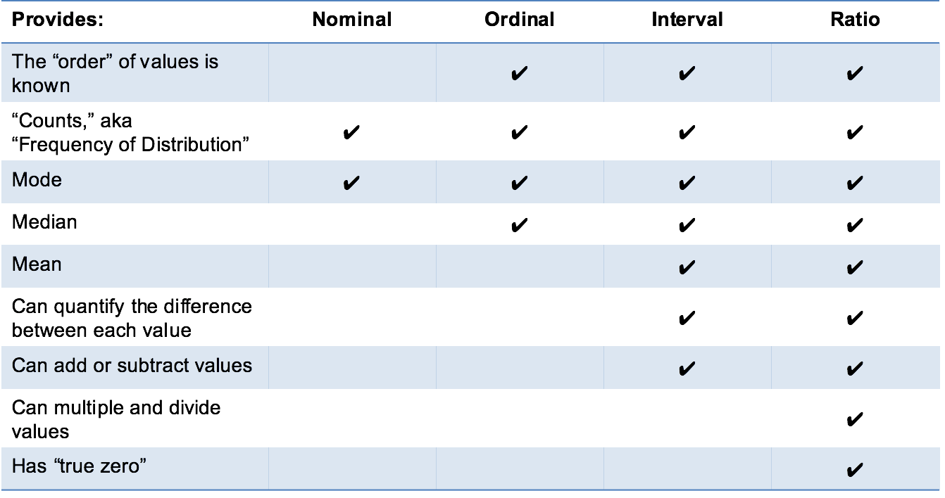
Levels of measurement
A3/3.4-A4/3.5
A3/3.2-3.3
http://www.mymarketresearchmethods.com/types-of-data-nominal-ordinal-interval-ratio/

Slide 27
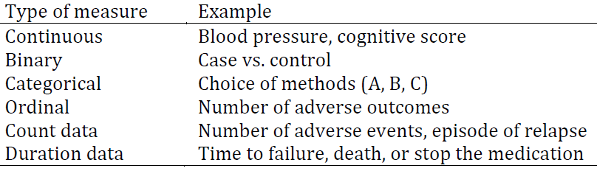
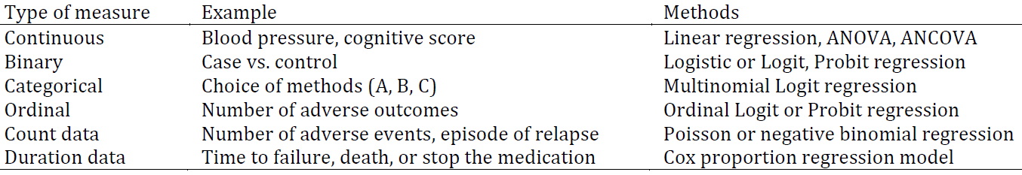
Data types and statistical analysis (preview)
Zhang F and Hughes C. Reporting standards for clinical and translational research. Glob Clin Transl Res. 2019; 1(2): 69-73

Slide 28
Time ?

Slide 29
Time
Nominal:
  AM versus PM (binary)
Ordinal:
  Night – dawn – morning – noon – afternoon – dusk
Interval:
  12 AM, 1 AM, 2AM, …
Ratio:
  Take 12AM as absolute zero .

Slide 30
Which one to select?

Slide 31
Pre-defined perspectives
Perspective label:
  Short term that functions as a name to identify the perspective in communications about the research.
Theoretical definition:
  Description that specifies what sort of PoR the defining researcher carved out through the perspective.
Operational definition:
  Description intended to allow other researchers
    (a) to observe (in case of concepts) the intended PoRs from the very same perspective objectively or,
    (b) to build (in case of constructs) the perspective in exactly the same way as intended.
Adapted from: James H. Watt and Sjef van den Berg. Research Methods For Communication Science. 2002
http://www.cios.org/readbook/rmcs/rmcs.htm

Slide 32
Requirements for operational definitions
A3/3.4-A4/3.5
Must contain instructions as precisely as possible for observations/calculations to be done repeatably and objectively;
Must specify:
  how observations are to be done, and calculations or logical combinations to be performed,
  units of measurements,
  level of measurement:
    categorical , … ?
Correspondence between theoretical and operational definition establishes the validity of the measurements.
Adapted from: James H. Watt and Sjef van den Berg. Research Methods For Communication Science. 2002
http://www.cios.org/readbook/rmcs/rmcs.htm

Slide 33
Example
A3/3.4-A4/3.5
Variable: SPPC
Label: Satisfaction with Primary Physician Communication
Theoretical definition: extent to which the subject is satisfied with the communication with his primary physician.
Operational definition 1 (nominal level of measurement)
    Response to the question: Do you feel that most of the time your communication with your primary physician is satisfactory?
    (a) YES or (b) NO
Operational definition 2 (ordinal level of measurement)
    Response to the question: Do you feel that most of the time your communication with your primary physician is:
    (a) very satisfactory (d) somewhat unsatisfactory
    (b) somewhat satisfactory (e) very unsatisfactory
    (c) neither
Adapted from: James H. Watt and Sjef van den Berg. Research Methods For Communication Science. 2002 http://www.cios.org/readbook/rmcs/rmcs.htm

Slide 34
Example
Variable: SPPC
Label: Satisfaction with Primary Physician Communication
Theoretical definition: extend to which the subject is satisfied with the communication with his primary physician.
Operational definition 1 (nominal level of measurement)
    Response to the question: Do you feel that most of the time your communication with your primary physician is satisfactory?
    (a) YES or (b) NO
Operational definition 2 (ordinal level of measurement)
    Response to the question: Do you feel that most of the time your communication with your primary physician is:
    (a) very satisfactory (d) somewhat unsatisfactory
    (b) somewhat satisfactory (e) very unsatisfactory
    (c) neither
exhibits variation in
values
Adapted from: James H. Watt and Sjef van den Berg. Research Methods For Communication Science. 2002. http://www.cios.org/readbook/rmcs/rmcs.htm

Slide 35
For your surveys (Q/I/F)
Provide THREE questions,
each one resulting in one variable,
each variable being of a distinct measurement type (nominal, …)
each variable described in the format provided in the proposal skeleton document.

Slide 36
Relationship with reality
Referents
Window on reality
References
  Portions of Reality ‘in focus’
  unit of analysis
  Perspective
  Label
  Definitions:
  Variable
  Values
  Face validity
  Theoretical
  definition
  Operational
  definition
  Measurement validity
Adapted from: James H. Watt and Sjef van den Berg. Research Methods For Communication Science. 2002
http://www.cios.org/readbook/rmcs/rmcs.htm

Slide 37
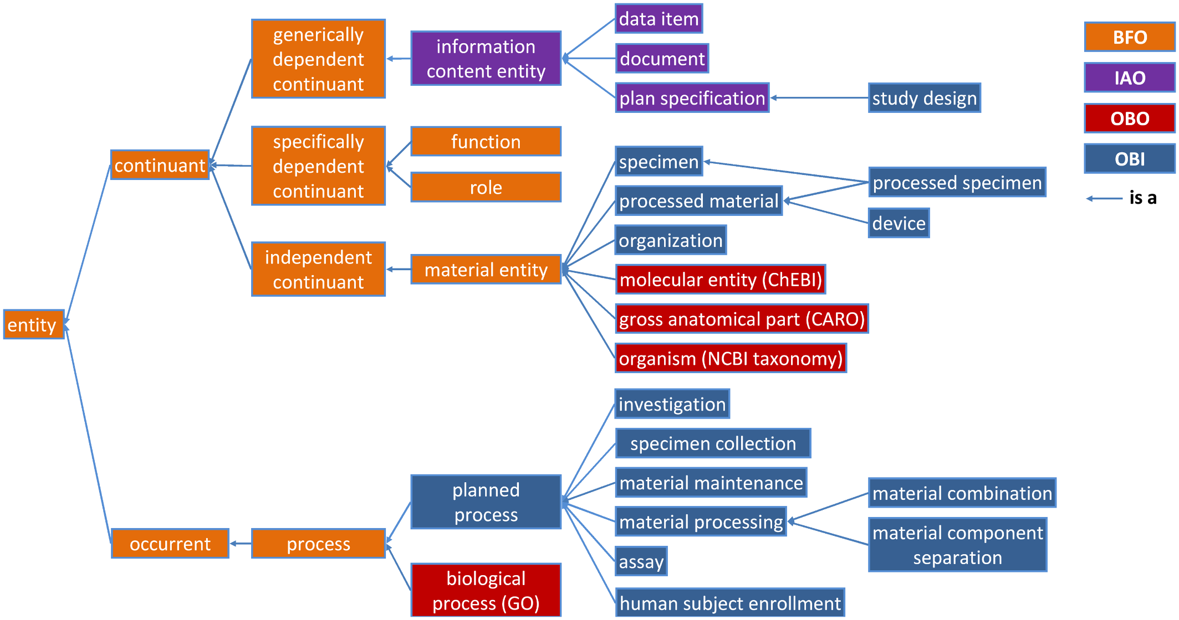
Operational definition IsA …?
A. Bandrowski et. Al. The Ontology for Biomedical Investigations. PlosOne. 2016. http://dx.doi.org/10.1371/journal.pone.0154556.g001

Slide 38
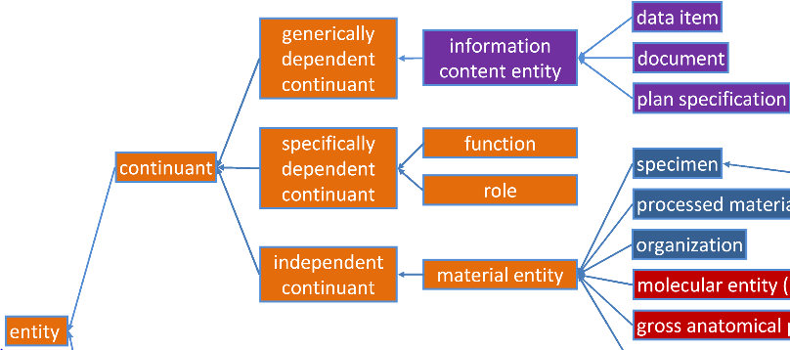
Operational definition IsA …?
Operational Definition

Slide 39
‘Interview age’ ?

Slide 40
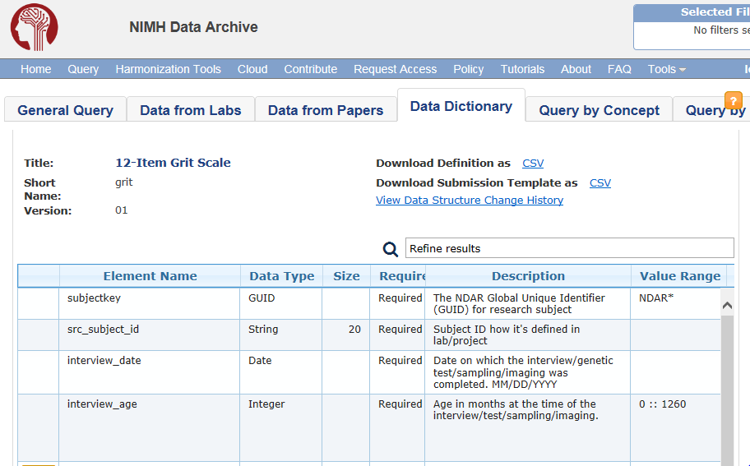
‘Interview age’ ?
https://ndar.nih.gov/data_structure.html?short_name=grit01

Slide 41
‘Interview age’ under the Grit perspective
Label: interview age
Theoretical definition (?):
    Age in months at the time of the interview / test / sampling / imaging.
Operational definition (?):
    Age is rounded to chronological month. If the research participant is 15-days-old at time of interview, the appropriate value would be 0 months. If the participant is 16-days-old, the value would be 1 month.
    Range: 0 -1260 [0 – 105 years]
https://ndar.nih.gov/data_structure.html?short_name=grit01

Slide 42
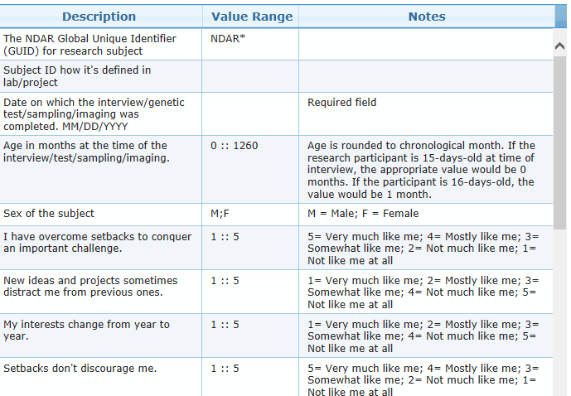
https://ndar.nih.gov/data_structure.html?short_name=grit01

Slide 43
Steps in data analysis (1.5)
Research question: Does doing physical exercise influences heart rate while doing the exercise?
Null hypothesis: Physical exercise does not influence heart rate while doing the exercise.
Statistical null hypothesis: the average heart rate observed in a sample of individuals working out is the same as in a sample of individuals being at rest.
Relevant variables: ‘heart rate’, ‘physical exercise’.
Determine what kind of variable each one is:

Slide 44
Steps in data analysis (1.5)
Research question: Does doing physical exercise influences heart rate while doing the exercise?
Null hypothesis: Physical exercise does not influence heart rate while doing the exercise.
Statistical null hypothesis: the average heart rate observed in a sample of individuals working out is the same as in a sample of individuals being at rest.
Relevant variables: ‘heart rate’, ‘physical exercise’.
Determine what kind of variable each one is:
  heart rate: ratio
  physical exercise: ???

Slide 45
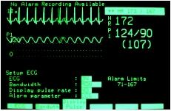
Operational definition for ‘heart rate’
Variable: HR
Label: Heart rate
Operational definition: (interval level of measurement)
    Heart rate of a subject connected to a heart rate monitor as displayed on that monitor at a specific moment in time.
    Values: integers
http://www.surgeryencyclopedia.com/A-Ce/Cardiac-Monitor.html

Slide 46
Operational definition for ‘physical exercise’
Variable: PE
Label: Physical exercise
Operational definition: (interval level of measurement)
    Level of resistance at which the elliptical on which the subject is running is set at a specific moment in time.
    Values: integers

Slide 47
Steps in data analysis (1.6)
Research question: Does doing physical exercise influences heart rate while doing the exercise?
Null hypothesis: Physical exercise does not influence heart rate while doing the exercise.
Statistical null hypothesis: the average heart rate observed in a sample of individuals working out is the same as in a sample of individuals being at rest.
Relevant variables: ‘heart rate’, ‘physical exercise’.
Determine what kind of variable each one is:
  heart rate: ratio
  physical exercise: ???
‘Design an experiment that controls or randomizes the confounding variables’.

Slide 48
Relationships between variables
No relationship:
  ‘person length’ ‘body temperature’
Covariance relationship:
    a change in one variable is associated with a change in another variable (in whatever way)
    ‘person length’ ‘person mass’
Causal relationship:
    a change in one variable brings about a change in another variable (in whatever way)
    ‘physical exercise’ ‘heart rate’
    cause / independent variable effect / dependent variable
+
+/-

Slide 49
Experiment
Non-experimental design:
  compare people who signed up for a program vs. people who did not sign up for any program.
  people who sign up may be different from those who don’t sign up.
Experimental design:
  Researcher randomly assigns people with alcoholism to treatment or no treatment
  Determination of cause and effect variable.

Slide 50
Remember the definition of ‘research’

Slide 51
Remember the definition of ‘research’
keywords
careful or diligent search
studious inquiry or examination; especially :
investigation or experimentation
aimed at
- the discovery and interpretation of facts,
- revision of accepted theories or laws in the light of new facts,
- or practical application of such new or revised theories or laws
the collecting of information about a particular subject
http://www.merriam-webster.com/dictionary/research

Slide 52
‘Scientific Laws’: a matter of relationships
Referents
Window on reality
References
  Portions of Reality
  ‘in focus’
  Perspective
  Variable
  Values
  How are these
  related?
  ‘Physical
  Exercise’
  ‘Heart rate’
  Working out
  Heart rate
  Relationship in reality (‘a priori relationship’)
  Relationships between variables

Slide 53
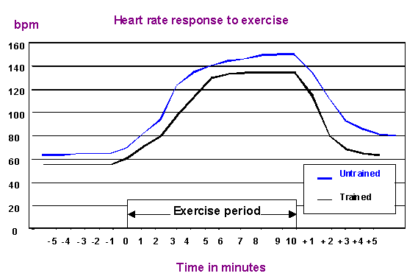
Heart rate during exercise trained/untrained
http://the-cardiorespiratory-system.weebly.com/heart-rate.html

Slide 54
Remember: steps in data analysis (1.3)
Specify the question you are asking.
  Does doing physical exercise influences heart rate while doing the exercise?
Put the question in the form of a null hypothesis and alternate hypothesis.
  Null hypothesis: Physical exercise does not influence heart rate while doing the exercise.
Put the question in the form of a statistical null hypothesis and alternative hypothesis.
  Statistical null hypothesis: the average heart rate observed in a sample of individuals working out is the same as in a sample of individuals being at rest.
If you fail to reject a statistical null hypothesis, is that enough evidence for the null hypothesis to be true?

Slide 55
Framing the research question
Two general strategies:
hypothesis testing:
  researchers construct a null hypothesis (“no effect” or “no difference”) and an alternative hypothesis;
  evidence is sought to disprove the null and/or support the alternative hypothesis.
Estimation:
  Compute differences in some outcome for two different events with appropriate precision;
  Appropriate precision is measured by the width of a confidence interval of the difference between the outcomes in the two groups.
Evans SR. Fundamentals of clinical trial design.
Journal of experimental stroke & translational medicine. 2010;3(1):19-27.

Slide 56
Specific strategy: PICO(TT) Framework
P | Patient Population of patients Problem | What is the best way to briefly describe this patient population or situation? E.g. pregnant women over 40 with preeclampsia, adolescent boys 13-15, etc.
I | Intervention (therapy or test) | What is the intervention? E.g. a drug, a questionnaire, a test, a procedure, etc.
C | Comparison | Is there an alternative intervention to compare to? E.g. placebo, current standard of care, another therapy, etc.
O | Outcome | Include specific patient-oriented outcomes E.g. morbidity, quality of life, etc.
T | Time for completion | Used to identify the time/duration for your data collection or for assessing your outcome. I.e. how long before you are to see that the intervention is having a positive impact OR the time in which the intervention will be delivered
T | Type of study | What is the ideal study design to answer this question? What type of study design do you realistically anticipate finding? E.g. randomized-controlled trial, systematic reviews, etc.

Slide 57
Evidence Based Medicine question types
Intervention/Therapy
Etiology
Diagnosis
Prognosis/Prediction
Meaning
https://www.aaacn.org/sites/default/files/documents/misc-docs/1e_PICOT_Questions_template.pdf

Slide 58
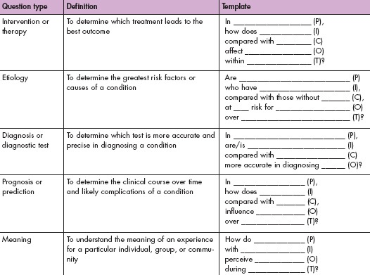
https://www.aaacn.org/sites/default/files/documents/misc-docs/1e_PICOT_Questions_template.pdf

Slide 59
Observed relationships and reality
Referents
Window on reality
References
Physical exercise
‘Physical
exercise’
+
Heart
efficiency
+
+
-
Heart rate
under effort
+
Heart rate
at rest
‘Heart rate’

Slide 60
Observed relationships and reality
Referents
Window on reality
References
Physical exercise
‘Physical
exercise’
+
Heart
efficiency
theory
+
+
-
Heart rate
under effort
+
Heart rate
at rest
‘Heart rate’

Slide 61

Observed relationships and reality
Referents
Window on reality
References
Physical exercise
‘Physical
exercise’
+
Heart
efficiency
theory
+
+
-
Heart rate
under effort
+
Heart rate
at rest
‘Heart rate’

Slide 62
Observed relationships and reality
Referents
Window on reality
References
The lesser preselection of tested relationships, the less likely research results are true.

Slide 63
What else from is relevant here?
Studies are less likely true when there is greater flexibility in designs, definitions, outcomes and analytical modes
http://the-cardiorespiratory-system.weebly.com/heart-rate.html

Slide 64
Requirements for causal relationships
Spatiotemporal contiguity:
    variables must be observed within units of analysis.
Adapted from: James H. Watt and Sjef van den Berg. Research Methods For Communication Science. 2002
http://www.cios.org/readbook/rmcs/rmcs.htm

Slide 65
Requirements for causal relationships
Spatiotemporal contiguity:
    variables must be observed within units of analysis.
    The units of analysis within which effort intensity and heart rate are observed are …
    specific human beings (or animals)

Slide 66
Requirements for causal relationships
Spatiotemporal contiguity:
    variables must be observed within units of analysis.
Covariance:
    the values of two variables must shift together in some systematic way.
Adapted from: James H. Watt and Sjef van den Berg. Research Methods For Communication Science. 2002
http://www.cios.org/readbook/rmcs/rmcs.htm

Slide 67
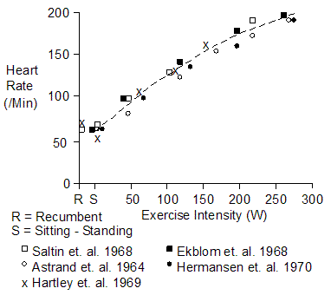
Requirements for causal relationships
Spatiotemporal contiguity:
    variables must be observed within units of analysis.
Covariance:
    the values of two variables must shift together in some systematic way.
Ekblom, B. P.-O. Åstrand, B. Saltin, J. Stenberg and B. Wallström. Effect of training on circulatory response to exercise. J. Appl. Physiol. 24:518-528, 1968.
Adapted from: James H. Watt and Sjef van den Berg. Research Methods For Communication Science. 2002
http://www.cios.org/readbook/rmcs/rmcs.htm

Slide 68
Requirements for causal relationships
Spatiotemporal contiguity:
    variables must be observed within units of analysis.
Covariance:
    the values of two variables must shift together in some systematic way.
Temporal ordering:
    a change in the cause variable must happen before the related change in the effect variable.
Necessary connection:
    A statement – the ‘theoretical linkage’ or ‘theoretical rationale’ - providing the justification for the posited causation within the theory.
Adapted from: James H. Watt and Sjef van den Berg. Research Methods For Communication Science. 2002
http://www.cios.org/readbook/rmcs/rmcs.htm

Slide 69
Be aware
Your hypothes(i)(e)s must reflect your research question(s)
Your hypothes(i)(e)s must:
  be expressed explicitly in terms of a causal relationship
  be motivated for why you assume such relationship
All your variables must be motivated and described in relation to the research questions, including ‘intermediate variables’ specified in your theory (theoretical linkage)
The set of your variables is the minimal set required to be able to accept/reject the null hypothesis.

Slide 70
‘Theoretical definition’ and
‘Theoretical linkage’
A3/3.2-3.3
The ‘theoretical definition’:
  Is a …

Slide 71
‘Theoretical definition’ and
‘Theoretical linkage’
A3/3.2-3.3
The ‘theoretical definition’:
  is a … description that specifies what sort of PoR the defining researcher carved out through the perspective.
  explains the nature of a PoR observed through a perspective.
The ‘theoretical linkage’:
  provides the justification for the posited causation within the theory;
  explains, as the product of a rational process, the nature of a relationship between two concepts/ constructs.

Slide 72
Warning !!!
DO NOT COPY JUST THIS LITTLE GRAPH AND REPLACE THE TERMS WITH SOME OF YOUR VARIABLES!!!
THE GRAPH NEEDS TO INCLUDE ALL VARIABLES THAT MAKE YOUR THEORY BELIEVABLE.

Slide 73
Variables in your proposal
Input V.
Independent V.
Theory supporting Variables
(including bias)
Output V.
Dependent V.
measured
Pre-established or
hypothesized and not measurable
measured
Theoretical Linkage

Slide 74
‘Operational Linkage’
A3/3.2-3.3
The operational linkage provides the means of testing the probable truth or falsity of the corresponding relationship between variables.
This distinguishes a scientific relationship, which must be shown to be true in the “measurement world” of observations, from an “a priori” relationship.
The operational linkage allows us to determine objectively if two concepts/constructs covary, by telling us how measured changes in one variable should be associated with measured changes in the other.
By determining if the two variables covary in the way described by the operational linkage, we can test the probable truth of the scientific relationship.
Adapted from: James H. Watt and Sjef van den Berg. Research Methods For Communication Science. 2002
http://www.cios.org/readbook/rmcs/rmcs.htm

Slide 75
Observed relationships and reality
Referents
Window on reality
References
Physical exercise
Hypothesis
‘Physical
exercise’
+
Heart
efficiency
Theoretical linkage
+
+
-
Operational linkage
Heart rate
under effort
+
Heart rate
at rest
‘Heart rate’

Slide 76
Be aware
For each of your hypothes(e)(i)s, you MUSTprovide:
The corresponding theoretical definition of each variable
The theoretical linkage
The operational linkage
Each one of them in a concise description which contains the relevant necessary and sufficient information about the role of the variables described in detail.

Slide 77
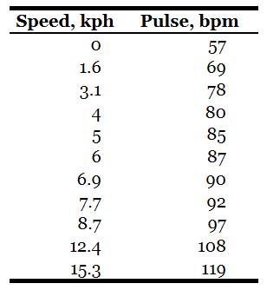
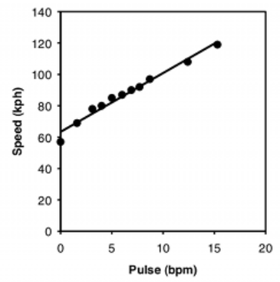
‘Operational Linkage’
http://www.biostathandbook.com/linearregression.html
This operational linkage tells us that a linear, positive relationship will be observed between the speed at which a person runs on an elliptical and the heart rate: as speed increases, heart rate will increase at a steady rate.
Adapted from: James H. Watt and Sjef van den Berg. Research Methods For Communication Science. 2002
http://www.cios.org/readbook/rmcs/rmcs.htm

Slide 78
From operational linkage to hypothesis
The operational linkage predicts the way in which the measured variables should behave. Its test of truth goes beyond simple logical deduction, and must include observation (previous studies) of the real world.
The vehicles for this observation are the operational definitions of variables in the “measurement world.”
We derive hypotheses from the operational linkages.
Hypotheses are verbal statements that specify how the variables, as defined by operational definitions, should be associated with one another if the theoretical linkage is, in fact, correct.
If they don’t do so, they should be revised!

