Slide 1
Statistical data analysis and research methods
BMI504
Course 16249 – Spring 2025
Qualitative Research Methods:
theory and data collection methods
Werner CEUSTERS

Slide 2
C8. Qualitative research methods: theory and data collection methods
Class structure:
  lecture on common qualitative data collection methods (Document Review, Observation, Interview (face-to-face), Focus Group Discussion, Ethnography,…)
  Time permitting: discussion of the research proposals in light of a).
Post-class assignments:
  R7 Delgado-Rodriguez, M. and J. Llorca, Bias. J Epidemiol Community Health, 2004. 58(8): p. 635-41.
    https://jech.bmj.com/content/58/8/635 [7]
  SUGGESTED: A3: Complete the sections marked ‘A3’ in the ProposalSkeleton2025 document. Preferred submission date: March 24 – noon.

Slide 3
Qualitative Research (QLR) Methods (QLRM)
Data Collection Methods
A3/3.3 – 3.4 – 3.6
A4/3.5

Slide 4
Quantitative research (QNR)
In natural sciences and social sciences, quantitative research is the systematic empirical investigation of observable phenomena via statistical, mathematical or computational techniques.
https://en.wikipedia.org/wiki/Quantitative_research
Qualitative research (QLR)
Qualitative Research is primarily exploratory research used to gain an understanding of underlying reasons, opinions, and motivations. It provides insights into the problem or helps to develop ideas or hypotheses for potential quantitative research.
http://www.snapsurveys.com/blog/what-is-the-difference-between-qualitative-research-and-quantitative-research/

Slide 5
Types of Data Collection in QLRM
Questionnaire
Interviews
Focus groups
Observations
(Data) extraction
Secondary data sources
Ethnography
MC. Harrell & MA. Bradley. Data Collection Methods: Semi-Structured Interviews and Focus Groups. RAND Corporation 2009. http://www.rand.org/pubs/technical_reports/TR718.html

Slide 6
Types of Data Collection in QLRM
Questionnaire
Interviews
Focus groups
Observations
(Data) extraction
Secondary data sources
Ethnography
Which one happens always in QLR?
MC. Harrell & MA. Bradley. Data Collection Methods: Semi-Structured Interviews and Focus Groups. RAND Corporation 2009. http://www.rand.org/pubs/technical_reports/TR718.html

Slide 7
Types of Data Collection in QLRM
Questionnaire = document
Interviews produce document
Focus groups produce document
Observations produce document
(Data) extraction
Secondary data sources = document
Ethnography produce document
MC. Harrell & MA. Bradley. Data Collection Methods: Semi-Structured Interviews and Focus Groups. RAND Corporation 2009. http://www.rand.org/pubs/technical_reports/TR718.html

Slide 8
Types of Data Collection in QLRM
}
Questionnaire
Interviews ‘surveys’
Focus groups
Observations
(Data) extraction
Secondary data sources
Ethnography
MC. Harrell & MA. Bradley. Data Collection Methods: Semi-Structured Interviews and Focus Groups. RAND Corporation 2009. http://www.rand.org/pubs/technical_reports/TR718.html

Slide 9
Survey
Is a method of gathering information — via electronic communication platforms, telephone or in-person — from a group of individuals, which often make up just a fraction of the population being studied;
  Compare with a census in which all members of some population are studied;
Is directed toward a specific administrative, commercial or scientific purpose;
Involves asking questions in order to obtain the desired information.

Slide 10
Survey Goals
Collect descriptive data about:
  attitudes or values in one or more groups,
  common practices in one or more groups,
  by asking questions to group members, NOT merely through observations or participation.
May be used to:
  describe elements of a specific group and possibly,
  generalize to a larger population.
May study relationships between/among variables.

Slide 11
Types of Data Collection in QRM
Questionnaire
Interviews
Focus groups
Observation
(Data) extraction
Secondary data sources
Ethnography
fixed sets of questions delivery methods:
  ‘paper and pencil’
  web form,
  by an interviewer who follows a strict script.
MC. Harrell & MA. Bradley. Data Collection Methods: Semi-Structured Interviews and Focus Groups. RAND Corporation 2009. http://www.rand.org/pubs/technical_reports/TR718.html

Slide 12
Steps for questionnaire-based surveys
A3/3.1
Write out the primary and secondary aims of the survey.
Identify the data elements to be collected relating to these aims.
Review the current literature to identify already validated questionnaires that use these or similar data elements.
Compose a draft of the questionnaire.
Solicit some advice on the draft and adjust accordingly.
Test it out in a small sample and adjust again.
Finalize and roll out.
If your research proposal requires or includes a questionnaire as data collection method, I want to see these steps concretely worked out in the proposal!!!

Slide 13
Distribution and roll out
On its own:
  mailings (usually with follow-up),
  email (usually with follow-up),
  telephone,
  online.
As starter in:
  structured interviews,
  focus groups.

Slide 14
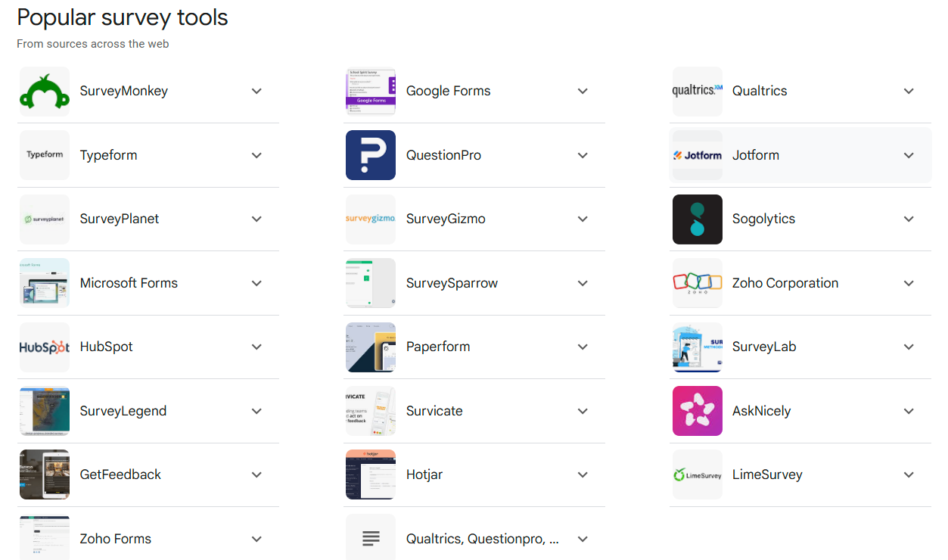
Web surveys, anything more popular?
https://www.google.com/search?q=online+survey+tools+for+research

Slide 15
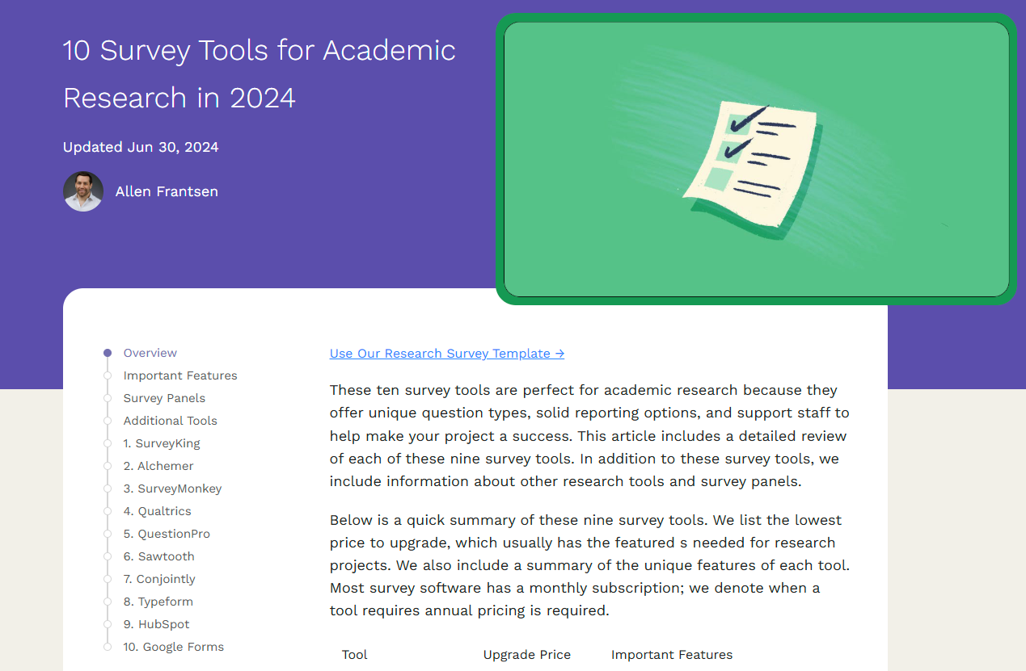
https://www.surveyking.com/blog/survey-tools-for-academic-research/

Slide 16
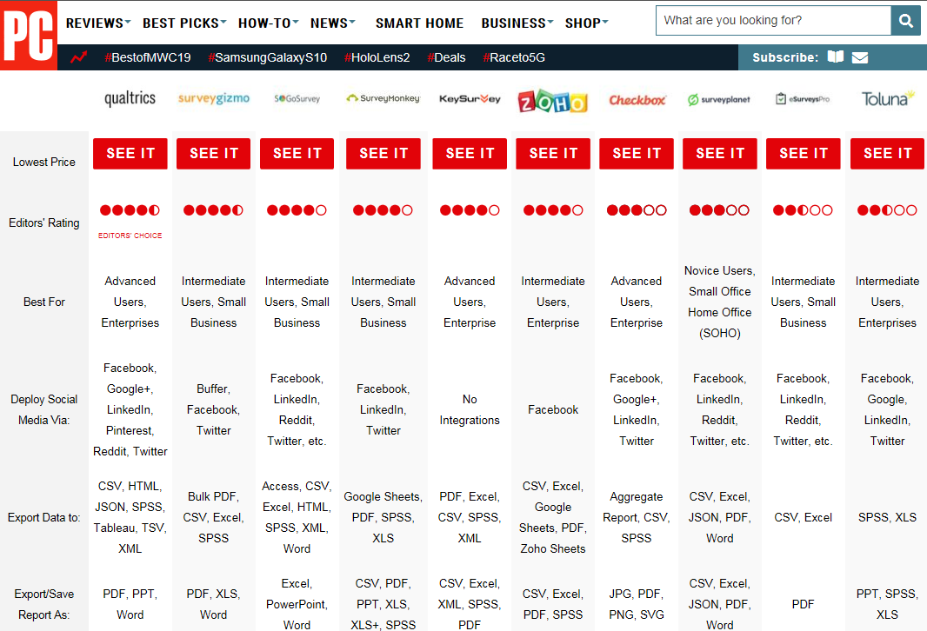
https://www.pcmag.com/roundup/339397/the-best-online-survey-tools

Slide 17
Questionnaire characteristics
Pre-determined set of questions.
All questions to be answered by all respondents where relevant.

Slide 18
Pros and cons of questionnaires
Advantages:
good for gathering descriptive data,
can cover a wide range of topics,
are relatively inexpensive to use,
may provide anonymity,
can be analyzed using a variety of existing software.
Disadvantages:
Self-report may lead to biased reporting;
Data may provide a general picture but lack depth;
May not provide adequate information on context.
NSF. The 2002 User Friendly Handbook for Project Evaluation. Section III - An Overview of Quantitative and Qualitative Data Collection Methods. https://www.nsf.gov/pubs/2002/nsf02057/nsf02057_4.pdf

Slide 19
Good Questionnaires
Goal is to collect information that is:
Valid:
Reliable:
Unbiased:
Discriminating:

Slide 20
Good Questionnaires
A3/3.4
Goal is to collect information that is:
Valid: measures the quantity or concept that is supposed to be measured.
Reliable: measures the quantity or concept in a consistent or reproducible manner.
Unbiased: measures the quantity or concept in a way that does not systematically under- or overestimate the true value.
Discriminating: can distinguish adequately between respondents for whom the underlying level of the quantity or concept is different.
If your research proposal requires or includes a questionnaire, I want to read in your proposal your arguments for WHY you believe the data collected will be valid, reliable, … !!!

Slide 21
Good Questions
Should be:
  focused on a single topic or issue,
  brief,
  grammatically simple,
  unambiguous.
Should not:
  lead respondents to a particular answer,
  use loaded wording or phrasing (e.g. be judgmental),
  be double barreled -having two possible responses,
  use dramatic expressions or overstatements absolutes and extremes (never, best, ever, …).

Slide 22
Questions (generally) to be avoided
Double-barreled:
    two questions in one;
Leading:
    Suggest answers in a certain direction;
Use of double negatives;
Use unfamiliar jargon or technical terms;
Vague questions;
Use of emotional language;
Questions beyond the respondent’s capability to answer.
MC. Harrell & MA. Bradley. Data Collection Methods: Semi-Structured Interviews and Focus Groups. RAND Corporation 2009. http://www.rand.org/pubs/technical_reports/TR718.html

Slide 23
Closed questions
Respondent selects from among several choices
Example - simple structure (dichotomous response)
  “Are you currently practicing physical therapy?”
    a. Yes
    b. No

Slide 24
Rating scale questions
Response over a continuum
  “How important do you feel clinical research is to the practice of physical therapy?”
    a. Very important
    b. Important
    c. Somewhat important
    d. Not important
    e. Not sure

Slide 25
Rating scale requirements
It should be easy to interpret the meaning of each scale point.
The meaning of scale points should be interpreted identically by all respondents.
The scale should give enough points to differentiate respondents from one another as much as validly possible.
Responses to the survey rating scale should be reliable, meaning that if we give the same question again, each respondent should provide the same answer.
The scale’s points should map as closely as possible to the underlying idea (construct) of the scale.
If you use an existing validated rating scale, give lit. reference of the validation. If you create one, describe the concrete steps you will take to demonstrate validity and reliability (who, when, how, …) !!!
https://www.qualtrics.com/blog/three-tips-for-effectively-using-scale-point-questions/

Slide 26

Two major types
Main differences between the two rating scales below?
https://www.qualtrics.com/blog/three-tips-for-effectively-using-scale-point-questions/

Slide 27
Number of scale points
For constructs that range from positive to negative (bi-polar constructs): use a 1-7 point scale that includes a middle or neutral point.
For constructs that range from zero to positive (unipolar constructs): use a 1-5 point scale.
https://www.qualtrics.com/blog/three-tips-for-effectively-using-scale-point-questions/

Slide 28
Rank-order questions
The following are characteristics of a researcher. Please order them in terms of importance from 1 (most important) to 4 (least important).
    _____methodical
    _____careful
    _____persistent
    _____on-time

Slide 29
Branching questions
  1. Do you read a professional journal such as the Journal of American Informatics Association at least one time per month?
    A. No > Go to question 3.
    B. Yes
  2. How many hours do you spend reading this journal? _________
  3. ….

Slide 30
Open-ended questions
“Describe the characteristics that you feel are important to be an effective biomedical informaticist.”
_______________________________
_______________________________
Pros – may get information that was missed out while designing survey
Cons – respondent bias

Slide 31
Some types of open-ended questions
Hypothetical:
    If you get the chance to be a biomedical informaticist, do you think you can improve EHR designs?
Provocative:
    I have heard people saying machine learning is overrated-what do you think?
Ideal:
    In your opinion, what would be the best solution for eliminating the dangers of Artificial Intelligence?
Interpretative:
    What do you mean by ‘good’?
Adapted from:Joan LaFrance. Fundamentals of Qualitative Research. AIHEC NARCH Meeting DinѐCollege. June 25, 2015

Slide 32
Some types of open-ended questions
Hypothetical:
    If you get the chance to be a biomedical informaticist, do you think you can improve EHR designs?
Provocative:
    I have heard people saying machine learning is overrated-what do you think?
Ideal:
    In your opinion, what would be the best solution for eliminating the dangers of Artificial Intelligence?
Interpretative:
    What do you mean by ‘good’?
One of these questions has a serious problem. Which one and why?
Adapted from:Joan LaFrance. Fundamentals of Qualitative Research. AIHEC NARCH Meeting DinѐCollege. June 25, 2015

Slide 33
Other survey question types
Multiple choice questions
Constant sum survey questions
Matrix table questions
Visual analog scale questions
Image chooser questions
Data reference or uploader questions …

Slide 34
Avoiding Bias
Respondent bias occurs when a participant is unable or unwilling to provide accurate or honest answers to a survey.
Inability to provide correct answers because of unfamiliarity, respondent fatigue, faulty recall, question format, and question context.
Opt out choice in the question design - do not know, not sure etc,
Proper screening questions should be used to select the respondents who will be able to answer the question correctly.

Slide 35
Types of Data Collection in QRM
Questionnaire
Interviews
Focus groups
Observation
(Data) extraction
Secondary data sources
Ethnography
One-to-one discussions;
Focused on specific topics;
Dialogue evolves based on experience and knowledge of interviewee.
MC. Harrell & MA. Bradley. Data Collection Methods: Semi-Structured Interviews and Focus Groups. RAND Corporation 2009. http://www.rand.org/pubs/technical_reports/TR718.html

Slide 36
Some interview types
By purpose:
  Opinions, perceptions, attitudes, …, or
  Background knowledge, facts, experiences.
By level of control:
  Unstructured;
  Semi-structured:
    Interviewer has various facets of answers to questions in mind, but wants also to determine whether interviewee categorizes similarly;
  Structured:
    Specific questions with room for unanticipated perspectives.
MC. Harrell & MA. Bradley. Data Collection Methods: Semi-Structured Interviews and Focus Groups. RAND Corporation 2009. http://www.rand.org/pubs/technical_reports/TR718.html

Slide 37
Quintamensional method for semi-structured interviews
determines the intensity of a respondent’s opinions and attitudes with five steps that assess
  (1) the degree of awareness of an issue,
  (2) uninfluenced attitudes,
  (3) specific attitudes,
  (4) reasons for these attitudes, and
  (5) intensity of these attitudes.
MC. Harrell & MA. Bradley. Data Collection Methods: Semi-Structured Interviews and Focus Groups. RAND Corporation 2009. http://www.rand.org/pubs/technical_reports/TR718.html

Slide 38
Example
Can you name and describe some current methods and tools to develop biomedical ontologies?
What, if any, are characteristics in these methods and tools that contribute positively or negatively to the quality of these ontologies?
Do you approve or disapprove of some of the current methods and tools?
Why do you feel this way?
How strongly do you feel about this? Strongly, very strongly, something that you would not change your mind on?

Slide 39
Risks for bias in interviews
Bias A:
  the effects of the researcher on the interviewees;
    e.g. researcher poses a threat to the interviewees.
Bias B:
  the effects of the interviewees on the researcher;
    e.g. researcher ‘becomes native’, part of the interviewees.
AJ. Onwuegbuzie et.al. Innovative Data Collection Strategies in Qualitative Research. The Qualitative Report 2010;15(3):696-726.
http://www.nova.edu/ssss/QR/QR15-3/onwuegbuzie.pdf

Slide 40
Advantages of interviews
Usually yield richest data, details, new insights;
Permit face-to-face contact with respondents;
Provide opportunity to explore topics in depth;
Allow interviewer to experience the affective as well as cognitive aspects of responses;
Allow interviewer to explain or help clarify questions, increasing the likelihood of useful responses;
Allow interviewer to be flexible in administering interview to particular individuals or in particular circumstances.
NSF. The 2002 User Friendly Handbook for Project Evaluation. Section III - An Overview of Quantitative and Qualitative Data Collection Methods. https://www.nsf.gov/pubs/2002/nsf02057/nsf02057_4.pdf

Slide 41
Disadvantages of interviews
Expensive and time-consuming;
Need well-qualified, highly trained interviewers;
Interviewee may distort information through recall error, selective perceptions, desire to please interviewer;
Flexibility can result in inconsistencies across interviews;
Volume of information very large;
May be difficult to transcribe and reduce data.
NSF. The 2002 User Friendly Handbook for Project Evaluation. Section III - An Overview of Quantitative and Qualitative Data Collection Methods. https://www.nsf.gov/pubs/2002/nsf02057/nsf02057_4.pdf

Slide 42
Types of Data Collection in QRM
Questionnaire
Interviews
Focus groups
Observation
(Data) extraction
Secondary data sources
Ethnography
Dynamic group discussions with more than one information source;
Dialogue evolves also in response to what sources bring on rather than interviewer alone.
MC. Harrell & MA. Bradley. Data Collection Methods: Semi-Structured Interviews and Focus Groups. RAND Corporation 2009. http://www.rand.org/pubs/technical_reports/TR718.html

Slide 43
Focus group characteristics
Required elements:
  Goal is research;
  Presence of a moderator;
  Dynamic verbal AND nonverbal discussion.
MC. Harrell & MA. Bradley. Data Collection Methods: Semi-Structured Interviews and Focus Groups. RAND Corporation 2009. http://www.rand.org/pubs/technical_reports/TR718.html

Slide 44
Non-verbal communication
Emotion | Iconics | Metaphorics | Beats | Deictics | Emblems
Happiness
Sadness
Anger
Fear
Disgust
Surprise
Other
AJ. Onwuegbuzie et.al. Innovative Data Collection Strategies in Qualitative Research. The Qualitative Report 2010;15(3):696-726.
http://www.nova.edu/ssss/QR/QR15-3/onwuegbuzie.pdf

Slide 45
Non-verbal communication
Emotion | Iconics | Metaphorics | Beats | Deictics | Emblems
Happiness
Sadness
Anger
Fear
Disgust
Surprise
Other
concrete gestures that simulate movements or depict movement or objects,
e.g. the simultaneous upper movement of the upper half of the body while stating that “the table jumped up in the air” when describing the observed effects of an earthquake.
AJ. Onwuegbuzie et.al. Innovative Data Collection Strategies in Qualitative Research. The Qualitative Report 2010;15(3):696-726.
http://www.nova.edu/ssss/QR/QR15-3/onwuegbuzie.pdf

Slide 46
Non-verbal communication
Emotion | Iconics | Metaphorics | Beats | Deictics | Emblems
Happiness
Sadness
Anger
Fear
Disgust
Surprise
Other
portray abstract thoughts or ideas.
e.g., the phrase (i.e., idiom), “take the bull by its horns,” could be depicted by the interviewee stretching out both hands and clenching both fists to indicate taking one horn with each hand, which, in turn, is used to indicate that the interviewee has started taking control of her life.
AJ. Onwuegbuzie et.al. Innovative Data Collection Strategies in Qualitative Research. The Qualitative Report 2010;15(3):696-726.
http://www.nova.edu/ssss/QR/QR15-3/onwuegbuzie.pdf

Slide 47
Non-verbal communication
Emotion | Iconics | Metaphorics | Beats | Deictics | Emblems
Happiness
Sadness
Anger
Fear
Disgust
Surprise
Other
portray ideas but are used to set assertions apart from other, as contrasts.
AJ. Onwuegbuzie et.al. Innovative Data Collection Strategies in Qualitative Research. The Qualitative Report 2010;15(3):696-726.
http://www.nova.edu/ssss/QR/QR15-3/onwuegbuzie.pdf

Slide 48
Non-verbal communication
Emotion | Iconics | Metaphorics | Beats | Deictics | Emblems
Happiness
Sadness
Anger
Fear
Disgust
Surprise
Other
involves an abstract level of pointing, i.e. a pointing to ideas that are represented in a metaphorical space.
These gestures are used to help the interviewee keep track of statements made and stories told during the course of the interview.
AJ. Onwuegbuzie et.al. Innovative Data Collection Strategies in Qualitative Research. The Qualitative Report 2010;15(3):696-726.
http://www.nova.edu/ssss/QR/QR15-3/onwuegbuzie.pdf

Slide 49
Non-verbal communication
Emotion | Iconics | Metaphorics | Beats | Deictics | Emblems
Happiness
Sadness
Anger
Fear
Disgust
Surprise
Other
represent the traditional notion of gestures that have specific linguistic designation
f.i.: nodding the head up and down to indicate a response in the affirmative.
AJ. Onwuegbuzie et.al. Innovative Data Collection Strategies in Qualitative Research. The Qualitative Report 2010;15(3):696-726.
http://www.nova.edu/ssss/QR/QR15-3/onwuegbuzie.pdf

Slide 50
Focus group characteristics
Required elements:
  Goal is research;
  Presence of a moderator;
  Dynamic verbal AND nonverbal discussion.
Variable elements:
  Number of participants;
  Whether participants know one another;
  Whether participants are present;
  Type of venue.
MC. Harrell & MA. Bradley. Data Collection Methods: Semi-Structured Interviews and Focus Groups. RAND Corporation 2009. http://www.rand.org/pubs/technical_reports/TR718.html

Slide 51
Purposes of focus groups (1)
Use in different phases of project;
Test survey questions or develop semantics;
Explain earlier survey results;
Provide insights into seemingly conflicting opinions;
Explore WHY people feel that way, though never help to really know how and why;
Never provide statistical “counts”.
MC. Harrell & MA. Bradley. Data Collection Methods: Semi-Structured Interviews and Focus Groups. RAND Corporation 2009. http://www.rand.org/pubs/technical_reports/TR718.html

Slide 52
Purposes of focus groups (2)
Identifying and defining problems in project implementation;
Pretesting topics or idea;
Identifying project strengths, weaknesses, and recommendations;
Assisting with interpretation of quantitative findings;
Obtaining perceptions of project outcomes and impacts;
Generating new ideas.
NSF. The 2002 User Friendly Handbook for Project Evaluation. Section III - An Overview of Quantitative and Qualitative Data Collection Methods. https://www.nsf.gov/pubs/2002/nsf02057/nsf02057_4.pdf

Slide 53
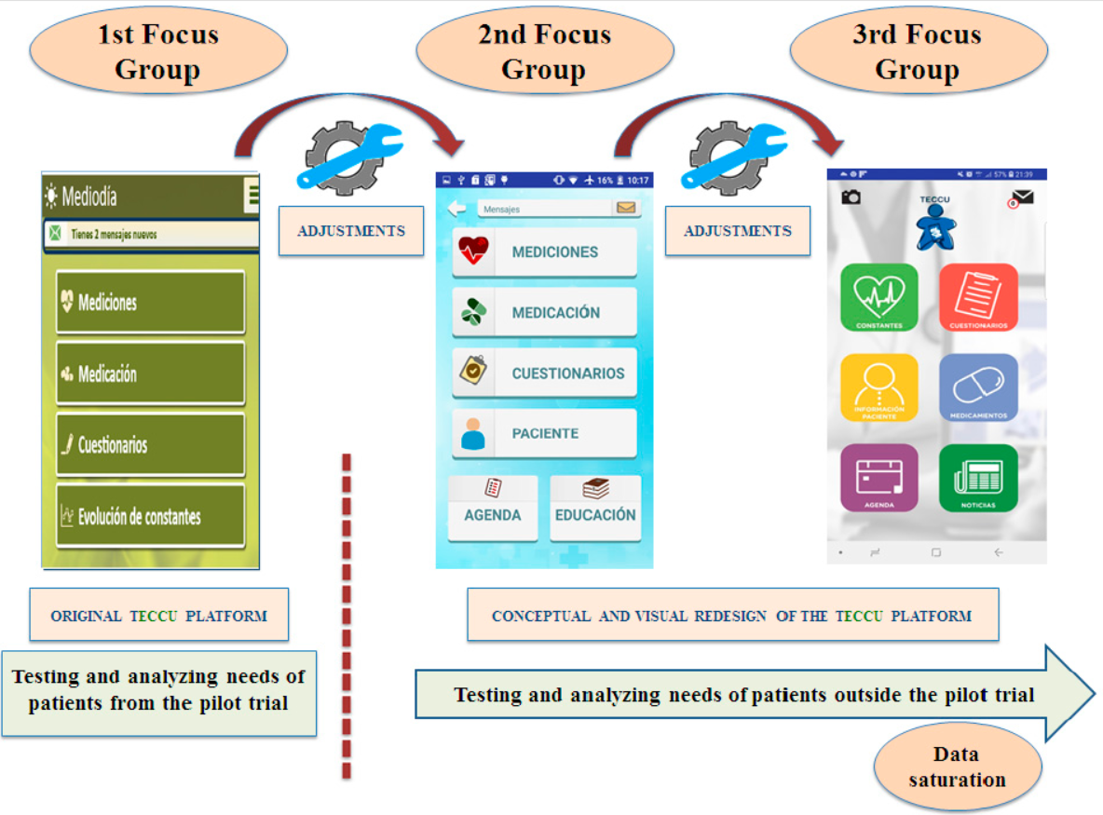
Del Hoyo et. al. Adaptation of TECCU App Based on Patients´ Perceptions for the Telemonitoring of Inflammatory Bowel Disease: A Qualitative Study Using Focus Groups. Int J Environ Res Public Health. 2020 Mar 13;17(6):1871. doi: 10.3390/ijerph17061871. PMID: 32183103; PMCID: PMC7143635. https://pubmed.ncbi.nlm.nih.gov/32183103/

Slide 54
Matrix for Assessing Level of Consensus
Question | Ind.1 | Ind.2 | Ind.3 | Ind.4 | Ind.5 | Ind.6
Q1
Q2
Q3
The following notations are entered in the cells:
A = Indicated agreement (i.e., verbal or nonverbal)
D = Indicated dissent (i.e., verbal or nonverbal)
SE = Provided significant statement or example suggesting agreement
SD = Provided significant statement or example suggesting dissent
NR = Did not indicate agreement or dissent (i.e., non-response)
Ind.n = individual n
AJ. Onwuegbuzie et.al. Innovative Data Collection Strategies in Qualitative Research. The Qualitative Report 2010;15(3):696-726.
http://www.nova.edu/ssss/QR/QR15-3/onwuegbuzie.pdf

Slide 55
Questionnaire, Interview, or Focus Group?
Characteristics of research | Q | I | FG
Depth of information required
Need to resolve (seemingly) conflicting information
Relative importance attached by sources to issue
Generalizability of findings
Timeliness of results
Sensitivity of the issue researched
MC. Harrell & MA. Bradley. Data Collection Methods: Semi-Structured Interviews and Focus Groups. RAND Corporation 2009. http://www.rand.org/pubs/technical_reports/TR718.html

Slide 56
Questionnaire, Interview, or Focus Group?
Characteristics of research | Q | I | FG
Depth of information required |  | + | +
Need to resolve (seemingly) conflicting information
Relative importance attached by sources to issue
Generalizability of findings
Timeliness of results
Sensitivity of the issue researched

Slide 57
Questionnaire, Interview, or Focus Group?
Characteristics of research | Q | I | FG
Depth of information required |  | + | +
Need to resolve (seemingly) conflicting information |  | +¹ | +
Relative importance attached by sources to issue
Generalizability of findings
Timeliness of results
Sensitivity of the issue researched
¹ Requires specific questions

Slide 58
Questionnaire, Interview, or Focus Group?
Characteristics of research | Q | I | FG
Depth of information required |  | + | +
Need to resolve (seemingly) conflicting information |  | +¹ | +
Relative importance attached by sources to issue | + | +¹
Generalizability of findings
Timeliness of results
Sensitivity of the issue researched
¹ Requires specific questions

Slide 59
Questionnaire, Interview, or Focus Group?
Characteristics of research | Q | I | FG
Depth of information required |  | + | +
Need to resolve (seemingly) conflicting information |  | +¹ | +
Relative importance attached by sources to issue | + | +¹
Generalizability of findings | + | +²
Timeliness of results
Sensitivity of the issue researched
¹ Requires specific questions
² Requires many interviews

Slide 60
Questionnaire, Interview, or Focus Group?
Characteristics of research | Q | I | FG
Depth of information required |  | + | +
Need to resolve (seemingly) conflicting information |  | +¹ | +
Relative importance attached by sources to issue | + | +¹
Generalizability of findings | + | +²
Timeliness of results |  | + | +
Sensitivity of the issue researched
¹ Requires specific questions
² Requires many interviews

Slide 61
Questionnaire, Interview, or Focus Group?
Characteristics of research | Q | I | FG
Depth of information required |  | + | +
Need to resolve (seemingly) conflicting information |  | +¹ | +
Relative importance attached by sources to issue | + | +¹
Generalizability of findings | + | +²
Timeliness of results |  | + | +
Sensitivity of the issue researched | + | +
¹ Requires specific questions
² Requires many interviews

Slide 62
Questionnaire, Interview, or Focus Group?
Characteristics of research | Q | I | FG
Depth of information required |  | + | +
Need to resolve (seemingly) conflicting information |  | +¹ | +
Relative importance attached by sources to issue | + | +¹
Generalizability of findings | + | +²
Timeliness of results |  | + | +
Sensitivity of the issue researched | + | +
When in doubt which one to select, go for: ….

Slide 63
Questionnaire, Interview, or Focus Group?
Characteristics of research | Q | I | FG
Depth of information required |  | + | +
Need to resolve (seemingly) conflicting information |  | +¹ | +
Relative importance attached by sources to issue | + | +¹
Generalizability of findings | + | +²
Timeliness of results |  | + | +
Sensitivity of the issue researched | + | +
When in doubt which one to select, go for: ….
interviews

Slide 64
Triangulation

Slide 65
Triangulation
Mixed method approach.
Methodology: Qualitative Quantitative Qualitative
Example:
Data
Collection Exploratory focus
Approach: group
Questionnaire Personal
Interview
NSF. The 2002 User Friendly Handbook for Project Evaluation. Section III - An Overview of Quantitative and Qualitative Data Collection Methods. https://www.nsf.gov/pubs/2002/nsf02057/nsf02057_4.pdf

Slide 66
Sampling methods
Random (in combination with others)
Stratified:
  the population is partitioned into non-overlapping groups (‘strata’) and a sample is selected by some design within each stratum.
      https://onlinecourses.science.psu.edu/stat506/node/27
Clustered: focus on a specific subpopulation;
Judgment-based: focus on subpopulations with specific knowledge or perspective.
Convenience-based.
Opportunity-based.
Snowball: e.g. suggestions by other interviewees.
MC. Harrell & MA. Bradley. Data Collection Methods: Semi-Structured Interviews and Focus Groups. RAND Corporation 2009. http://www.rand.org/pubs/technical_reports/TR718.html

Slide 67
Types of Data Collection in QRM
Questionnaire
Interviews
Focus groups
Observation
(Data) extraction
Secondary data sources
Ethnography
No participation of researcher in the interaction;
Level of impact by mere presence may factor in.
MC. Harrell & MA. Bradley. Data Collection Methods: Semi-Structured Interviews and Focus Groups. RAND Corporation 2009. http://www.rand.org/pubs/technical_reports/TR718.html

Slide 68
Pros and cons of observations
Advantages:
· Provide direct information about behavior of individuals and groups;
· Permit evaluator to enter into and understand situation/context;
· Provide good opportunities for identifying unanticipated outcomes;
· Exist in natural, unstructured, and flexible setting.
Disadvantages:
· Expensive and time consuming;
· Need well-qualified, highly trained observers; may need to be content experts;
· May affect behavior of participants;
· Selective perception of observer may distort data;
· Behavior or set of behaviors observed may be atypical.
NSF. The 2002 User Friendly Handbook for Project Evaluation. Section III - An Overview of Quantitative and Qualitative Data Collection Methods. https://www.nsf.gov/pubs/2002/nsf02057/nsf02057_4.pdf

Slide 69
Special setup: case studies
Pros and cons
Advantages:
· Provide a rich picture of what is happening, as seen through the eyes of many individuals;
· Allow a thorough exploration of interactions between treatment and contextual factors;
· Can help explain changes or facilitating factors that might otherwise not emerge from the data.
Disadvantages:
· Require a sophisticated and well-trained data collection and reporting team;
· Can be costly in terms of the demands on time and resources;
· Individual cases may be over-interpreted or overgeneralized.
NSF. The 2002 User Friendly Handbook for Project Evaluation. Section III - An Overview of Quantitative and Qualitative Data Collection Methods. https://www.nsf.gov/pubs/2002/nsf02057/nsf02057_4.pdf

Slide 70
Types of Data Collection in QLRM
Questionnaire
Interviews
Focus groups
Observation
(Data) extraction
Secondary data sources
Ethnography
No participation of researcher in the interaction;
Usually on documents either already available, or created in the course of other data collection methods.
MC. Harrell & MA. Bradley. Data Collection Methods: Semi-Structured Interviews and Focus Groups. RAND Corporation 2009. http://www.rand.org/pubs/technical_reports/TR718.html

Slide 71
Pros and cons of pre-existing document studies
Advantages:
· Grounded in setting and language in which they occur;
· Useful for determining value, interest, positions, political climate, public attitudes;
· Provide information on historical trends or sequences;
· Provide opportunity for study of trends over time;
· Unobtrusive.
Disadvantages:
· May be incomplete;
· May be inaccurate or of questionable authenticity;
· Locating suitable documents may pose challenges;
· Analysis may be time consuming and access may be difficult.
NSF. The 2002 User Friendly Handbook for Project Evaluation. Section III - An Overview of Quantitative and Qualitative Data Collection Methods. https://www.nsf.gov/pubs/2002/nsf02057/nsf02057_4.pdf

Slide 72
Data extraction
Select text to examine;
Identify themes;
Build codebook;
Tag text for themes;
Search for subthemes;
Search for patterns among themes:
    Examine distribution of themes across types of people/cases;
    Examine relationships among themes (potential hypotheses).
MC. Harrell & MA. Bradley. Data Collection Methods: Semi-Structured Interviews and Focus Groups. RAND Corporation 2009. http://www.rand.org/pubs/technical_reports/TR718.html

Slide 73
Data extraction: code assignment
Aboutness:
  Characteristics of respondents,
  Topics researched.
Form:
  Meaningless,
  Taxonomic.
Organization
  Categorical,
  Broader – narrower,
  Subsumption.
‘Coding tree’

Slide 74
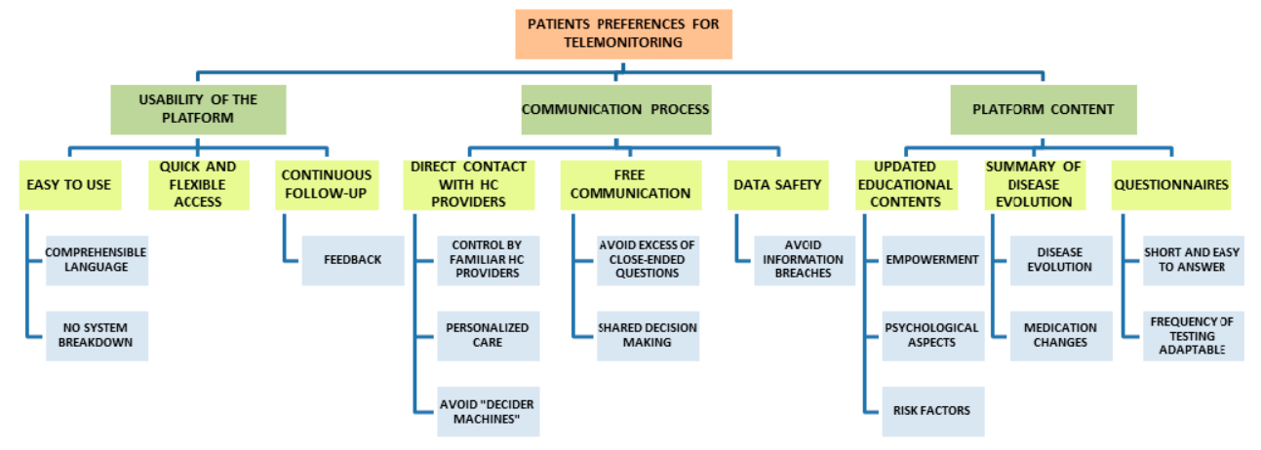
Coding tree example
Del Hoyo et. al. Adaptation of TECCU App Based on Patients´ Perceptions for the Telemonitoring of Inflammatory Bowel Disease: A Qualitative Study Using Focus Groups. Int J Environ Res Public Health. 2020 Mar 13;17(6):1871. doi: 10.3390/ijerph17061871. PMID: 32183103; PMCID: PMC7143635. https://pubmed.ncbi.nlm.nih.gov/32183103/

Slide 75
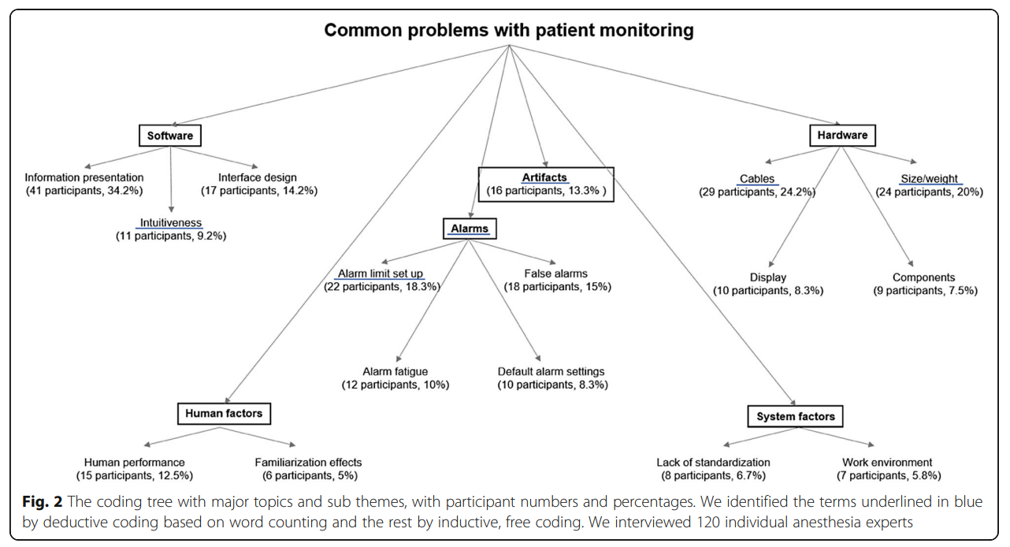
Other coding tree example
https://pubmed.ncbi.nlm.nih.gov/31138143/

Slide 76
Coding tree development and use
Initial tree based on expectations;
Test against data;
Test understanding of codes within research team;
Revisit coding tree as necessary;
Test reliability of coding across coders;
  Roundtable,
  Statistically (kappa);
• Adjust amount of double-coding as necessary.
MC. Harrell & MA. Bradley. Data Collection Methods: Semi-Structured Interviews and Focus Groups. RAND Corporation 2009. http://www.rand.org/pubs/technical_reports/TR718.html

Slide 77
‘Old style’ relationships
Attributive: X defined with respect to one or more attributes of Y
Contingency: X is defined as with relation to an antecedent or concomitant of Y
Function: X is defined as the means of effecting Y
Spatial: X is oriented spatially with respect to Y
Operational: X is defined with respect to an action of Y of which it is a goal or recipient
Comparison: X is defined in terms of its similarity or contrast with Y
Exemplification: X is defined by citing an appropriate co-occurrent Y
Class inclusion: X is defined with respect to its membership in a hierarchical class Y
Synonymy: X is defined as an equivalent to Y
Antonymy: X is defined as the negation of Y
Provenance: X is defined with respect to its source Y
Grading: X is defined with respect to its placement in a series or spectrum that also includes Y
Circularity: X is defined as X
Casagrande, J. B., & Hale, K. L. (1967). Semantic relationships in Papago folkdefinitions. In D. Hymes & W. E. Bittle (Eds.), Studies in southwestern ethnolinguistics (pp. 165-196). The Hague, Netherlands: Mouton.

Slide 78
Types of Data Collection in QRM
Questionnaire
Interviews
Focus groups
Observation
(Data) extraction
Secondary data sources
Ethnography
Data collected for different purposes
Secondary use
MC. Harrell & MA. Bradley. Data Collection Methods: Semi-Structured Interviews and Focus Groups. RAND Corporation 2009. http://www.rand.org/pubs/technical_reports/TR718.html

Slide 79
Types of Data Collection in QRM
Questionnaire
Interviews
Focus groups
Observation
(Data) extraction
Secondary data sources
Ethnography
Understandings of culture through representation of 'insider's point of view.’
Participating observation.
MC. Harrell & MA. Bradley. Data Collection Methods: Semi-Structured Interviews and Focus Groups. RAND Corporation 2009. http://www.rand.org/pubs/technical_reports/TR718.html

Slide 80
More on Ethnography
A Simple Introduction to the Practice of Ethnography and Guide to Ethnographic Fieldnotes
Brian A Hoey, Marshall University
http://works.bepress.com/brian_hoey/12/

Slide 81
COREQ (COnsolidated criteria for REporting Qualitative research) Checklist
Covers:
  Research team and reflexivity
  Study design
  Analysis and findings
Origine:
    Tong A, Sainsbury P, Craig J.
    Consolidated criteria for reporting qualitative research (COREQ): a 32-item checklist for interviews and focus groups.
    International Journal for Quality in Health Care. 2007. Volume 19, Number 6: pp. 349 – 357.
Required for publishing papers in certain journals.
https://content.sph.harvard.edu/wwwhsph/sites/2448/2021/02/Consolidated-criteria-for-reporting-qualitative-research-COREQ.pdf

Slide 82
  Discussion
Integration of these methods in the research proposals.

