Slide 1
Statistical data analysis and research methods
BMI504
Course 15735 – Spring 2026
Class 9 – March 26, 2026
Bias
Werner CEUSTERS, MD

Slide 2
The slides in this set may not to be distributed, shared with, or shown to anybody else than the students registered for this course, i.e. BMI504-2026.

Slide 3
Objectives
A3/3.4 - A4/3.5
Being able to identify various data quality parameters;
Understand how, in what way and what types of bias impact these parameters;
Being able to explain why certain research designs are prone to certain types of bias;
Being able to prevent bias to creep in at various research phases and correct for it after the facts when needed.

Slide 4
Fifteen common mistakes encountered in clinical research. Failure to …
carefully examine the literature for similar, prior research
critically assess the prior literature
specify the inclusion and exclusion criteria for your subjects
determine and report the error of your measurement methods
specify the exact statistical assumptions made in the analysis
perform sample size analysis before the study begins
implement adequate bias control measures
write and stick to a detailed time line
vigorously recruit and retain subjects
have a detailed, written and vetted protocol
examine for normality of the data
report missing data, dropped subjects and use of an intention to treat analysis
perform and report power calculations
point out the weaknesses of your own study
understand and use correct scientific
Journal of Prosthodontic Research 55 (2011) 1–6

Slide 5

Reality Representation
data
organization
model development
observation &
measurement
further R&D
(instrument and
study optimization)
add
verify
use
Δ = outcome
Generic
beliefs
application

Slide 6
Variables in your proposal
Input V.
Independent V.
Theory Variables
(including bias)
Output V.
Dependent V.
Theoretical Linkage

Slide 7
Some Data Quality Dimensions
Dimension | # cited | Dimension | # cited | Dimension | # cited
Accuracy | 25 | Format | 4 | Comparability | 2
Reliability | 22 | Interpretability | 4 | Conciseness | 2
Timeliness | 19 | Content | 3 | Freedom from bias | 2
Relevance | 16 | Efficiency | 3 | Informativeness | 2
Completeness | 15 | Importance | 3 | Level of detail | 2
Currency | 9 | Sufficiency | 3 | Quantitativeness | 2
Consistency | 8 | Usableness | 3 | Scope | 2
Flexibility | 5 | Usefulness | 3 | Understandability | 2
Precision | 5 | Clarity | 2
Wang, R.Y., Storey, V.C., and Firth, C.P.
A framework for analysis of data quality research.
IEEE Trans. on Knowl. Data Eng. 7, 4 (1995), pp. 623–640.

Slide 8
Some Data Quality Dimensions (2)
Dimension | # cited | Dimension | # cited | Dimension | # cited
Accuracy | 25 | Format | 4 | Comparability | 2
Reliability | 22 | Interpretability | 4 | Conciseness | 2
Timeliness | 19 | Content | 3 | Freedom from bias | 2
Relevance | 16 | Efficiency | 3 | Informativeness | 2
Completeness | 15 | Importance | 3 | Level of detail | 2
Currency | 9 | Sufficiency | 3 | Quantitativeness | 2
Consistency | 8 | Usableness | 3 | Scope | 2
Flexibility | 5 | Usefulness | 3 | Understandability | 2
Precision | 5 | Clarity | 2
Wang, R.Y., Storey, V.C., and Firth, C.P.
A framework for analysis of data quality research.
IEEE Trans. on Knowl. Data Eng. 7, 4 (1995), pp. 623–640.

Slide 9
Precision and accuracy of representations (1)
A3/3.4.c - A4/3.5.c
Precision
  The degree to which distinct representations (references) about the same portion of reality (the referent) are similar when derived under similar circumstances.

Slide 10
Precision and accuracy of representations (2)
A3/3.4.c - A4/3.5.c
Precision
  The degree to which distinct representations (references) about the same portion of reality (the referent) are similar when derived under similar circumstances.
Accuracy
  The degree to which a representation actually represents what it was intended to represent.
  How close is a representation to the truth?

Slide 11
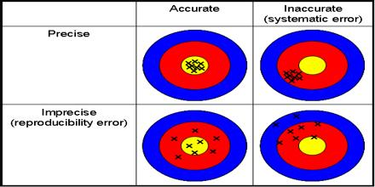
‘Classical’ picture

Slide 12
Accurate ? (1)
x
x
x
x
x
x
x
x
x
x

Slide 13
Accurate ? (2)
x
x
x
x
x
x
x
x
x
x
X = ? = ?

Slide 14
Accurate ? (3)
x
x
x
x
x
x
x
x
x
x
X = data / information = information /
knowledge

Slide 15
Information gain?
No!
Experiment 1
Experiment 2
x
x
x
x
x
x
x
x
x
x
x
x
x
x
x
x
x
x
x
x
x
x
x
x
x
x
x
x
x
x
x
x
x
x
X = data / information = information /
knowledge

Slide 16
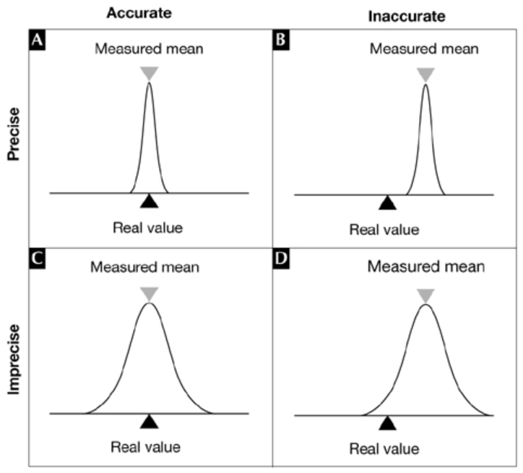
For repeated measurements
(on variables for which ‘mean’ is allowed)
Cave !
Static or dynamic phenomenon

Slide 17
Some Data Quality Dimensions (3)
Dimension | # cited | Dimension | # cited | Dimension | # cited
Accuracy | 25 | Format | 4 | Comparability | 2
Reliability | 22 | Interpretability | 4 | Conciseness | 2
Timeliness | 19 | Content | 3 | Freedom from bias | 2
Relevance | 16 | Efficiency | 3 | Informativeness | 2
Completeness | 15 | Importance | 3 | Level of detail | 2
Currency | 9 | Sufficiency | 3 | Quantitativeness | 2
Consistency | 8 | Usableness | 3 | Scope | 2
Flexibility | 5 | Usefulness | 3 | Understandability | 2
Precision | 5 | Clarity | 2
Validity
Wang, R.Y., Storey, V.C., and Firth, C.P.
A framework for analysis of data quality research.
IEEE Trans. on Knowl. Data Eng. 7, 4 (1995), pp. 623–640.

Slide 18
Construct/concept appropriateness (1)
Caroline Stone. A Defense and Definition of Construct Validity in Psychology
Philosophy of Science, vol 86:5, 11 December 2019.

Slide 19
Construct/concept appropriateness
A3/3.4.d - A4/3.5.d
Construct validity:
  A measure, m, of some construct, C, is construct valid if and only if we are sufficiently justified in believing m tracks C.
Construct legitimacy:
  A construct, C, is legitimate if and only if the theory that posits C is sufficiently justified.
Caroline Stone. A Defense and Definition of Construct Validity in Psychology
Philosophy of Science, vol 86:5, 11 December 2019.

Slide 20
Validity and reliability of representational methods/procedures
A3/3.4.d - A4/3.5.d
Validity
  The extent to which a method or procedure allows or is able to derive representations of what is intended to be represented.
Reliability
  The degree to which a method or procedure allows or is able to derive similar representations under similar circumstances.

Slide 21
Remember: scientific objectivity
Science is objective in that, or to the extent that:
its products—theories, laws, experimental results and observations—constitute accurate representations of the external world. The products of science are not tainted by human desires, goals, capabilities or experience.
  product objectivity
the processes and methods that characterize it neither depend on contingent social and ethical values, nor on the individual bias of a scientist
  → process objectivity.
http://plato.stanford.edu/entries/scientific-objectivity

Slide 22
Validity
A3/3.4.d - A4/3.5.d
Internal validity
  The method produces an accurate representation for the portion of reality under scrutiny.
External validity
  The method produces for all similar portions of reality representations which with respect to these portions of reality are accurate to the same degree.
  → generalizability

Slide 23
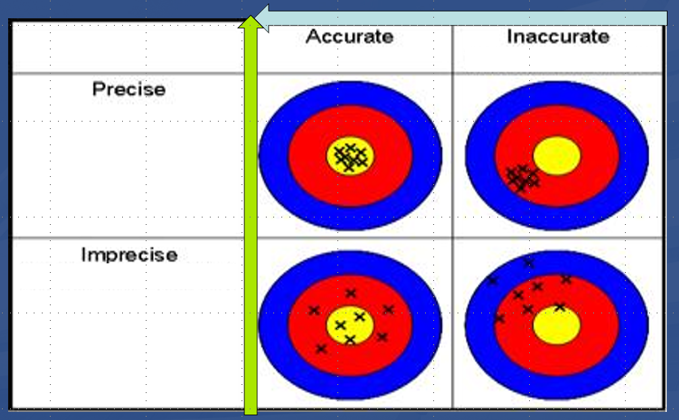
Reliability Validity of method
Relations between reliability, validity, accuracy and precision.

Slide 24
Reliability Validity of method
Your proposal needs to demonstrate concretely for your research how you intend to maximize these 4 metrics, what you expect them to be, and how you will assess whether your expectations are correct.

Slide 25
Error
Error: the difference between the representation and the referent

Slide 26
Error types
Random error:
  An error of a sort we can’t predict (even if we tried with all means possible)
  Only caused by chance.
Systematic error:
  An error due to any cause other than sampling variability.

Slide 27
Error types
Random error:
  An error of a sort we can’t predict (even if we tried with all means possible)
  Only caused by chance.
→ contributes to reduction in precision
Systematic error:
  An error due to any cause other than sampling variability.
  → contributes to reduction in accuracy

Slide 28
Validity (again)
Internal validity
  The method produces an accurate representation for the portion of reality under scrutiny.
External validity
  The method produces for all similar portions of reality representations which with respect to these portions of reality are accurate to the same degree.
  → generalizability
  Similarity of portions of reality can only be guaranteed by absence of sampling error.

Slide 29
Bias
Most accurate, general determination:
Error introduced by lack of internal validity of a method which therefor produces inaccurate representations

Slide 30
Bias and Error
Difference between error and bias: true error is random while bias is systematic error.
Random sampling error can occur while selecting a population to survey due to uncontrollable issues.
A probability survey must include a margin of error and a confidence level. This tells us how much effect random sampling error could have on a study’s results.
Bias cannot be measured statistically and it can give a skewed artificial result.

Slide 31
Potential effects of biased methods
Need to be accounted for when distinctions in references are used as estimates for distinctions in referents assumed to exist because of some factor:
  Positive bias:
    The real distinction has a smaller magnitude than the estimated one.
  Negative bias:
    The real distinction is larger than …
  Bias ‘away from the null’:
    The estimated distinction is further away from ‘no distinction’ than the real distinction is away from it.
  Bias ‘towards the null’:
    The estimated distinction is closer to ‘no distinction’ than …
VJ. Schoenbach J. Schildkraut, W. Rosamond, Sources of error, 2001. http://www.epidemiolog.net/

Slide 32
Previous slide more precise than …
‘Biases can be classified by the direction of the change they produce in a parameter (for example, the odds ratio (OR)). Toward the null bias or negative bias yields estimates closer to the null value (for example, lower and closer OR to 1), whereas away from the null bias produces the opposite, higher estimates than the true ones.’
In what way is this statement different from the previous one?
J Epidemiol Community Health 2004;58:635–641

Slide 33
Previous slide more precise than …
‘Biases can be classified by the direction of the change they produce in a parameter (for example, the odds ratio (OR)). Toward the null bias or negative bias yields estimates closer to the null value (for example, lower and closer OR to 1), whereas away from the null bias produces the opposite, higher estimates than the true ones.’
In what way is this statement different from the previous one?
Seems to equate ‘toward the null bias’ with ‘negative bias’
J Epidemiol Community Health 2004;58:635–641

Slide 34
Mainstream classification of bias types
Selection bias:
  distortion that results from the method by which referents are selected into the study population,
Information bias (also called misclassification bias):
  distortion that results from
    inaccuracies in the representation of referent characteristics,
    incorrect classification therefrom,
Confounding bias:
  distortion in the interpretation of representations due to failure to take into account the effect of non-represented portions of reality other than the represented referent(s).
Adapted from: Kleinbaum DG, Kupper LL, Morgenstern H. Epidemiologic research. Belmont, CA: Lifetime Learning Publications, 1982.

Slide 35
Bias and research designs (1)
A good research design minimizes bias

Slide 36
For example: Randomization
Goal: minimizing treatment selection bias;
    assignment to treated group not based on prognostic factors;
    prevents confounding of the treatment effects with other prognostic variables.
Strategies:
  Simple: flip a coin for each subject.
  Constrained: subjects pick token (T or nT) from a bag.
  Adaptive, several schemas, e.g.:
    pick token from bag to determine group, put it back, add one token from opposite category, or,
    pick from bag, give selected treatment, if treatment successful add two tokens of same treatment to bag, otherwise, one of each.
  Stratified: create treatment groups that are balanced with respect to confounding (prognostic) variables.

Slide 37
Fight bias through management plans
A4/3.5.g
Essential elements of your method’s section:
  explain the procedures or extras steps to be taken to minimize the risk of bias.
    The procedures or protections put into place to reduce the risk of bias are often called “controls.”
  Explain how they are tailored to your specific study and/or sponsor and/or your financial interests.
J. Moore, C. McGoff, MA. Conflicts of Interest in Human Subjects. Research. https://about.citiprogram.org/en/homepage/ .

Slide 38
Bias and research designs (2)
A good research design minimizes bias
Some studies are purposefully set up to take advantage of bias.

Slide 39
Sneakily biased surveys
Issuing only questions about what one is opposed to.
Phrase questions as if they are about facts:
  ‘3.) How concerned are you about proposals to ban Muslims from entering America based solely on their religious beliefs?’ (2016 ACLU Survey)
  ‘How concerned are you about Donald Trump abusing power and undermining the rule of law’ (Q6. 2017)

Slide 40
Bias and research designs (3)
A good research design minimizes bias
Some studies are purposefully set up to take advantage of bias.
Certain designs are more prone to certain biases.

Slide 41
Risks for bias in interviews
Bias A:
  the effects of the researcher on the interviewees;
    e.g. researcher poses a threat to the interviewees.
Bias B:
  the effects of the interviewees on the researcher;
    e.g. researcher ‘becomes native’, part of the interviewees.
AJ. Onwuegbuzie et.al. Innovative Data Collection Strategies in Qualitative Research. The Qualitative Report 2010;15(3):696-726.
http://www.nova.edu/ssss/QR/QR15-3/onwuegbuzie.pdf

Slide 42
Bias in questionnaires / interviews
Respondent bias occurs when a participant is unable or unwilling to provide accurate or honest answers to a survey.
Inability to provide correct answers because of unfamiliarity, respondent fatigue, faulty recall, question format, and question context.
Opt out choice in the question design - do not know, not sure etc,
Proper screening questions should be used to select the respondents who will be able to answer the question correctly. Use branching questions.

Slide 43
Cohort studies: disadvantages re bias
Total population
Population of interest
Cohort
General:
  Susceptible to selection bias.
Prospective Cohort Study:
  Susceptible to loss to follow-up or withdrawals.
Retrospective Cohort Study:
  Susceptible to recall bias or information bias;
  Less control over variables.
Song JW, Chung KC. Observational studies: Cohort and case-control studies. Plast Reconstr Surg 2010;126:2234-42

Slide 44
Bias in case control studies
Total population
Population of interest
Case
Control
Sampling bias:
  may occur if the cases and controls are taken from different subgroups of the population.
  difference in exposure may be due to some other inherent differences between the groups rather than the risk factor being studied.
Recall bias:
  May happen when subjects are asked to answer questions about exposure to risk factors in the past.
  People who are diseased (cases) tend to remember their exposure to the risk factor more accurately as compared to the controls.

Slide 45
Bias and research designs (3)
A good research design minimizes bias
Some studies are purposefully set up to take advantage of bias.
Certain designs are more prone to certain biases.
Conflicts of Interest may taint any design.

Slide 46
Bias through Conflicts of Interest (COI)
• Decisions about enrollment and inclusion/exclusion criteria.
• Decisions about the choice of personnel to conduct the study.
• Recruitment and consenting of research subjects.
• Vendor selection in the purchase of equipment and other supplies.
• Data collection, analysis, and interpretation.
• Sharing of research results.
• Choice of research design and statistical methods.

Slide 47
Controls for avoiding COI (1)
• Adding an independent monitor to the study team to make sure that the research procedures are transparent.
• Creating a safe environment for any research team member and/or student to report any perceived conflicts that may occur while the study is being conducted.
• Disclosing the potential COI to the subjects in the informed consent form.
• Reducing the researcher’s role in the research if they have a COI (less interaction with subjects, less data analysis).
…
J. Moore, C. McGoff, MA. Conflicts of Interest in Human Subjects. Research. https://about.citiprogram.org/en/homepage/.

Slide 48
Controls for avoiding COI (2)
• Using an independent third-party review of data.
• Ensuring a careful study design, which may include randomization and blinding.
• Disclosure of the COI, including in publications or presentations of the study results.
• Requiring an independent monitor to ensure that student progress is not affected by the conflicted mentor’s activities (for example, doing work for the mentor’s start-up company at the expense of doing work for a graduate or doctoral thesis).
J. Moore, C. McGoff, MA. Conflicts of Interest in Human Subjects. Research. https://about.citiprogram.org/en/homepage/.

Slide 49
Some methods for dealing with bias after the facts
Typical for ‘opt-in’ surveys where responses come not from pre-determined cohorts of respondents.
    Population: 50 % males, 40% > 50 years
    Respondents: 30 % males, 10% > 50 years
Introduction of ‘weighting’ factors.
  Raking: an iterative computational process which is repeated until the weighted distribution of all of the weighting variables matches their specified targets.
  Matching: start with a representative sample and match each case with a very similar case. Discard any un-matched responses.
  Propensity weighting: weighting each case by the inverse of its estimated probability of selection.
Method(s) to be used must be reported in the proposal.
https://www.pewresearch.org/methods/2018/01/26/how-different-weighting-methods-work/

Slide 50
Bias in biomedical informatics

Slide 51
Does Health IT improves outcome?
Science Daily, August 31, 2011
Federal Investment in Electronic Health Records Likely to Reap Returns in Quality of Care, Study Finds
A study . . . involving more than 27,000 adults with diabetes found that those in physician practices using EHRs were significantly more likely to have health care and outcomes that align with accepted standards than those where physicians rely on patient records.
(Excerpt from www.sciencedaily.com/releases/2011/08/110831115930.htm. )

Slide 52
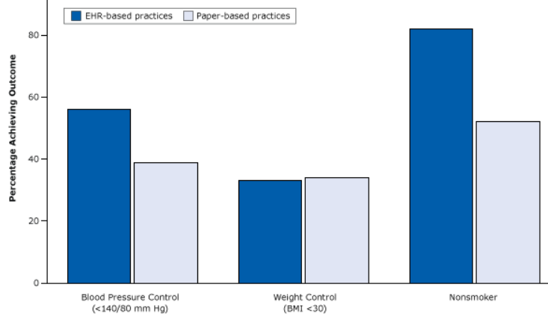
The ‘evidence’ …
https://www.cdc.gov/pcd/issues/2015/15_0187.htm

Slide 53
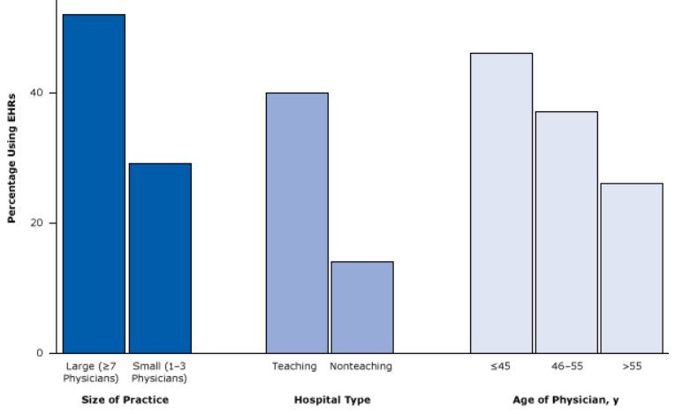
The bias
https://www.cdc.gov/pcd/issues/2015/15_0187.htm

Slide 54
Missing data in EHRs
EHRs are notorious for incompleteness of information
Completeness can be defined in various ways and patient records classified according to their degree of completeness.
  Weiskopf NG, Hripcsak G, Swaminathan S, Weng C. Defining and measuring completeness of electronic health records for secondary use. Journal of Biomedical Informatics. 2013 Oct;46(5):830-836.
Would there be bias in doing secondary data analysis when filtering for complete records?
→ Yes !!! It tends to select sicker patients.
Rusanov, A., Weiskopf, N.G., Wang, S. et al. Hidden in plain sight: bias towards sick patients when sampling patients with sufficient electronic health record data for research. BMC Med Inform Decis Mak 14, 51 (2014)

Slide 55
Sources of bias in EHR-based studies
Health care system bias, emanating from: Reimbursement system, pay for performance parameters
‎Role of general practitioner in the health care system; gatekeeping/nongatekeeping
‎Professional clinical guidelines
‎Ease of access by patients to their records
‎Data sharing between health care providers
‎Practice workload
‎Variations between electronic health record (EHR) system functionalities and lay-out
‎Coding systems and thesauruses
‎Knowledge and education regarding the use of EHR systems
‎Data extraction tools
‎Data processing—redatabasing
‎Research dataset preparation
‎Research methodologies
Verheij RA, Curcin V, Delaney BC, McGilchrist MM
Possible Sources of Bias in Primary Care Electronic Health Record Data Use and Reuse
J Med Internet Res 2018;20(5):e185

Slide 56
Bias at warp speed: how AI may contribute to the disparities gap in the time of COVID-19
‘Furthermore, a systematic review study of COVID-19 prediction models uncovered that serious shortcomings, particularly in regard to potential biases, are alarmingly widespread. The PROBAST (Prediction model Risk Of Bias ASsessment Tool) study tool rated all 66 screened models at “high” or “unclear” risk of bias. The most frequent problems encountered were:
unrepresentative data samples,
high likelihood of model overfitting, and
imprecise reporting of study populations and intended model use.’
Eliane Röösli, Brian Rice, Tina Hernandez-Boussard
Journal of the American Medical Informatics Association, Volume 28, Issue 1, January 2021, Pages 190–192, https://doi.org/10.1093/jamia/ocaa210

Slide 57
Gene annotation bias impedes biomedical research
‘our results provide an evidence of a strong research bias in literature that focuses on well-annotated genes instead of those with the most significant disease relationship in terms of both expression and genetic variation.’
this experimental paradigm has led to a gene-centric disease research bias where hypotheses are confounded by the streetlight effect of looking for “answers where the light is better rather than where the truth is more likely to lie”’
‘the list of unannotated genes is simply ignored because pathway analysis tools cannot map them to any GO terms. Hence, the self-perpetuating cycle of inequality continues.’
Haynes, W.A., Tomczak, A. & Khatri, P. Gene annotation bias impedes biomedical research. Sci Rep 8, 1362 (2018). https://doi.org/10.1038/s41598-018-19333-x

Slide 58
Biases in electronic health record data due to processes within the healthcare system: retrospective observational study
https://www.bmj.com/content/361/bmj.k1479
Objective: evaluate the impact of healthcare processes on the predictive value of EHR data.
Design: Retrospective observational study on 669 452 patients treated at the two hospitals over one year between 2005 and 2006.
Main outcome measures: the relative predictive accuracy of each laboratory test for three year survival, using the time of the day, day of the week, and ordering frequency of the test, compared to the value of the test result.
Results: the presence of a lab test order, regardless of any other info about the test result, is associated (P<0.001) with the odds of survival in 233 of 272 (86%) tests. When lab tests were ordered was more accurate than the test results in predicting survival in 118 of 174 tests (68%).
Conclusions: healthcare processes must be accounted for in analysis of observational health data. Without careful consideration to context, EHR data are unsuitable for many research questions.

Slide 59
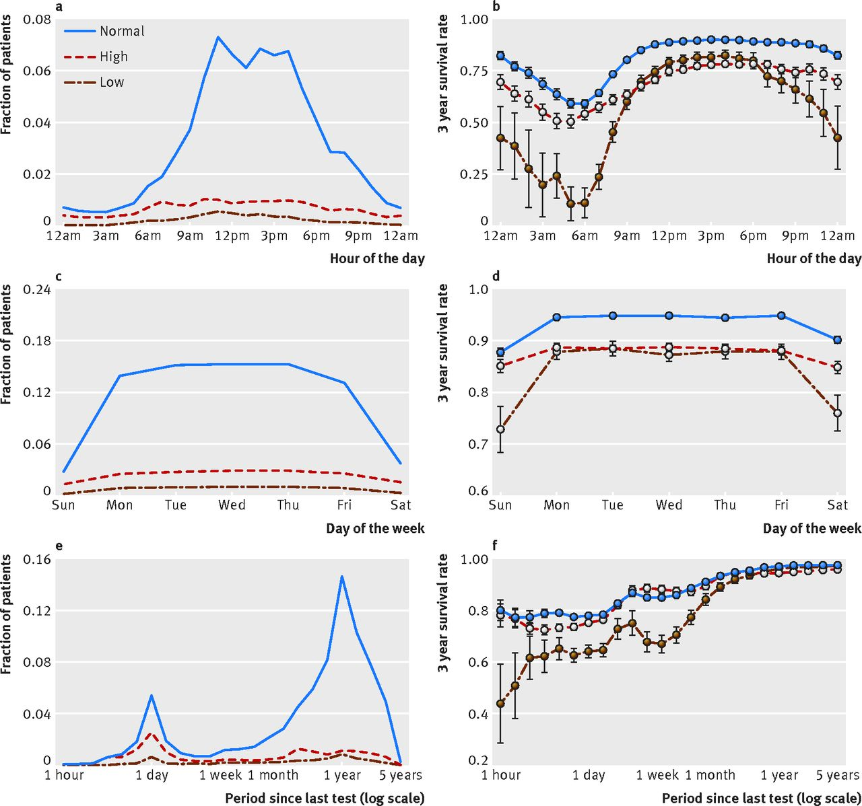
https://www.bmj.com/content/bmj/361/bmj.k1479/F3.large.jpg

Slide 60
Questions?

Slide 61
Guided exercise
You may use paper R7

Slide 62
What type of bias ?
For disease surveillance and registries
  health-care providers are more likely to report a case that results in severe illness and hospitalization than a mild case, even though a person with mild illness might be more likely to transmit infection to others because the person might not be confined at home or in the hospital.
  health-care providers are more likely to report cases when the disease is receiving media attention.

Slide 63
What type of bias ?
For disease surveillance and registries
  health-care providers are more likely to report a case that results in severe illness and hospitalization than a mild case, even though a person with mild illness might be more likely to transmit infection to others because the person might not be confined at home or in the hospital.
  health-care providers are more likely to report cases when the disease is receiving media attention.
Reporting bias

Slide 64
Consequence of the bias ?
For disease surveillance and registries
  health-care providers are more likely to report a case that results in severe illness and hospitalization than a mild case, even though a person with mild illness might be more likely to transmit infection to others because the person might not be confined at home or in the hospital.

Slide 65
Consequence of the bias ?
For disease surveillance and registries
  health-care providers are more likely to report a case that results in severe illness and hospitalization than a mild case, even though a person with mild illness might be more likely to transmit infection to others because the person might not be confined at home or in the hospital.
  inflated estimate of disease severity in such measures as the death-to-case ratio.

Slide 66
Consequence of the bias ?
For disease surveillance and registries
  health-care providers are more likely to report cases when the disease is receiving media attention.

Slide 67
Consequence of the bias ?
For disease surveillance and registries
  health-care providers are more likely to report cases when the disease is receiving media attention.
an underestimate of the baseline incidence of disease after media attention wanes

Slide 68
Which of these constitute bias ?
a systematic deviation of results or inferences from the truth or processes leading to such systematic deviation;
a systematic tendency in the collection, analysis, interpretation, publication, or review of data that can lead to conclusions that are systematically different from the truth.

Slide 69
Which of these constitute bias ?
a systematic deviation of results or inferences from the truth or processes leading to such systematic deviation;
a systematic tendency in the collection, analysis, interpretation, publication, or review of data that can lead to conclusions that are systematically different from the truth.
Both

Slide 70
What highest level type of bias?
systematic difference in the collection of data regarding the participants in a study (e.g., about exposures in a case-control study, or about health outcomes in a cohort study) that leads to an incorrect result (e.g., risk ratio or odds ratio) or inference.

Slide 71
What highest level type of bias?
systematic difference in the collection of data regarding the participants in a study (e.g., about exposures in a case-control study, or about health outcomes in a cohort study) that leads to an incorrect result (e.g., risk ratio or odds ratio) or inference.
Information bias

Slide 72
Danger for which types of bias?
Patient knows he has disease X
He performs searches online from which he ‘learns’ the variety of symptoms that it may come with and what causes there might be.
By doing so, he comes across a patient recruitment website for a trial involving signs, symptoms and causes for disease X.
He believes he qualifies.

Slide 73
Danger for which types of bias?
Rumination bias
  = recall bias occurring if the presence of some outcome or effect influences the perception of its causes.
  he might confuse signs and symptoms he really has with signs and symptoms described.
Exposure submission bias
  = the presence of some outcome or effect influences the search for exposure to the putative cause.
  he might ascribe an event in his past which is similar to one of the listed causes, as the real cause for his disease.

Slide 74
What type of bias ?
  Cimetidine is indicated by gastric ulcer;
  Gastric ulcer is a risk factor for gastric cancer;
  More patients taking cimetidine showed to have gastric cancer than non-takers.
  →? Cimetidine causes gastric cancer.

Slide 75
What type of bias ?
  Cimetidine is indicated by gastric ulcer;
  Gastric ulcer is a risk factor for gastric cancer;
  More patients taking cimetidine showed to have gastric cancer than non-takers.
  →? Cimetidine causes gastric cancer.
Confounding: an apparent effect is attributed to the exposure of interest, whereas in fact it ought to have been attributed to some other factor.
Confounding by indication: the indication is the confounding factor.

Slide 76
Referral filter bias
As stated in paper R7:
  ‘Healthcare access bias may be due: […] to the healthcare organization if it is organized in increasing levels of complexity and [if] ‘‘difficult’’ cases are referred to tertiary care (referral filter bias)’
Potential source of the bias?

Slide 77
Referral filter bias
As stated in paper R7:
  ‘Healthcare access bias may be due: […] to the healthcare organization if it is organized in increasing levels of complexity and [if] ‘‘difficult’’ cases are referred to tertiary care (referral filter bias)’
Potential source of the bias?
  A patient is subjectively ‘difficult’ if it exceeds the competence/willingness to manage of the referrer, rather than objectively ‘difficult’.

Slide 78
New diagnostic test (NDT)
 | Existing diagnostic criteria
 | None satisfied | Few satisfied | Most satisfied | Fully satisfied
Disease X | 5% | 15% | 50% | 30%
NDT+ | 70% | 80% | 90% | 95%
NDT- | 30% | 20% | 10% | 5%
Not disease X | 50% | 30% | 15% | 5%
NDT+ | 1% | 3% | 5% | 7%
NDT- | 99% | 97% | 95% | 93%
Risk for what type of bias?

Slide 79
Spectrum bias
‘In the assessment of validity of a diagnostic test this bias is produced when researchers included only ‘‘clear’’ or ‘‘definite’’ cases, not representing the whole spectrum of disease presentation, and/or ‘‘clear’’ or healthy controls subjects, not representing the conditions in which a differential diagnosis should be carried out’
Being ‘diagnosed with X’ does not mean ‘you have X’.
Being diagnosed as ‘not having X’ does not mean ‘you don’t have X’.
  → misdiagnosis exists
  Comparing diagnosis with actual disease in a population gives you a probability of true diagnosis.
  A disease of type X can present itself differently in different patients
    Presentation of type A → probability of disease X 90% = ‘relatively clear case’
    Presentation of type B → probability of disease X 55% = ‘quite unclear case’
  The goal is a diagnostic test: one that works only with clear cases misses a lot of the patients with unclear cases.

Slide 80
What is a correct term for this?
difference in the enrollment of participants in a study that leads to an incorrect result (e.g., risk ratio or odds ratio) or inference.

Slide 81
What is a correct term for this?
difference in the enrollment of participants in a study that leads to an incorrect result (e.g., risk ratio or odds ratio) or inference.
Error

Slide 82
What type(s) of error are involved here?
Purpose of study:
assessing whether blood pressure at time t1 is an indicator for developing some disease at a later time.

Slide 83
What type(s) of error are involved here?
Purpose of study:
assessing whether blood pressure at time t1 is an indicator for developing some disease at a later time.
Answer:
Blood pressure varies from moment to moment, so that every measurement of blood pressure reflects a degree of random variability → random error.
Therefor:
  Subjects who were classified as "high" on their initial measurement will include some who were "high" just by chance.
  Subjects classified as "low" will include some who were "low" just by chance. The resulting error in exposure measurement will muddy the contrast between the group outcomes compared to what would obtain if our "high" group contained only those who were truly "high" and low group contained only those who were truly "low".
Assuming that chance variability is independent of study outcomes, then the result is nondifferential misclassification bias, and the observed association will be weaker than the "true" association.
Thus, random error can produce systematic error, or bias.
VJ. Schoenbach J. Schildkraut, W. Rosamond, Sources of error, 2001. http://www.epidemiolog.net/

Slide 84
Discussion
What about specific proposals?
Hard due date for voluntary A4 (all sections)
April 5 – noon!

