Slide 1
BMI508 – Fall 2025 Introduction to Biomedical Ontology Class 13 – Nov 19, 2025 Axioms in Ontologies
Werner CEUSTERS^{1,2}
¹ Department of Biomedical Informatics, University at Buffalo, USA
² Department of Psychiatry, University at Buffalo, USA

Slide 2
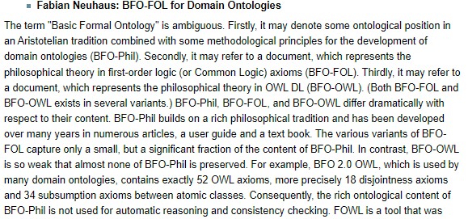
Never forget

Slide 3
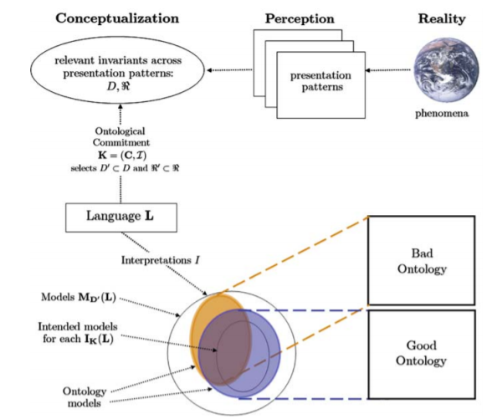
BFO framework
BFO Theory
BFO ontologies
axioms
vocabulary
OWL FOL
Ontological principles
Logical principles
Representational
Drift / burden
What Is an Ontology? Nicola Guarino, Daniel Oberle, and Steffen Staab, S. Staab and R. Studer (eds.), Handbook on Ontologies, International Handbooks 1 on Information Systems, DOI 10.1007/978-3-540-92673-3, Springer-Verlag Berlin Heidelberg 2009.

Slide 4
Basic BFO building blocks
Renderings of BFO consist of a variable number of terms and relational expressions:
terms: ‘continuant’, ‘occurrent’, ‘instance of at’, ‘isa’, …
relational expressions: ‘a instance of A at t’, ‘A isa B’, …
Both terms and relational expressions can be primitive (syn: elucidated), or defined:
defined: when described by a statement satisfying both (1) built out of logically more primitive terms and (2) expressing individually necessary and jointly sufficient conditions for an entity to fall under the designated type, or for a relation to hold.
primitive: when they are so basic to our understanding of reality that there is no way of defining them in a noncircular fashion, or when only necessary conditions are specified.

Slide 5
Term examples
Primitive:
Entity: (elucidation) anything that exists or has existed or will exist.
Continuant: (elucidation) an entity that persists, endures, or continues to exist through time while maintaining its identity.
Defined:
b is an independent continuant =Def. b is a continuant which is such that there is no c such that b s‐depends on c and no c such that b g‐depends on c.

Slide 6
Relational expression examples
Primitive:
Elucidation: b continuant part of c at t means: b and c are continuants and b is a part of c at t
Defined:
A is a B =Def.
for all x, t, if x is an instance of A at t then x is an instance of B at t
b has continuant part c at t =Def.
b and c are continuants and b is a continuant part of c at t

Slide 7
Axioms
Expressions built out of already defined or elucidated terms or expressions stating that something else is also the case, either because:
it is true, but not provable, or
it is ‘enforced’, e.g. by further restricting the meaning of terms, or the logical consequences of relations.
Theorems
Expressions built out of already defined or elucidated terms or expressions stating that something logically provable is the case.

Slide 8
Continuant axioms
If:
b is a continuant
and if:
for some c and some t, c continuant_part of b at t, then:
c is a continuant.
If:
b is a continuant
and if:
for some t, c has_continuant_part b at t,
Then:
c is a continuant.

Slide 9
Continuant-part axioms
Elucidation: b continuant_part_of c at t =Def. b is a part of c at t & t is a time & b and c are continuants .
Axioms:
continuant_part_of is antisymmetric.
continuant_part_of is transitive.
continuant_part_of satisfies weak supplementation.
continuant_part_of satisfies unique product.
Theorem:
continuant_part_of is reflexive.

Slide 10
E.g. weak supplementation
If x continuant_part_of y at t
& not x = y,
then there is some z such that
( z continuant_part_of y at t
& there is no w
( w continuant_part_of z at t
& w continuant_part_of x at t)).
Y
x
Z

Slide 11
Some Axioms between different entity types
If x instance of Continuant at t
then not (x instance of Occurrent at t).
At every time a specific dependent s participates in a process p there’s a part of that time, during which there’s an independent continuant that s s depends on, and that participates in p at that time.

Slide 12
Axioms are better expressed in a formal language
Logic

Slide 13
What is ‘a logic’
A formal or informal language together with a deductive system and/or a model-theoretic semantics.
The language has components that correspond to a part of a natural language like English or Greek.
The deductive system is to capture, codify, or simply record arguments that are valid for the given language.
The semantics is to capture, codify, or record the meanings, or truth-conditions for at least part of the language.
Shapiro, Stewart and Teresa Kouri Kissel, "Classical Logic",
The Stanford Encyclopedia of Philosophy (Spring 2021 Edition), Edward N. Zalta (ed.).
https://plato.stanford.edu/archives/spr2021/entries/logic-classical/

Slide 14
Propositional Logic (PL) essentials

Slide 15
Language and semantics of PL
A well-formed formula is either atomic or composed following allowed composition rules.
Atomic formulae stand for propositions that must either be true or false:
A: ‘John eats too much’.
B: ‘John has a normal BMI’.
C: ‘John is careful’.
Formula connectors:
Negation (not): ¬ ~
Conjunction (and): ∧ & ∙
Disjunction (or): ∨
Material implication (if...then): → ⇒ ⊃
Biconditional (if and only if): ↔ ⬄ ≡ =

Slide 16
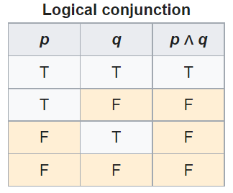
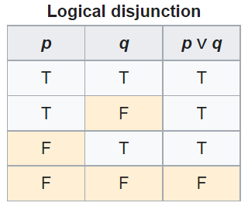
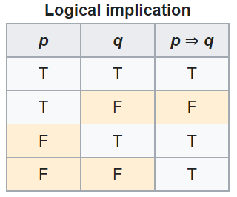
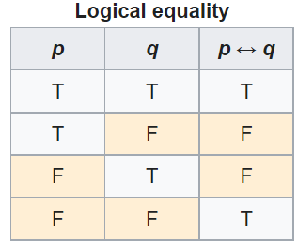
PL’s Deductive system: truth tables

Slide 17
Some PL laws
Truth tables can be used to prove laws, e.g.:
a Λ (b V c) = (a Λ b) V (a Λ c)
¬ (a Λ b) = ¬ a V ¬b
(a Λ (a → b)) → b
(a→ b) Λ ¬b) → ¬a
((a V b) Λ ¬a) → b
((a → b) Λ (b → c)) → (a → c)
…
More examples:
https://math.stackexchange.com/questions/1449866/catalogue-of-propositional-logic-laws
http://mathonline.wikidot.com/the-laws-of-propositional-logic#toc0
Both truth tables and laws can be used to solve puzzles.

Slide 18
Exercise
Given:
If John eats too much, then he does not have a normal BMI.
If John is not careful, then he eats too much.
John has a normal BMI.
Question
Is John careful?

Slide 19
Translate sentences into PL
Propositions
John eats too much |  |  | a
John has a normal BMI |  |  | b
John is careful |  |  | c
Given
If John eats too much, then he does not have a normal BMI |  |  | a → ¬b
If John is not careful, then he eats too much. |  |  | ¬c → a
John has a normal BMI |  |  | b
Determine the truth value of: |  | (a → ¬b) ∧ (¬c → a) ∧ b

Slide 20
Method 1: Determine with tables

Slide 21
Method 2: Determine using laws
Propositions
John eats too much |  | a
John has a normal BMI |  | b
John is careful |  | c
Given
If John eats too much, then he does not have a normal BMI |  | a → ¬b | g1
If John is not careful, then he eats too much. |  | ¬c → a | g2
John has a normal BMI |  | b | g3
Rule application: | (x→ y) Λ ¬y) → ¬x | ¬a | g3/g1 | g4
 | (x→ y) Λ ¬y) → ¬x | c | g2/g4

Slide 22
Another exercise
Solve this puzzle:
Given:
Everybody who eats too much, does not have a normal BMI.
Everybody who is not careful, eats too much.
Everybody has a normal BMI.
Question
Is everybody careful?
Same as before: yes.

Slide 23
What about this one?
Solve this puzzle:
Given:
Everybody who eats too much, does not have a normal BMI.
Everybody who is not careful, eats too much.
John has a normal BMI.
Question
Is John careful?
Can not be done with propositional logic!
There is no way to create propositions (within the syntax and semantics of propositional logic) so that ‘everybody’ nor ‘John’ can be represented or related.

Slide 24
First Order Logics (FOL) (Predicate Logic)

Slide 25
First-order logic
Propositional logic with predicates, variables and quantifiers.
Predicate: a proposition that some property holds for some entity, or a relation between entities.
Prop.L. : A = ‘everybody eats too much’
FOL: A = ‘eats too much’ A(x)
Quantifiers:
‘all’ ∀ ∀x.A(x) everything eats too much
‘some’ ∃ ∃x.A(x) something eats too much
‘everybody eats too much’
∀x.person(x) → A(x)

Slide 26
First-Order Logic (FOL) - Syntax
User defines these primitives:
Constant symbols (i.e., the "individuals" in the world) E.g., bfo, 3
Function symbols (mapping individuals to individuals) E.g., author-of(bfo) = barry_smith
Predicate symbols (mapping from individuals to truth values)
E.g., greater(5,3) = true, smart(barry_smith) = true

Slide 27
First-Order Logic (FOL) - Syntax…
FOL supplies these primitives:
Variable symbols. E.g., x,y
Connectives.
Same as in PL:
not (~),
and (^),
or (v),
implies (→),
if and only if (<=>)
Quantifiers: Universal (∀) and Existential (∃)

Slide 28
Truth values of quantifiers
Statement | True when | False when
∀x.A(x) | A(x) is true for every x. | There is an x for which A(x) is false
∃x.A(x) | There is an x for which A(x) is true. | A(x) is false for every x.
Open or Closed World
Reality
Represented Reality

Slide 29
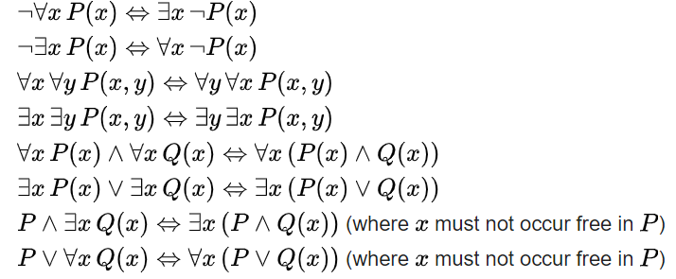
Some equivalences
A free variable is a variable not bound by a quantifier:
∀x.P(x) → Q(x) in contradistinction to ∀x.(P(x) → Q(x))

Slide 30

Flexibility in predicate formation
Some people eat too much:
∃x (person(x) Λ eats_too_much(x))
∃x (person(x) Λ eats(x, ‘too much’))
∃x ∃y (person(x) Λ eats(x, y) Λ quantity(y, ‘too much’))
However:
Are not equivalent,
Are based on a different ontology.
As a realist ontologist, make your choice on the basis of the method described in
https://genomebiology.biomedcentral.com/articles/10.1186/gb-2005-6-5-r46

Slide 31
Be careful with quantifiers
Order is important!
∀x ∃y symptomOf(x, y)
For all x, there exist some y such that x is a symptom of y
Every symptom originates from some disease;
Does not exclude that there is only one disease, and that all symptoms come from that one disease.
∃y ∀x symptomOf(x, y)
There exist some y, such that for all x, x is a symptom of y
There is a disease which is the cause of all symptoms that exist.

Slide 32
Be aware of ambiguities in language
‘Every patient has some provider’
Can mean:
∀x ∃y patientOf(x, y)
For all x, there exist some y such that x is a patient of y
Every patient has some provider.
∃y ∀x patientOf(x, y)
There exist some y, such that for all x, x is a patient of y
There is some provider that provides for all patients.

Slide 33
Description Logics

Slide 34
Description Logic(s)
A DL is a fragment of FOL.
DLs come in many varieties, most of which are decidable.
A logic is decidable if there is an effective method for determining whether arbitrary formulas of the logic are logically valid formulas.
A FOL is not decidable if its signature (i.e. the list and description of non-logical symbols) includes equality and at least one other predicate with two or more arguments.
Flavors: https://en.wikipedia.org/wiki/Description_logic .

Slide 35
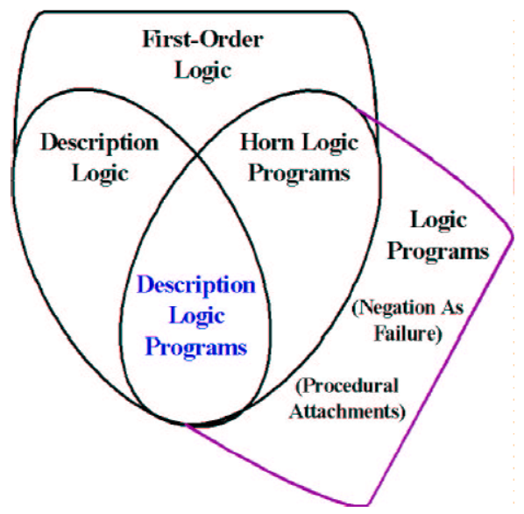
Relations between some logics
DL
Benjamin Grosof , Ian Horrocks, Raphael Volz, Stefan Decker.
Description Logic Programs: Combining Logic Programs with Description Logic. 2004 Research Papers in Economics.. http://www.cs.man.ac.uk/~horrocks/Publications/download/2003/p117-grosof.pdf

Slide 36
Description Logic(s)
Three essential components of a DL system:
Abox: Father(john). concept assertion
fatherOf(john, barry). role assertion
john ≠ barry
…
Tbox: Father Parent concept inclusion
Person ≡ Human concept equivalence
…
Rbox: fatherOf parentOf role inclusion
disjoint(parentOf, childOf) disjointness of roles
…
Assertions need to be interpreted as being about sets.

Slide 37
DL constructors
Male Parent intersection / conjunction
Male Female union / disjunction
¬ Male complement / negation
…
Can be used in Tbox axioms, e.g.
Father ≡ Male Parent
T Male Female everything is included in the set of males and females
Male Female ⊥ the intersection of the set of males and the set of females is empty
…
Markus Krötzsch, Frantisek Simancik, Ian Horrocks. A Description Logic Primer. https://arxiv.org/pdf/1201.4089.pdf

Slide 38
Role restrictions
Universal restriction:
∀parentOf.Female
The set of individuals all of whose children are female including those that have no children at all.
Existential restriction:
∃parentOf.T
The set of individuals that are parents of at least one individual.
Combinations:
construct: ∃parentOf.T ∀parentOf.Female
The set of all individuals with at least one child, all children being female.
axiom: ∃sonOf.T male
The set of individuals that are the son of at least one individual is a subset of the set of males.
Markus Krötzsch, Frantisek Simancik, Ian Horrocks. A Description Logic Primer. https://arxiv.org/pdf/1201.4089.pdf

Slide 39
Characteristics of OWL-based DLs
Ideal for fixing the terminology of a domain
→ constructors
DL-reasoners can detect contradicting definitions and classify terms automatically
Drawbacks:
Based on non-defeasible logic, hence no exceptions are possible
One cannot:
represent classes of classes,
make statements about classes
‘Tweaking’ axioms for desired outcomes though ontologically nonsensical

Slide 40

A ‘must’ read

Slide 41
Say no more …
‘ 6.2. Conclusion
In summary, OWL has been a major step forward for representing terminologies and the invariant part of background knowledge bases. However, the W3C’s standardisation on OWL has led to pressure to use OWL, often beyond its limitations and contributed to confusion over vocabulary and to neglect and misunderstanding of other representations.’
Rector, A., Schulz, S., Rodrigues, J. M., Chute, C. G., & Solbrig, H. (2019).
On beyond Gruber: "Ontologies" in today's biomedial information systems and the limit of OWL.
Journal of Biomedical Informatics: X, 2(June, 2019), Article 100002.
https://doi.org/10.1016/j.yjbinx.2019.100002
https://www.sciencedirect.com/science/article/pii/S2590177X19300010?via%3Dihub

Slide 42
Common Logic (barely scratching the surface)

Slide 43
Common Logic (CL)
CL is a family of first-order logics which share a common abstract syntax and model theory, and an XML framework for encoding and transmitting them, or their content, on an open network.
CL syntax is very relaxed in the expressions it allows, in some ways going beyond classical FO logic.
ISO standard: https://standards.iso.org/ittf/PubliclyAvailableStandards/c066249_ISO_IEC_24707_2018.zip
https://www.w3.org/2004/12/rules-ws/slides/pathayes.pdf

Slide 44
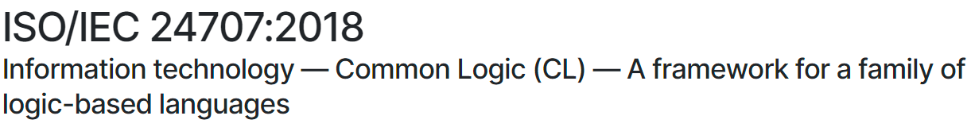
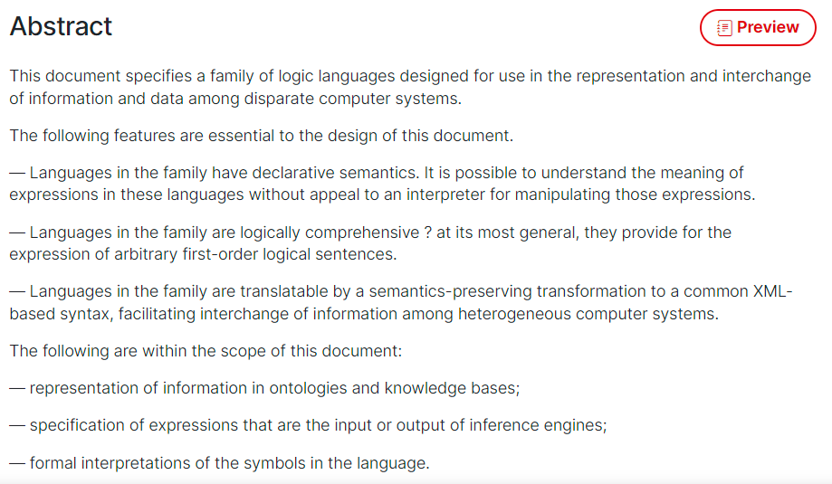
CLIF ISO Standard
https://www.iso.org/standard/66249.html

Slide 45
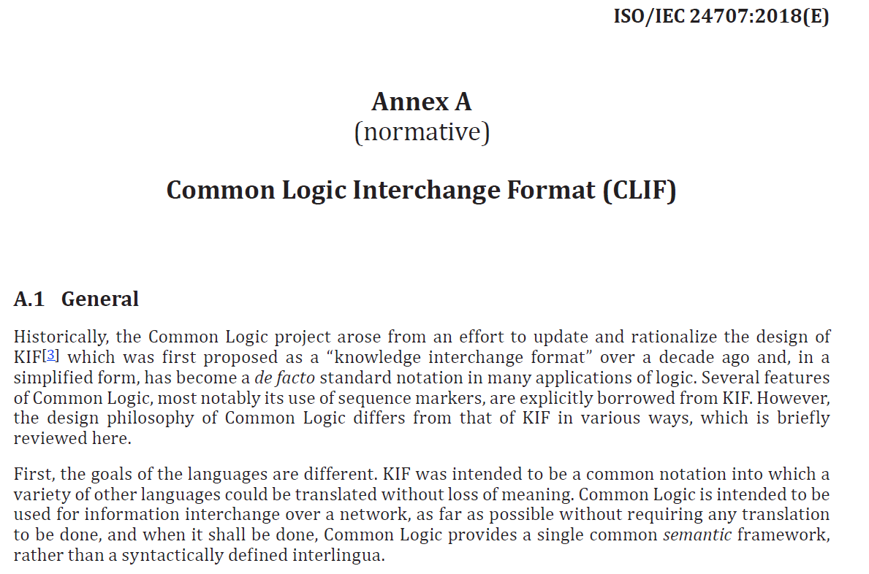
CLIF

Slide 46
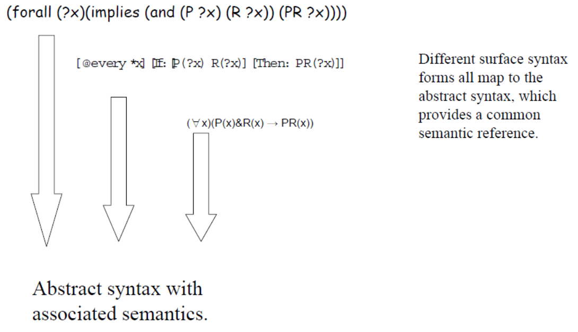
CL dialects
https://www.w3.org/2004/12/rules-ws/slides/pathayes.pdf

Slide 47
Gentle introduction to BFO’s axiomatization
BFO’s basic assumptions

Slide 48
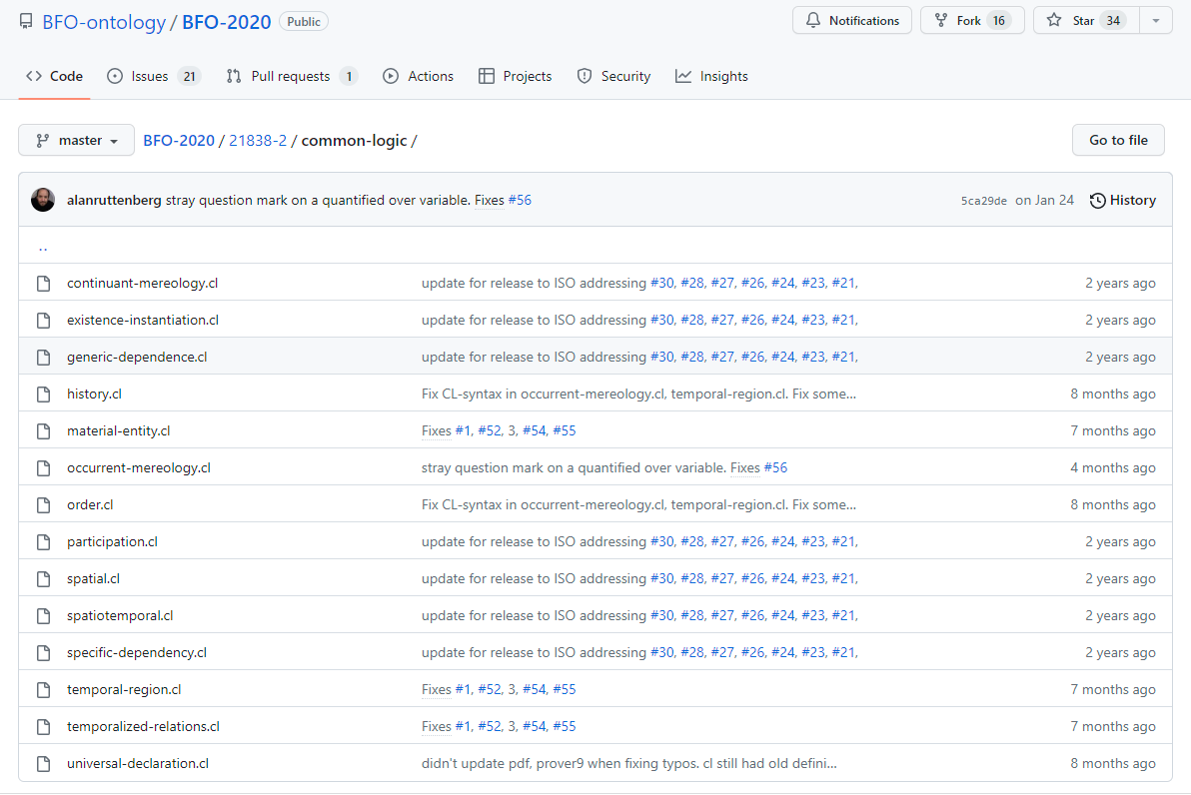
BFO2020-CLIF
https://github.com/BFO-ontology/BFO-2020/tree/master/21838-2/common-logic

Slide 49
BFO2020 axiomatization in CLIF
Uses only parts of the CLIF specifications.
Expressed in FOL with as important features:
use of equality,
(1-,) 2-, and 3-ary predicates,
no functions,
no sequence markers,
standard PL/FOL connectives:
OR, AND, IF, IFF, NOT
universal and existential quantification
FORALL, EXISTS
‘Realism-based’ choice of predicates.

Slide 50
‘BFO2020-style’ CLIF template
(cl:comment
" SOME TEXT "
(cl:text
(cl:ttl "SOME TEXT"
(cl:outdiscourse PREDICATE-NAMES )
(cl:comment "SOME TEXT [AXIOM-ID]"
( ...AXIOM...) )
(cl:comment "SOME TEXT [AXIOM-ID]"
( ...AXIOM...) )
…
)))

Slide 51
‘Particulars exist at some time’
(forall (p) (if (particular p) (exists (t) (exists-at p t))))
⇓ Standard FOL notation
∀p ( particular(p) → (∃t existsAt(p, t)))
The CL axiomatization contains also:
(cl:outdiscourse continuant-part-of temporal-part-of
exists-at particular universal instance-of)

Slide 52
‘Particulars exist at some time’
(forall (p) (if (particular p) (exists (t) (exists-at p t))))
⇓ Standard FOL notation
∀p ( particular(p) → (∃t existsAt(p, t)))
The CL axiomatization contains also:
(cl:outdiscourse continuant-part-of temporal-part-of
exists-at particular universal instance-of)
= ‘we don’t talk of these’, ‘they are not ‘individuals’ in our domain (of discourse)’
Do not confuse this with ‘individuals’ as synonym for ‘particular’ in ontological realism.
Only the p’s and t’s in the above are in the domain.

Slide 53
Individual universals are in the domain of discourse, but not ‘universal’ !!!
(cl:comment "1. There is always something that exists“
(forall (t)
(if (instance-of t temporal-region t)
(exists (u i) (and (not (= i t))
(universal u)
(particular i)
(instance-of i u t))))))
(cl:comment "No role changes type during its existence [bks-1]"
(forall (o)
(if (exists (t) (instance-of o role t))
(forall (u)
(if (exists (t) (instance-of o u t))
(forall (t) (iff (instance-of o role t) (instance-of o u t))))))))

Slide 54
‘Particulars exist at some time’
(forall (p) (if (particular p) (exists (t) (exists-at p t))))
⇓ Standard FOL notation
∀p ( particular(p) → (∃t existsAt(p, t)))
Is there anything here that says that ‘t’ or ‘time(t)’ is a time?
No!

Slide 55
However!
(cl:comment "6. Particulars exist at some time"
(forall (p)
(if (particular p) (exists (t) (exists-at p t)))))
(cl:comment "9. Relata of exists-at are particulars."
(forall (i t)
(if (exists-at i t)
(and (particular i)
(particular t)
(instance-of t temporal-region t)))))
→ The CLIF sentences do not reflect the comments faithfully, and vv. This doesn’t mean they are wrong.

Slide 56
‘Realism-based’ predicates
Criteria:
Restricted to formal relations.
Grounded in the distinction between types (universals and defined classes) and particulars.
Use of temporal indexing.
Example: ‘all soccer balls are round’
FOL with properties ‘fantologically conceived’:
(forall (x) (if (soccer-ball x) (round x)))
Realism-based (but perhaps not faithfull):
(forall (x t)
(if (instance-of x soccer-ball t)
(exists (y)
(and (instance-of y round t)
(inheres-in y x)))))
http://ontology.buffalo.edu/bfo/Against_Fantology.pdf

Slide 57

Deflated soccer balls are not round
No problem for fantologists:
(forall (x) (if (deflated-soccer-ball x)
(not-round x)))
For realism-based ontologists:
One should not cram everything
together in a predicate
Explicit time-indexing draws attention to issues of generalization
…
Trying to adhere to realism-based principles requires thinking beyond merely applying logic.
https://soccerlifestyle.com/how-to-deflate-a-soccer-ball/

Slide 58
Educational tools to train logical AND ontological thinking
For working with BFO2020-style CLIF:
BFO2020-style CLIF template,
BFO2020-style CLIF parser with:
Various error-checking functions,
Warnings,
Tracking ontology-dependencies,
Conversion to various formats.
CLIF → CNF → CF → Kowalski rules
Kowalski-rule-based reasoner:
Consistency checking for fact-based scenarios,
Predicate derivation.

Slide 59
Why a possible improvement?
Making it easier to grasp what BFO really says about reality
Way less, and more, than I thought!
Improving quality of ontology design by using FOL as a basis:
Detecting inconsistencies
Identifying unintended consequences
Improving quality of information systems, especially electronic healthcare records and repositories.
Leveraging Referent Tracking.

Slide 60
Example: simplification of axioms (1)
(cl:comment "No role changes type during its existence [bks-1]“
(forall (o)
(if (exists (t) (instance-of o role t))
(forall (u)
(if (exists (t) (instance-of o u t))
(forall (t) (iff (instance-of o role t) (instance-of o u t))))))))
Conversion to Kowalski-rules (in Prolog-readable syntax):
kow(if([['instance-of',E,D,A],
['instance-of',E,D,C],
['instance-of',E,role,B]]),
then(['instance-of',E,role,A]))).
Redundant literals can be removed
kow(if([['instance-of',E,role,A],
['instance-of',E,D,C],
['instance-of',E,role,B]]),
then(['instance-of',E,D,A]))).

Slide 61
Example: simplification of axioms (2)
kow(if([['instance-of',E,D,A],
['instance-of',E,role,B]]),
then(['instance-of',E,role,A]))).
Rename singular variable and re-order
kow(if([['instance-of',E,D,A],
['instance-of',E,role,B]]),
then(['instance-of',E,role,A]))).
Rename variables to match other formula
kow(if([['instance-of',E,D,A],
['instance-of',E,role,B]]),
then(['instance-of',E,role,A]))).
kow(if([['instance-of',E,role,A],
['instance-of',E,D,C],
then(['instance-of',E,D,A]))).
kow(if([['instance-of',E,D,B],
['instance-of',E,role,A],
then(['instance-of',E,D,A]))).
kow(if([['instance-of',E,D,A],
['instance-of',E,role,B],
then(['instance-of',E,D,B]))).

Slide 62
Example: simplification of axioms (3)
kow(if([['instance-of',E,D,A],
['instance-of',E,role,B]]),
then(['instance-of',E,role,A]))).
Back to CLIF:
(forall (e d b a)
(if (and (instance-of e d a) (instance-of e role b))
(and (instance-of e role a) (instance-of e d b))))
Compare with:
(forall (o)
(if (exists (t) (instance-of o role t))
(forall (u)
(if (exists (t) (instance-of o u t))
(forall (t) (iff (instance-of o role t)
(instance-of o u t))))))))
kow(if([['instance-of',E,D,A],
['instance-of',E,role,B],
then(['instance-of',E,D,B]))).

Slide 63
5 forms of Kowalski rules
‘if-then’-rules:
( A & B & … ) → P
true → P
‘if-then-or’-rules:
( A & B & …) → ( P v Q v … )
true → ( P v Q v … )
‘false-hood’-rules:
( A & B & … ) → false

Slide 64
Horn Logic
‘if-then’-rules:
( A & B & … ) → P
true → P
‘if-then-or’-rules:
( A & B & …) → ( P v Q v … )
true → ( P v Q v … )
‘false-hood’-rules:
( A & B & … ) → false
A, B, … may be true or false
P must be true

Slide 65
Current reasoning modes
Classic Propositional
Modus ponendo ponens
Modus ponendo tollens
Modus tollendo tollens
Modus tollendo ponens
Possible world approach to assumptions
Heuristics
Limits on function embedding
Tame incompleteness

Slide 66
‘BFO2020-style’ CLIF reasoner current reasoning modes (1)
ont = defined in ontology
mpp = modus ponendo ponens:
A ( ...& ... ) → B
A ( ...& ... )
---------------------
B
mpt = modus ponendo tollens:
(A & ...) & B → false
(A & ...)
--------------------------
not B

Slide 67
‘BFO2020-style’ CLIF reasoner current reasoning modes (2)
mtt = modus tollendo tollens:
A → B
not B
------
not A
A & B & C → D
not D
A
B
------
not C
mtp = modus tollendo ponens:
A → B v C
A
not B
------
C
alternative generation
A → B v C
A
------
B v C

Slide 68
‘BFO2020-style’ CLIF reasoner current reasoning modes (4)
Reductio ad absurdum:
rana = ra with negative assumption
B v C
assume not B
------
inconsistent → B
rapa = ra with positive assumption
B v C
assume B
------
inconsistent → not B
repl: replicate
fact with A
A = B
--------
fact with B

Slide 69
‘BFO2020-style’ CLIF reasoner current reasoning modes (3)
Computing undeniables from remaining alternatives ...
mtpa: mtp on alternatives
(B v C v D) & not B & not D → C
tapw: true in all possible worlds
Process one by one all instantiated rule R of form: ‘true → A v B v …’
Assume each consequent of R to be true in its own possible world and further inference using proven facts from the base world and the specific possible world
Processing in a possible world stops when either
inconsistency derived, → assumed alternative false in the base world
If no further facts can be derived, evaluate all possible worlds (PW) for R
if all PW inconsistent: then either the set of axioms is inconsistent or the input facts
if all but one possible worlds leads to an inconsistency: then the orginal assumption for that one world is true in the base world as well as all derivations made
if at least two PW not inconsistent: the derivations which are exactly similar in all PW are true in the base world. The original assumptions for these PW are then NOT proven.

Slide 70
Why possible worlds? Some very odd conversions, eg [ild-1]
(cl:comment "participates-in is time indexed and has domain: independent-continuant but not spatial-region or specifically-dependent-continuant or generically-dependent-continuant and range: process [ild-1]"
(forall (a b t)
(if (participates-in a b t)
(and (or (and (instance-of a independent-continuant t)
(not (instance-of a spatial-region t)))
(instance-of a specifically-dependent-continuant t)
(instance-of a generically-dependent-continuant t))
(instance-of b process t)
(instance-of t temporal-region t)))))
‘or’ here reads as XOR but is not XOR!

Slide 71
Reasoning example
(cl:comment "participates-in is time indexed and has domain: independent-continuant but not spatial-region or specifically-dependent-continuant or generically-dependent-continuant and range: process [ild-1]"
(forall (a b t)
(if (participates-in a b t)
(and (or (and (instance-of a independent-continuant t)
(not (instance-of a spatial-region t)))
(instance-of a specifically-dependent-continuant t)
(instance-of a generically-dependent-continuant t))
(instance-of b process t)
(instance-of t temporal-region t)))))
‘or’ here reads as XOR but is not XOR!

Slide 72
ILD-1 generates 4 rules
If([participates-in,A,B,C]) →
then_or([ [instance-of,A,generically-dependent-continuant,C],
[instance-of,A,independent-continuant,C],
[instance-of,A,specifically-dependent-continuant,C] ]).
if([participates-in,A,B,C]),then([instance-of,B,process,C]).
if([participates-in,A,B,C]),then([instance-of,C,temporal-region,C]).
if([ [instance-of,A,spatial-region,C],
[participates-in,A,B,C]]) →
then_or( [ [instance-of,A,generically-dependent-continuant,C],
[instance-of,A,specifically-dependent-continuant,C] ]).
?

Slide 73
Reasoner input
Kowalski-rule base from axiomatized ontologies,
Assertions in referent tracking style:
Example:
t([0,instance-of,p,process,t]).
t([0,instance-of,s,spatial-region,t]).
t([0,participates-in, s, p, t]).

Slide 74
Reasoner at work …
BFO2020 Style CLIF reasoner, Version April 16, 2025
Copyright: Werner Ceusters. All rights reserved.
PRE-PROCESSING
Checking start conditions ...OK!
Optimizing Kowalski input ...
Reading data input ...
Total facts: 6
REASONING
modus ponendo ponens ...
Total facts: 239
modus ponendo tollens ...
Total facts: 436
modus tollendo tollens ...
Total facts: 552
modus tollendo ponens ...
Total facts: 552
% 3,424,691 inferences, 1.797 CPU in 1.906 seconds (94% CPU, 1905915 Lips)
INCONSISTENCY FOUND: []
Rule: -101
Axiom: BFO-ild-1
[]
Inconsistent facts: [[instance-of,s,spatial-region,t]]
Saving inconsistency proof to CLIFreasoner-inconsistency-proof.csv
Writing skolem constants to CLIFreasoner-main_skolems.txt
Press any character key to finish.
|:

Slide 75
Inconsistency proof
Input in CLIF notation:
(instance-of p process t)
(instance-of s spatial-region t)
(participates-in s p t)
553 | ERROR | inconsistency |  |  |  | -101 | BFO-ild-1 | inc | 4 | 552
552 | FALSE | 'instance-of' | s | 'spatial-region' | t | 261 | BFO-ild-1 | mtt | 341 | 342 | 6
342 | FALSE | 'instance-of' | s | 'specifically-dependent-continuant' | t | 671 | BFO-cig-1 | mpt | 75
341 | FALSE | 'instance-of' | s | 'generically-dependent-continuant' | t | 673 | BFO-cig-1 | mpt | 75
75 | TRUE | 'instance-of' | s | 'independent-continuant' | t | 138 | BFO-udu-1 | mpp | 11
11 | TRUE | 'instance-of' | s | 'immaterial-entity' | t | 616 | BFO-bre-1 | mpp | 4
6 | TRUE | 'participates-in' | s | p | t | 0 | unmarked | input
4 | TRUE | 'instance-of' | s | 'spatial-region' | t | 0 | unmarked | input

Slide 76
Assignment A10
Prepare a PowerPoint presentation of your ontology for presentation (A11) in two weeks. It must contain:
Purpose statement
Explanation of 3 types (below BFO and OGMS levels) most central with respect to the ontology’s purpose
History of all changes made over versions and motivations therefore for the type of these 3 that changed the most
Where your ontology fits in the overall merged ontology developed in C12 (A9) for practical purposes.
Unresolved issues
Lessons learned
15-20 minutes presentation / 15-10 minutes discussion
Due date: Dec 1 – noon. Uploaded as usual.

Slide 77
Note !!!
Paper for final exam is uploaded to UB Box
BMI508-2025-finalexampaper.pdf
Task: read it. Questions can be asked and will be answered after your presentations during C14.

Slide 78
Axiom exercises

