Slide 1
BMI508 – Fall 2025
Introduction to Biomedical Ontology
Class 9 – Oct 22, 2025
Principles for Change Management in Ontologies
Werner CEUSTERS^{1,2}
¹ Department of Biomedical Informatics, University at Buffalo, USA
² Department of Psychiatry, University at Buffalo, USA

Slide 2
Required reading for next week
R13: Amith, M., et al., Assessing the practice of biomedical ontology evaluation: Gaps and opportunities. J Biomed Inform, 2018. 80: p. 1-13. [10]
https://www.sciencedirect.com/science/article/pii/S1532046418300285
NO assignment, however next week: in-class test T2 on all material covered thus far!

Slide 3
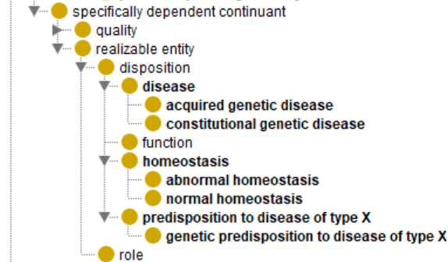
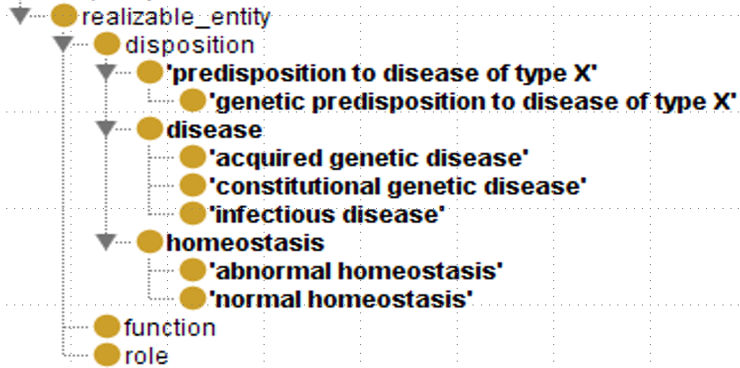
Different OGMS versions on ‘disposition’
← Older
Newer →

Slide 4
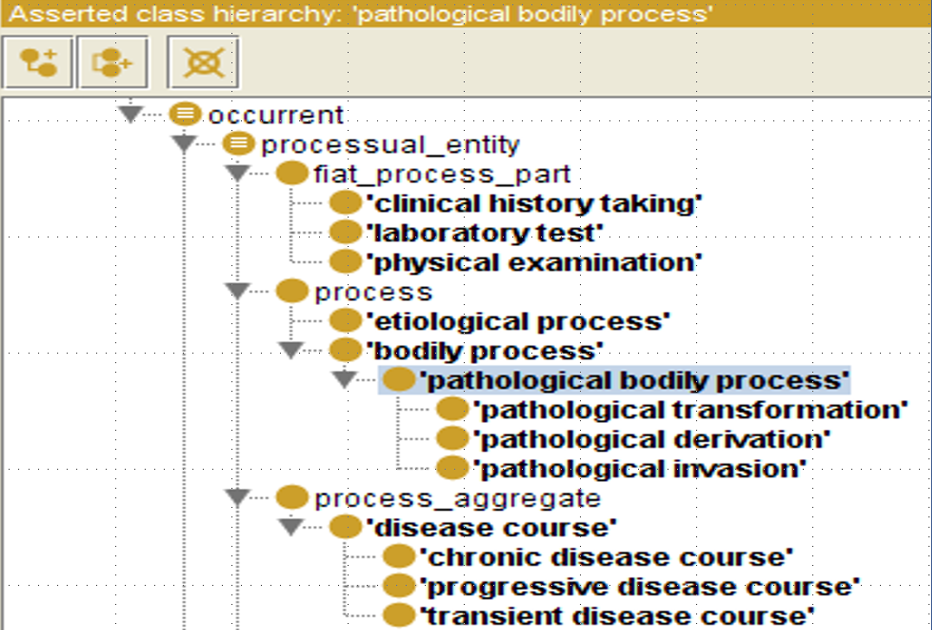
Previous OGMS version on ‘occurrent’

Slide 5
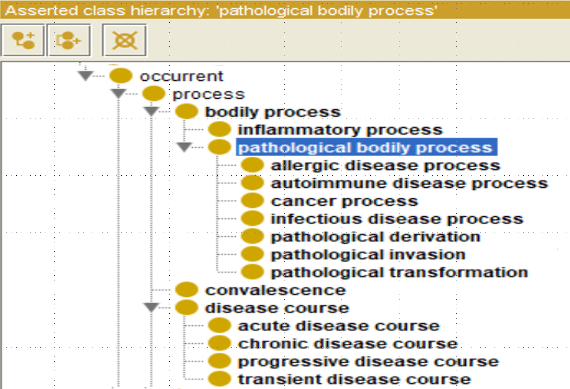
Latest OGMS version on ‘occurrent’

Slide 6
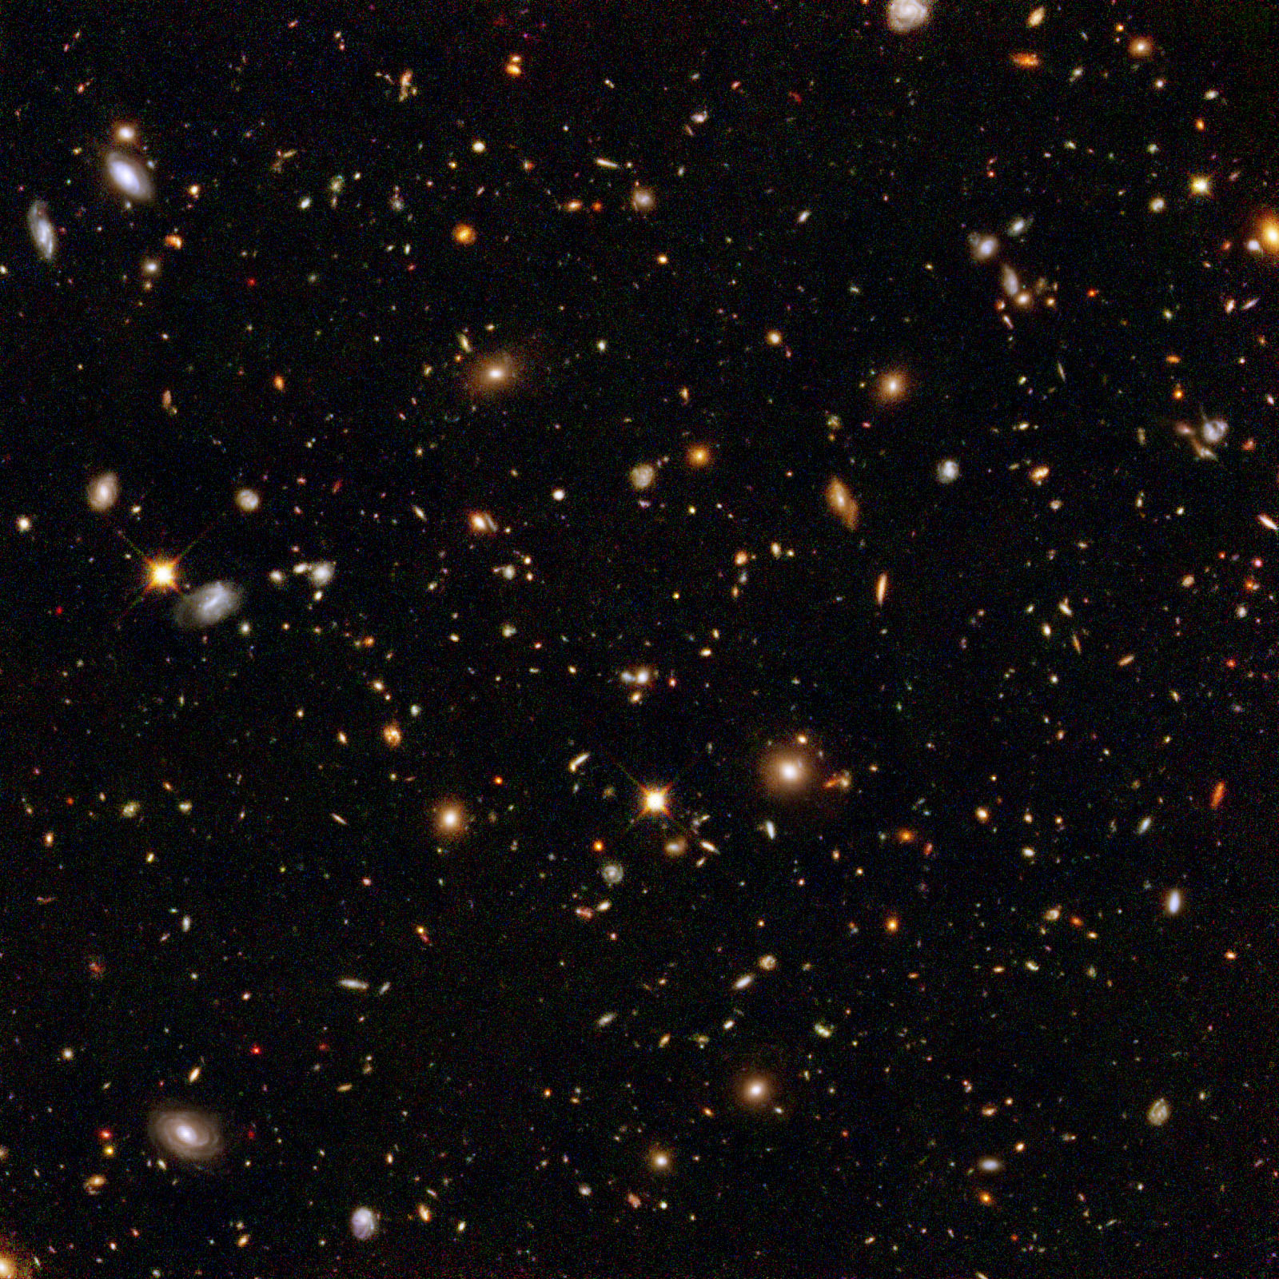

Ontological Realism claims about reality:
There is an external reality which is ‘objectively’ the way it is;
That reality is accessible to us;
We build in our brains cognitive representations of reality;
We communicate with others about what is there, and what we believe there is there.
Smith B, Kusnierczyk W, Schober D, Ceusters W. Towards a Reference Terminology for Ontology Research and Development in the Biomedical Domain. Proceedings of KR-MED 2006, Biomedical Ontology in Action, November 8, 2006, Baltimore MD, USA

Slide 7
Ontological Realism’s aim for representations:
A representation should be faithful (veridical) with respect to the part of the reality that it covers
Smith B, Ceusters W. Ontological Realism as a Methodology for Coordinated Evolution of Scientific Ontologies. Applied Ontology, 2010;5(3-4):139-188.

Slide 8



Ontological Realism’s aim for representations:
A representation should be faithful (veridical) with respect to the part of the reality that it covers
Smith B, Ceusters W. Ontological Realism as a Methodology for Coordinated Evolution of Scientific Ontologies. Applied Ontology, 2010;5(3-4):139-188.

Slide 9
Scientific Realism
Our best scientific theories give true or approximately true descriptions of observable and unobservable aspects of a mind-independent world.
http://plato.stanford.edu/entries/scientific-realism/#WhaSciRea

Slide 10
Representational artifacts
Ideally built out of representational units and relationships that mirror the entities and their relationships in reality.
 | Non-Formalized | Formalized
Primarily about particulars | Progress notes, discharge letters, medical summaries, maps | Inventories, referent tracking database
Primarily about universals and defined classes | Medical textbooks, scientific theories | Ontologies, terminologies,

Slide 11
Scientific Realism
Our best scientific theories give true or approximately true descriptions of observable and unobservable aspects of a mind-independent world.
A reference ontology is an ontology that is created in such a way as to serve the representation of what are assumed to be corresponding types in reality.
http://plato.stanford.edu/entries/scientific-realism/#WhaSciRea
Ontological Realism
Smith B, Ceusters W.
Ontological Realism as a Methodology for Coordinated Evolution of Scientific Ontologies.
Applied Ontology, 2010;5(3-4):139-188.

Slide 12
Central research questions
How can ontologies be designed in such a way that:
they are faithful representations of reality, and that
changes introduced in updates reflect faithfully corresponding changes in reality?
What are the requirements for formalisms able to concretize ontologies satisfying (1a) and (1b) to allow users thereof acquiring a faithful representation of the changes in reality by merely looking at the changes in the ontology?

Slide 13
Some characteristics of representational units
each unit is assumed by the creators of the representation to be veridical, i.e. to conform to some relevant portion of reality (POR) as conceived on the best current scientific understanding;
several units may correspond to the same POR by presenting different though still veridical views or perspectives;
what is to be represented by the units in a representation depends on the purposes which the representation is designed to serve.

Slide 14
What influences the development of ontologies?
Level of biomedical reality:
  Persons, diseases, pathological structures and formations,... do exist as particulars (p, d, ps, pf, ... ) and universals (P, D, PS, PF, ...), and are related in specific ways prior to our perception;
  Biomedical reality changes:
    d’s, p’s, ... come and go; D’s, P’s, ...
Level of biomedical science and case perception:
  Mirrors reality only partially.
  Evolves over time towards better understanding.

Slide 15
What influences the development of ontologies?
Level of concretizations:
  Mirrors biomedical science and case perception only partially:
    Editing mistakes;
    Leaving out diseases or pathological behaviours for non-biomedical reasons:
      Smoking;
    Adding non-pathological behaviour as a disease:
      Homosexuality;
    Leaving out wat is considered not relevant.

Slide 16
Reality versus representations, both in evolution
t
U1
U2
Reality
p3
Some represented PORs:
  (2) the history of 2 universals (U1, U2),
  (1) the coming into existence of particular p3 as an instance of U1,
  (1) the instantiation of U2 by p3,
  (1) the going out of existence of p3.

Slide 17
Reality versus representations, both in evolution
t
U1
U2
Reality
p3
Some represented PORs:
  (2) the history of 2 universals (U1, U2),
  (1) the coming into existence of particular p3 as an instance of U1,
  (1) the instantiation of U2 by p3,
  (1) the going out of existence of p3.
At least 2 other events must have happened. Which ones?

Slide 18
Reality versus representations, both in evolution
t
U1
U2
Reality
p3
Some represented PORs:
  (2) the history of 2 universals (U1, U2),
  (1) the coming into existence of particular p3 as an instance of U1,
  (1) the instantiation of U2 by p3,
  (1) the going out of existence of p3.
At least 2 other events must have happened. Which ones?
  (1) the coming into existence of some particular as an instance of U1,
  (2) either that particular becoming an instance of U2, OR the coming into existence of a third particular as an instance of U2.

Slide 19
If something exists, it instatiates a universal and vice-versa [bee-1]
(forall (a t)
(iff (exists (u)
(and (universal u)
(instance-of a u t)
(instance-of t temporal-region t)))
(and (particular a)
(instance-of t temporal-region t)
(exists-at a t))))

Slide 20
Reality versus representations, both in evolution
t
U1
U2
Reality
p3
IUI-#3
O-#0
O-#2
Representation
O-#1
= ‘denotes’
= what constitutes the meaning of representational units
…. Therefore: O-#0 is meaningless

Slide 21
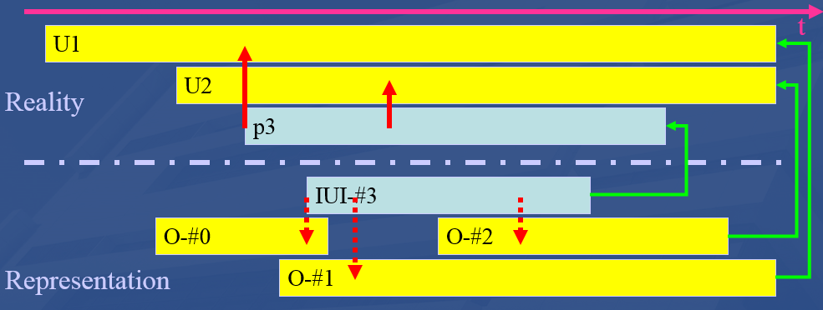
Reality versus representations, both in evolution
‘Representation’:
  can be beliefs (B) and communicated representations (CR);
  Bs and CRs from some author #n usually don’t contradict each other;
    some exceptions: lying, deception, priorities in updates, …
Schema shows the case for universals and instantiations, but the phases are equally valid for configurations and axioms.

Slide 22
Milestones in scientific discovery and case assessment.
U1
t
U2
p3
IUI-#3
O-#0
O-#2
O-#1

Slide 23
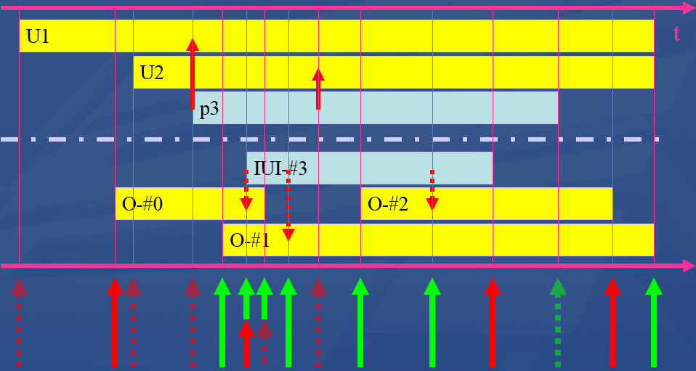
Milestones in scientific discovery and case assessment.
What sort of milestones do the arrows represent?
Discovery
Being lucky
Misrepresentation
Being ignorant
Note: do not confuse the red arrows:
In ‘reality’ portion: instantiation
In ‘representation’ portion: assertion of instantiation
At the bottom: milestones

Slide 24
Representation versus reality in ontologies
U1
t
U2
p3
IUI-#3
O-#0
O-#2
O-#1
Total ignorance. Example: a disease already exists, but instances thereof have gone unnoticed thus far (e.g. AIDS).

Slide 25
Representation versus reality in ontologies
U1
t
U2
p3
IUI-#3
O-#0
O-#2
O-#1
Start of false belief in the existence of a type, e.g. ‘diabolic possession’
Caveats: ‘type-illusion’ and ‘type-delusion’

Slide 26
Representation versus reality in ontologies
U1
t
U2
p3
IUI-#3
O-#0
O-#2
O-#1
The coming into existence of a new universal remains unnoticed: Covid-19 existed before being discovered.

Slide 27
Representation versus reality in EHR
U1
t
U2
p3
IUI-#3
O-#0
O-#2
O-#1
Some patient develops AIDS but nobody notices (pre-clinical phase)

Slide 28
Representation versus reality in ontologies
U1
t
U2
p3
IUI-#3
O-#0
O-#2
O-#1
An advance in science: the existence of U1 became acknowledged.

Slide 29
Representation versus reality in an EHR
U1
t
U2
p3
IUI-#3
O-#0
O-#2
O-#1
The existence of John Doe’s aberrant behavior is acknowledged, however, believed to be an instance of what in reality is a fantasy: diabolic possession.

Slide 30
Representation versus reality in ontologies
U1
t
U2
p3
IUI-#3
O-#0
O-#2
O-#1
Another advance in science: the false belief O-#0 is rightfully abandoned, necessitating therefore to reconsider of what p3 must be believed to be an instance of.

Slide 31
Representation versus reality in ontologies
U1
t
U2
p3
IUI-#3
O-#0
O-#2
O-#1
Advance in science: “AIDS” is discovered as a new disease entity.

Slide 32
Representation versus reality in ontologies
U1
t
U2
p3
IUI-#3
O-#0
O-#2
O-#1
For ‘utilitarian’ reasons, lobbyists succeed in smoking to be removed from an ontology as risk factor for cancer.

Slide 33
A possible ontology evolution
V1
O-#0

Slide 34
A possible ontology evolution
V2
V1
O-#0 & O-#1
O-#0

Slide 35
A possible ontology evolution
V3
V2
V1
O-#0 & O-#1 [& #3 instanceOf O-#0]
O-#0 & O-#1
O-#0

Slide 36
A possible ontology evolution
V4
V3
V2
V1
O-#1 [& #3 instanceOf O-#0]
O-#0 & O-#1 [& #3 instanceOf O-#0]
O-#0 & O-#1
O-#0

Slide 37
A possible ontology evolution
V5
V4
V3
V2
V1
O-#2 & O-#1
O-#1 [& #3 instanceOf O-#0]
O-#0 & O-#1 [& #3 instanceOf O-#0]
O-#0 & O-#1
O-#0

Slide 38
A possible ontology evolution
V6
V5
V4
V3
V2
V1
O-#1
O-#2 & O-#1
O-#1 [& #3 instanceOf O-#0]
O-#0 & O-#1 [& #3 instanceOf O-#0]
O-#0 & O-#1
O-#0

Slide 39
Sorts of changes in ontologies: the simplistic main view
Ontology versions exhibit differences of the following sorts:
  Add a subtree
  Delete a subtree
  Move a subtree to a different location
  Move a set of sibling classes to a different location
  Create a new abstraction and move a set of siblings down in a class hierarchy, creating a new superclass.
  Delete a class, moving its subclasses to become subclasses of its superclass.
  Split a class
  Merge classes
These distinctions don’t tell us the motivations behind the changes
Noy, N.F., Kunnatur, S., Klein, M., and Musen, M.A. Tracking changes during ontology evolution. In Proceeding of the 3rd International Semantic Web Conference (ISWC2004), Hiroshima, Japan, November 2004.

Slide 40
An “optimal” ontology (1)
Because ontologies, as conceived on realist terms,
  are artifacts created for some purpose (e.g. to serve as controlled vocabulary, or to provide domain knowledge to a software application),
  are at the same time intended to mirror reality,
  should allow reasoning which is efficient from a computational point of view,
we argue that an optimal ontology should constitute a representation of all and only those portions of reality that are relevant for its purpose.

Slide 41
An “optimal” ontology (2)
Each term in such an ontology would designate
  (1) a single portion of reality (POR), which is
  (2) relevant to the purposes of the ontology and such that
  (3) the authors of the ontology intended to use this term to designate this POR, and
  (4) there would be no PORs objectively relevant to these purposes that are not referred to in the ontology
  (5) there would be no relevant PORs designated more than once.

Slide 42
But things may go wrong …
assertion errors:
  ontology developers may be in error as to what is the case in their target domain;
relevance errors:
  they may be in error as to what is objectively relevant to a given purpose;
encoding errors:
  they may not successfully translate their underlying cognitive representations, so that particular representational units fail to point to the intended PORs.

Slide 43
Key requirement for versioning
Any change in an ontology or data repository should be associated with the reason for that change to be able to assess later what kind of mistake has been made !

Slide 44
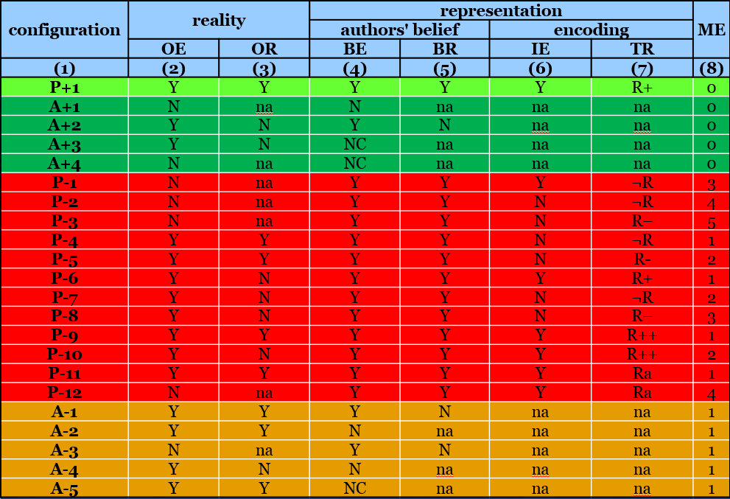
RU – reality correspondence types
1st version (2006):
Ceusters W, Smith B. A Realism-Based Approach to the Evolution of Biomedical Ontologies. Proceedings of AMIA 2006, Washington DC, 2006;:121-125.
1st revision (2009):
Ceusters W. Applying Evolutionary Terminology Auditing to the Gene Ontology. Journal of Biomedical Informatics 2009;42:518–529.
2nd revision (2014):
Seppãlã S, Smith B, Ceusters W. Applying the realism-based ontology versioning method for tracking changes in the Basic Formal Ontology. Formal Ontology in Information Systems. Proceedings of the Eight International Conference (FOIS 2014), Amsterdam: IOS Press, 2014;:227-240.

Slide 45
RU – reality correspondence types
configuration | reality |  | representation |  |  |  | ME
 |  |  | authors' belief |  | encoding
 | OE | OR | BE | BR | IE | TR
(1) | (2) | (3) | (4) | (5) | (6) | (7) | (8)
Reality:
  OE: Objective existence
  OR: Objective relevance
          Representation:
            BE: Author’s belief in existence
            BR: Author’s belief in relevance
              IE: Author’s intended encoding
              TR: Type of reference

Slide 46
configuration | reality |  | representation |  |  |  | ME
 |  |  | authors' belief |  | encoding
 | OE | OR | BE | BR | IE | TR
(1) | (2) | (3) | (4) | (5) | (6) | (7) | (8)
P+1
A+1
A+2
A+3
A+4
P-1
P-2
P-3
P-4
P-5
P-6
P-7
P-8
P-9
P-10
P-11
P-12
A-1
A-2
A-3
A-4
A-5
Configuration types
    P: present in the ontology
      P+: justifiably present
      P–: unjustifiably present
    A: absent from the ontology
      A+: justifiably absent
      A–: unjustifiably absent

Slide 47
configuration | reality |  | representation |  |  |  | ME
 |  |  | authors' belief |  | encoding
 | OE | OR | BE | BR | IE | TR
(1) | (2) | (3) | (4) | (5) | (6) | (7) | (8)
P+1
A+1
A+2
A+3
A+4
P-1
P-2
P-3
P-4
P-5
P-6
P-7
P-8
P-9
P-10
P-11
P-12
A-1
A-2
A-3
A-4
A-5
Configuration types
    1+4+12+5=22 possible configurations based on (mis)matches between reality, beliefs, and encodings

Slide 48
configuration | reality |  | representation |  |  |  | ME
 |  |  | authors' belief |  | encoding
 | OE | OR | BE | BR | IE | TR
(1) | (2) | (3) | (4) | (5) | (6) | (7) | (8)
P+1 | Y | Y | Y | Y | Y | R+ | 0
A+1 | N | na | N | na | na | na | 0
A+2 | Y | N | Y | N | na | na | 0
A+3 | Y | N | NC | na | na | na | 0
A+4 | N | na | NC | na | na | na | 0
P-1 | N | na | Y | Y | Y | ¬R | 3
P-2 | N | na | Y | Y | N | ¬R | 4
P-3 | N | na | Y | Y | N | R– | 5
P-4 | Y | Y | Y | Y | N | ¬R | 1
P-5 | Y | Y | Y | Y | N | R- | 2
P-6 | Y | N | Y | Y | Y | R+ | 1
P-7 | Y | N | Y | Y | N | ¬R | 2
P-8 | Y | N | Y | Y | N | R– | 3
P-9 | Y | Y | Y | Y | Y | R++ | 1
P-10 | Y | N | Y | Y | Y | R++ | 2
P-11 | Y | Y | Y | Y | Y | Ra | 1
P-12 | N | na | Y | Y | Y | Ra | 4
A-1 | Y | Y | Y | N | na | na | 1
A-2 | Y | Y | N | na | na | na | 1
A-3 | N | na | Y | N | na | na | 1
A-4 | Y | N | N | na | na | na | 1
A-5 | Y | Y | NC | na | na | na | 1
OE/BE value pairs
Y/Y: correct assertion of the existence of a POR;
Y/N: lack of awareness of a POR, reflecting an assertion error;
N/N: correct assertion that some putative POR does not exist ;
N/Y: the false belief that some putative POR exists;
Y/NC: not considering that some POR exists;
N/NC: not considering that some putative POR does not exist.

Slide 49
configuration | reality |  | representation |  |  |  | ME
 |  |  | authors' belief |  | encoding
 | OE | OR | BE | BR | IE | TR
(1) | (2) | (3) | (4) | (5) | (6) | (7) | (8)
P+1 | G1 | Y | Y | Y | Y | Y | R+ | 0
A+1 | G2 | N | na | N | na | na | na | 0
A+2 | G3 | Y | N | Y | N | na | na | 0
A+3 | G4 | Y | N | NC | na | na | na | 0
A+4 | G4 | N | na | NC | na | na | na | 0
P-1 | G5 | N | na | Y | Y | Y | ¬R | 3
P-2 | G6 | N | na | Y | Y | N | ¬R | 4
P-3 | G7 | N | na | Y | Y | N | R– | 5
P-4 | G6 | Y | Y | Y | Y | N | ¬R | 1
P-5 | G7 | Y | Y | Y | Y | N | R- | 2
P-6 | G1 | Y | N | Y | Y | Y | R+ | 1
P-7 | G6 | Y | N | Y | Y | N | ¬R | 2
P-8 | G7 | Y | N | Y | Y | N | R– | 3
P-9 | G8 | Y | Y | Y | Y | Y | R++ | 1
P-10 | G8 | Y | N | Y | Y | Y | R++ | 2
P-11 | G9 | Y | Y | Y | Y | Y | Ra | 1
P-12 | G9 | N | na | Y | Y | Y | Ra | 4
A-1 | G3 | Y | Y | Y | N | na | na | 1
A-2 | G2 | Y | Y | N | na | na | na | 1
A-3 | G3 | N | na | Y | N | na | na | 1
A-4 | G2 | Y | N | N | na | na | na | 1
A-5 | G4 | Y | Y | NC | na | na | na | 1
Ignoring reality
Only 9 configurations
Distinctions lost:
Justified versus unjustified absences
Correct representation versus one case of unjustified presence

Slide 50
configuration | reality |  | representation |  |  |  | ME
 |  |  | authors' belief |  | encoding
 | OE | OR | BE | BR | IE | TR
(1) | (2) | (3) | (4) | (5) | (6) | (7) | (8)
P+1 | Y | Y | Y | Y | Y | R+ | 0
A+1 | N | na | N | na | na | na | 0
A+2 | Y | N | Y | N | na | na | 0
A+3 | Y | N | NC | na | na | na | 0
A+4 | N | na | NC | na | na | na | 0
P-1 | N | na | Y | Y | Y | ¬R | 3
P-2 | N | na | Y | Y | N | ¬R | 4
P-3 | N | na | Y | Y | N | R– | 5
P-4 | Y | Y | Y | Y | N | ¬R | 1
P-5 | Y | Y | Y | Y | N | R- | 2
P-6 | Y | N | Y | Y | Y | R+ | 1
P-7 | Y | N | Y | Y | N | ¬R | 2
P-8 | Y | N | Y | Y | N | R– | 3
P-9 | Y | Y | Y | Y | Y | R++ | 1
P-10 | Y | N | Y | Y | Y | R++ | 2
P-11 | Y | Y | Y | Y | Y | Ra | 1
P-12 | N | na | Y | Y | Y | Ra | 4
A-1 | Y | Y | Y | N | na | na | 1
A-2 | Y | Y | N | na | na | na | 1
A-3 | N | na | Y | N | na | na | 1
A-4 | Y | N | N | na | na | na | 1
A-5 | Y | Y | NC | na | na | na | 1
2
4
1
3
‘na’ = not applicable
If there is no POR of a specific sort, relevance is not applicable.
If an author does not believe in some POR, believed relevance is not applicable.
If an author did not consider (‘nc’) existence of some POR, believed relevance is not applicable.
If believed relevance is either negative or not applicable, encoding is not applicable.

Slide 51
configuration | reality |  | representation |  |  |  | ME
 |  |  | authors' belief |  | encoding
 | OE | OR | BE | BR | IE | TR
(1) | (2) | (3) | (4) | (5) | (6) | (7) | (8)
P+1 | Y | Y | Y | Y | Y | R+ | 0
A+1 | N | na | N | na | na | na | 0
A+2 | Y | N | Y | N | na | na | 0
A+3 | Y | N | NC | na | na | na | 0
A+4 | N | na | NC | na | na | na | 0
P-1 | N | na | Y | Y | Y | ¬R | 3
P-2 | N | na | Y | Y | N | ¬R | 4
P-3 | N | na | Y | Y | N | R– | 5
P-4 | Y | Y | Y | Y | N | ¬R | 1
P-5 | Y | Y | Y | Y | N | R- | 2
P-6 | Y | N | Y | Y | Y | R+ | 1
P-7 | Y | N | Y | Y | N | ¬R | 2
P-8 | Y | N | Y | Y | N | R– | 3
P-9 | Y | Y | Y | Y | Y | R++ | 1
P-10 | Y | N | Y | Y | Y | R++ | 2
P-11 | Y | Y | Y | Y | Y | Ra | 1
P-12 | N | na | Y | Y | Y | Ra | 4
A-1 | Y | Y | Y | N | na | na | 1
A-2 | Y | Y | N | na | na | na | 1
A-3 | N | na | Y | N | na | na | 1
A-4 | Y | N | N | na | na | na | 1
A-5 | Y | Y | NC | na | na | na | 1
Modes of reference:
R+ | : faithful reference to correct referent
¬R | : no referent exist
R– | : reference to wrong referent
R++ | : redundant reference
Ra | : ambiguous reference

Slide 52
configuration | reality |  | representation |  |  |  | ME
 |  |  | authors' belief |  | encoding
 | OE | OR | BE | BR | IE | TR
(1) | (2) | (3) | (4) | (5) | (6) | (7) | (8)
P+1 | Y | Y | Y | Y | Y | R+ | 0
A+1 | N | na | N | na | na | na | 0
A+2 | Y | N | Y | N | na | na | 0
A+3 | Y | N | NC | na | na | na | 0
A+4 | N | na | NC | na | na | na | 0
P-1 | N | na | Y | Y | Y | ¬R | 3
P-2 | N | na | Y | Y | N | ¬R | 4
P-3 | N | na | Y | Y | N | R– | 5
P-4 | Y | Y | Y | Y | N | ¬R | 1
P-5 | Y | Y | Y | Y | N | R- | 2
P-6 | Y | N | Y | Y | Y | R+ | 1
P-7 | Y | N | Y | Y | N | ¬R | 2
P-8 | Y | N | Y | Y | N | R– | 3
P-9 | Y | Y | Y | Y | Y | R++ | 1
P-10 | Y | N | Y | Y | Y | R++ | 2
P-11 | Y | Y | Y | Y | Y | Ra | 1
P-12 | N | na | Y | Y | Y | Ra | 4
A-1 | Y | Y | Y | N | na | na | 1
A-2 | Y | Y | N | na | na | na | 1
A-3 | N | na | Y | N | na | na | 1
A-4 | Y | N | N | na | na | na | 1
A-5 | Y | Y | NC | na | na | na | 1

Slide 53
configuration | reality |  | representation |  |  |  | ME
 |  |  | authors' belief |  | encoding
 | OE | OR | BE | BR | IE | TR
(1) | (2) | (3) | (4) | (5) | (6) | (7) | (8)
P+1 | Y | Y | Y | Y | Y | R+ | 0
A+1 | N | na | N | na | na | na | 0
A+2 | Y | N | Y | N | na | na | 0
A+3 | Y | N | NC | na | na | na | 0
A+4 | N | na | NC | na | na | na | 0
P-1 | N | na | Y | Y | Y | ¬R | 3
P-2 | N | na | Y | Y | N | ¬R | 4
P-3 | N | na | Y | Y | N | R– | 5
P-4 | Y | Y | Y | Y | N | ¬R | 1
P-5 | Y | Y | Y | Y | N | R- | 2
P-6 | Y | N | Y | Y | Y | R+ | 1
P-7 | Y | N | Y | Y | N | ¬R | 2
P-8 | Y | N | Y | Y | N | R– | 3
P-9 | Y | Y | Y | Y | Y | R++ | 1
P-10 | Y | N | Y | Y | Y | R++ | 2
P-11 | Y | Y | Y | Y | Y | Ra | 1
P-12 | N | na | Y | Y | Y | Ra | 4
A-1 | Y | Y | Y | N | na | na | 1
A-2 | Y | Y | N | na | na | na | 1
A-3 | N | na | Y | N | na | na | 1
A-4 | Y | N | N | na | na | na | 1
A-5 | Y | Y | NC | na | na | na | 1
Evolution example:
A POR ceases to exist, but ontology is not updated: P+1 → P-1

Slide 54
Updating is an active process
authors assume in good faith that:
  all included representational units are of the P+1 type, and,
  all they are aware of, but not included, of A+1 … A+4.
If they become aware of a mistake, they make a change under the assumption that their changes are also towards the P+1, A+1, … A+4 cases.
Thus at that time, they know:
  of what configuration type the previous entry must have been under the belief what the current configuration is, and,
  the reason for the change.

Slide 55
configuration | reality |  | representation |  |  |  | ME
 |  |  | authors' belief |  | encoding
 | OE | OR | BE | BR | IE | TR
(1) | (2) | (3) | (4) | (5) | (6) | (7) | (8)
P+1 | Y | Y | Y | Y | Y | R+ | 0
A+1 | N | na | N | na | na | na | 0
A+2 | Y | N | Y | N | na | na | 0
A+3 | Y | N | NC | na | na | na | 0
A+4 | N | na | NC | na | na | na | 0
P-1 | N | na | Y | Y | Y | ¬R | 3
P-2 | N | na | Y | Y | N | ¬R | 4
P-3 | N | na | Y | Y | N | R– | 5
P-4 | Y | Y | Y | Y | N | ¬R | 1
P-5 | Y | Y | Y | Y | N | R- | 2
P-6 | Y | N | Y | Y | Y | R+ | 1
P-7 | Y | N | Y | Y | N | ¬R | 2
P-8 | Y | N | Y | Y | N | R– | 3
P-9 | Y | Y | Y | Y | Y | R++ | 1
P-10 | Y | N | Y | Y | Y | R++ | 2
P-11 | Y | Y | Y | Y | Y | Ra | 1
P-12 | N | na | Y | Y | Y | Ra | 4
A-1 | Y | Y | Y | N | na | na | 1
A-2 | Y | Y | N | na | na | na | 1
A-3 | N | na | Y | N | na | na | 1
A-4 | Y | N | N | na | na | na | 1
A-5 | Y | Y | NC | na | na | na | 1
Evolution example:
The Higg’s boson was discovered and added to the ontology:
A-5 → P+1

Slide 56
Post-hoc application of realism-based ontology management to the Basic Formal Ontology
Seppãlã S, Smith B, Ceusters W.
Applying the realism-based ontology versioning method for tracking changes in the Basic Formal Ontology.
Formal Ontology in Information Systems. Proceedings of the Eight International Conference (FOIS 2014), Amsterdam: IOS Press, 227-240.

Slide 57
A Qualitative Versioning Method
Considers representational elements (REs):
  Representational units (RUs) (e.g. categories);
  Representational configurations (RCs):
  ➔ ‘entity type + relation + entity type’ triples
  (e.g. ‘process is_a occurrent’).
Keeps track of changes:
  Between successive versions of the ontology;
  By tagging each RE in the earlier version as a match or mismatch with the corresponding POR/latest version;
  Changes explained by 22 configurations based on
  6 types of errors.
Seppãlã S, Smith B, Ceusters W. Applying the realism-based ontology versioning method for tracking changes in the Basic Formal Ontology. Formal Ontology in Information Systems. Proceedings of the Eight International Conference (FOIS 2014), Amsterdam: IOS Press, 227-240.

Slide 58
Changes in BFO
# of REs | Configuration patterns | Explanations
81 | P+1 P+1 P+1 | No changes (e.g. ‘continuant’, ‘realizable entity’)
46 | A–5 A–5 P+1 | REs that were not considered at all were introduced in the last version (e.g. ‘continuant fiat boundray’)
40 | P–6 P–6 A+2 | REs previously considered objectively relevant are now considered not relevant (e.g. ‘BFO1-process’)
13 | A–1 A–1 P+1 | REs that were not believed to be relevant were introduced in the last version (e.g. ‘material entity’, ‘immaterial entity’)
12 | P–12 P–12 A+1 | REs that referred ambiguously were deleted in the latest version because the POR does in fact not objectively exist (e.g. dependent continuant’, ‘realizable entity is_a dependent continuant’ )
11 | A–5 P+1 P+1 | REs that were not considered at all were introduced in newer versions (e.g. ‘continuant fiat boundray is_a immaterial entity’)
5 | P–1 P–1 A+1 | REs were deleted in the latest version because the POR does in fact not objectively exist and the REs did not refer to anything (e.g. ‘processual context’)
2 | A+4 P–12 A+1 | REs that were not considered at all were introduced in a newer version and subsequently deleted because the POR did in fact not objectively exist (e.g. ‘GDC is_a dependent continuant’)
Seppãlã S, Smith B, Ceusters W. Applying the realism-based ontology versioning method for tracking changes in the Basic Formal Ontology. Formal Ontology in Information Systems. Proceedings of the Eight International Conference (FOIS 2014), Amsterdam: IOS Press, 227-240.
Notes:
Results at t3 reveal 8 configuration patterns & 7 explanations for the changes unergone by BFO, of which 4 result from our extension of the evaluation schema.
The last case shows how the introduction of the new NC value allows to give different explanations to the justified absence of some elements in BFO 1.0 and 2.0 at t3.

Slide 59
Principles for determining the configurations
Principle of Consistency with Established Science
  ➔ Assumes the latest version of BFO is most faithful to reality.
Reference Ontology Principle
  ➔ include only general terms denoting universals in reality and assertions of relations between their instances.
Principle of Obsoletion
  ➔ Do obsolete terms that fail in designation.
Principle of Inertia of Existence
  ➔ entities in the latest version of BFO have always existed, exist now and will always exist in the future (OE).
Principle of Inertia of Relevance
  ➔ entities marked as OR in the latest version of BFO have been relevant throughout their entire existence.
Seppãlã S, Smith B, Ceusters W. Applying the realism-based ontology versioning method for tracking changes in the Basic Formal Ontology. Formal Ontology in Information Systems. Proceedings of the Eight International Conference (FOIS 2014), Amsterdam: IOS Press, 227-240.

Slide 60
Explanations of Changes
Based on 6 types of errors:
Assertion errors: the previous version wrongly asserted the existence of some portion of reality (POR).
Relevance errors: the previous version wrongly considered some POR to be objectively relevant to the purposes of the ontology.
Omission errors: a relevant POR failed to be represented.
Encoding errors: some term in the previous version failed to refer to the intended POR due to encoding errors, such as spelling mistakes.
Redundancy errors: two or more distinct terms in a previous version referred to the same POR.
Ambiguity error: one RE denotes more than one POR.
Seppãlã S, Smith B, Ceusters W. Applying the realism-based ontology versioning method for tracking changes in the Basic Formal Ontology. Formal Ontology in Information Systems. Proceedings of the Eight International Conference (FOIS 2014), Amsterdam: IOS Press, 227-240.
Notes:
Changes characterized as involving the correction of 5 types of errors.

Slide 61
Conclusion
Identifying the motivations for changes (assigning the right configuration) is hard to do a posteriori.
For a reliable assessment of the successive versions of an ontology, the method should be applied:
  In collaboration with its authors,
  During the revision process.
The resulting quality assessment tables can be used to systematically complement the specifications with more detailed explanations on the changes.
Seppãlã S, Smith B, Ceusters W. Applying the realism-based ontology versioning method for tracking changes in the Basic Formal Ontology. Formal Ontology in Information Systems. Proceedings of the Eight International Conference (FOIS 2014), Amsterdam: IOS Press, 227-240.
Notes:
What we can conclude from this study.
3. Once these quality assessment tables are established for each version, the authors can systematically complement the specifications with more detailed explanations.

