Slide 1
BMI508 – Fall 2025 Introduction to Biomedical Ontology Class 4 – Sept 17, 2025 Basic Formal Ontology II: occurrents
Werner CEUSTERS^{1,2}
¹ Department of Biomedical Informatics, University at Buffalo, USA
² Department of Psychiatry, University at Buffalo, USA

Slide 2
Assignment
A3: Create a first version of your ontology consisting of at least 5 continuants and 5 occurrents satisfying the following requirements:
(1) they belong to your selected research domain presented in A2,
(2) they have not been discussed in class as part of A1, although they might have been mentioned,
(3) they are not terms from BFO,
(4) they are not all present in one single ontology published on the BioPortal or anywhere else,
(5) no two entity types you selected may be directly subsumed by the same BFO universal,
(6) no selected entity type may be subsumed by another selected entity type.
For each term, indicate the most specific BFO2020-term by which it is subsumed.
Upload your work in an Excel file to UB Box as ‘BMI508-A3-[UBITNAME].xlsx’.
Due date: Sep 22 – noon.

Slide 3
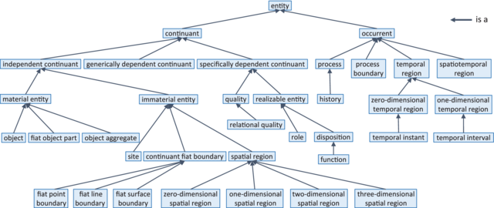
Allowed choices for immediate supertypes

Slide 4
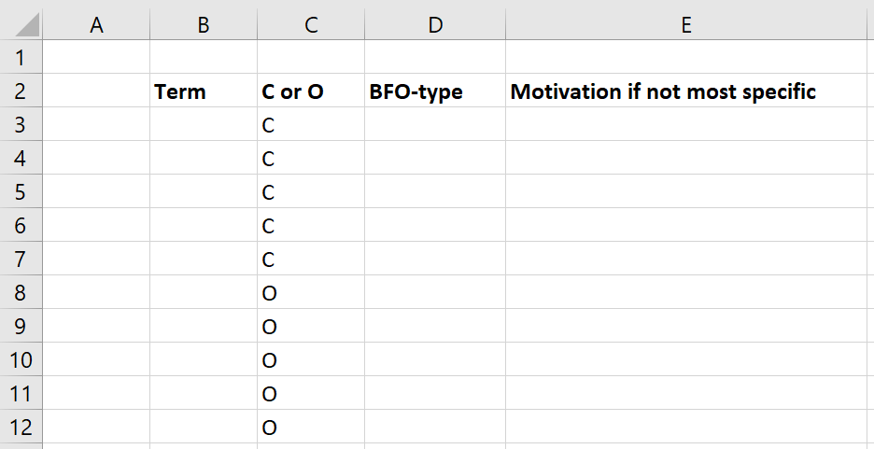
Format
Motivation

Slide 5
Assessment A3
1) The ten terms satisfy the six requirements: 40% (1% loss for each requirement not satisfied)
2) The ten terms are corrected classified in BFO at the appropriate level according to the figure on the next slide: 40% (% loss for magnitude of the difference between selected level and correct level)
3) Motivation for your decisions: 20%. (2% for each term) A motivation which is plausible or for which reasonable arguments are provided may be positively scored, despite the wrong classification of the term.

Slide 6
Required reading pre-class
R9 Principles of best practice I and II. (pages 43-84) in:
Arp, R., B. Smith, and A.D. Spear, Building ontologies with basic formal ontology. 2015, The MIT Press,: Cambridge, Massachusetts. p. 1 online resource (245 p.)

Slide 7
Today’s class
Answers to Test T1.
Presentation of students’ ontology proposals.
Lecture on occurrents.

Slide 8
Major references
The BFO 2.0 Specifications (last update: June 26, 2015)
The ‘BFO-book’ (July 2015)
The ISO-standard (2020):
https://github.com/BFO-ontology/BFO/raw/master/docs/bfo2-reference/BFO2-Reference.docx
Arp, R., B. Smith, and A.D. Spear,
Building ontologies with basic formal ontology. 2015,
The MIT Press,: Cambridge, Massachusetts. p. 1 online resource (245 p).
ISO/IEC PRF 21838-2:2020(E)
https://standards.iso.org/iso-iec/21838/-2/ed-1/en/

Slide 9
BFO top
Entity
Continuant
Occurrent
Winston Churchill Churchill’s life
end of his life
the time during which Churchill lived
the spatiotemporal region in which he lived

Slide 10
Occurrent
Elucidation:
an occurrent is an entity that:
unfolds itself in time, or
it is the start or end of such an entity, or
it is a temporal or spatiotemporal region.
However:
‘19. Do not create terms for universals through logical combination.’ Arp, Robert, et al. Building Ontologies with Basic Formal Ontology, MIT Press, 2015. ProQuest Ebook Central, http://ebookcentral.proquest.com/lib/buffalo/detail.action?docID=3433795.
Contradiction?

Slide 11
Occurrent
Occurrent
Process
Temporal Region
?
unfolds itself in time
Process
Boundary
Spatiotemporal
Region
start or end of process
…
The elucidation seems to exclude it, but there is no such axiom in BFO2020-FOL!

Slide 12
Process
Elucidation: p is a process =Def. p is an occurrent that has some temporal proper part and for some time t, p has some material entity as participant
Definition: p is a process = Def. p is an occurrent that has temporal proper parts and for some time t, p s-depends_on some material entity at t.
Examples:
An act of selling, the life of an organism, a process of sleeping, a process of cell-division, a beating of the heart, …
ISO/IEC PRF 21838-2:2020(E)
BFO 2.0 Specifications

Slide 13
Process and change
2007:
occurrents are ‘entities which occur, which happen to continuants, more familiarly referred to as processes, events, activities, changes, happenings’ [p36],
‘changes are processes’ [p34],
2012:
‘processes are changes’ [p478].
Consistent throughout the literature:
‘processes don’t change […] because if two processes should differ with regard to even the smallest part, then these two processes are non-identical’ [p122].
P. Grenon, B. Smith. Persistence and Ontological Pluralism. In: C Kanzian, editor. Persistence. Boston: De Gruyter; 2007. p. 33-48.
B. Smith. Classifying Processes: An Essay in Applied Ontology. Ratio (Oxf). 2012 Dec 1;25(4):463-88
R. Arp, B. Smith, A. Spear. Building Ontologies with Basic Formal Ontology. Cambridge, MA: MIT Press; 2015.

Slide 14
Process: elucidation and axioms are not in agreement !
Process: ‘an occurrent that has some temporal proper part and for some time t, p has some material entity as participant at t’
An odd allowed model:
m instantiates material-entity prior to t₀, from t₀ through t₅, and a bit afterwards;
s instantiates SDC but at each tr_{x} which is temporal-part-of tr, a distinct more determinate subtype of SDC;
p instantiates process and occupies-temporal-region tr₁ through tr₄;
m participates-in p at tr₂ only while s from tr₁ to tr₄.
Oddity: although p exists-at tr₁, tr₂, tr₃, and tr₄, there exists no proper-temporal-part of p that occupies-temporal-region tr₁, tr₃, or tr₄!
material-entity
specifically-dependent-continuant
process
temporal-
parts-of
CEUSTERS W, RUTTENBERG A. Towards Representing Change in the BFO. Form Ontol Inf Syst. 2025;409:94–108. doi: 10.3233/faia250486. PMCID: PMC12423956. https://ebooks.iospress.nl/doi/10.3233/FAIA250486

Slide 15
Process: elucidation and axioms are not in agreement !
Process: ‘an occurrent that has some temporal proper part and for some time t, p has some material entity as participant at t’
(forall (p q) [csk-1]
(if (occurrent-part-of p q)
(if (exists (t) (instance-of p process t))
(exists (t) (instance-of q process t))))))
material-entity
specifically-dependent-continuant
process
(forall (p q) [ccz-1]
(if (has-occurrent-part p q)
(if (exists (t) (instance-of p process t))
(exists (t)
(or (instance-of q process t)
(instance-of q process-boundary t)))))))
temporal-
parts-of
(forall (a b) [bal-1]
(if (temporal-part-of a b)
(occurrent-part-of a b))))
CEUSTERS W, RUTTENBERG A. Towards Representing Change in the BFO. Form Ontol Inf Syst. 2025;409:94–108. doi: 10.3233/faia250486. PMCID: PMC12423956. https://ebooks.iospress.nl/doi/10.3233/FAIA250486

Slide 16
Issues with the ‘Process’ definition?
Elucidation: p is a process =Def. p is an occurrent that has some temporal proper part and for some time t, p has some material entity as participant.
Seems to suggest:
A process can only have material entities as participants.
A process can have temporal parts during which there is no participant.
But that is not the case!
ISO/IEC PRF 21838-2:2020(E)

Slide 17
Axioms are important
‘Participates in’ is time indexed and has domain (1) independent continuant but not spatial region, or (2) specifically dependent continuant, or (3) generically dependent continuant, and range process.
(forall (a b t)
(if (participates-in a b t)
(and (or (and (instance-of a independent-continuant t)
(not (instance-of a spatial-region t)))
(instance-of a specifically-dependent-continuant t)
(instance-of a generically-dependent-continuant t))
(instance-of b process t)
(instance-of t temporal-region t)))))
At every time a process exists it has a participant
(forall (p t)
(if (instance-of p process t)
(exists (c) (participates-in c p t))))
ISO/IEC PRF 21838-2:2020(E)

Slide 18
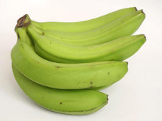
‘Change in color process’
Object
Quality
isa
isa
Banana
isa
Color
isa
Green
instance
of at t₁
isa
instance of at t₁
Yellow
isa
Brown
Black

Slide 19
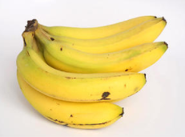
‘Change in color process’
Object
Quality
isa
isa
Banana
isa
Color
isa
Green
instance
of at t₂
isa
instance of at t₂
Yellow
isa
Brown
Black

Slide 20
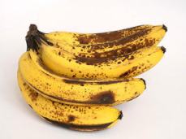
‘Change in color process’
Object
Quality
isa
isa
Banana
isa
Color
isa
Green
instance
of at t₃
isa
Yellow
isa
Brown
instance of at t₃
Black

Slide 21
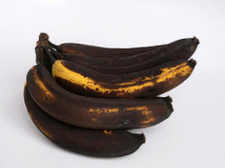
‘Change in color process’
Object
Quality
isa
isa
Banana
isa
Color
isa
Green
instance
of at t₄
isa
Yellow
isa
Brown
Black
instance of at t₄

Slide 22
Participation of an SDC (idem GDC)
At every time a specific dependent s participates in a process p there’s a part of that time, during which there’s an independent continuant that s s-depends on, and that participates in p at that time.
material-entity
(forall (sdc p t)
(if (and
(instance-of sdc specifically-dependent-continuant t)
(participates-in sdc p t))
(exists (tp ic)
(and
(instance-of tp temporal-region tp)
(temporal-part-of tp t)
(instance-of ic independent-continuant tp)
(not (instance-of ic spatial-region tp))
(specifically-depends-on sdc ic)
(participates-in ic p tp)))))
specifically-dependent-continuant
process
CEUSTERS W, RUTTENBERG A. Towards Representing Change in the BFO. Form Ontol Inf Syst. 2025;409:94–108. doi: 10.3233/faia250486. PMCID: PMC12423956. https://ebooks.iospress.nl/doi/10.3233/FAIA250486

Slide 23
Proposed change hierarchy
CEUSTERS W, RUTTENBERG A. Towards Representing Change in the BFO. Form Ontol Inf Syst. 2025;409:94–108. doi: 10.3233/faia250486. PMCID: PMC12423956. https://ebooks.iospress.nl/doi/10.3233/FAIA250486

Slide 24
The history of ‘history’
‘We can define the life of a continuant as the aggregate of the occurrents in which it participates’
P. Grenon, B. Smith. Persistence and Ontological Pluralism. In: C Kanzian, editor. Persistence. Boston: De Gruyter; 2007., p44.
‘A history is a Process that is the sum of the totality of Processes taking place in the Spatiotemporal Region occupied by a Material Entity or Site, including Processes on the surface of the entity or within the cavities to which it serves as host [138-001]’
Barry Smith, Mauricio Almeida, Jonathan Bona, Mathias Brochhausen, et al. Basic Formal Ontology 2.0 - Specification and user's guide.2015 June 26, 2015., p70.

Slide 25
History in BFO2020
Elucidation:
A history is a process that is the sum of the totality of processes taking place in the spatiotemporal region occupied by the material part of a material entity.
The relation between a material entity and its history is one-to-one.
Histories are very special kinds of processes:
for any material entity a, there is exactly one process which is the history of a,
for every history there is exactly one material entity which it is the history of.
ISO/IEC PRF 21838-2:2020(E)
BFO 2.0 Specifications

Slide 26
Undesirable consequences
Can instances of the following processes be part of some person’s history?
Tooth extraction
Colonoscopy
Urinating
Building a house
Living in The White House
Insulting somebody
Receiving the Noble prize

Slide 27
Use of ‘history’ in BioPortal ‘ontologies’ (1)
124 of 1,169 include ‘history’ as a class (Nov 31, 2023).
42 of them did not use the BFO as upper ontology.
18 of these 42 used the term ‘history’ without a definition and provide a hodgepodge of subclasses of various sorts such as historical eras and time periods (e.g. ‘pre-historic period’), sections in medical records (e.g. ‘family history’) or the sorts of assertions that are typically listed in such sections (e.g. ‘history of diabetes’), and fields of study (e.g. ‘history of feminism’);
Another 18 ontologies provide definitions that when interpreted under a BFO2020 perspective would make the term fall under Process (though not History), Generically Dependent Continuant or Independent Continuant;
6 ontologies conflate Continuant and Occurrent by defining ‘history’ as:
‘the aggregate of past events;
the continuum of events occurring in succession leading from the past to the present;
a record or narrative description of past events’.
Werner Ceusters and Alan Ruttenberg. History in the Basic Formal Ontology. Proceedings of the International Conference on Biological and Biomedical Ontologies 2025, November 3-9, 2025 (under review)

Slide 28
Use of ‘history’ in BioPortal ‘ontologies’ (2)
82 ontologies imported History from the BFO, 80 of them annotated with the BFO 2.0 elucidation and two with the BFO-2020 one
only 10 have at least one subclass of History, and only one a subclass which is consistent with History, i.e. ‘system history’ defined as ‘the history of a system’, ‘system’ being defined as a subclass of Material Entity.
Inadequate definitions:
disease course: ‘the totality of all processes through which a given disease instance is realized’
experience: ‘to conscious events in general, more specifically to perceptions, or to the practical knowledge and familiarity that is produced by these conscious processes’
kidney transplant status: ‘used to specify conditions like chronic kidey [sic] disease’
life course: ‘a processual entity which has as parts all the processes in which a given organism is participant’
life cycle: ‘an entire span of an organism's life, commencing with the zygote stage and ending in the death of the organism’
life history: ‘a history which includes all the processes during which resources are used by an organism to grow, survive, and reproduce over its lifetime’
provenance: ‘the process history leading to the creation and current condition of an artifact’
radiation attenuation: ‘the reduction of radiation intensity upon passage of radiation through matter’
Werner Ceusters and Alan Ruttenberg. History in the Basic Formal Ontology. Proceedings of the International Conference on Biological and Biomedical Ontologies 2025, November 3-9, 2025 (under review)

Slide 29
History axioms
(forall (t x) (if (instance-of x history t) (instance-of x process t))))
(forall (h m) (if (history-of h m) (forall (t) (if (exists-at m t) (participates-in m h t)))))
(forall (m h) (if (history-of h m) (forall (t) (iff (instance-of m material-entity t) (instance-of h history t)))))
(forall (h) (if (exists (t) (instance-of h history t)) (exists (m) (history-of h m))))
(forall (p q r) (if (and (history-of p q) (history-of r q)) (= p r)))
(forall (p q r) (if (and (history-of p q) (history-of p r)) (= q r)))

Slide 30
Temporal region
Given a temporal reference frame R, ‘time_{R}’ is defined as the maximal instance of the universal temporal region.
Elucidation: A temporal region is an occurrent entity that is part of time as defined relative to some reference frame.
A temporal region is an occurrent entity upon which a process can be projected. Temporal regions are introduced in BFO to provide a basis for consistent representation of temporal data.
BFO 2.0 Specifications

Slide 31
Temporal regions
Temporal Region
0D - Temporal Region
1D - Temporal Region
Temporal Instant
Temporal Interval
Temporal instants do not have temporal parts.
1-dimensional temporal regions have at least two temporal instants as temporal part.
A temporal interval is self-connected.

Slide 32
Process parts of ‘this class C4’ (1)
t
Temporal parts of a process ( ) are phases ‘sliced vertically’ through the entire ‘thickness’ of the process:
Discussion of test T1 part of class C4
Student proposal presentation part of class C4
BFO:occurrents teaching part of class C4

Slide 33
Process parts of ‘this class C4’ (2)
t
Occurrent parts are ‘horizontally sliced’ parts:
Ceusters’ history part during class C4; his teaching;
his T1 explaining; his first sneezing during class; his
listening to the students presentation, …
student X’s participation in class C4.

Slide 34
A process temporally occupies at least a temporal interval
(forall (proc tr)
(if (and (exists (t) (instance-of proc process t)) (occupies-temporal-region proc tr))
(exists (interval)
(and (instance-of interval temporal-interval interval) (temporal-part-of interval tr))))))
This axiom is satisfied for a proc, tr and interval such that
(proper-temporal-part-of interval tr) holds.
→ ‘scattered’ temporal regions exist, and processes can occupy them!

Slide 35
Occupies-temporal-region is total !!! (idem occupies-spatiotemporal-region and occupies-spatial-region)
(forall (o t)
(if (and (or (exists (t1) (instance-of o process t1)) (exists (t1) (instance-of o process-boundary t1))) (instance-of t temporal-region t))
(iff (occupies-temporal-region o t)
(and (forall (op)
(if (occurrent-part-of op o)
(forall (tp) (if (occupies-temporal-region op tp)
(occurrent-part-of tp t)))))
(not (exists (tprime)
(and (not (= tprime t))
(occurrent-part-of tprime t)
(occupies-temporal-region o tprime)))))))))
tr =
tr₁
tr₂
If p occupies-temporal-region tr, then p does not temporally occupy tr₁ or tr₂ !!!

Slide 36
Spatiotemporal region
A spatiotemporal region is an occurrent entity that is part of spacetime. ‘Spacetime’ here refers to the maximal instance of the universal spatiotemporal region.
Spatiotemporal regions are such that they can be occupied_by processes.
Examples:
the spatiotemporal region occupied by a human life,
the spatiotemporal region occupied by the development of a cancer tumor,
the spatiotemporal region occupied by a process of cellular meiosis.
Each spatiotemporal region projects_onto some temporal region.
Each spatiotemporal region at any time t projects_onto some spatial region at t.
BFO 2.0 Specifications

Slide 37
More than 1 process can spatiotemporally occupy the same spatiotemporal region !
Example: a spinning ball heating up.
However: mistake in the BFO2020-FOL axioms (see next slide)!

Slide 38
Extra credit: find and correct the mistake
If a process is part of another, their spatiotemporal regions are part too:
(forall (p1 p2)
(if (and (exists (t) (instance-of p1 process t)) (exists (t) (instance-of p2 process t)))
(iff (occurrent-part-of p1 p2)
(exists (st1 st2)
(and (occupies-spatiotemporal-region p1 st1) (occupies-spatiotemporal-region p2 st2) (occurrent-part-of st1 st2))))))
Occurrent-part-of is antisymmetric:
(forall x y) (if (and (occurrent-part-of x y)
(occurrent-part-of y x))
(= x y)))

Slide 39
Process Boundary
Definition: p is a process boundary =Def.
p is a temporal part of a process & p has no proper temporal parts.
Example: the boundary between the 2nd and 3rd year of your life.
BFO 2.0 Specifications

Slide 40
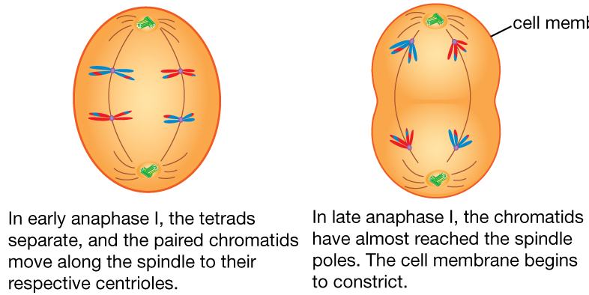
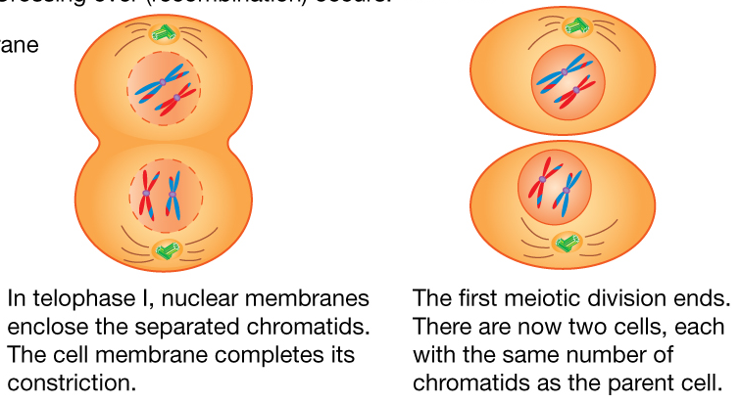
Meiosis
1
2
From Encyclopædia Britannica
2012
https://www.britannica.com/science/cell-biology/Meiosis
3
4

