Slide 1
BMI508 – Fall 2025
Introduction to Biomedical Ontology
Class 6 – Oct 1, 2025
Relations in
Biomedical Ontologies
Werner CEUSTERS^{1,2}
¹ Department of Biomedical Informatics, University at Buffalo, USA
² Department of Psychiatry, University at Buffalo, USA

Slide 2
Essentials
Distinguishing what is denoted by ‘relation’ in technical sense (‘formal relations’) from what is denoted by ‘relation’ in non-formal language (‘material relations’);
Differences between type-level formal relations, particular-level formal relations and particular-type-level formal relations;
Arity and other properties of formal relations and differences thereof between particular-type formal relations and their corresponding type-level formal relations;
Elucidation versus definition of formal relations;
‘Basic’ formal relations versus ‘shortcut’ formal relations;
Axiomatic characterization of formal relations (Class C13).

Slide 3
Remember !
BFO2020-FOL’s axiomatization, compared to the definitions in previous versions, changed the arity of some relations.
  Previous principle: all relations in which at least one continuant is involved, should be time-indexed.
  Now: some exceptions
For your assignments:
  Use the allowed BFO2020-FOL relations wherever sufficient (see bfo-2020-defhelp.xlsx)
  For any relation you introduce and which is not in BFO2020, you MUST time-index it if there is a continuant in at least one argument.

Slide 4

What is out there …
(… we want/need to deal with)?
portions of reality
formal
relations
configurations
relationships
participation
me participating in my life
types
particulars
universals
continuants
me
occurrents
representations
organism
defined
classes
my life

Slide 5
Distinguishing what is denoted by ‘relation’ in technical sense from what is denoted by ‘relation’ in non-formal language

Slide 6
‘John is in a relation with Mary’

Slide 7
‘Relations’
(mainstream view)
Relations:
  ‘entities that glue together other entities’
  Formal relations:
    ‘hold between two or more entities directly, without any further intervening individual’.
  Material relations:
    ‘have material structure on their own’.
        = are entities (not, of course, material entities)
    Guizzardi & Wagner. What’s in a Relationship: An Ontological Analysis. In: Qing Li, Stefano Spaccapietra, Eric Yu, Antoni Olivé (Eds.), Conceptual Modeling - ER 2008. Lecture Notes in Computer Science, Vol. 5231, 83-97, 2008 https://doi.org/10.1007/978-3-540-87877-3_8↗

Slide 8
Material relation
‘John is in a relation with Mary’
isAbout
JM Romantic relationship
John
Mary

Slide 9
Is-about
x is_about y means:
    x refers to or is cognitively directed towards y. Domain: representations; Range: portions of reality. Axiom: if x is_about y then y exists (veridicality).
BFO does not represent portions of reality!
Take the sentence ‘Obama is POTUS in 2025’.
  What is the sentence about?
  What are parts of the sentence about?
Smith B, Ceusters W. Aboutness: Towards Foundations for the Information Artifact Ontology. International Conference on Biomedical Ontologies, ICBO 2015, Lisbon, Portugal, July 27-30, 2015;47-51. (video, paper, slides)

Slide 10
Material relation
‘John is in a relation with Mary’
isAbout
JM Romantic relationship
John
Mary
instanceOf at t
BFO:Object
BFO:Relational Quality

Slide 11
Material relation
‘John is in a relation with Mary’
isAbout
inheresIn
JM Romantic relationship
inheresIn
John
Mary
instanceOf at t
BFO:Object
BFO:Relational Quality

Slide 12
Material relation
‘John is in a relation with Mary’
isAbout
inheresIn
JM Romantic relationship
inheresIn
John
Mary
instanceOf at t
BFO:Object
BFO:Relational Quality

Slide 13
Material relation
‘John is in a relation with Mary’
isAbout
inheresIn
JM Romantic relationship
inheresIn
John
Mary
instanceOf at t
BFO:Object
BFO:Relational Quality

Slide 14
Material relations
‘have material structure on their own’
Are entities in their own right.
Relate other entities to each other by means of formal relations.
Examples: what might by some be denoted by:
  ‘patient’,
  ‘treatment’,
  ‘driver’.
Examples in BFO:
  relational qualities
      Have independent continuants as their bearers.
  relational processes: kissing, buying, …

Slide 15
Material relation
‘John is in a relation with Mary’
isAbout
inheresIn
JM Romantic relationship
inheresIn
John
Mary
instanceOf at t
BFO:Object
BFO:Relational Quality

Slide 16
Formal relations
‘John is in a relation with Mary’
isAbout
inheresIn
JM Romantic relationship
inheresIn
John
Mary
instanceOf at t
BFO:Object
BFO:Relational Quality

Slide 17
Formal relations
‘hold between two or more entities directly, without any further intervening individual’
Basic formal relations:
  existential dependence, inherence, subtype-of, part-of, subset-of, instantiation, …
Domain formal relations:
  ‘relations that exhibit similar characteristics, i.e., those relations of comparison such as is taller than, is older than, knows more Greek than’.
    Guizzardi & Wagner. What’s in a Relationship: An Ontological Analysis. In: Qing Li, Stefano Spaccapietra, Eric Yu, Antoni Olivé (Eds.), Conceptual Modeling - ER 2008. Lecture Notes in Computer Science, Vol. 5231, 83-97, 2008 https://doi.org/10.1007/978-3-540-87877-3_8↗

Slide 18
Relationships
‘John is in a relation with Mary’
isAbout
inheresIn
JM Romantic relationship
inheresIn
John
Mary
instanceOf at t
BFO:Object
BFO:Relational Quality

Slide 19
Configurations
‘John is in a relation with Mary’
isAbout
inheresIn
JM Romantic relationship
inheresIn
John
Mary
instanceOf at t
BFO:Object
BFO:Relational Quality

Slide 20
Configurations
‘John is in a relation with Mary’
isAbout
inheresIn
JM Romantic relationship
inheresIn
John
Mary
instanceOf at t
BFO:Object
BFO:Relational Quality

Slide 21
Configurations
‘John is in a relation with Mary’
isAbout
inheresIn
JM Romantic relationship
inheresIn
John
Mary
instanceOf at t
BFO:Object
BFO:Relational Quality

Slide 22
Configurations
‘John is in a relation with Mary’
isAbout
inheresIn
JM Romantic relationship
inheresIn
John
Mary
instanceOf at t
BFO:Object
BFO:Relational Quality

Slide 23
Relational PoRs ←→ relational expressions
‘Mary is patient of John’

Slide 24
Relational PoRs ←→ relational expressions
‘Mary is patient of John’
isAbout
Mary
John
patientOf at t
inheresIn
instanceOf
at t
Mary’s patient role
patient
role
instanceOf at t
Patient
‘knowledge graph’

Slide 25
Role (Externally-Grounded Realizable Entity)
role =def. a realizable entity
  which exists because the bearer is in some special physical, social, or institutional set of circumstances in which the bearer does not have to be, and
  is not such that, if it ceases to exist, then the physical make-up of the bearer is thereby changed.

Slide 26
Relational PoRs ←→ relational expressions
‘Mary is patient of John’
isAbout
Mary
John
patientOf at t
inheresIn at t
instanceOf
at t
Mary’s patient role
patient
role
instanceOf at t
²
p to p relations
particulars
types
relational expression
p to u relations
Patient
³
²
¹
²

Slide 27
Relational PoRs ←→ relational expressions
‘Mary is friend of John’

Slide 28
Relational PoRs ←→ relational expressions
‘Mary is friend of John’
isAbout
Mary
John
friendOf
inheresIn
inheresIn
M&J’s friendship
instanceOf at t
friendship

Slide 29
Properties of formal relations

Slide 30
Arity of a relation
Binary:
  My youth partOf my life
1 2
Ternary:
  My hand partOf me now
1 2 3
Quaternary:
  My left middle finger between my left index finger
    1 2
  and my left ring finger now
  3 4
…
Arguments of a relation are ordered !

Slide 31
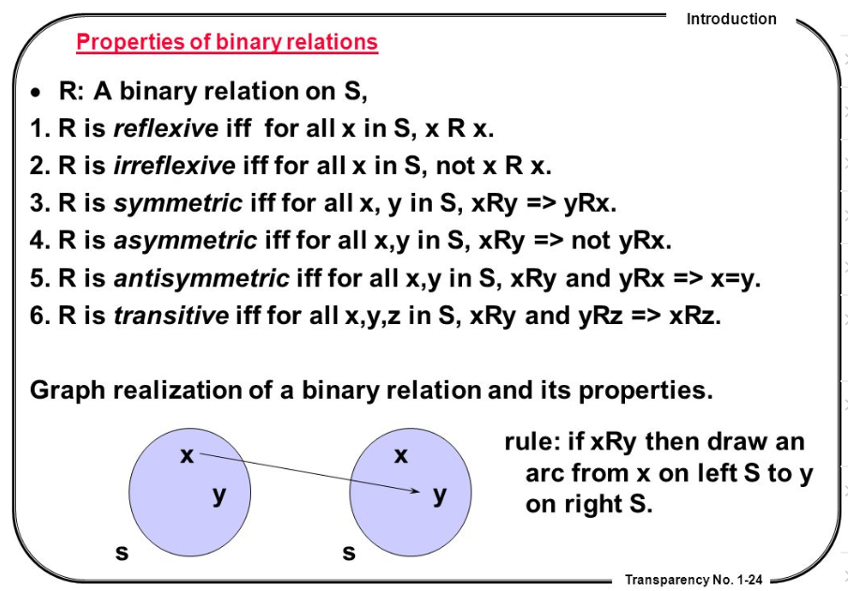
Properties of binary relations
http://en.ndncdc.org/page/symmetric-binary-relation-on-set/

Slide 32
Such properties can also hold for 3-ary relations
(cl:comment "continuant-part-of is reflexive at a time [mcd-1]“
(forall (a t)
(if (instance-of a independent-continuant t)
(continuant-part-of a a t))))
(cl:comment "continuant-part-of is transitive at a time [plp-1]“
(forall (a b c t t2)
(if (and (continuant-part-of a b t)
(continuant-part-of b c t2)
(temporal-part-of t t2))
(continuant-part-of a c t))))

Slide 33
Distinct levels at which formal relations exist

Slide 34
Relations in Ontological Realism
particular-level relations (pp)
  Your heart (instance-level) continuant_part_of your body at t
  Your heart beating (instance-level) has_participant your heart at t
particular-type relations (pt)
  John’s heart instantiates human heart at t
  John’s heart beating instantiates human heart beating at t
Type-level relations (tt)
  human heart continuant_part­_of human body
  human heart beating process has_occurrent_part beat profile
  Must be defined in terms of pp and pt relations!!!

Slide 35
the all-some form for tt relations
A continuant_part_of B =def.
  for all instances a and times t,
  If a is an instance of the universal A at t,
  then there is some instance b of the universal B
  such that
  a is an instance-level part_of b at t
Domain: Continuant
Range: Continuant

Slide 36
Example template
human heart tt_continuant_part­_of human body
(cl:comment “elucidation of type-level continuant parthood [tcon-1]"
(forall (u1 u2)
(if (tt-continuant-part-of u1 u2)
(forall (c1 t)
(if (and (instance-of c1 u1 t)
(instance-of c1 continuant t))
(exists (c2)
(and (instance-of c2 u2 t)
(instance-of c2 continuant t)
(continuant-part-of c1 c2 t)))))))

Slide 37
Definitions of the all-some form allow cascading inferences
If A R₁ B and B R₂ C, then we know that:
  every A stands in R₁ to some B,
  whichever B this is, it can be plugged into the R₂ relation, because R₂ is defined for every B.
Also allows for the definition of ‘shortcut’ relations:
  A R₃ C =def. A R₁ B and B R₂ C

Slide 38
Features of relations on the level of instances may not hold on the level of universals
nucleus adjacent_to cytoplasm
  Not: cytoplasm adjacent_to nucleus
    Red blood cells don’t have a nucleus
seminal vesicle adjacent_to urinary bladder
  Not: urinary bladder adjacent_to seminal vesicle
    Women don’t have seminal vesicles
Adjacency as a relation between universals is not symmetric while it is symmetric at particular level.

Slide 39
the universal red
the universal eye
Instantiates at t
Instantiates at t
the particular case of redness (of a particular fly eye)
inheresIn
an instance of an eye (in a particular fly)

Slide 40
the universal
color
the universal
object
isa
isa
inheresIn ?
the universal red
the universal eye
Instantiates at t
Instantiates at t
the particular case of redness (of a particular fly eye)
inheresIn at t
an instance of an eye (in a particular fly)

Slide 41
Remember !!!
Formal relations expressed in the BFO are all type-type relations.
    IC isa Continuant
    SDC specifically depends on IC
However !!! BFO’s type-type relations don’t express anything about types, but only what is the case for all particulars in the domain position of the relation.
BFO’s type-type relations are defined / elucidated on the basis of instance-level relations.

Slide 42
Elucidations and definitions of formal relations

Slide 43
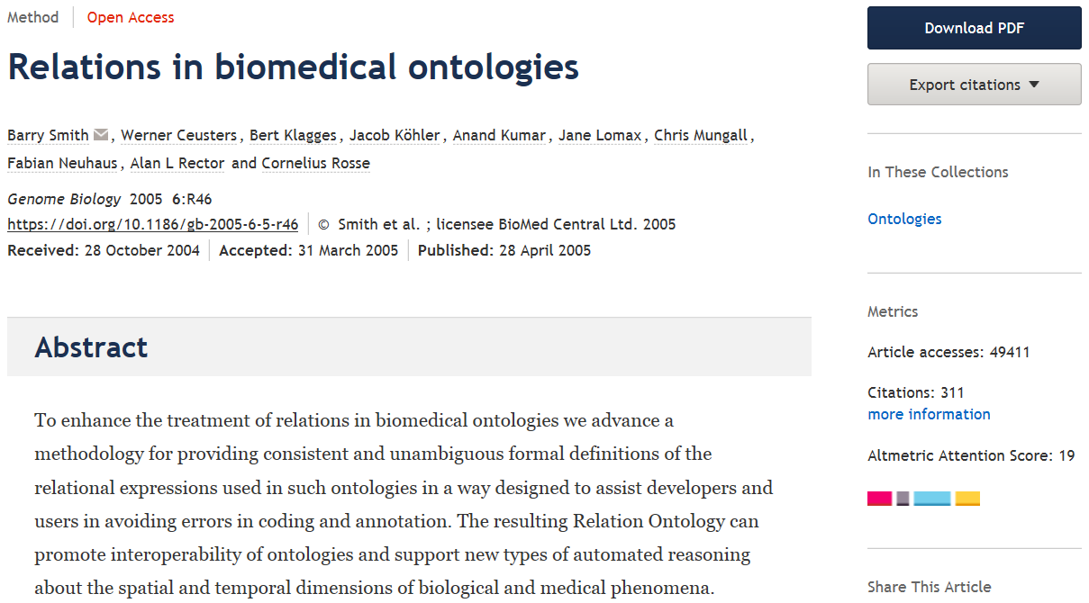

Slide 44
Elucidation of a formal relation
BFO 2.0 (obsolete):
  The instance_of relation holds between particulars and universals. It comes in two forms, for continuants (C, C1, …) and occurrents (P, P1, …) as follows:
    c instance_of C at t means: the particular continuant entity c instantiates the universal C at t
    p instance_of P means: the particular occurrent entity p instantiates the universal P.
BFO2020:
    p instance_of P at t means: particular entity c instantiates the universal C at t

Slide 45
Elucidation of a formal relation
x is_about y means:
  x refers to or is cognitively directed towards y.
      Domain: representations;
      Range: portions of reality.
      Axiom: if x is_about y then y exists (veridicality).
x concretizes y at t means:
  x is a quality & y is a generically dependent continuant
  & for some material entity z,
    x specifically_depends_on z at t &
    y generically_depends_on z at t
  & if y migrates from bearer z to another bearer w then a copy of x will be created in w.
Smith B, Ceusters W. Aboutness: Towards Foundations for the Information Artifact Ontology. International Conference on Biomedical Ontologies, ICBO 2015, Lisbon, Portugal, July 27-30, 2015;47-51.

Slide 46
Definition of a formal relation
x is_a_representation_of y =def.
  x is a representa­tion & x is_about y (where y is a portion of reality). Note that not all representations are about something.
x is_conformant_to y =def.
  x is an information quality entity &
  y is a cognitive representa­tion &
  there is some GDC g such that x concretizes g and y concretizes g.
  Example: x is a sentence on a piece of paper, y is the belief of the author of the sentence who wrote the sentence as an expression of her belief, and g is the ICE (the content) that belief and sentence share.
Smith B, Ceusters W. Aboutness: Towards Foundations for the Information Artifact Ontology. International Conference on Biomedical Ontologies, ICBO 2015, Lisbon, Portugal, July 27-30, 2015;47-51.

Slide 47
Elucidation versus definition
x is_about y means:
  x refers to or is cognitively directed towards y. Domain: representations; Range: portions of reality. Axiom: if x is_about y then y exists (veridicality).
‘A means B’:
    If A is the case, you can conclude that B holds.
    If B is the case, you cannot conclude anything re A.
x is_a_representation_of y =def.
  x is a representa­tion & x is_about y (where y is a portion of reality). Note that not all representations are about something.
‘A =def. B’ :
    If A is the case, you can conclude that B holds.
    If B is the case, you can conclude that A holds.
    If one doesn’t hold, the other one doesn’t hold.

Slide 48
Key idea in defining ontological relations
Not enough to look just at universals or types
We need also to take account of instances and time.
This will yield an automatic bridge to the instance data in information systems, databases, repositories, …

Slide 49
How to define A is_a B
A is_a B =def.
  A and B are names of universals (natural kinds, types) in reality or of defined classes
  all instances of A are as a matter of science also instances of B
  for all times t, all instances of A at t are as a matter of science also instances of B at t

Slide 50
Formal BFO definition for is_a
The is_a relation is the subtype or subuniversal relation between universals or types.
  C is_a C1 =def.:
    C and C1 are continuant universals, and
    for all c, t, if c instance_of C at t then c instance_of C1 at t
  P is_a P1 =def.:
    P and P1 are occurrent universals, and
    for all p, t, if p instance_of P at t then p instance_of P1
Is_a is NOT used in BFO2020-FOL !

Slide 51
Compare with RDFS / OWL
AXIOM SCHEMA: class description rdfs:subClassOf class description
The rdfs:subClassOf construct is defined as part of RDF Schema [RDF Vocabulary]. Its meaning in OWL is exactly the same: if the class description C1 is defined as a subclass of class description C2, then the set of individuals in the class extension of C1 should be a subset of the set of individuals in the class extension of C2.
Differences with BFO:
  subClass is primitive, being a subset is a consequence
  You just have to declare it → how do you want the domain to be, not how the domain is!
  No time indexing.

Slide 52
‘Part-of’ different for continuants and occurrents
process
living creature
Is_a
Is_a
leg
Is_a
human being
leg moving
walking
Instance-of
at t
Instance-of at t
Instance-of
at t
this leg moving
Instance-of at t
continuant-part-of
at t
occurrent-part-of
my left leg
me
this walking

Slide 53
Part-of can be generalized, … with care !
C tt_continuant_part_of C1 = [def]
for all c, t,
if c instanceOf C at t
then there is some c1 such that
c1 instanceOf C1 at t
and c continuant-part-of c1 at t.
living creature
leg
Is_a
human being
Instance-of
at t
Instance-of
at t
continuant-part-of
at t
my left leg
me

Slide 54
Part-of can be generalized, … with care !
C tt_continuant_part_of C1 = [def]
for all c, t,
if c instanceOf C at t
then there is some c1 such that
c1 instanceOf C1 at t
and c continuant-part-of c1 at t.
living creature
?
leg
Is_a
human being
Instance-of
at t
Instance-of
at t
continuant-part-of
at t
my left leg
me

Slide 55
Part-of can be generalized, … with care !
Horse legs are not parts of human beings
Amputated legs are not parts of human beings
‘Canonical leg is part of canonical human being’, but…, there are (very likely) no such particulars
…
living creature
?
leg
Is_a
human being
Instance-of
at t
Instance-of
at t
continuant-part-of
at t
my left leg
me

Slide 56
Parthood as partial ordering
Partial ordering:
  a reflexive, transitive, antisymmetric relation
Axioms:
Everything is part of itself.
Any part of any part of a thing is itself part of that thing.
Two distinct things cannot be part of each other.

Slide 57
Various forms of realization per type of dependent continuant as recognized in language
– execution (of a plan)
– performance (of an act, of a symphony)
– expression (of a function, of a character, of an emotion)
– exercise (of a power, of a role)
– actualization (of a disposition)
– utterance (of a sentence)
– application (of a therapy, of a law)
– course (of a disease)
– increase (in temperature)
But there is no need to represent these as distinct formal relations in an ontology!
Barry SMITH and Pierre GRENON.
The Cornucopia of Formal-Ontological Relations.
Dialectica Vol. 58, No 3 (2004), pp. 279-296

Slide 58
derives_from
C
c at t
C₁
c₁ at t₁
time
C'
c' at t
instances
ovum
zygote derives_from
sperm

Slide 59
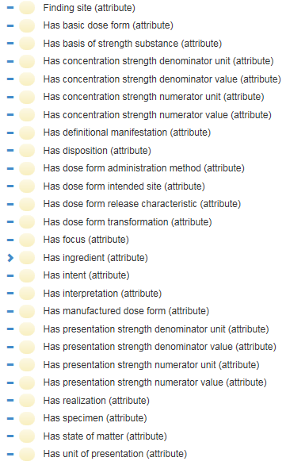
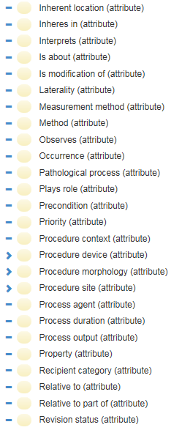
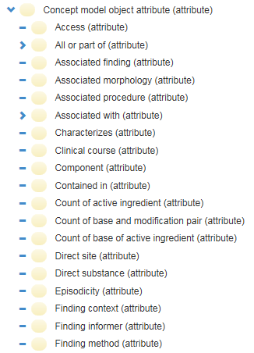
Relations in SNOMED CT
…

Slide 60
Avoid at all cost!!!
X hasY Y
Disease hasSymptom Symptom
Object hasTemperature Temperature
…

Slide 61
All BFO2020 relations
bearer of
concretizes at
continuant part of at
environs
first instant of
generically depends on at
has continuant part at
has first instant
has history
has last instant
has location at
has material basis at
has member part at
has occurrent part
has participant at
has proper continuant part at
has proper occurrent part
has proper temporal part
is concretized by at
last instant of
located in at
material basis of at
member part of at
occupies spatial region at
occupies spatiotemporal region
occupies temporal region
occurrent part of
occurs in
participates in at
preceded by
precedes
proper continuant part of at
proper occurrent part of
proper temporal part of
has realization
has temporal part
history of
inheres in
is carrier of at
realizes
spatially projects onto at
specifically-depended on by
specifically-depends on
temporal part of
temporally projects onto
Definitions: see bfo-2020-defhelp.xlsx in UB Box

Slide 62
Examples:
p exists-at t:
  between a particular and some temporal region at which the particular (non-exclusively) exists
b member-part-of c at t:
  between an object and an object aggregate
b located-in c at t:
  b and c are independent continuants and not spatial regions, and the spatial region which b occupies at t is a continuant part of the spatial region which c occupies at t
b realizes c:
  there is some material or immaterial entity, d and
  c is a realizable entity that inheres in d, and
  for all t, if b has participant d at t then c exists at t, and
  the type instantiated by b is correlated with the type instantiated by c

Slide 63
Assignment
A5: Apply a relational analysis to the definitions (to be corrected from assignment A4) indicated by the instructor so as to create one large relational PoR as exemplified in slide 23. This may require further entities to be defined to tie the entities referenced in the definitions together by means of relations. All relations used must either have been taken from a realism-based source in which the relation is formally defined, OR you create a relation and define it appropriately.
Upload your work to the dedicated UB Box folder.
Name of the file: ‘BMI508-A5-[your UBITname].XXX’ where ‘XXX’ conforms to the Excel format selected.
Due date: Oct 6 – noon!

Slide 64
Hint
For each entity in your domain ontology, think of a scenario with ‘concrete’ particulars each one of which instantiates a type that is mentioned in your definition.
Eg: mutating: the mechanism by which an organism's genetic material, usually DNA, changes, either on its own or as a result of external factors. It is changes in the DNA sequence that can cause uncontrolled cell division, treatment resistance, and tumor development.
Scenario particulars:
  John
  The mutation occurring (?) in John at some time
  John’s DNA
  A particular sequence in John’s DNA
  The external factor that caused the mutation in John.

Slide 65
Important !
Do not forget to provide full Aristotelian definitions for all new type-terms you introduce as part of this and forthcoming assignments!
Assessment:
  Definitions appropriately corrected in Aristotelian form and jointly complete: 20%
    (note: this means that all entities must be subsumed by the appropriate lowest level BFO universal)
  BFO relations correctly applied or new ones correctly defined (this requires to introduce a certain number of particulars): 40%
  Adequate motivations for decisions made in (1) and (2): 40%.

Slide 66
Demo’s

Slide 67
Reading pre-class!
Required reading pre-class:
  R7 Ceusters, W. and B. Smith, Tracking referents in electronic health records. Stud Health Technol Inform, 2005. 116: p. 71-6.[3]
  PDF downloadable from: http://ebooks.iospress.nl/publication/10278
More in detail:
  https://osf.io/preprints/osf/q8hts
Suggested additional reading (for sure for students with concentration in Biomedical Ontology):
  R8 Ceusters, W. and B. Smith, Strategies for referent tracking in electronic health records. J Biomed Inform, 2006. 39(3): p. 362-78.[4]
  https://www.sciencedirect.com/science/article/pii/S1532046405000754

