Slide 1
BMI508 – Fall 2025
Introduction to Biomedical Ontology
Class 8 – Oct 15, 2025
The Ontology for General Medical Science
Werner CEUSTERS^{1,2}
¹ Department of Biomedical Informatics, University at Buffalo, USA
² Department of Psychiatry, University at Buffalo, USA

Slide 2
The reference for OGMS:

Slide 3
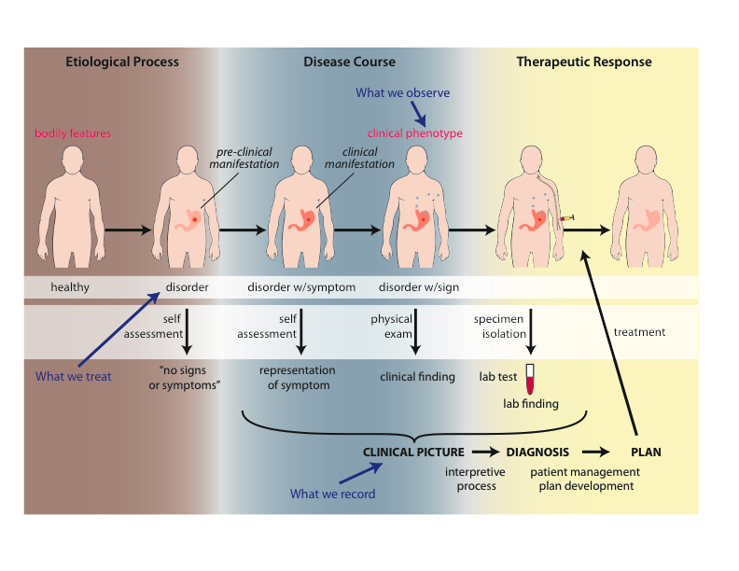
How a disease ‘evolves’

Slide 4
Motivation for the design of OGMS
Clarity about:
    disease etiology and progression;
    disease on the side of the patient and the diagnostic process on the side of the clinician or healthcare system;
    phenotype and signs/symptoms;
    how the entities relate to each other.
Better support for use of evidence in the context of patient care, clinical research and translational research;
    Includes use of medical record information in support for clinical and translation research.
Extensibility.

Slide 5
Goals of OGMS (1)
What are the fundamental types of things for which we need ontological categories (what’s the domain)?
  disease initiation, progression, pathogenesis, signs, symptoms, assessments, clinical and laboratory findings, disease diagnosis, treatment, treatment response and outcome;
  normal phenotype, homeostatic (normal) profile.
Notes:
Answer the following questions.

Slide 6
Goals of OGMS (2)
What are the fundamental relationships:
  between the process of observing, the results of the observation and what is being observed;
  between signs/symptoms and disease (no absolutes?);
  between clinical and pre-clinical pathological processes, their manifestations and their representations in the EHR.
Notes:
Answer the following questions.

Slide 7
Goals of OGMS (3)
How should ontologies be developed - intelligent design or natural selection (evolution)?
What is the relationship between
  the ontologies,
  the terminologies and
  the information models?
Notes:
Answer the following questions.

Slide 8
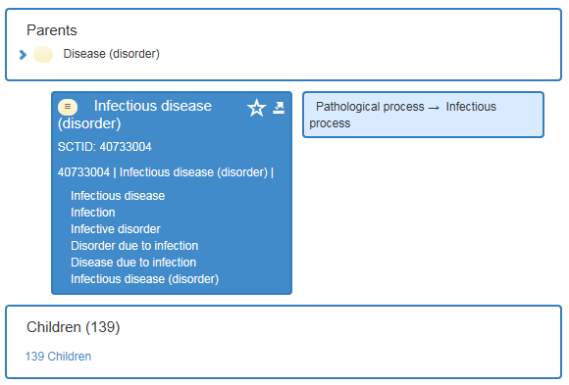
Ontology versus Terminology in Snomed CT
Notes:
http://browser.ihtsdotools.org/?perspective=full&conceptId1=40733004&edition=en-edition&release=v20160731&server=http://browser.ihtsdotools.org/api/snomed&langRefset=900000000000509007

Slide 9
Ontology / Terminology
Notes:
http://browser.ihtsdotools.org/?perspective=full&conceptId1=40733004&edition=en-edition&release=v20160731&server=http://browser.ihtsdotools.org/api/snomed&langRefset=900000000000509007

Slide 10
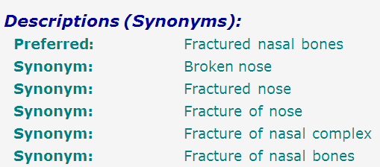
SNOMED-CT: abundance of false synonymy
bones
nose
fracture

Slide 11
EHR Information Models (simplified)
diagnosis
finding
finding
patient
patient
encounter
drug
drug
diagnosis

Slide 12
Approach of OGMS design
Propose terms and provide definitions for a representational framework drawing on best practices in ontology development as promulgated within the OBO Foundry for:
  Etiological process
  Disorder
  Disease
  Pathological process
  Sign
  Risk factor
  Symptom
  Laboratory finding
  Diagnosis
  Pre-disposition
  Clinically abnormal
  Biomarker
Notes:
Answer the following questions.

Slide 13
Approach
a disease is a disposition rooted in a physical disorder in the organism and realized in pathological processes.
produces
bears
realized_in
etiological process
disorder
disposition
pathological process
produces
diagnosis
interpretive process
signs & symptoms
abnormal bodily features
produces
participates_in
recognized_as
Notes:
font was too small, color inside green boxes was hardly readable

Slide 14
Cirrhosis - environmental exposure
Etiological process - phenobarbitol-induced hepatic cell death
  produces
Disorder - necrotic liver
  bears
Disposition (disease) - cirrhosis
  realized_in
Pathological process - abnormal tissue repair with cell proliferation and fibrosis that exceed a certain threshold; hypoxia-induced cell death
  produces
Abnormal bodily features
  recognized_as
Symptoms - fatigue, anorexia
Signs - jaundice, splenomegaly
Symptoms & Signs
  used_in
Interpretive process
  produces
Hypothesis - rule out cirrhosis
  suggests
Laboratory tests
  produces
Test results – documentation of elevated liver enzymes in serum
  used_in
Interpretive process
  produces
Result - diagnosis that patient X has a disorder that bears the disease cirrhosis

Slide 15
Part 1:
Foundational type-terms for entities on the side of the patient
produces
bears
realized_in
etiological process
disorder
disposition
pathological process
produces
diagnosis
interpretive process
signs & symptoms
abnormal bodily features
produces
participates_in
recognized_as
Notes:
font was too small, color inside green boxes was hardly readable

Slide 16
Foundational Term: disorder
Disorder =def. – A causally linked combination of physical components of the extended organism that is
  (a) clinically abnormal and
  (b) maximal, in the sense that it is not a part of some larger such combination.

Slide 17
Some axioms for disorder (1)
(cl:comment "A disorder is a clinically abnormal material entity that is part of an extended organism [diso-002]"
(forall (do t)
(if (instance-of do disorder t)
(and (instance-of do material-entity t)
(exists (ca eo)
(and (instance-of ca clinically-abnormal-sdc t)
(inheres-in ca do)
(instance-of eo extended-organism t)
(continuant-part-of do eo t)))))))

Slide 18
Some axioms for disorder (2)
(cl:comment "A disorder is a clinically abnormal material entity that is part of an extended organism [diso-002]"
(forall (do t)
(if (instance-of do disorder t)
(and (instance-of do material-entity t)
(exists (ca eo)
(and (instance-of ca clinically-abnormal-sdc t)
(inheres-in ca do)
(instance-of eo extended-organism t)
(continuant-part-of do eo t)))))))
(cl:comment "No proper part of a disorder is a disorder [diso-003]"
(forall (do pp t)
(if (and (instance-of do disorder t)
(proper-continuant-part-of pp do t))
(not (instance-of pp disorder t)))))

Slide 19
Physical Disorder
  – independent continuant
    objects
    fiat object parts
    object aggregates
    A causally linked combination of physical components of the extended organism.

Slide 20
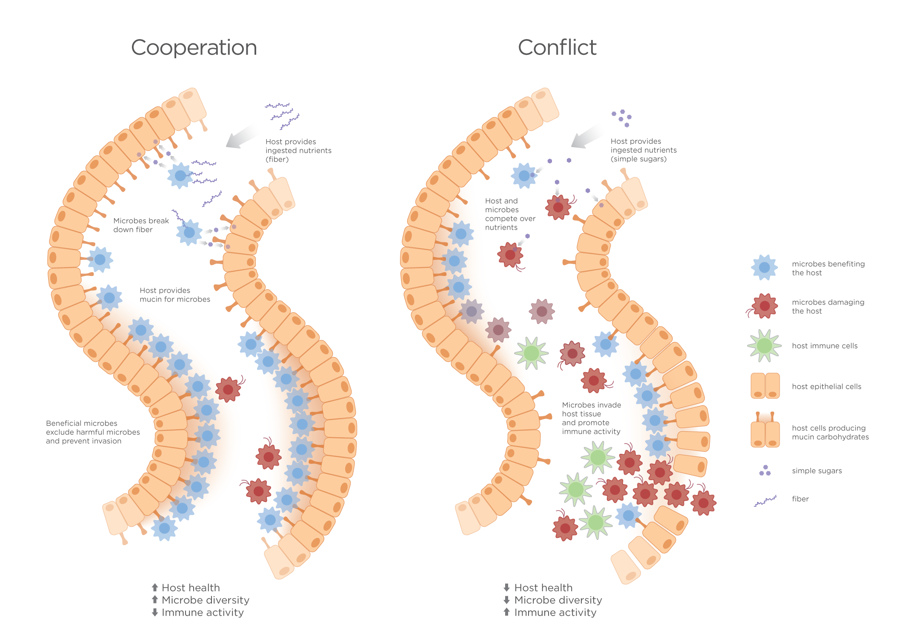
Extended organism
Harth R. War and peace in the human gut: probing the microbiome
https://biodesign.asu.edu/sites/default/files/news/AthenaHostcooperation7.png

Slide 21
Clinically abnormal
something is clinically abnormal if:
  is not part of the life plan for an organism of the relevant type (unlike aging or pregnancy),
  is causally linked to an elevated risk either of pain or other feelings of illness, or of death or dysfunction, and
  is such that the elevated risk exceeds a certain threshold level.

Slide 22
Foundational Term: pathological process
Disorder =def. – A causally linked combination of physical components of the extended organism that is
  (a) clinically abnormal and
  (b) maximal, in the sense that it is not a part of some larger such combination.
Pathological Process =def. – A bodily process that is a manifestation of a disorder and is clinically abnormal.

Slide 23
Foundational Terms (3)
Disorder =def. – A causally linked combination of physical components of the extended organism that is (a) clinically abnormal and (b) maximal, in the sense that it is not a part of some larger such combination.
Pathological Process =def. – A bodily process that is a manifestation of a disorder and is clinically abnormal.
Disease =def. – A disposition (i) to undergo pathological processes that (ii) exists in an organism because of one or more disorders in that organism.

Slide 24
Disposition
if it ceases to exist, then its bearer and/or its immediate surrounding environment is physically changed;
its realization occurs when its bearer is in some special physical circumstances;
its realization is what it is in virtue of the bearer’s physical make-up.

Slide 25
independent
continuant
Specifically
dependent
continuant
occurrent
disposition
process
integumentary
system
process of going bald
to go bald
John’s
integumentary
system
John’s
disposition:
to go bald
John’s going
bald

Slide 26
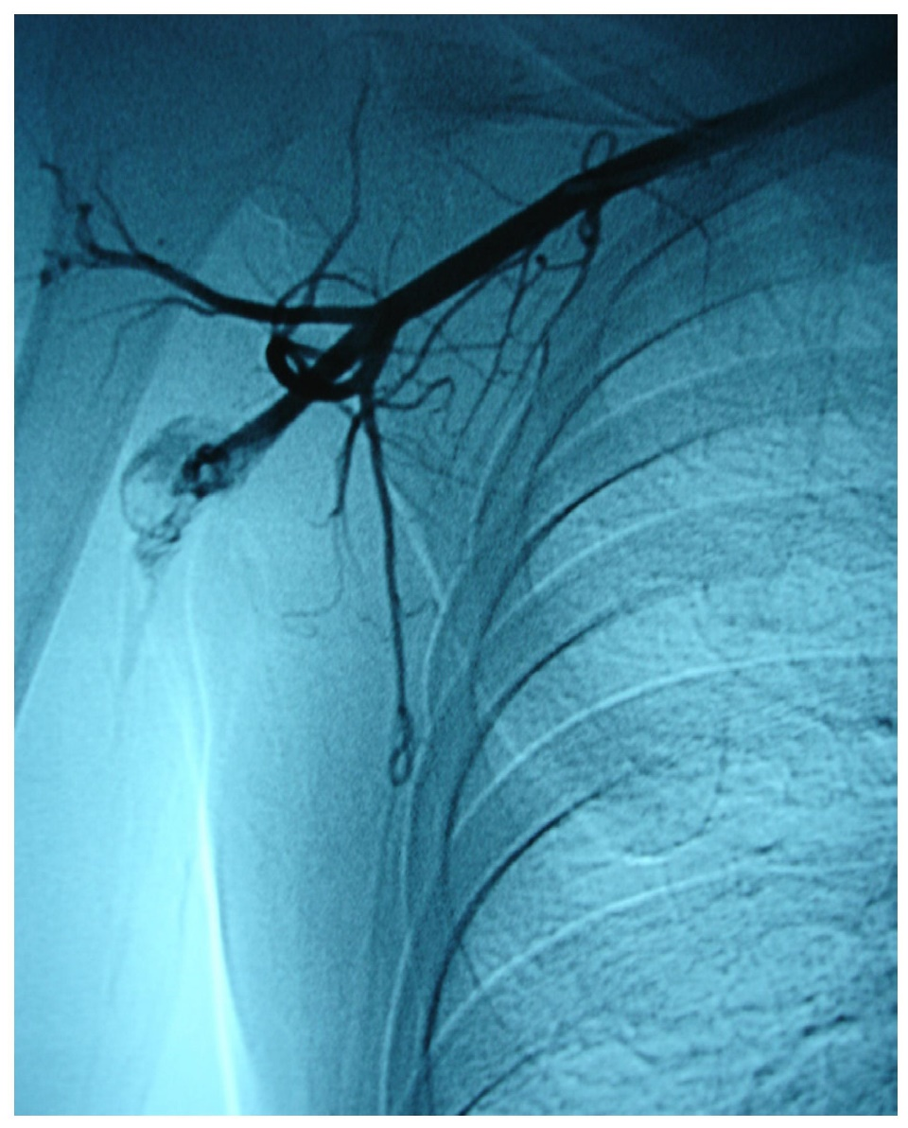
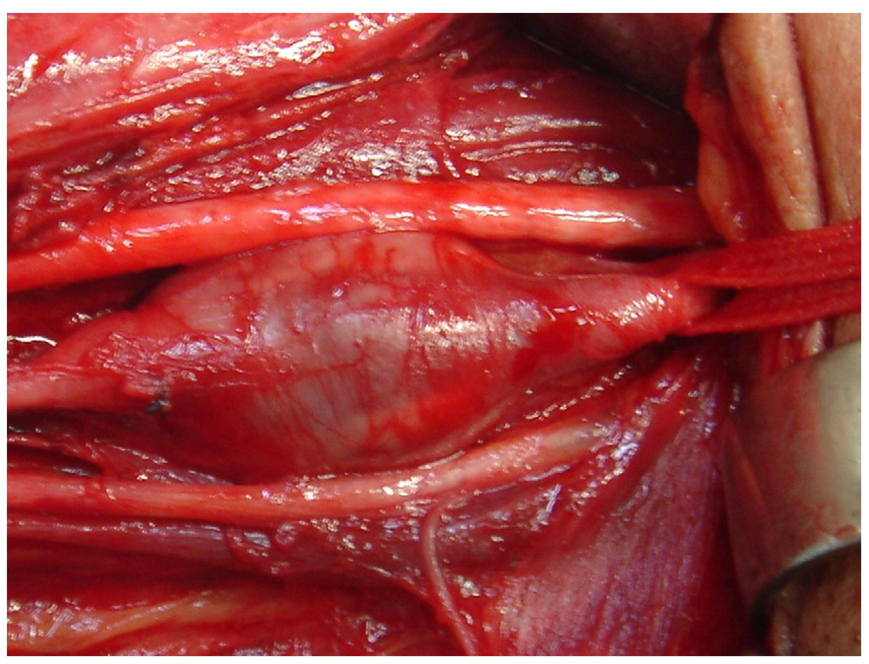
Arterial aneurysm
Jornal Vascular Brasileiro Print version ISSN 1677-5449
J. vasc. bras. vol.12 no.4 Porto Alegre Oct./Dec. 2013 Epub Dec 15, 2013
http://dx.doi.org/10.1590/jvb.2013.054
Subclavian and axillary arterial aneurysms: two case reports
Fernando Pinho Esteves¹ , André Ventura Ferreira¹ , Vanessa Prado dos Santos² , Gabriel Santos Novaes¹ , Álvaro Razuk Filho¹ , Roberto Augusto Caffaro¹

Slide 27
Arterial Aneurysm
Disposition – atherosclerosis
  realized in
Pathological process – fatty material collects within the walls of arteries
  produces
Disorder – artery with weakened wall
  bears
Disposition – of artery to become distended
  realized_in
Pathological process – process of distending
  produces
Disorder – arterial aneurysm
  bears
Disposition – of artery to rupture
  realized in
Pathological process – (catastrophic event) of rupturing
  produces
Disorder – ruptured artery, arterial system with dangerously low blood pressure
  bears
Disposition – circulatory failure
  realized in
Pathological process – exsanguination, failure of homeostasis
  produces
Death

Slide 28
coronary heart disease
disease associated with early lesions and small fibrous plaques
disease associated with asymptomatic (‘silent’) infarction
disease associated with surface disruption of plaque
unstable angina
stable angina
instantiates at t₂
instantiates at t₃
instantiates at t₄
instantiates at t₅
instantiates at t₁
John’s coronary heart disease
time

Slide 29
independent
continuant
specifically
dependent
continuant
occurrent
disposition
process
heart
disease course
coronary heart disease
John’s heart
John’s coronary
heart disease
course of John’s
coronary heart disease

Slide 30
Disease course
The totality of all PROCESSes through which a given DISEASE instance is realized.

Slide 31
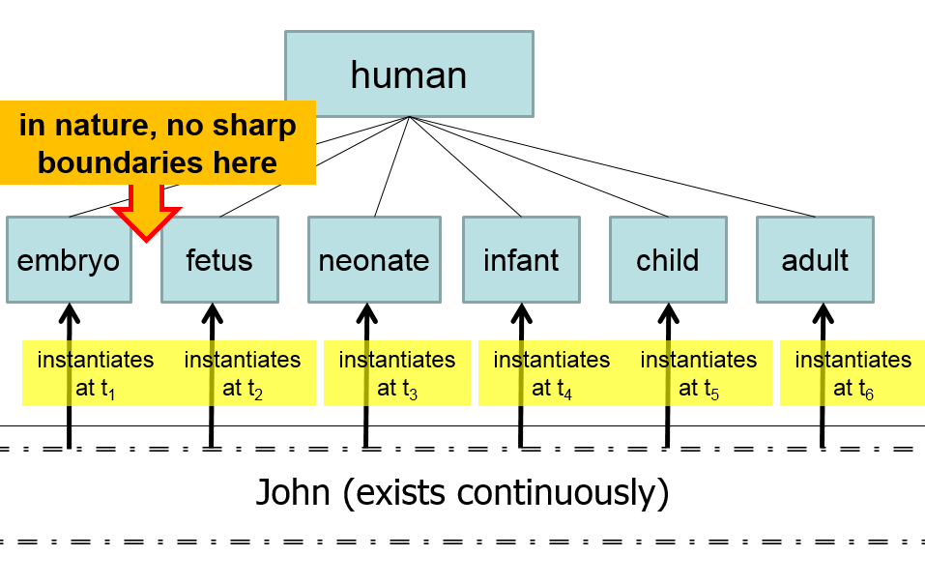
Compare with

Slide 32
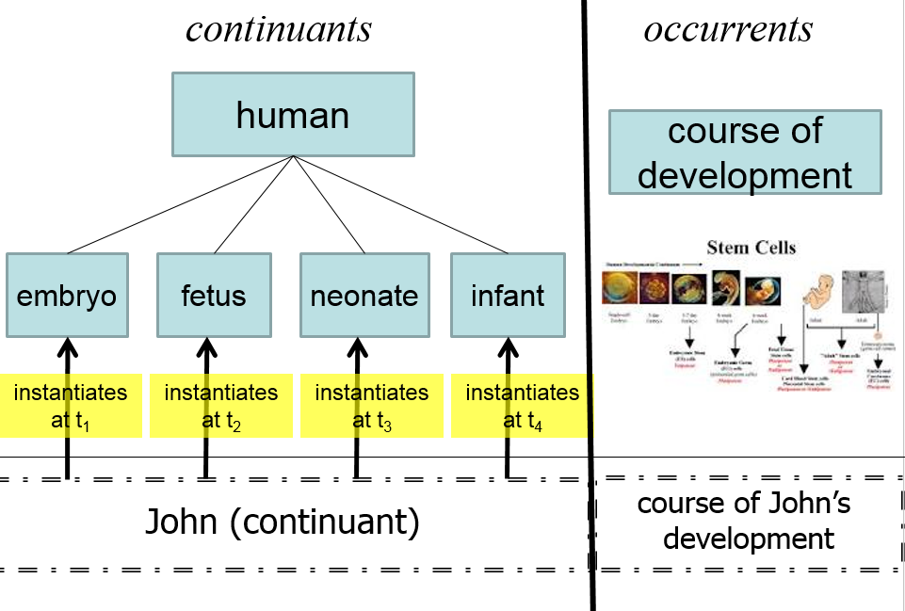

Slide 33
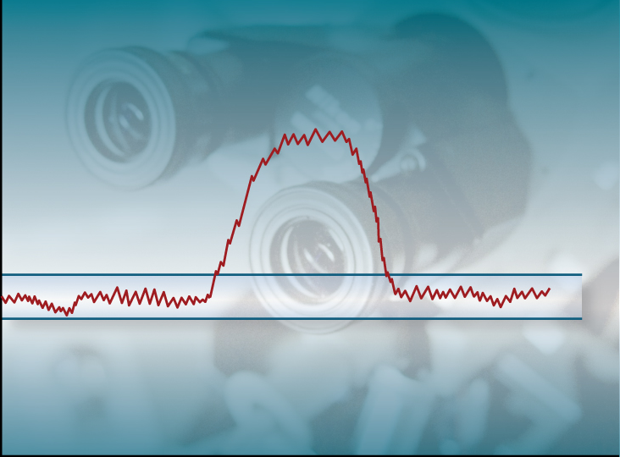
Acute Influenza Infection Process
Immune response
Pathogen sterilization
State
Viral replication
& tissue destruction
Normal Homeostatic
Range
Etiological
Event
Time

Slide 34
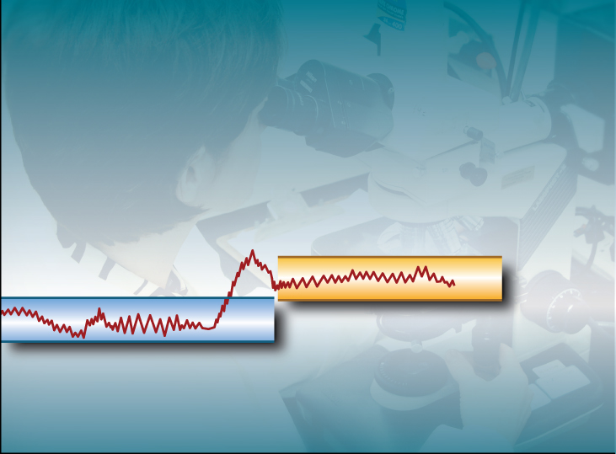
Normal Adaptation
State
Etiological
Event
Normal Homeostatic
Range
Normal Homeostatic
Range
Time

Slide 35
Acute Pathological Process
State
Etiological
Event
Normal Homeostatic
Range
Time

Slide 36
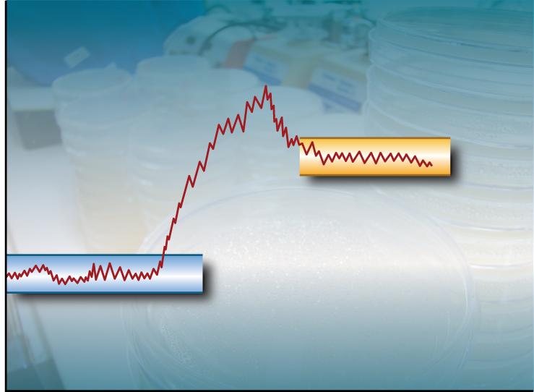
Chronic Pathological Process
State
Abnormal
Homeostatic
Range
Etiological
Event
Normal Homeostatic
Range
Time

Slide 37
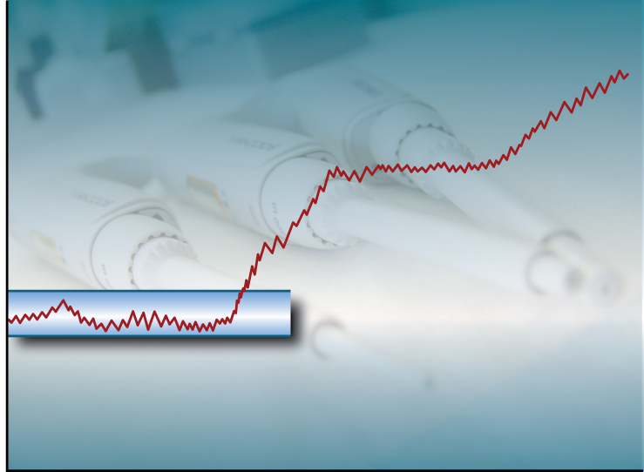
Progressive Pathological Process
State
Etiological
Event
Normal Homeostatic
Range
Time

Slide 38
Etiology
Etiological Process =def. – A process in an organism that leads to a subsequent disorder.
Examples:
  toxic chemical exposure resulting in a mutation in the genomic DNA of a cell;
  infection of a human with a pathogenic virus;
  inheritance of two defective copies of a metabolic gene.
The etiological process creates the physical basis of that disposition to pathological processes which is the disease.

Slide 39
Dispositions and Predispositions
All diseases are dispositions; not all dispositions are diseases.
A predisposition is a disposition.
Predisposition to Disease of Type X =def. – A disposition in an organism that constitutes an increased risk of the organism’s subsequently developing the disease X.
Hereditary Non-polyposis Colorectal Cancer (HNPCC) is caused by a:
  disorder (mutation) in a DNA mismatch repair gene that
  disposes to the acquisition of additional mutations from defective DNA repair processes, and thus
  predisposition to the development of colon cancer.

Slide 40
Hereditary Non-polyposis Colorectal Cancer HNPCC - genetic pre-disposition
Etiological process - inheritance of a mutant mismatch repair gene
  produces
Disorder - chromosome 3 with abnormal hMLH1
  bears
Disposition (disease) - Lynch syndrome
  realized_in
Pathological process - abnormal repair of DNA mismatches
  produces
Disorder - mutations in proto-oncogenes and tumor suppressor genes with microsatellite repeats (e.g. TGF-beta R2)
  bears
Disposition (disease) - non-polyposis colon cancer

Slide 41
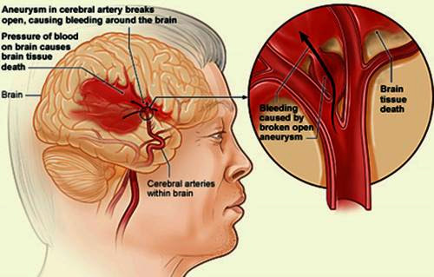
Hemorrhagic stroke
http://www.tomfit247.com/2013/05/stroke-what-is-it-what-causes-it-and.html

Slide 42
Hemorrhagic stroke
Disorder – cerebral arterial aneurysm
  bears
Disposition – of weakened artery to rupture
  realized in
Pathological process – rupturing of weakened blood vessel
  produces
Disorder – Intraparenchymal cerebral hemorrhage
  bears
Disposition (disease) – to increased intra-cranial pressure
  realized in
Pathological process – increasing intra-cranial pressure, compression of brain structures
  produces
Disorder – Cerebral ischemia, Cerebral neuronal death
  bears
Disposition (disease) – stroke
  realized in
Symptoms – weakness/paralysis, loss of sensation, etc

Slide 43
Definitions - Clinical Evaluation Terms
(on the side of the patient!)
‘bodily feature’ - an abbreviation for physical component, a bodily quality, or a bodily process.
Sign =def. – A bodily feature of a patient that is observed in a physical examination and is deemed by the clinician to be of clinical significance. (Objectively observable features)
Symptom =def. – A bodily feature of a patient that is observed by the patient and is hypothesized by the patient to be a realization of a disease. (a restricted family of phenomena (including pain, nausea, anger, drowsiness), which are of their nature experienced in the first person)
Laboratory Test =def. – A measurement assay that has as input a patient-derived specimen, and as output a result representing a quality of the specimen.
Laboratory Finding =def. – A representation of a quality of a specimen that is the output of a laboratory test and that can support an inference to an assertion about some quality of the patient.

Slide 44
Part 2
Foundational type-terms for clinical entities on the side of the patient
produces
bears
realized_in
etiological process
disorder
disposition
pathological process
produces
diagnosis
interpretive process
signs & symptoms
abnormal bodily features
produces
participates_in
recognized_as
Notes:
font was too small, color inside green boxes was hardly readable

Slide 45
Definitions - manifestations
Manifestation of a Disease =def. – A bodily feature of a patient that is (a) a deviation from clinical normality that exists in virtue of the realization of a disease and (b) is observable.
  Observability includes observable through elicitation of response or through the use of special instruments.
Preclinical Manifestation of a Disease =def. – A manifestation of a disease that exists prior to its becoming detectable in a clinical history taking or physical examination.
Clinical Manifestation of a Disease =def. – A manifestation of a disease that is detectable in a clinical history taking or physical examination.
Phenotype =def. – A (combination of) bodily feature(s) of an organism determined by the interaction of its genetic make-up and environment.
Clinical Phenotype =def. – A clinically abnormal phenotype.

Slide 46
Phenotype
On the side of the patient
Bodily features
  Symptoms
  Signs
    Observed through physical examination
    Observed through lab test

Slide 47
Phenotype
On the side of the patient
Bodily features
  Symptoms
  Signs
    Observed through physical examination
    Observed through lab test
Phenotype =def. – A (combination of) bodily
feature(s) of an organism determined by the
interaction of its genetic make-up and environment.
Clinical Phenotype =def. – A clinically abnormal
phenotype.

Slide 48
Part 3
Foundational type-terms for representations of entities on the side of the patient
produces
bears
realized_in
etiological process
disorder
disposition
pathological process
produces
diagnosis
interpretive process
signs & symptoms
abnormal bodily features
produces
participates_in
recognized_as
Notes:
font was too small, color inside green boxes was hardly readable

Slide 49
‘Findings’ / ‘observations’
On the side of the patient
Bodily features
  Symptoms
  Signs
    Observed through physical examination
    Observed through lab test
Representations
Findings
  Anamnestic findings
    Clinical findings
    Laboratory findings

Slide 50
‘Findings’ / ‘observations’
On the side of the patient
Bodily features
  Symptoms
  Signs
    Observed through physical examination
    Observed through lab test
    (clinical) phenotype
Representations
Findings
  Anamnestic findings
    Clinical findings
    Laboratory findings
    clinical picture

Slide 51
Clinical picture
Clinical Picture =def. – A representation of a clinical phenotype that is inferred from the combination of laboratory, image and clinical findings about a given patient.

Slide 52
‘Findings’ / ‘observations’
On the side of the patient
Bodily features
  Symptoms
  Signs
    Observed through physical examination
    Observed through lab test
Diseases
Representations
Findings
  Anamnestic findings
    Clinical findings
    Laboratory findings
Diagnoses

Slide 53
Diagnosis
Clinical Picture =def. – A representation of a clinical phenotype that is inferred from the combination of laboratory, image and clinical findings about a given patient.
Diagnosis =def. – A conclusion of an interpretive process that has as input a clinical picture of a given patient and as output an assertion to the effect that the patient has a disease of such and such a type.

Slide 54
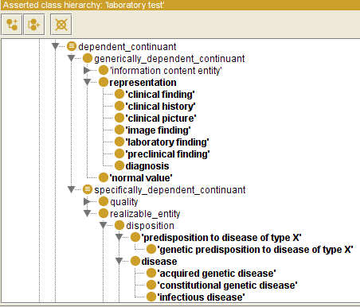

Slide 55
Generically Dependent Continuants
Generically
Dependent
Continuant
if one bearer ceases to exist, then the entity can survive, because there are other bearers
(copyability)
the pdf file on my laptop
the DNA (sequence) in this chromosome
Information
Content
Entity
Gene
Sequence

Slide 56
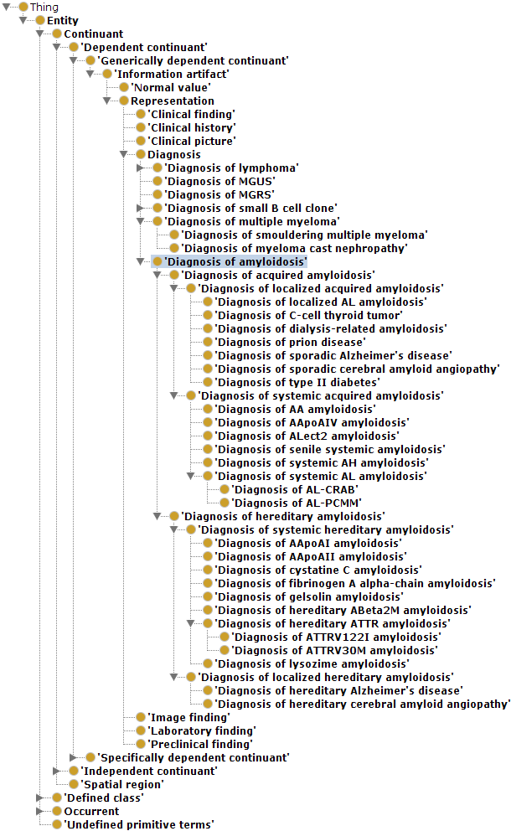
Although ontologically correct, it is totally ridiculous to implement this in this fashion, as ridiculous it would be to implement in this way an ontology for natural numbers.

Slide 58
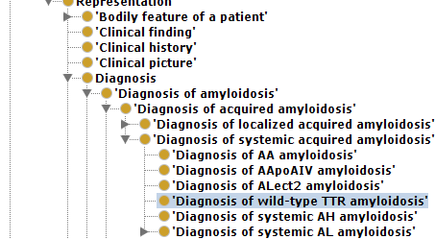
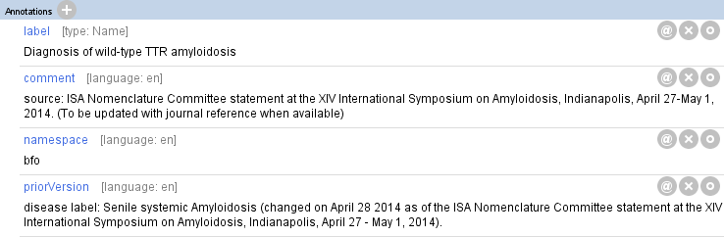
It is for sure incorrect when these correspond to GDC instances !!!

Slide 59
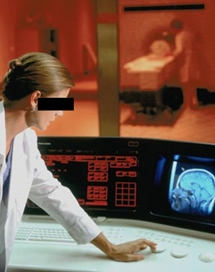
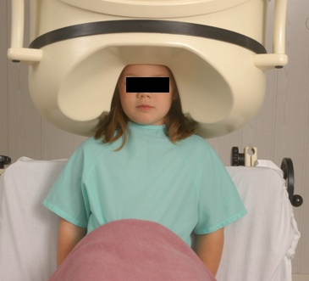
No conflation of diagnosis, disease, and disorder
The diagnosis is here
The disorder is there
The disease is there

Slide 60
No conflation of diagnosis, disease, and disorder
produces
bears
realized_in
etiological process
disorder
disease
pathological process
produces
diagnosis
interpretive process
signs & symptoms
abnormal bodily features
produces
participates_in
recognized_as
Notes:
font was too small, color inside green boxes was hardly readable

Slide 61
Application of OGMS in medical documentation

Slide 62
Key OGMS definitions
DISORDER
DISEASE
DISEASE COURSE
DIAGNOSIS
Scheuermann R, Ceusters W, Smith B. Toward an Ontological Treatment of Disease and Diagnosis. 2009 AMIA Summit on Translational Bioinformatics, San Francisco, California, March 15-17, 2009;: 116-120. Omnipress ISBN:0-9647743-7-2

Slide 63
Key OGMS definitions
DISORDER | A causally relatively isolated combination of physical components that is (a) clinically abnormal and (b) maximal, in the sense that it is not a part of some larger such combination.
DISEASE
DISEASE COURSE
DIAGNOSIS
Scheuermann R, Ceusters W, Smith B. Toward an Ontological Treatment of Disease and Diagnosis. 2009 AMIA Summit on Translational Bioinformatics, San Francisco, California, March 15-17, 2009;: 116-120. Omnipress ISBN:0-9647743-7-2

Slide 64
Key OGMS definitions
DISORDER | A causally relatively isolated combination of physical components that is (a) clinically abnormal and (b) maximal, in the sense that it is not a part of some larger such combination.
DISEASE | A DISPOSITION (i) to undergo PATHOLOGICAL PROCESSes that (ii) exists in an ORGANISM because of one or more DISORDERs in that ORGANISM.
DISEASE COURSE
DIAGNOSIS
Scheuermann R, Ceusters W, Smith B. Toward an Ontological Treatment of Disease and Diagnosis. 2009 AMIA Summit on Translational Bioinformatics, San Francisco, California, March 15-17, 2009;: 116-120. Omnipress ISBN:0-9647743-7-2

Slide 65
Key OGMS definitions
DISORDER | A causally relatively isolated combination of physical components that is (a) clinically abnormal and (b) maximal, in the sense that it is not a part of some larger such combination.
DISEASE | A DISPOSITION (i) to undergo PATHOLOGICAL PROCESSes that (ii) exists in an ORGANISM because of one or more DISORDERs in that ORGANISM.
DISEASE COURSE | The totality of all PROCESSes through which a given DISEASE instance is realized.
DIAGNOSIS
Scheuermann R, Ceusters W, Smith B. Toward an Ontological Treatment of Disease and Diagnosis. 2009 AMIA Summit on Translational Bioinformatics, San Francisco, California, March 15-17, 2009;: 116-120. Omnipress ISBN:0-9647743-7-2

Slide 66
Key OGMS definitions
DISORDER | A causally relatively isolated combination of physical components that is (a) clinically abnormal and (b) maximal, in the sense that it is not a part of some larger such combination.
DISEASE | A DISPOSITION (i) to undergo PATHOLOGICAL PROCESSes that (ii) exists in an ORGANISM because of one or more DISORDERs in that ORGANISM.
DISEASE COURSE | The totality of all PROCESSes through which a given DISEASE instance is realized.
DIAGNOSIS | A conclusion of an interpretive PROCESS that has as input a CLINICAL PICTURE of a given patient and as output an assertion (diagnostic statement) to the effect that the patient has a DISEASE of such and such a type.
Scheuermann R, Ceusters W, Smith B. Toward an Ontological Treatment of Disease and Diagnosis. 2009 AMIA Summit on Translational Bioinformatics, San Francisco, California, March 15-17, 2009;: 116-120. Omnipress ISBN:0-9647743-7-2

Slide 67
Disorder related configurations
No disorder instance → no disease instance,
→ no pathological processes;
A disorder instance can eliminate the range of circumstances under which another disorder instance can lead to pathological processes → no disease instance;
Disorders of the same type in distinct patients, or in the same patient at distinct times, may lead to diseases of distinct types;
Diseases of the same type may unfold themselves in disease courses of distinct types;
Diseases of distinct types may unfold themselves in disease courses of the same type;
…

Slide 68
A little exercise

Slide 69
What are diagnoses in EHRs about?
(What are the options?)
DISORDER | A causally relatively isolated combination of physical components that is (a) clinically abnormal and (b) maximal, in the sense that it is not a part of some larger such combination.
DISEASE | A DISPOSITION (i) to undergo PATHOLOGICAL PROCESSes that (ii) exists in an ORGANISM because of one or more DISORDERs in that ORGANISM.
DISEASE COURSE | The totality of all PROCESSes through which a given DISEASE instance is realized.
DIAGNOSIS | A conclusion of an interpretive PROCESS that has as input a CLINICAL PICTURE of a given patient and as output an assertion (diagnostic statement) to the effect that the patient has a DISEASE of such and such a type.
Scheuermann R, Ceusters W, Smith B. Toward an Ontological Treatment of Disease and Diagnosis. 2009 AMIA Summit on Translational Bioinformatics, San Francisco, California, March 15-17, 2009;: 116-120. Omnipress ISBN:0-9647743-7-2

Slide 70
What are diagnoses in EHRs about?
(What are the options?)
DISORDER | A causally relatively isolated combination of physical components that is (a) clinically abnormal and (b) maximal, in the sense that it is not a part of some larger such combination.
DISEASE | A DISPOSITION (i) to undergo PATHOLOGICAL PROCESSes that (ii) exists in an ORGANISM because of one or more DISORDERs in that ORGANISM.
DISEASE COURSE | The totality of all PROCESSes through which a given DISEASE instance is realized.
DIAGNOSIS | A conclusion of an interpretive PROCESS that has as input a CLINICAL PICTURE of a given patient and as output an assertion (diagnostic statement) to the effect that the patient has a DISEASE of such and such a type.
781.2 Abnormality of gait

Slide 71
What are diagnoses in EHRs about?
(What are the options?)
DISORDER | A causally relatively isolated combination of physical components that is (a) clinically abnormal and (b) maximal, in the sense that it is not a part of some larger such combination.
DISEASE | A DISPOSITION (i) to undergo PATHOLOGICAL PROCESSes that (ii) exists in an ORGANISM because of one or more DISORDERs in that ORGANISM.
DISEASE COURSE | The totality of all PROCESSes through which a given DISEASE instance is realized.
DIAGNOSIS | A conclusion of an interpretive PROCESS that has as input a CLINICAL PICTURE of a given patient and as output an assertion (diagnostic statement) to the effect that the patient has a DISEASE of such and such a type.
781.2 Abnormality of gait

Slide 72
What are diagnoses in EHRs about?
(What are the options?)
DISORDER | A causally relatively isolated combination of physical components that is (a) clinically abnormal and (b) maximal, in the sense that it is not a part of some larger such combination.
DISEASE | A DISPOSITION (i) to undergo PATHOLOGICAL PROCESSes that (ii) exists in an ORGANISM because of one or more DISORDERs in that ORGANISM.
DISEASE COURSE | The totality of all PROCESSes through which a given DISEASE instance is realized.
DIAGNOSIS | A conclusion of an interpretive PROCESS that has as input a CLINICAL PICTURE of a given patient and as output an assertion (diagnostic statement) to the effect that the patient has a DISEASE of such and such a type.
256.0 - Hyperestrogenism

Slide 73
What are diagnoses in EHRs about?
(What are the options?)
DISORDER | A causally relatively isolated combination of physical components that is (a) clinically abnormal and (b) maximal, in the sense that it is not a part of some larger such combination.
DISEASE | A DISPOSITION (i) to undergo PATHOLOGICAL PROCESSes that (ii) exists in an ORGANISM because of one or more DISORDERs in that ORGANISM.
DISEASE COURSE | The totality of all PROCESSes through which a given DISEASE instance is realized.
DIAGNOSIS | A conclusion of an interpretive PROCESS that has as input a CLINICAL PICTURE of a given patient and as output an assertion (diagnostic statement) to the effect that the patient has a DISEASE of such and such a type.
256.0 - Hyperestrogenism

Slide 74
What are diagnoses in EHRs about?
(What are the options?)
DISORDER | A causally relatively isolated combination of physical components that is (a) clinically abnormal and (b) maximal, in the sense that it is not a part of some larger such combination.
DISEASE | A DISPOSITION (i) to undergo PATHOLOGICAL PROCESSes that (ii) exists in an ORGANISM because of one or more DISORDERs in that ORGANISM.
DISEASE COURSE | The totality of all PROCESSes through which a given DISEASE instance is realized.
DIAGNOSIS | A conclusion of an interpretive PROCESS that has as input a CLINICAL PICTURE of a given patient and as output an assertion (diagnostic statement) to the effect that the patient has a DISEASE of such and such a type.
250.23 Diabetes with hyperosmolarity, type I, uncontrolled

Slide 75
What are diagnoses in EHRs about?
(What are the options?)
DISORDER | A causally relatively isolated combination of physical components that is (a) clinically abnormal and (b) maximal, in the sense that it is not a part of some larger such combination.
DISEASE | A DISPOSITION (i) to undergo PATHOLOGICAL PROCESSes that (ii) exists in an ORGANISM because of one or more DISORDERs in that ORGANISM.
DISEASE COURSE | The totality of all PROCESSes through which a given DISEASE instance is realized.
DIAGNOSIS | A conclusion of an interpretive PROCESS that has as input a CLINICAL PICTURE of a given patient and as output an assertion (diagnostic statement) to the effect that the patient has a DISEASE of such and such a type.
250.23 Diabetes with hyperosmolarity, type I, uncontrolled

Slide 76
What are diagnoses in EHRs about?
(What are the options?)
DISORDER | A causally relatively isolated combination of physical components that is (a) clinically abnormal and (b) maximal, in the sense that it is not a part of some larger such combination.
DISEASE | A DISPOSITION (i) to undergo PATHOLOGICAL PROCESSes that (ii) exists in an ORGANISM because of one or more DISORDERs in that ORGANISM.
DISEASE COURSE | The totality of all PROCESSes through which a given DISEASE instance is realized.
DIAGNOSIS | A conclusion of an interpretive PROCESS that has as input a CLINICAL PICTURE of a given patient and as output an assertion (diagnostic statement) to the effect that the patient has a DISEASE of such and such a type.
749.01 - Cleft palate, unilateral, complete

Slide 77
What are diagnoses in EHRs about?
(What are the options?)
DISORDER | A causally relatively isolated combination of physical components that is (a) clinically abnormal and (b) maximal, in the sense that it is not a part of some larger such combination.
DISEASE | A DISPOSITION (i) to undergo PATHOLOGICAL PROCESSes that (ii) exists in an ORGANISM because of one or more DISORDERs in that ORGANISM.
DISEASE COURSE | The totality of all PROCESSes through which a given DISEASE instance is realized.
DIAGNOSIS | A conclusion of an interpretive PROCESS that has as input a CLINICAL PICTURE of a given patient and as output an assertion (diagnostic statement) to the effect that the patient has a DISEASE of such and such a type.
749.01 - Cleft palate, unilateral, complete

Slide 78
What are diagnoses in EHRs about?
(What are the options?)
DISORDER | A causally relatively isolated combination of physical components that is (a) clinically abnormal and (b) maximal, in the sense that it is not a part of some larger such combination.
DISEASE | A DISPOSITION (i) to undergo PATHOLOGICAL PROCESSes that (ii) exists in an ORGANISM because of one or more DISORDERs in that ORGANISM.
DISEASE COURSE | The totality of all PROCESSes through which a given DISEASE instance is realized.
DIAGNOSIS | A conclusion of an interpretive PROCESS that has as input a CLINICAL PICTURE of a given patient and as output an assertion (diagnostic statement) to the effect that the patient has a DISEASE of such and such a type.
V65.5 - Person with feared complaint in whom no diagnosis was made

Slide 79
What are diagnoses in EHRs about?
(What are the options?)
DISORDER | A causally relatively isolated combination of physical components that is (a) clinically abnormal and (b) maximal, in the sense that it is not a part of some larger such combination.
DISEASE | A DISPOSITION (i) to undergo PATHOLOGICAL PROCESSes that (ii) exists in an ORGANISM because of one or more DISORDERs in that ORGANISM.
DISEASE COURSE | The totality of all PROCESSes through which a given DISEASE instance is realized.
DIAGNOSIS | A conclusion of an interpretive PROCESS that has as input a CLINICAL PICTURE of a given patient and as output an assertion (diagnostic statement) to the effect that the patient has a DISEASE of such and such a type.
V65.5 - Person with feared complaint in whom no diagnosis was made

Slide 80
Application of OGMS to insights in other disease related ontologies

Slide 81
‘Disease’ in BioPortal junk
https://bioportal.bioontology.org/search?utf8=%E2%9C%93&query=disease&button=

Slide 82
Bad ‘disease ontologies’
Despite being listed in the OBO-Foundry: http://www.obofoundry.org/ontology/doid.html
Mondo Disease Ontology: junky collection of several other ‘ontologies’:
  https://mondo.monarchinitiative.org/
  https://www.ebi.ac.uk/ols/ontologies/mondo
The Semantic Science Ontology: junk as a foundation
https://bioportal.bioontology.org/ontologies/SIO?p=classes&conceptid=http%3A%2F%2Fsemanticscience.org%2Fresource%2FSIO_010299

Slide 83
Assignment A7
Add to (or re-classify in) your ontology 3 (or all such classifiable) terms each one of which
  (1) is a subtype of an OGMS entity and
  (2) has thus far not been included (classified under OGMS) in your ontology.
Use referent tracking statements for these terms to relate them to relevant existing terms in your ontology and improve where needed the definitions. The result is version 5.
Form: copy your ‘A6’ file to A7-file, in that file, copy the A6-sheet as A7-sheet, and updated that copy, leaving the original A6-sheet untouched.
Upload your work as usual.
Due date: Oct 20 – noon.

Slide 84
Suggested pre-class reading
R12 Seppälä, S., B. Smith, and W. Ceusters, Applying the Realism-Based Ontology-Versioning Method for Tracking Changes in the Basic Formal Ontology, in Formal Ontology in Information Systems (FOIS 2014), P. Garbacz and O. Kutz, Editors. 2014, IOS Press. p. 227-240. [9]
http://ontology.buffalo.edu/smith/articles/fois2014.pdf

