Slide 1
BMI508 – Fall 2026
Introduction to Biomedical Ontology
Class 3 – Sept 9, 2026
Logics for ontology development and axiomatization
Werner CEUSTERS
Department of Biomedical Informatics, University at Buffalo, USA

Slide 2
Assignment A2
prepare a short powerpoint presentation (maximum 5 minutes for presentation during the class) in which you describe in what area and how you intend to develop a small realism-based ontology useful for your final MSc or PhD project/thesis.
Required content: precise description of domain, motivation, examples of terms to be represented, challenges you see, intended application with concrete indication of the sort of topic entities it will be applied to. For students in BMI or Biomedical Sciences, the topic entity must be within the domain of biomedical informatics. Other students may select another topic type (pieces of equipment, plants, environmental entities, …). Use previous classes, slides and readings as a guide.
Upload your work in a PowerPoint file to the assignment upload folder. Name of the file: ‘BMI508-A2-[your ubitname].pptx’
Assessment: extent to which the material discussed in classes C1 to C3 is appropriately applied.
Due date: Sep 14 – noon.
4% of total final score.

Slide 3
The many faces of ‘BFO’
The term "Basic Formal Ontology" is ambiguous. Firstly, it may denote some ontological position in an Aristotelian tradition combined with some methodological principles for the development of domain ontologies (BFO-Phil). Secondly, it may refer to a document, which represents the philosophical theory in first-order logic (or Common Logic) axioms (BFO-FOL). Thirdly, it may refer to a document, which represents the philosophical theory in OWL DL (BFO-OWL). (Both BFO-FOL and BFO-OWL exists in several variants.) BFO-Phil, BFO-FOL, and BFO-OWL differ dramatically with respect to their content. BFO-Phil builds on a rich philosophical tradition and has been developed over many years in numerous articles, a user guide and a text book. The various variants of BFO-FOL capture only a small, but a significant fraction of the content of BFO-Phil. In contrast, BFO-OWL is so weak that almost none of BFO-Phil is preserved. For example, BFO 2.0 OWL, which is used by many domain ontologies, contains exactly 52 OWL axioms, more precisely 18 disjointness axioms and 34 subsumption axioms between atomic classes. Consequently, the rich ontological content of BFO-Phil is not used for automatic reasoning and consistency checking.
Fabian Neuhaus, 2023.

Slide 4
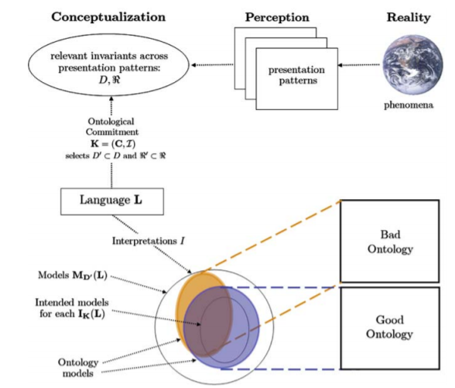
Ontology, principles, and language
Ontological principles
Logical principles
What Is an Ontology?
Nicola Guarino, Daniel Oberle, and Steffen Staab
S. Staab and R. Studer (eds.), Handbook on Ontologies, International Handbooks 1
on Information Systems, DOI 10.1007/978-3-540-92673-3,
Springer-Verlag Berlin Heidelberg 2009

Slide 5
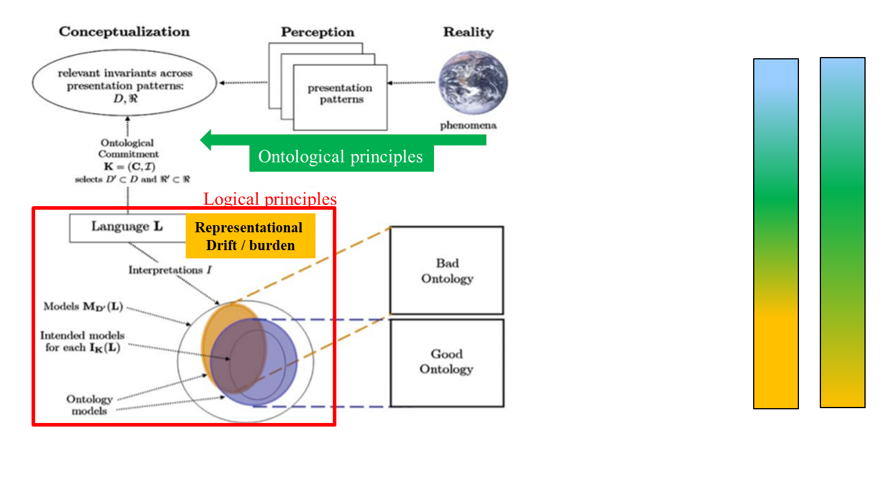
BFO framework

Slide 6
Basic BFO building blocks (1)
Renderings of BFO consist of a variable number of terms and relational expressions:
    terms: ‘continuant’, ‘occurrent’, ‘instance of at’, ‘isa’, …
    relational expressions: ‘a instance of A at t’, ‘A isa B’, …

Slide 7
Basic BFO building blocks (2)
Renderings of BFO consist of a variable number of terms and relational expressions:
    terms: ‘continuant’, ‘occurrent’, ‘instance of at’, ‘isa’, …
    relational expressions: ‘a instance of A at t’, ‘A isa B’, …
Both terms and relational expressions can be primitive (syn: elucidated), or defined:
    fully defined: when described by a statement satisfying both:
      (1) built out of logically more primitive terms, and
      (2) expressing individually necessary and jointly sufficient conditions for an entity to fall under the designated type, or for a relation to hold.
    primitive: when they are so basic to our understanding of reality that there is no way of defining them in a noncircular fashion, or when only necessary conditions are specified.

Slide 8
Term examples (1)
Primitive:
  Entity: (elucidation) anything that exists or has existed or will exist.
  Continuant: (elucidation) an entity that persists, endures, or continues to exist through time while maintaining its identity.

Slide 9
Term examples (2)
Primitive:
  Entity: (elucidation) anything that exists or has existed or will exist.
  Continuant: (elucidation) an entity that persists, endures, or continues to exist through time while maintaining its identity.
Defined:
  b is an independent continuant =Def. b is a continuant which is such that there is no c such that b s‐depends on c and no c such that b g‐depends on c.

Slide 10
Relational expression examples (1)
Primitive:
  Elucidation: b continuant part of c at t means: b and c are continuants and b is a part of c at t

Slide 11
Relational expression examples (2)
Primitive:
  Elucidation: b continuant part of c at t means: b and c are continuants and b is a part of c at t
Defined:
  A is a B =Def.
    for all x, t, if x is an instance of A at t then x is an instance of B at t
  b has continuant part c at t =Def.
    b and c are continuants and b is a continuant part of c at t

Slide 12
Avoid primitives !!!
Best approach to do so: use BFO !
(requirement for this course!)

Slide 13
Axioms
Expressions built out of already defined or elucidated terms or expressions stating that something else is also the case, either because:
  it is true, but not provable from other axioms, or
  it is ‘enforced’, e.g. by further restricting the meaning of terms, or the logical consequences of relations.

Slide 14
Axioms versus theorems
Expressions built out of already defined or elucidated terms or expressions stating that something else is also the case, either because:
  it is true, but not provable from other axioms, or
  it is ‘enforced’, e.g. by further restricting the meaning of terms, or the logical consequences of relations.
  Theorems
Expressions built out of already defined or elucidated terms or expressions stating that something logically provable is the case.

Slide 15
Axioms – Definitions – Elucidations
Definitions:
  for types T: describe how what are colloquially called ‘conditions’, ‘situations’ or ‘states of affairs’ holding for entities E determine which of these Es are instances of T.
    possibilities: sufficient, necessary, sufficient and necessary
  for relations: describe what makes them hold between instances of certain types.
Elucidations: use other or extra means to clarify what definitions try to achieve.
Axioms: can not only express what definitions express, but also what relates ‘conditions, …’ to other ‘conditions …’.

Slide 16
Axioms about continuants
If:
b is a continuant
and if:
for some c and some t, c continuant-part-of b at t, then:
c is a continuant.
If:
b is a continuant
and if:
for some c and some t, c has-continuant-part b at t,
Then:
c is a continuant.

Slide 17
Continuant-part axioms
Definition: b continuant_part_of c at t =Def. b is a part of c at t & t is a time & b and c are continuants .
Axioms:
  continuant_part_of is antisymmetric.
  continuant_part_of is transitive.
  continuant_part_of satisfies weak supplementation.
  continuant_part_of satisfies unique product.
Theorem:
  continuant_part_of is reflexive.

Slide 18
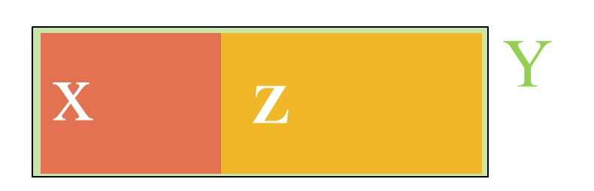
E.g. weak supplementation
If x continuant_part_of y at t
& not x = y,
then there is some z such that
( z continuant_part_of y at t
& there is no w
( w continuant_part_of z at t
& w continuant_part_of x at t)).

Slide 19
Some Axioms between different entity types
If x instance of Continuant at t
  then not (x instance of Occurrent at t).
At every time a specifically-dependent-continuant s participates in a process p there’s a part of that time during which there’s an independent-continuant that s s-depends-on, and that participates in p at that time.

Slide 20
Axioms are better expressed in a formal language

Slide 21
Formal Language
A language defined by an alphabet and formation rules.
The alphabet is a set of symbols, some of which may have a special meaning or belong to a certain type:
  a , b , c , …
  and, or, ‘ ’, …
The formation rules specify which strings of symbols count as well-formed:
  rules postulating that such and such expressions belong to the language in question.
  rules establishing how to build well-formed expressions from other expressions belonging to the language,
  …

Slide 22
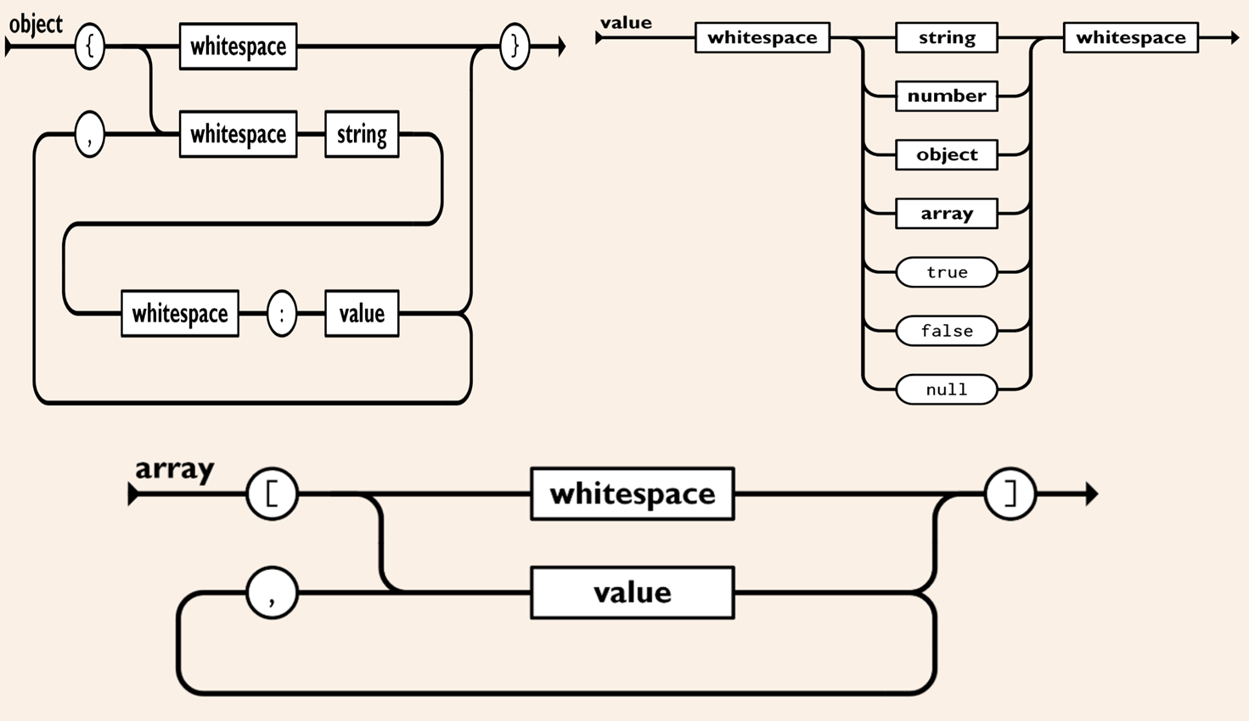
Some JSON formation rules and symbols

Slide 23
JSON data example
{ "first_name": "John",
"last_name": "Smith",
"is_alive": true,
"age": 27,
"address": { "street_address": "21 2nd Street",
"city": "New York",
"state": "NY",
"postal_code": "10021-3100" },
"phone_numbers":
[ { "type": "home",
"number": "212 555-1234" },
{ "type": "office",
"number": "646 555-4567" } ],
"children": [ "Catherine", "Thomas", "Trevor" ],
"spouse": null }

Slide 24
JSON data example
{ "first_name": "John",
"last_name": "Smith",
"is_alive": true,
"age": 27,
"address": { "street_address": "21 2nd Street",
"city": "New York",
"state": "NY",
"postal_code": "10021-3100" },
"phone_numbers":
[ { "type": "home",
"number": "212 555-1234" },
{ "type": "office",
"number": "646 555-4567" } ],
"children": [ "Catherine", "Thomas", "Trevor" ],
"spouse": null }
JSON does not have a formal semantics !!!

Slide 25
People and GenAI use intuitive semantics
Gemini AI prompt: What would be a relational database representation for the following JSON object:
{ "first_name": "John",
"last_name": "Smith",
"is_alive": true,
"age": 27,
"address": { "street_address": "21 2nd Street",
"city": "New York",
"state": "NY",
"postal_code": "10021-3100" },
"phone_numbers":
[ { "type": "home",
"number": "212 555-1234" },
{ "type": "office",
"number": "646 555-4567" } ],
"children": [ "Catherine", "Thomas", "Trevor" ],
"spouse": null }

Slide 26
Gemini output in SQL (1)
26
-- ============================================================================
-- RELATIONAL DATABASE REPRESENTATION FOR THE JSON OBJECT
-- ============================================================================
-- Target Design: Fully Normalized (3NF) Relational Schema
-- This schema splits multi-valued attributes (arrays like phone_numbers and children)
-- and nested objects (address) into standard relational tables linked via Foreign Keys.
-- ============================================================================
-- 1. Main Person / Profile Table
CREATE TABLE users (
user_id INT AUTO_INCREMENT PRIMARY KEY,
first_name VARCHAR(50) NOT NULL,
last_name VARCHAR(50) NOT NULL,
is_alive BOOLEAN NOT NULL DEFAULT TRUE,
age INT,
spouse_id INT NULL, -- Can self-reference the users table if a spouse profile exists
created_at TIMESTAMP DEFAULT CURRENT_TIMESTAMP
);

Slide 27
Gemini output in SQL (2)
27
-- 2. Address Table (1:1 Relationship or 1:Many shared addresses)
-- Maps the nested "address" object.
CREATE TABLE addresses (
address_id INT AUTO_INCREMENT PRIMARY KEY,
user_id INT NOT NULL UNIQUE, -- Ensures a 1:1 structure for this user profile profile
street_address VARCHAR(255) NOT NULL,
city VARCHAR(100) NOT NULL,
state CHAR(2) NOT NULL, -- Specifically for US state abbreviations like 'NY'
postal_code VARCHAR(20) NOT NULL,
FOREIGN KEY (user_id) REFERENCES users(user_id) ON DELETE CASCADE
);
-- 3. Phone Numbers Table (1:Many Relationship)
***
-- 4. Children Table (1:Many Relationship)
***

Slide 28
Gemini output in SQL (3)
28
--==========================================================================
-- SAMPLE DATA INSERTION (Populating from the provided JSON values)
--==========================================================================
-- Step 1: Insert core user entity
INSERT INTO users (user_id, first_name, last_name, is_alive, age, spouse_id)
VALUES (1, 'John', 'Smith', TRUE, 27, NULL);
-- Step 2: Insert nested address components
INSERT INTO addresses (user_id, street_address, city, state, postal_code)
VALUES (1, '21 2nd Street', 'New York', 'NY', '10021-3100');
-- Step 3: Insert items from the phone numbers sub-array
INSERT INTO phone_numbers (user_id, type, number) VALUES
(1, 'home', '212 555-1234'),
(1, 'office', '646 555-4567');
-- Step 4: Insert items from the children scalar array
INSERT INTO children (user_id, child_name) VALUES
(1, 'Catherine'),
(1, 'Thomas'),
(1, 'Trevor');

Slide 29
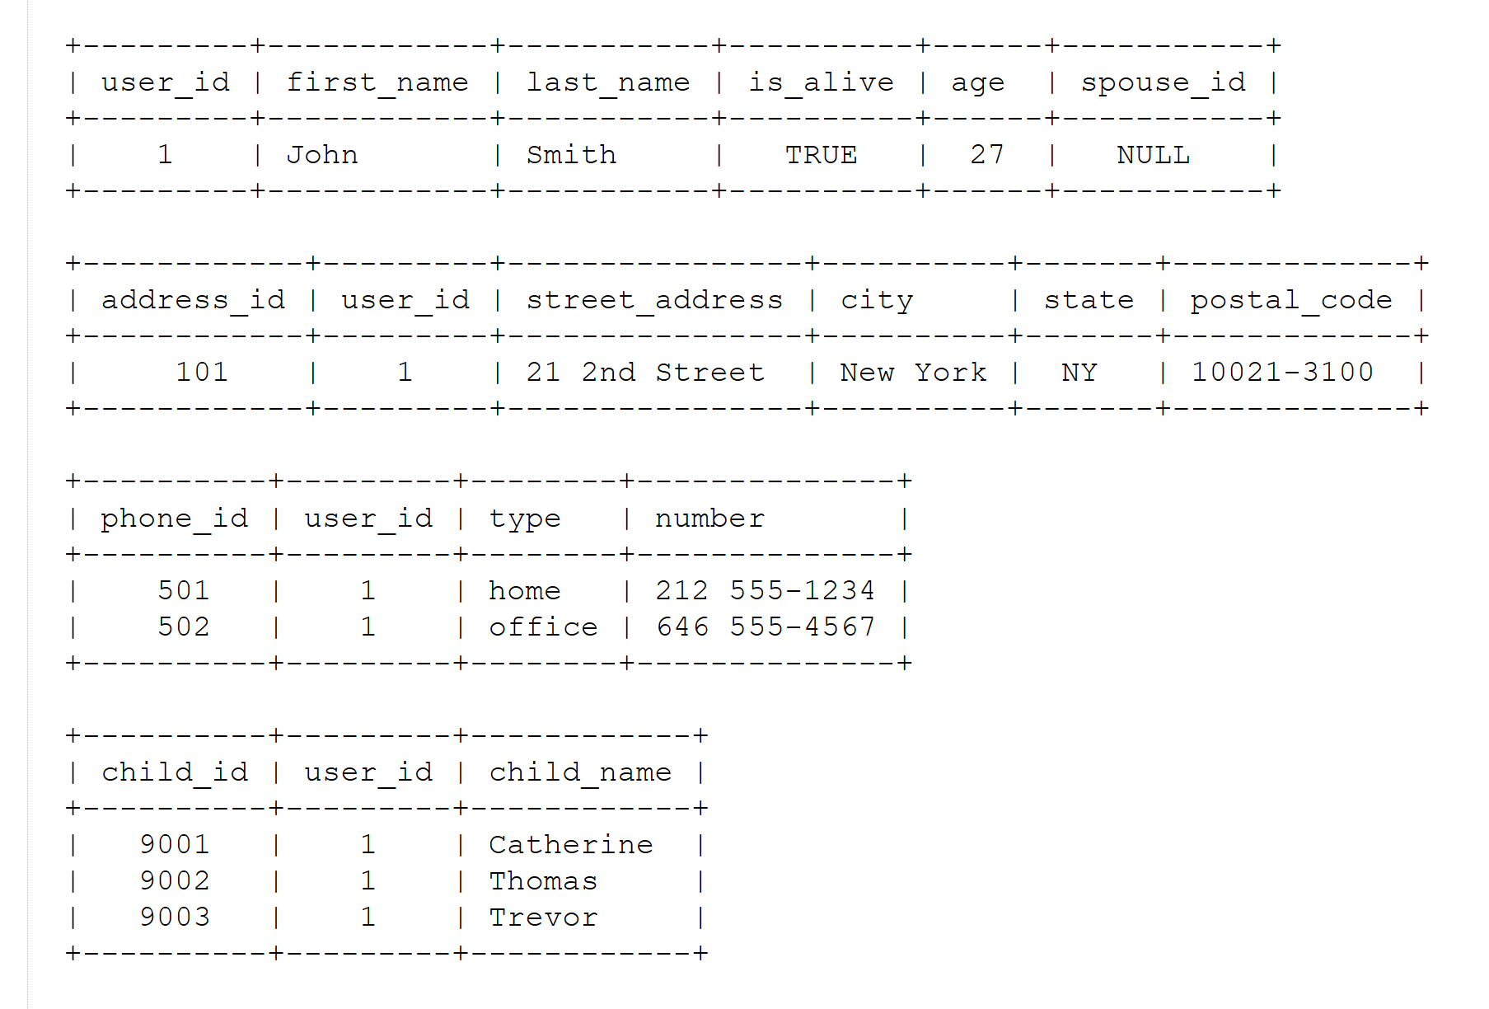
Continued prompt: render as tables

Slide 30
Formal semantics of a language
Core components:
Truth Conditions:
  meaning is defined by knowing what the world must look like for a statement to be true.
Compositionality:
  the meaning of a whole sentence is calculated directly from the meanings of its smaller parts and how they connect.
Model Theory:
  the language maps to a simplified, mathematical model of reality containing specific objects, properties, and sets.
Symbolic Logic:
  replaces ambiguous words and sentences with precise logical formulas.

Slide 31
Logic(s)

Slide 32
What is ‘a logic’
A formal or informal language together with a deductive system and/or a model-theoretic semantics.
The language has components that correspond to a part of a natural language like English or Greek.
The deductive system is to capture, codify, or simply record arguments that are valid for the given language.
The semantics is to capture, codify, or record the meanings, or truth-conditions for at least part of the language.
Shapiro, Stewart and Teresa Kouri Kissel, "Classical Logic",
The Stanford Encyclopedia of Philosophy (Spring 2021 Edition), Edward N. Zalta (ed.).
https://plato.stanford.edu/archives/spr2021/entries/logic-classical/

Slide 33
Propositional Logic (PL) essentials

Slide 34
Language and semantics of PL
A well-formed formula is either atomic or composed following allowed composition rules.
Atomic formulae stand for propositions that must either be true or false:
  A: ‘John eats too much’.
  B: ‘John has a normal BMI’.
  C: ‘John is careful’.
Formula connectors:
  Negation (not): ¬ ~
  Conjunction (and): ∧ & ∙
  Disjunction (or): ∨
  Material implication (if...then): → ⇒ ⊃
  Biconditional (if and only if): ↔ ⬄ ≡ =

Slide 35
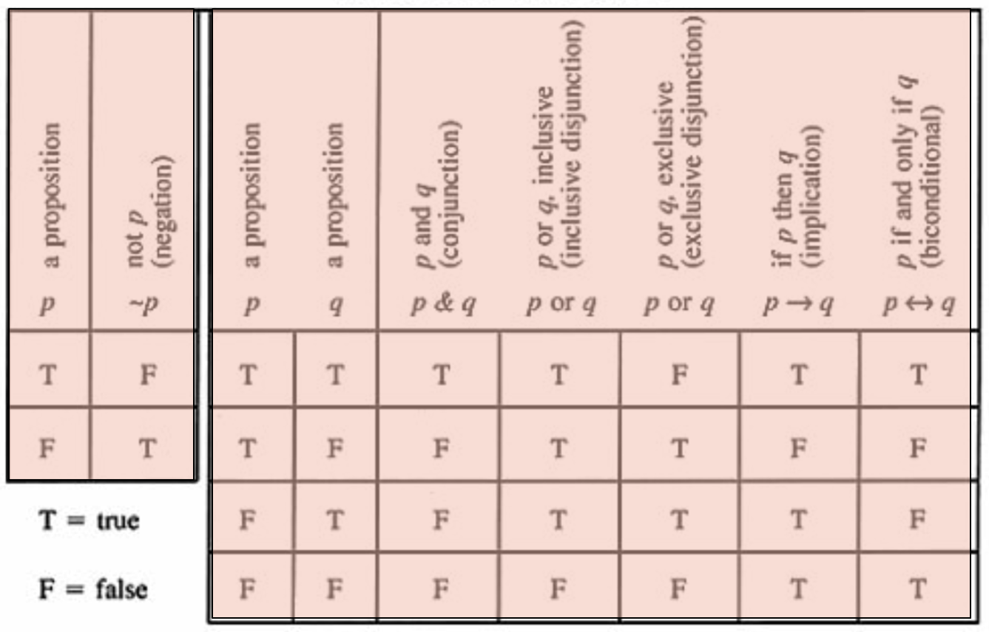
PL’s Deductive system: truth tables

Slide 36
Some PL laws
Truth tables can be used to prove laws, e.g.:
  a Λ (b V c) = (a Λ b) V (a Λ c)
  ¬ (a Λ b) = ¬ a V ¬b
  (a Λ (a → b)) → b
  (a→ b) Λ ¬b) → ¬a
  ((a V b) Λ ¬a) → b
  ((a → b) Λ (b → c)) → (a → c)
  …
  More examples:
    https://math.stackexchange.com/questions/1449866/catalogue-of-propositional-logic-laws
    http://mathonline.wikidot.com/the-laws-of-propositional-logic#toc0
Both truth tables and laws can be used to solve puzzles.

Slide 37
Exercise
Given:
  If John eats too much, then he does not have a normal BMI.
  If John is not careful, then he eats too much.
  John has a normal BMI.
Question
  Is John careful?

Slide 38
Translate sentences into PL
Propositions
John eats too much |  |  | a
John has a normal BMI |  |  | b
John is careful |  |  | c
Given
If John eats too much, then he does not have a normal BMI |  |  | a → ¬b
If John is not careful, then he eats too much. |  |  | ¬c → a
John has a normal BMI |  |  | b
Determine the truth value of: |  | (a → ¬b) ∧ (¬c → a) ∧ b

Slide 39
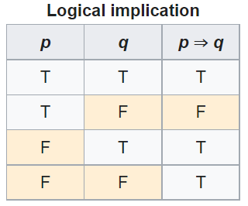

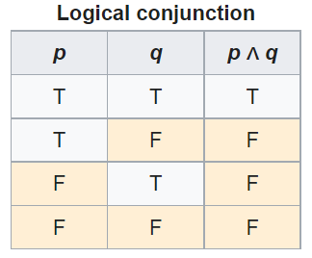
Method 1: Determine with tables

Slide 40
Method 2: Determine using laws
Propositions
John eats too much |  | a
John has a normal BMI |  | b
John is careful |  | c
Given
If John eats too much, then he does not have a normal BMI |  | a → ¬b | g1
If John is not careful, then he eats too much. |  | ¬c → a | g2
John has a normal BMI |  | b | g3
Rule application: | (x→ y) Λ ¬y) → ¬x | ¬a | g3/g1 | g4
 | (x→ y) Λ ¬y) → ¬x | c | g2/g4

Slide 41
Another exercise
Solve this puzzle:
  Given:
    Everybody who eats too much, does not have a normal BMI.
    Everybody who is not careful, eats too much.
    Everybody has a normal BMI.
  Question
    Is everybody careful?
Same as before: yes.

Slide 42
What about this one?
Solve this puzzle:
  Given:
    Everybody who eats too much, does not have a normal BMI.
    Everybody who is not careful, eats too much.
    John has a normal BMI.
  Question
    Is John careful?
Can not be done with propositional logic!
  There is no way to create propositions (within the syntax and semantics of propositional logic) so that ‘everybody’ nor ‘John’ can be represented or related.

Slide 43
First Order Logics (FOL)
(Predicate Logic)

Slide 44
First-order logic
Propositional logic with predicates, variables and quantifiers.
Predicate: a proposition that some property holds for some entity, or a relation between entities.
  Prop.L. : A = ‘everybody eats too much’
  FOL: A = ‘eats too much’ A(x)
Quantifiers:
  ‘all’ ∀ ∀x.A(x) everything eats too much
  ‘some’ ∃ ∃x.A(x) something eats too much
‘everybody eats too much’
  ∀x.person(x) → A(x)

Slide 45
First-Order Logic (FOL) - Syntax
User defines these primitives:
  Constant symbols (i.e., the "individuals" in the world) E.g., bfo, 3
  Function symbols (mapping individuals to individuals) E.g., author-of(bfo) = barry_smith
  Predicate symbols (mapping from individuals to truth values)
E.g., greater(5,3) = true, smart(barry_smith) = true

Slide 46
First-Order Logic (FOL) - Syntax…
FOL supplies these primitives:
  Variable symbols. E.g., x,y
  Connectives.
    Same as in PL:
      not (~),
      and (^),
      or (v),
      implies (→),
      if and only if (<=>)
  Quantifiers: Universal (∀) and Existential (∃)

Slide 47
Truth values of quantifiers
Statement | True when | False when
∀x.A(x) | A(x) is true for every x. | There is an x for which A(x) is false
∃x.A(x) | There is an x for which A(x) is true. | A(x) is false for every x.
Open or Closed World
Reality
Represented Reality

Slide 48
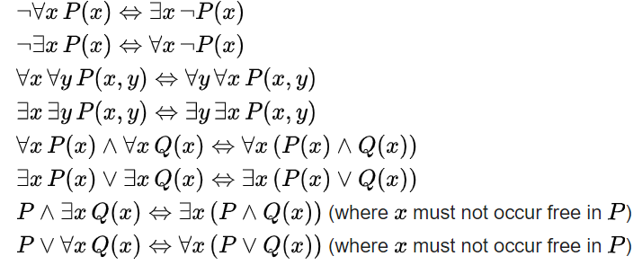
Some equivalences
A free variable is a variable not bound by a quantifier:
∀x.P(x) → Q(x) in contradistinction to ∀x.(P(x) → Q(x))

Slide 49
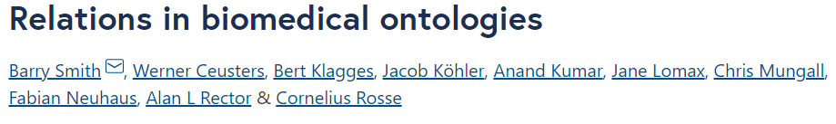
Flexibility in predicate formation
Some people eat too much:
  ∃x (person(x) Λ eats_too_much(x))
  ∃x (person(x) Λ eats(x, ‘too much’))
  ∃x ∃y (person(x) Λ eats(x, y) Λ quantity(y, ‘too much’))
However:
  Are not equivalent,
  Are based on a different ontology.
As a realist ontologist, make your choice on the basis of the method described in
https://genomebiology.biomedcentral.com/articles/10.1186/gb-2005-6-5-r46

Slide 50
Be careful with quantifiers
Order is important!
  ∀x ∃y symptomOf(x, y)
    For all x, there exist some y such that x is a symptom of y
      Every symptom originates from some disease;
      Does not exclude that there is only one disease, and that all symptoms come from that one disease.
  ∃y ∀x symptomOf(x, y)
    There exist some y, such that for all x, x is a symptom of y
      There is a disease which is the cause of all symptoms that exist.

Slide 51
Be aware of ambiguities in language
‘Every patient has some provider’
  Can mean:
    ∀x ∃y patientOf(x, y)
      For all x, there exist some y such that x is a patient of y
        Every patient has some provider.
    ∃y ∀x patientOf(x, y)
      There exist some y, such that for all x, x is a patient of y
        There is some provider that provides for all patients.

Slide 52
Description Logics

Slide 53
Description Logic(s)
A DL is a fragment of FOL.
DLs come in many varieties, most of which are decidable.
  A logic is decidable if there is an effective method for determining whether arbitrary formulas of the logic are logically valid formulas.
  A FOL is not decidable if its signature (i.e. the list and description of non-logical symbols) includes equality and at least one other predicate with two or more arguments.
  Flavors: https://en.wikipedia.org/wiki/Description_logic .

Slide 54
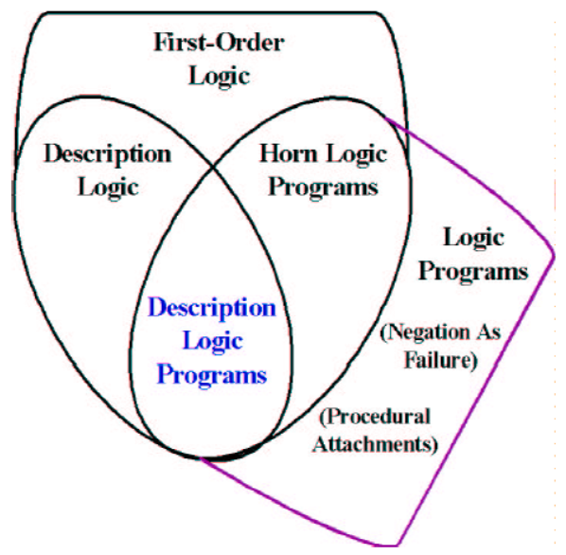
Relations between some logics
DL
Benjamin Grosof , Ian Horrocks, Raphael Volz, Stefan Decker.
Description Logic Programs: Combining Logic Programs with Description Logic. 2004 Research Papers in Economics.. http://www.cs.man.ac.uk/~horrocks/Publications/download/2003/p117-grosof.pdf

Slide 55
Description Logic(s)
Three essential components of a DL system:
  Abox: Father(john). concept assertion
  fatherOf(john, barry). role assertion
  john ≠ barry
  …
  Tbox: Father Parent concept inclusion
  Person ≡ Human concept equivalence
  …
  Rbox: fatherOf parentOf role inclusion
  disjoint(parentOf, childOf) disjointness of roles
  …
Assertions need to be interpreted as being about sets.

Slide 56
DL constructors
Male Parent intersection / conjunction
Male Female union / disjunction
¬ Male complement / negation
…
Can be used in Tbox axioms, e.g.
  Father ≡ Male Parent
  T Male Female everything is included in the set of males and females
  Male Female ⊥ the intersection of the set of males and the set of females is empty
  …
Markus Krötzsch, Frantisek Simancik, Ian Horrocks. A Description Logic Primer. https://arxiv.org/pdf/1201.4089.pdf

Slide 57
Role restrictions
Universal restriction:
  ∀parentOf.Female
    The set of individuals all of whose children are female including those that have no children at all.
Existential restriction:
  ∃parentOf.T
    The set of individuals that are parents of at least one individual.
Combinations:
  construct: ∃parentOf.T ∀parentOf.Female
    The set of all individuals with at least one child, all children being female.
  axiom: ∃sonOf.T male
    The set of individuals that are the son of at least one individual is a subset of the set of males.
Markus Krötzsch, Frantisek Simancik, Ian Horrocks. A Description Logic Primer. https://arxiv.org/pdf/1201.4089.pdf

Slide 58
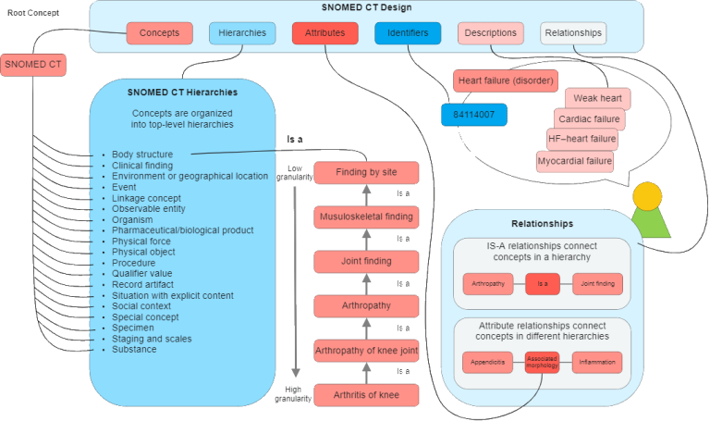
An example: Snomed CT
https://enonic.com/blog/what-is-snomed-ct

Slide 59
Snomed’s DL is EL++ (1)
The description logic EL++ allows the following concept declarations:
C, D → A | (atomic concept)
T | (universal concept)
⊥ | (bottom concept)
{a} | (singular enumeration)
C D | (intersection / conjunction)
∃R.C | (existential restriction)
With axioms of the following sorts:
  C D and C ≡ D for concept descriptions C and D.
  P Q and P ≡ Q for roles P, Q.
  C(a) and R(a, b) for concept C, role R and individuals a, b

Slide 60
Snomed’s DL is EL++ (2)
It lacks:
  negation, (only disjointness of classes: C D ⊥),
  disjunction,
  universal quantification,
  cardinalities,
  inverse roles,
  some role characteristics

Slide 61
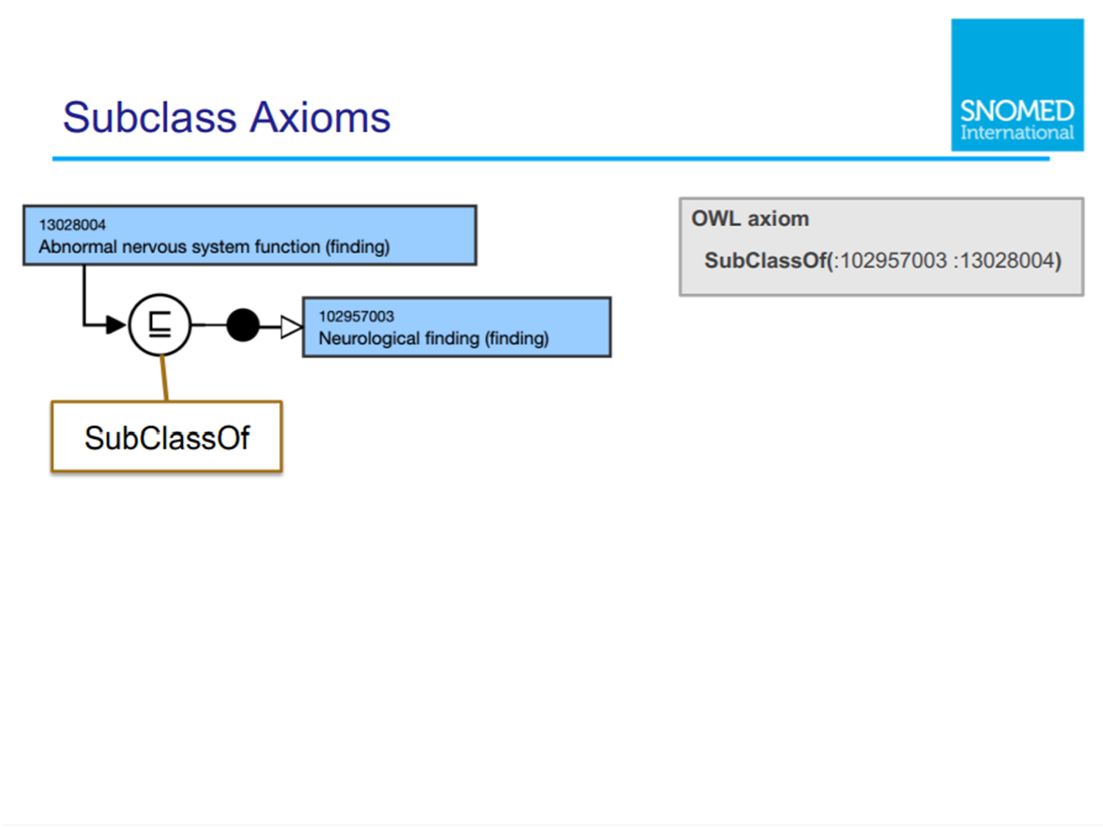

Slide 62
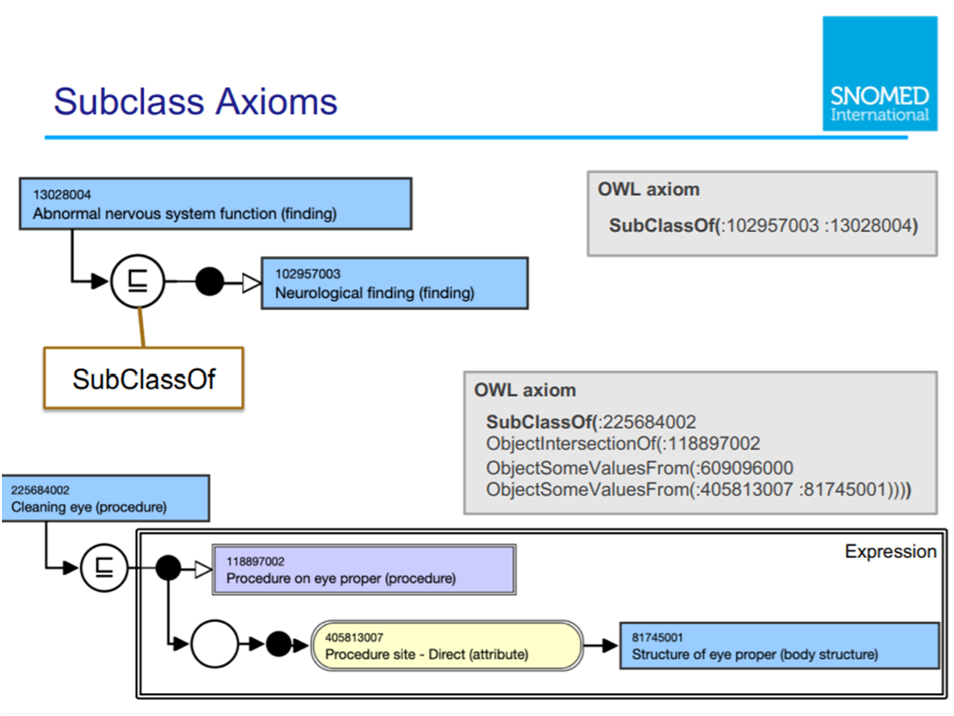

Slide 63
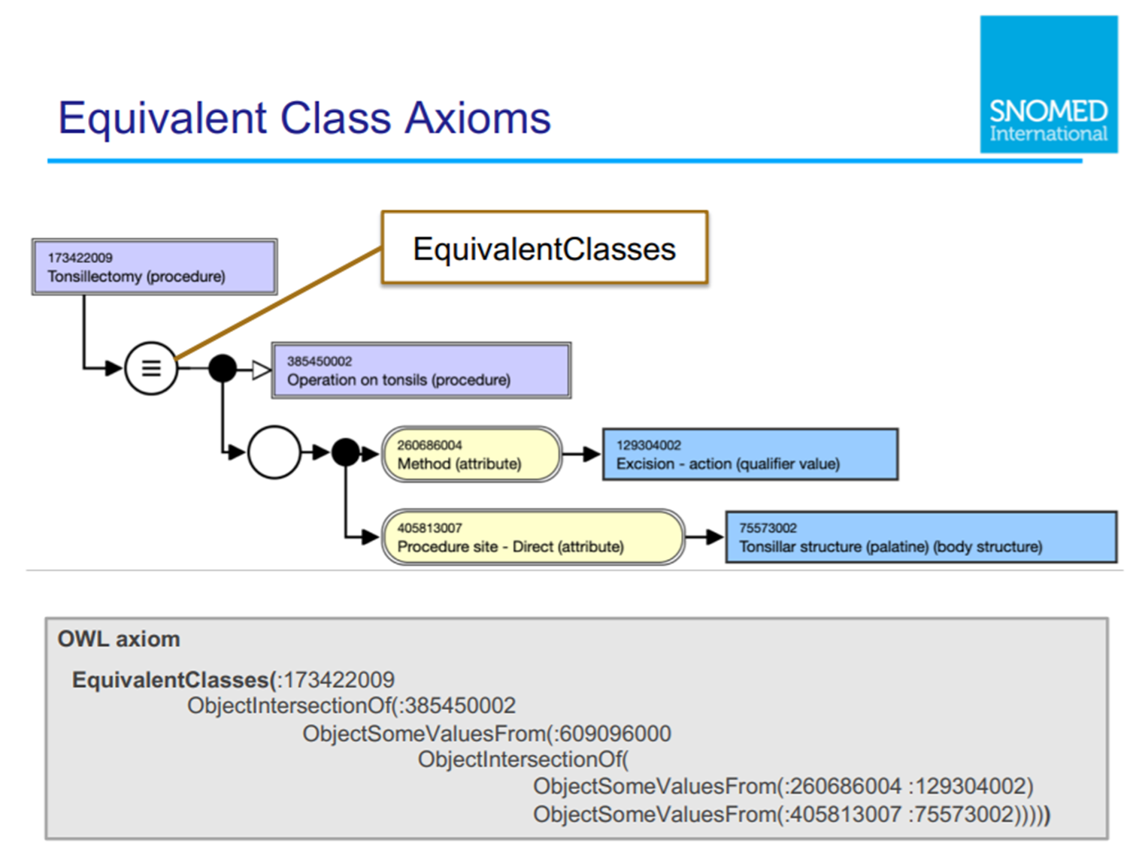

Slide 64
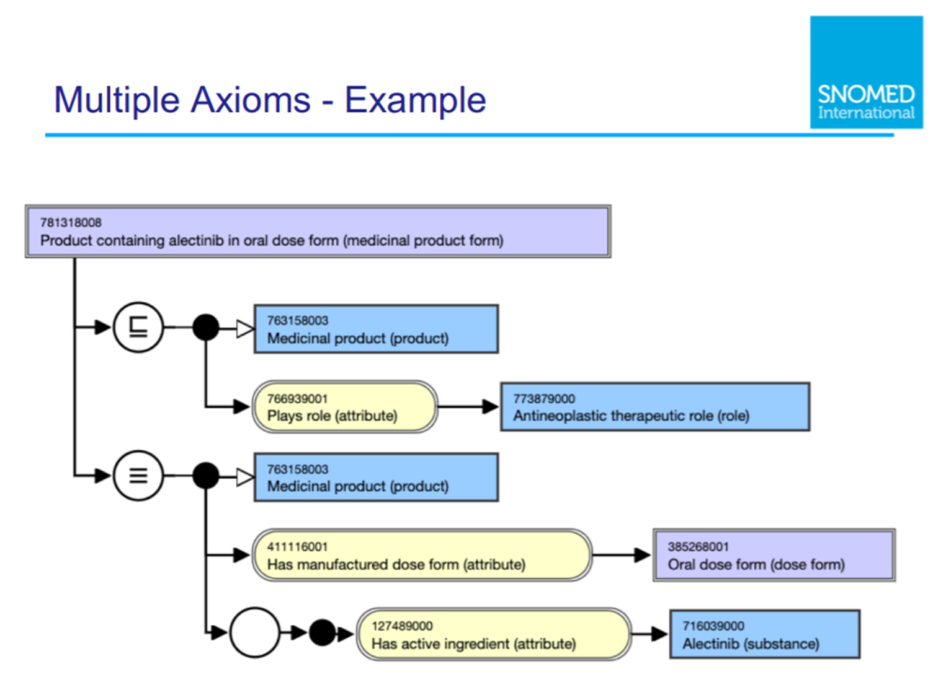

Slide 65
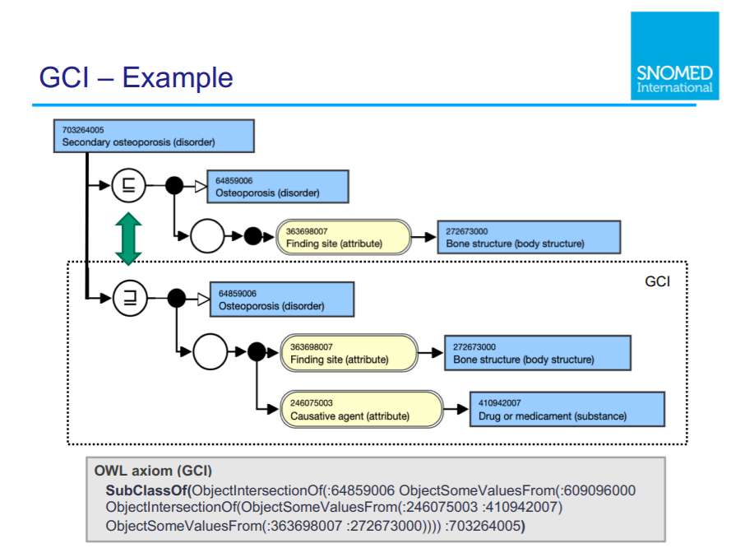

Slide 66
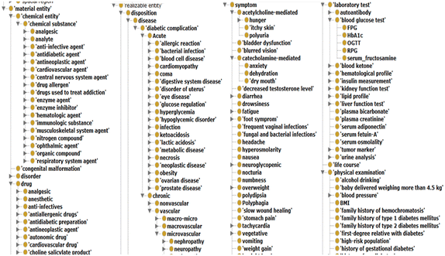
SubClassOf hierarchies = concept inclusion!
No reference provided due to vicarious embarrassment

Slide 67
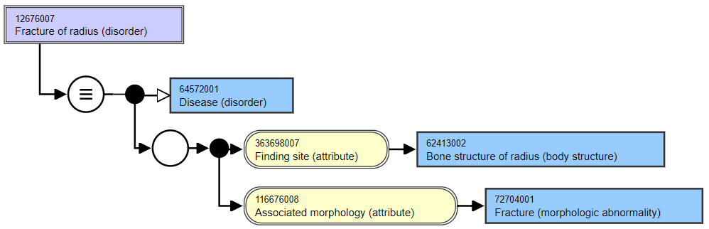
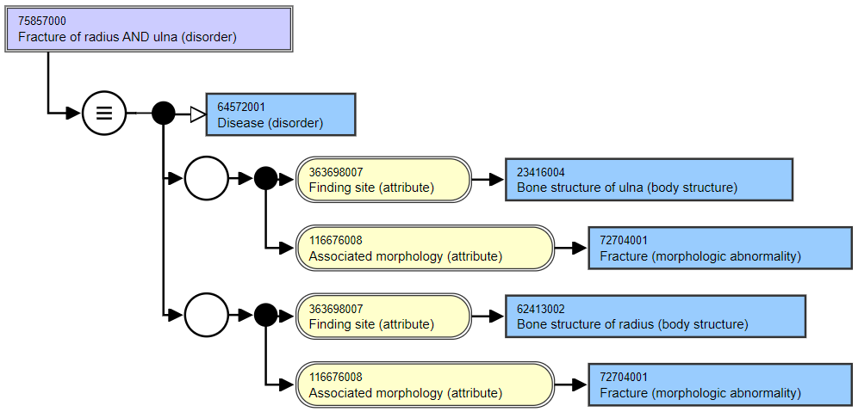
Asserted
Asserted

Slide 68
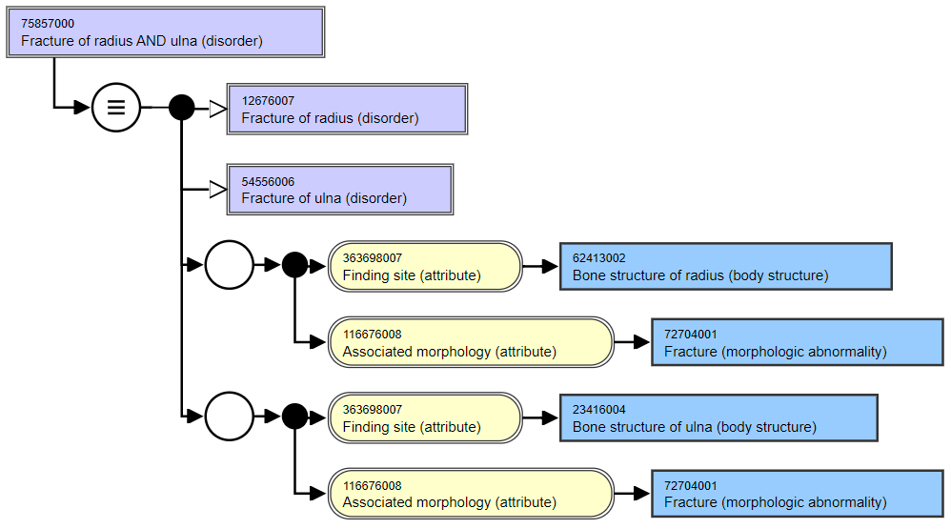
Role groups in
Snomed CT: odd
consequences by design

Slide 69
Characteristics of OWL-based DLs
Ideal for fixing the terminology of a domain
  → constructors
  DL-reasoners can detect contradicting definitions and classify terms automatically
Drawbacks:
  Based on non-defeasible logic, hence no exceptions are possible
  One cannot:
    represent classes of classes,
    make statements about classes
  ‘Tweaking’ axioms for desired outcomes though ontologically nonsensical

Slide 70

A ‘must’ read

Slide 71
Say no more …
‘ 6.2. Conclusion
In summary, OWL has been a major step forward for representing terminologies and the invariant part of background knowledge bases. However, the W3C’s standardisation on OWL has led to pressure to use OWL, often beyond its limitations and contributed to confusion over vocabulary and to neglect and misunderstanding of other representations.’
Rector, A., Schulz, S., Rodrigues, J. M., Chute, C. G., & Solbrig, H. (2019).
On beyond Gruber: "Ontologies" in today's biomedial information systems and the limit of OWL.
Journal of Biomedical Informatics: X, 2(June, 2019), Article 100002.
https://doi.org/10.1016/j.yjbinx.2019.100002
https://www.sciencedirect.com/science/article/pii/S2590177X19300010?via%3Dihub

Slide 72
Common Logic
(barely scratching the surface)

Slide 73
Common Logic (CL)
CL is a family of first-order logics which share a common abstract syntax and model theory, and an XML framework for encoding and transmitting them, or their content, on an open network.
CL syntax is very relaxed in the expressions it allows, in some ways going beyond classical FO logic.
ISO standard: https://standards.iso.org/ittf/PubliclyAvailableStandards/c066249_ISO_IEC_24707_2018.zip
https://www.w3.org/2004/12/rules-ws/slides/pathayes.pdf

Slide 74
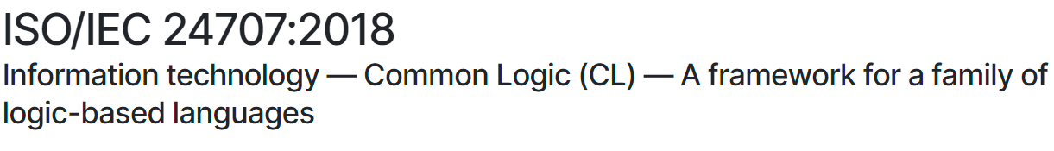
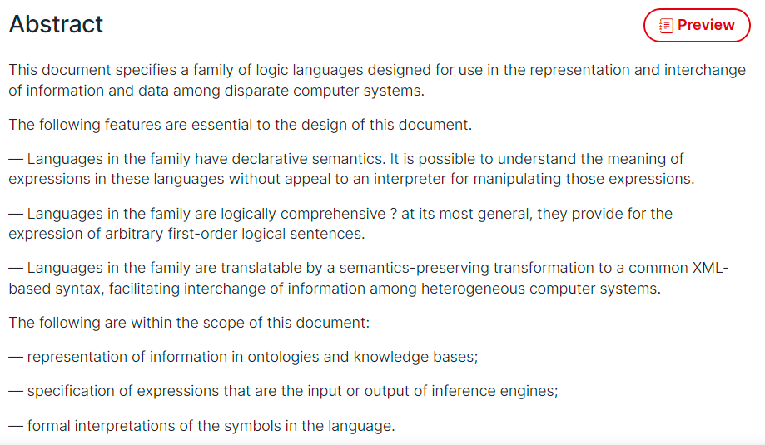
CLIF ISO Standard
https://www.iso.org/standard/66249.html

Slide 75
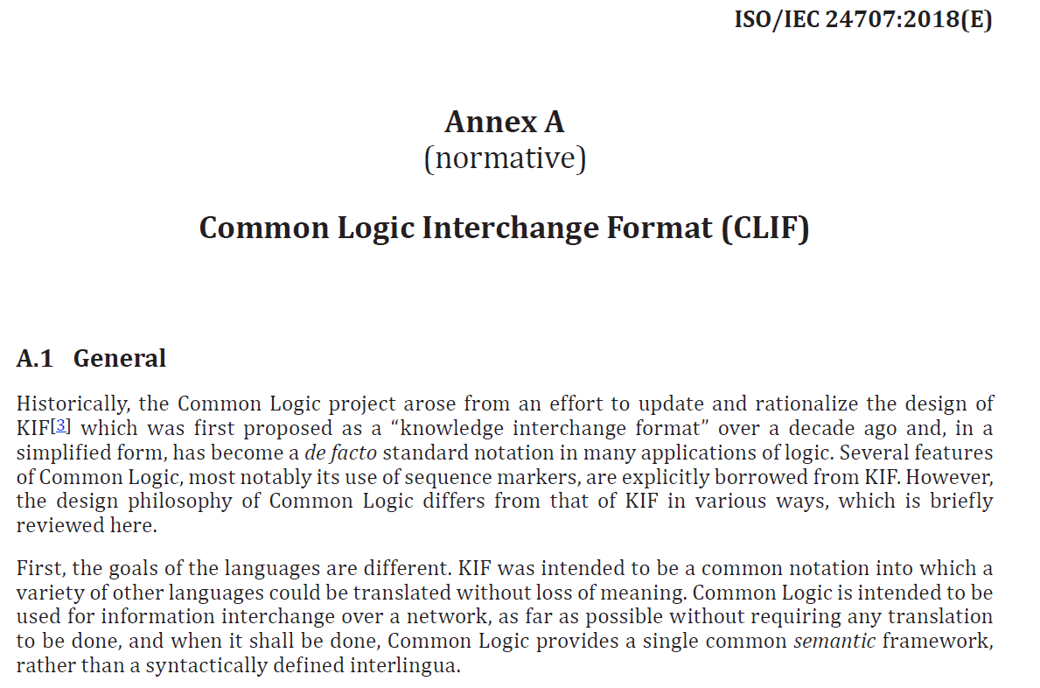
CLIF

Slide 76
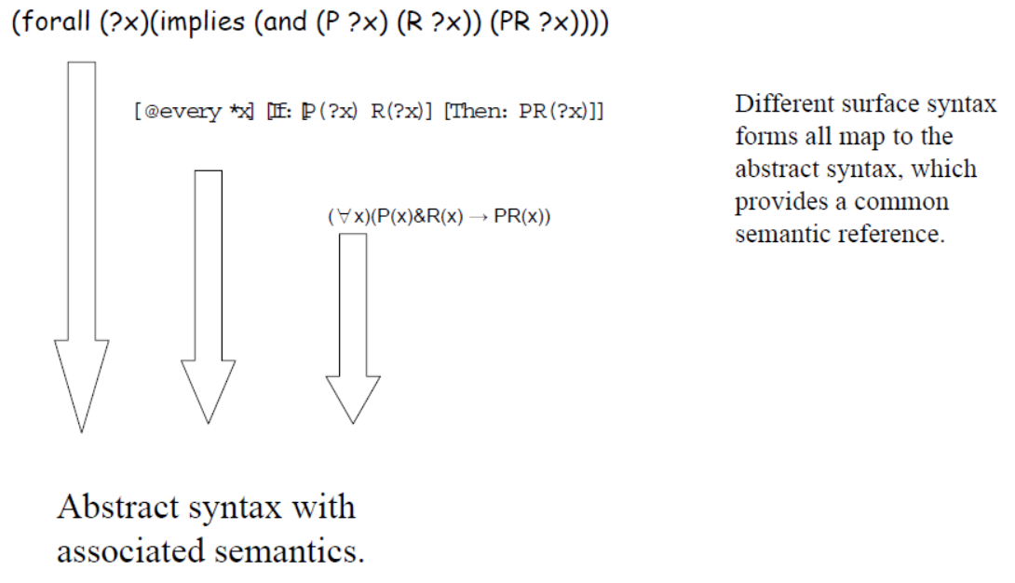
CL dialects
https://www.w3.org/2004/12/rules-ws/slides/pathayes.pdf

Slide 77
Gentle introduction to
BFO’s axiomatization using CLIF

Slide 78
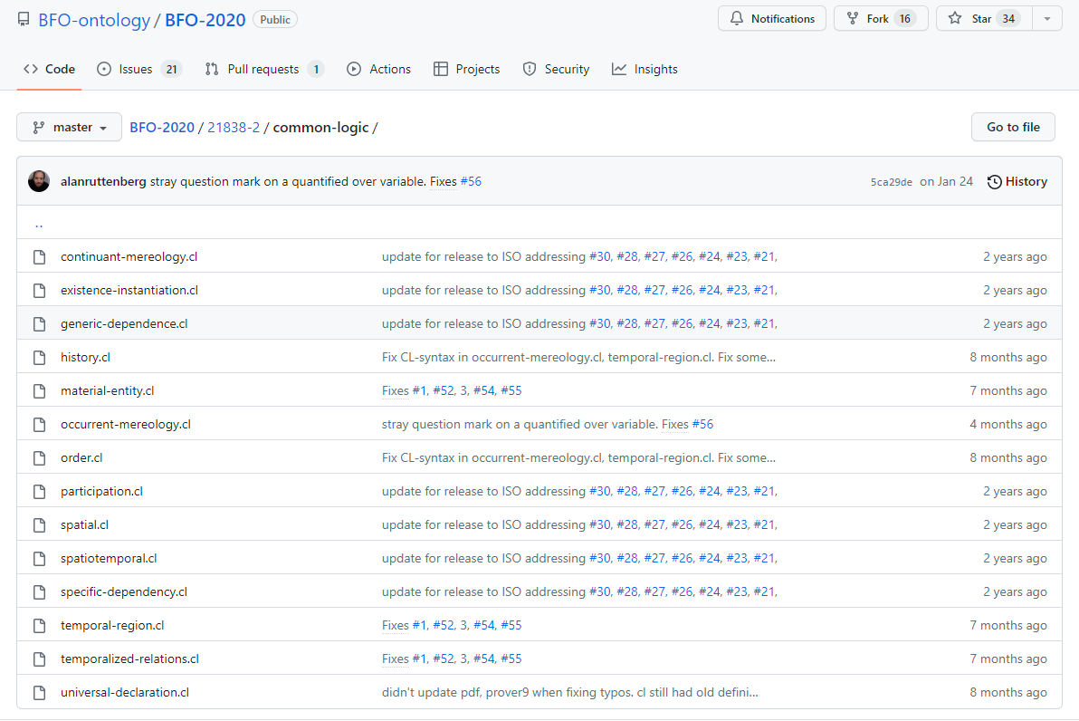
BFO2020-CLIF
https://github.com/BFO-ontology/BFO-2020/tree/master/21838-2/common-logic

Slide 79
BFO2020 axiomatization in CLIF
Uses only parts of the CLIF specifications.
Expressed in FOL with as important features:
  use of equality,
  (1-,) 2-, and 3-ary predicates,
  no functions,
  no sequence markers,
  standard PL/FOL connectives:
    OR, AND, IF, IFF, NOT
  universal and existential quantification
    FORALL, EXISTS
  ‘Realism-based’ choice of predicates.

Slide 80
‘BFO2020-style’ CLIF template
(cl:comment
‘ SOME TEXT ‘
(cl:ttl “ SOME TEXT ”
(cl:text
(cl:outdiscourse PREDICATE-NAMES )
(cl:comment ‘ SOME TEXT [AXIOM-ID]’
( ...CLIF AXIOM...) )
(cl:comment ‘ SOME TEXT [AXIOM-ID]’
( ...CLIF AXIOM...) )
…
)))

Slide 81
RUs of BFO-style CLIF axioms with color conventions (for my lecture slides)
Relation: always the first symbol in a predication
  continuant-part-of particular exists-at …
Variable: always characterized by quantifier
  a b p1 particular continuant1 …
Named Individual:
  continuant process john …
Quantifier:
  forall exists
Logical connector:
  and or if iff not
Identity: =
Parentheses: ( )

Slide 82
Atomic sentence (aka predication)
Structure: (relation arg1 arg2 …)
  Number of arguments determined by the relation
  Arguments can be variables or named individuals
  Special case – identity: (= arg1 arg2)
    ‘=‘ is not a relation, but a logical connector
Examples:
  (continuant-part-of nose-of-john john april-1-2026)
  (particular john)
  (instance-of april-1-2026 temporal-region april-1-2026)
  (= richard-walter-jenkins richard-burton)
  (continuant-part-of x john april-1-2026) *

Slide 83
Quantified atomic sentences
When in a predication variables are used, they must be quantified !
Structure: (quantifier (variables) sentence)
  (exists (x) (instance-of x continuant april-1-2026))
A quantified atomic sentence is also a sentence:
  (forall (y) (exists (x) (= y x)))
  (exists (y) (forall (x) (= y x))) ???

Slide 84
Complex sentences
(and sentence1 sentence2 sentence …)
(or sentence1 sentence2 sentence …)
(if sentence1 sentence2)
(iff sentence1 sentence2)
(not sentence)

Slide 85
Backus-Naur-Form of BFO-CLIF axioms
<sentence> ::= <atom> | <boolean-sentence> | <quantified-sentence>
<atom> ::= <predicate-application> | <equation>
<predicate-application>::= "(" <predicate> { <term> } ")"
<equation> ::= "(" "=" <term> <term> ")"
<boolean-sentence> ::= "(" "and" { <sentence> } ")" |
"(" "or" { <sentence> } ")“ |
"(" "not" <sentence> ")" |
"(" "if" <sentence> <sentence> ")" |
"(" "iff" <sentence> <sentence> ")"
<quantified-sentence> ::= "(" <quantifier> "(" { <variable> } ")" <sentence> ")“
<quantifier> ::= "forall" | "exists“
<term> ::= <constant> | <variable>
<predicate> ::= <term>

Slide 86
‘Particulars exist at some time’
(forall (p) (if (particular p) (exists (t) (exists-at p t))))
⇓ Standard FOL notation
∀p ( particular(p) → (∃t existsAt(p, t)))
The CL axiomatization contains also:
(cl:outdiscourse continuant-part-of temporal-part-of
exists-at particular universal instance-of)

Slide 87
‘Particulars exist at some time’
(forall (p) (if (particular p) (exists (t) (exists-at p t))))
⇓ Standard FOL notation
∀p ( particular(p) → (∃t existsAt(p, t)))
The CL axiomatization contains also:
(cl:outdiscourse continuant-part-of temporal-part-of
exists-at particular universal instance-of)
  = ‘we don’t talk of these’, ‘they are not ‘individuals’ in our domain (of discourse)’
  Do not confuse this with ‘individuals’ as synonym for ‘particular’ in ontological realism.
  Only the p’s and t’s in the above denote entities of a type that are in the domain.

Slide 88
Individual universals are in the domain of discourse, but not ‘universal’ !!!
(cl:comment "1. There is always something that exists“
(forall (t)
(if (instance-of t temporal-region t)
(exists (u i) (and (not (= i t))
(universal u)
(particular i)
(instance-of i u t))))))
(cl:comment "No role changes type during its existence [bks-1]"
(forall (o)
(if (exists (t) (instance-of o role t))
(forall (u)
(if (exists (t) (instance-of o u t))
(forall (t) (iff (instance-of o role t) (instance-of o u t))))))))

Slide 89
‘Particulars exist at some time’
(forall (p) (if (particular p) (exists (t) (exists-at p t))))
⇓ Standard FOL notation
∀p ( particular(p) → (∃t existsAt(p, t)))
Is there anything here that says that ‘t’ or ‘time(t)’ is a time?
No!

Slide 90
However!
(cl:comment "6. Particulars exist at some time"
(forall (p)
(if (particular p) (exists (t) (exists-at p t)))))
(cl:comment "9. Relata of exists-at are particulars."
(forall (i t)
(if (exists-at i t)
(and (particular i)
(particular t)
(instance-of t temporal-region t)))))
→ The CLIF sentences do not always reflect the comments faithfully, and vv. This doesn’t mean they are wrong.

Slide 91
‘Realism-based’ predicates
Criteria:
  Restricted to formal relations.
  Grounded in the distinction between types (universals and defined classes) and particulars.
  Use of temporal indexing.
Example: ‘all soccer balls are round’
  FOL with properties ‘fantologically conceived’:
    (forall (x) (if (soccer-ball x) (round x)))
  Realism-based (but perhaps not faithfull):
    (forall (x t)
      (if (instance-of x soccer-ball t)
      (exists (y)
      (and (instance-of y round t)
      (inheres-in y x)))))
http://ontology.buffalo.edu/bfo/Against_Fantology.pdf

Slide 92

Deflated soccer balls are not round
No problem for fantologists:
  (forall (x) (if (deflated-soccer-ball x)
  (not-round x)))
For realism-based ontologists:
  One should not cram everything
  together in a predicate
  Explicit time-indexing draws attention to issues of generalization
  …
Trying to adhere to realism-based principles requires thinking beyond merely applying logic.
https://soccerlifestyle.com/how-to-deflate-a-soccer-ball/

Slide 93
Ontology development using FOL
See: https://www.youtube.com/watch?v=75l7N3Vg0Fs

