Slide 1
BMI508 – Fall 2025
Introduction to Biomedical Ontology
Class 4 – Sept 16, 2026
Basic Formal Ontology I: continuants
Werner CEUSTERS
Department of Biomedical Informatics, University at Buffalo, USA

Slide 2
Required reading post-class
R4 Introduction to Basic Formal Ontology II: occurrents. (pages 121-130) in: Arp, R., B. Smith, and A.D. Spear, Building ontologies with basic formal ontology. 2015, The MIT Press,: Cambridge, Massachusetts. p. 1 online resource (245 p.) [1]
UB login: https://ebookcentral-proquest-com.gate.lib.buffalo.edu/lib/buffalo/detail.action?docID=3433795&pq-origsite=primo

Slide 3
Today’s class
Lecture on continuants in Basic Formal Ontology (BFO).
Students assignment A2.
Test T1. (time permitting, in-class, otherwise as homework due Thursday Sept 17, before 8pm)

Slide 4
Major references for BFO
The BFO 2.0 Specifications (last update: June 26, 2015)
The ‘BFO-book’ (July 2015)
The ISO-standard (2020):
https://github.com/BFO-ontology/BFO/raw/master/docs/bfo2-reference/BFO2-Reference.docx
https://github.com/BFO-ontology/BFO-2020/tree/master/21838-2/common-logic
Arp, R., B. Smith, and A.D. Spear,
Building ontologies with basic formal ontology. 2015,
The MIT Press,: Cambridge, Massachusetts. p. 1 online resource (245 p).
  ISO/IEC PRF 21838-2:2020(E)
  https://standards.iso.org/iso-iec/21838/-2/ed-1/en/

Slide 5
BFO
BFO is a domain-independent top ontology
  All entity types represented in it are relevant for all domains
  Yet independent from any domain perspective
Compare with SNOMED CT:
  It has a top-ontology, but:
    Domain-dependent
    Relevant from the perspective of individual patient care.
    https://browser.ihtsdotools.org/?perspective=full&conceptId1=138875005&edition=MAIN/2024-09-01&release=&languages=en

Slide 6
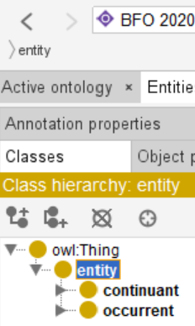
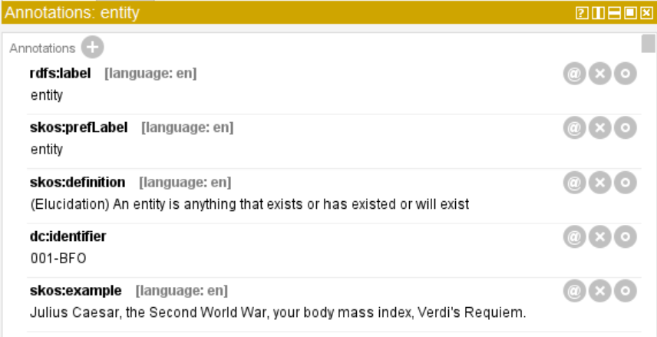
BFO-OWL top
Elucidation:
An entity is anything that exists or has existed or will exist.

Slide 7
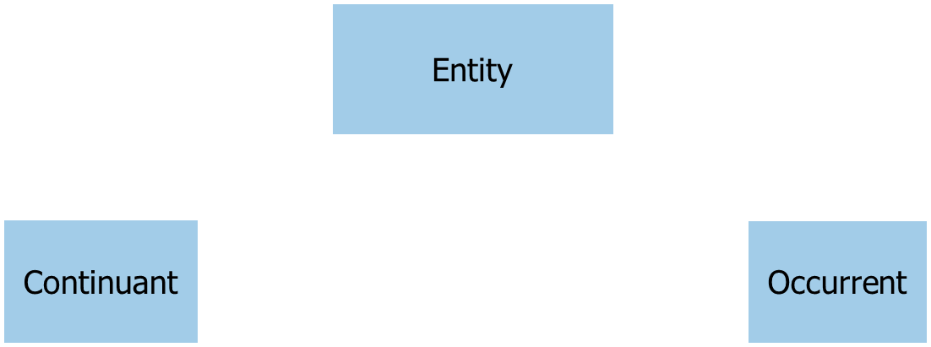
BFO-OWL top
me my life
my intelligence my reasoning
my heart function my heart pumping blood
my instructor role my teaching
… …

Slide 8
BFO2020-FOL top
(cl:comment ‘Entity is either universal or particular, so not all are instantiated. Instead make a predicate 'entity' analogous to particular universal [vgn-1]’
(forall (x)
(if (exists (t)
(or (instance-of x continuant t)
(instance-of x occurrent t)))
(entity x))))
→ ‘entity’ is represented as unary predicate!
Note: #123 The comment for [vgn-1] is a bit more inadequate

Slide 9
Various elucidations of ‘continuant’
Elucidations:
  ‘An entity that at any time it exists, exists in total.’
Smith B, Ceusters W.
Ontological Realism as a Methodology for Coordinated Evolution of Scientific Ontologies.
Applied Ontology, 2010;5(3-4):139-188.
    Time-instant ?
  ‘An entity that persists, endures, or continues to exist through time while maintaining its identity.’
  ISO/IEC PRF 21838-2:2020(E)
  ‘[idem] … and has no temporal parts’
        Arp, R., B. Smith, and A.D. Spear,
        Building ontologies with basic formal ontology. 2015,
        The MIT Press,: Cambridge, Massachusetts. p. 1 online resource (245 p).

Slide 10
Time in BFO
Occurrent
Temporal Region
…
Temporal Instant
(0-dimensional
temporal region)
1-dimensional
temporal region
Temporal instants do not have temporal parts.
1-dimensional temporal regions have at least two temporal instants as temporal part.

Slide 11
Continuant
Elucidations:
  ‘An entity that at any time it exists, exists in total.’
Smith B, Ceusters W.
Ontological Realism as a Methodology for Coordinated Evolution of Scientific Ontologies.
Applied Ontology, 2010;5(3-4):139-188.
    Time-instant ?
  ‘An entity that persists, endures, or continues to exist through time while maintaining its identity.’
  ISO/IEC PRF 21838-2:2020(E)
  ‘[idem] … and has no temporal parts’
        Arp, R., B. Smith, and A.D. Spear,
        Building ontologies with basic formal ontology. 2015,
        The MIT Press,: Cambridge, Massachusetts. p. 1 online resource (245 p).

Slide 12
exists at
Elucidation: exists at is a relation between a particular and some temporal region at which the particular exists.
Domain: entity
Range: temporal region
Examples:
  First World War exists at 1914-1916,
  Mexico exists at January 1, 2000.
  ISO/IEC PRF 21838-2:2020(E)

Slide 13
Exist-at axiom
(cl:comment "Relata of exists-at are particulars. [oap-1]"
(forall (i t)
(if (exists-at i t)
(and (particular i)
(particular t)
(instance-of t temporal-region t)))))
Legend:
logical connector
quantifier
relation
variable; denoting a particular or a universal
universal

Slide 14
Continuant
Elucidations:
  ‘An entity that at any time it exists, exists in total.’
Smith B, Ceusters W.
Ontological Realism as a Methodology for Coordinated Evolution of Scientific Ontologies.
Applied Ontology, 2010;5(3-4):139-188.
    Time-instant ?
  ‘An entity that persists, endures, or continues to exist through time while maintaining its identity.’
  ISO/IEC PRF 21838-2:2020(E)
  ‘[idem] … and has no temporal parts’
        Arp, R., B. Smith, and A.D. Spear,
        Building ontologies with basic formal ontology. 2015,
        The MIT Press,: Cambridge, Massachusetts. p. 1 online resource (245 p).

Slide 15
‘Identity’
Three broad meanings:
  As in ‘legal identity’, ‘self-identifying as’, …,
  As ‘being unique’,
  As ‘being exactly similar’.
It is in the second sense that ‘maintaining its identity’ is intended: → ‘numerically identical’.
Suggested further ‘expert’ reading:
    Noonan, Harold and Ben Curtis, "Identity", The Stanford Encyclopedia of Philosophy (Summer 2018 Edition), Edward N. Zalta (ed.). https://plato.stanford.edu/archives/sum2018/entries/identity/ .

Slide 16
Identity criteria issues
Transformation:
  Sperm + egg → zygote → morula → blastula → gastrula → embryo → fetus → baby → child → adult → senior → corps → portion of ashes.
      How many numerically distinct entities?
Existence at ‘scattered temporal region’:
‘beam me up, Scotty’
Gradual repair with replacement and reconstruction:
  Ship of Theseus.
time
#1
#1
?
#1
#2
?

Slide 17
Continuant
Elucidations:
  ‘An entity that at any time it exists, exists in total.’
Smith B, Ceusters W.
Ontological Realism as a Methodology for Coordinated Evolution of Scientific Ontologies.
Applied Ontology, 2010;5(3-4):139-188.
    Time-instant ?
  ‘An entity that persists, endures, or continues to exist through time while maintaining its identity.’
  ISO/IEC PRF 21838-2:2020(E)
  ‘[idem] … and has no temporal parts’
        Arp, R., B. Smith, and A.D. Spear,
        Building ontologies with basic formal ontology. 2015,
        The MIT Press,: Cambridge, Massachusetts. p. 1 online resource (245 p).

Slide 18
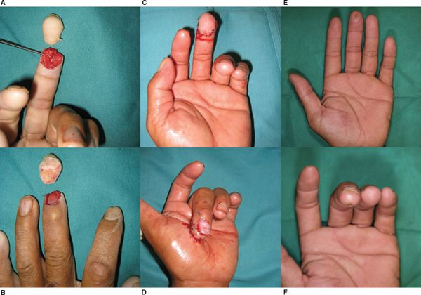
https://doctorlib.info/surgery/plastic/83.html

Slide 19
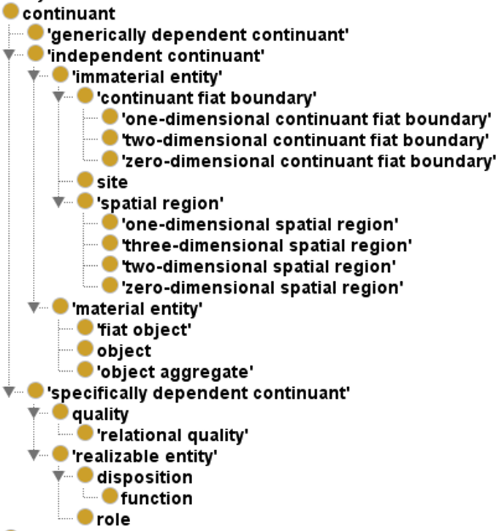
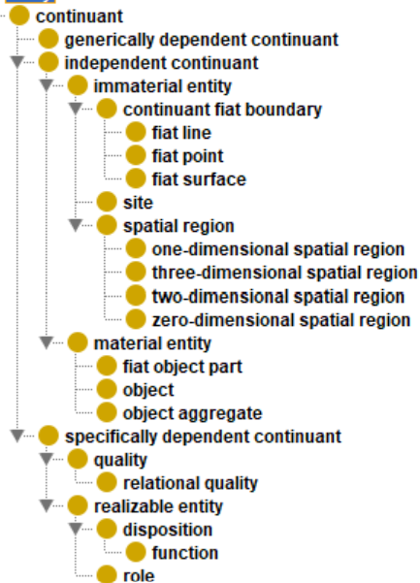
BFO continuant hierarchy: 2.0 vs. BFO2020

Slide 20
Two major continuant types in BFO 1.0
Continuant
Independent
Continuant
Dependent
Continuant

Slide 21
Three major continuant types in BFO 2.0
Continuant
Independent
Continuant
Dependent
Continuant
IC
Specifically
dependent
continuant
Generically
dependent
continuant
SDC
GDC

Slide 22
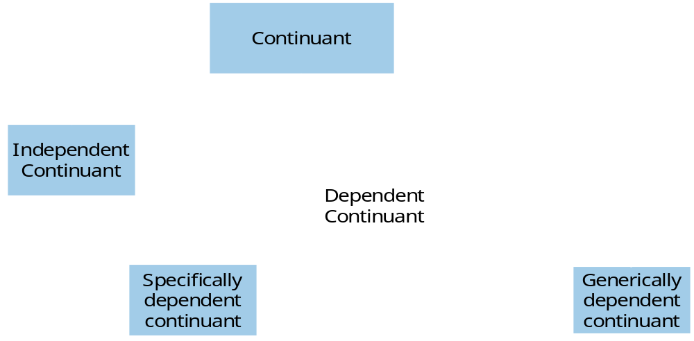
Why the change?
Two dependency relations, both elucidated:
  S-dependence,
  G-dependence.
GDC is elucidated on the basis of g-dependence.
SDC is defined on the basis of s-dependence.
GDCs and SDCs ‘depend’ on ICs in different, incompatible, i.e. not generalizable ways.

Slide 23
IC, SD, GDC are disjoint (BFO2020-FOL)
(cl:comment "specifically-dependent-continuant, independent-continuant, generically-dependent-continuant are mutually disjoint [cig-1]"
(and (not (exists (x t)
(and (instance-of x specifically-dependent-continuant t) (instance-of x independent-continuant t))))
(not (exists (x t)
(and (instance-of x specifically-dependent-continuant t) (instance-of x generically-dependent-continuant t))))
(not (exists (x t)
(and (instance-of x independent-continuant t)
(instance-of x generically-dependent-continuant t))))))
Notice difference with:
(not (= specifically-dependent-continuant independent-continuant))
(not (= specifically-dependent-continuant generically-dependent-continuant))
(not (= generically-dependent-continuant independent-continuant))
…

Slide 24
Independent Continuant (IC)
Elucidation: an entity which does not ontologically depend on another entity.
Definition: b is an independent continuant =Def.
  b is a continuant which is such that there is no c such that b s-depends-on c and no c such that b g-depends-on c.
    ‘b s-depends-on c’ means: b and c do not share common parts & b is of a nature such that at all times t it cannot exist at t unless c exists at t & b is not a boundary of c.
    ‘b g-depends-on c at t’ means: there inheres in c an s-dependent continuant which concretizes b at t.
Examples: An atom, a molecule, an organism, a heart, a chair, the bottom right portion of a human torso, a leg; the interior of your mouth; a spatial region; an orchestra.
  ISO/IEC PRF 21838-2:2020(E)

Slide 25
Specifically Dependent Continuant (SDC)
Definition:
  b is a specifically dependent continuant =Def.
    b is a continuant
    & there is some independent continuant c
      which is not a spatial region
      & which is such that b s-depends on c.
Examples:
  with one bearer:
    The mass of this tomato, the pink colour of a medium rare piece of grilled filet mignon at its centre, the smell of this portion of mozzarella,
  with multiple bearers:
    love, authority
  ISO/IEC PRF 21838-2:2020(E)

Slide 26
Generically Dependent Continuant (GDC)
Elucidation: a generically dependent continuant is an entity that exists in virtue of the fact that there is at least one of what may be multiple copies; it is the content or the pattern that the multiple copies share.
Examples:
  The pdf file of which a copy is on laptop a, the pdf file that is a copy thereof on laptop b;
  the sequence of this protein molecule; the sequence that is a copy thereof in that protein molecule;
  the content of a sentence;
  an engineering blueprint.
  ISO/IEC PRF 21838-2:2020(E)

Slide 27

GDCs require SDCs
Generically
dependent
continuant
Instance of at
BMI508-2026
syllabus
concretizes at
Instance of at
BMI508-2026
syllabus copy 1
Specifically
dependent
continuant
concretizes at
Instance of at
BMI508-2026
syllabus copy 2
Independent
Continuant
Instance of at
inheres in
inheres in)
g-depends-on at
Instance of at
g-depends-on at

Slide 28
‘concretizes’
(cl:comment "concretizes is time indexed and has domain: specifically-dependent-continuant or process and range: generically-dependent-continuant [rog-1]"
(forall (a b t)
(if (concretizes a b t)
(and
(or (instance-of a specifically-dependent-continuant t)
(instance-of a process t))
(instance-of b generically-dependent-continuant t)
(instance-of t temporal-region t)))))
(cl:comment "If a specifically-dependent-continuant concretizes a gdc then the gdc generically-depends-on the bearer of the sdc [cik-1]"
(forall (g b sdc)
(if (and (exists (t) (instance-of g generically-dependent-continuant t)) (exists (t) (instance-of sdc specifically-dependent-continuant t)) (exists (t) (instance-of b independent-continuant t)))
(forall (t)
(if (and (concretizes sdc g t) (inheres-in sdc b))
(generically-depends-on g b t))))))

Slide 29
A VERY USEFUL tool
BFO’s ‘CLIF formula search’ by Alan Ruttenberg
Use it:
  To find all axioms in which a specific type or relation is used,
  To check the arity of relations,
  To use the structure of certain axioms as a template for what you want to say about types you introduce,
  To assess whether if a posited axiom exhibits a template found in a BFO axiom, what other related axiom should be added too in your ontology,
  …

Slide 30
Material and Immaterial Entity
Independent Continuant
Material Entity
Immaterial Entity
Elucidation: A material entity is an independent continuant that at all times at which it exists has some portion of matter as continuant part.
Definition: a is an immaterial entity =Def. a is an independent continuant which is such that there is no time t when it has a material entity as continuant part at t
  ISO/IEC PRF 21838-2:2020(E)

Slide 31
Material and Immaterial
(cl:comment "material-entity, immaterial-entity are mutually disjoint [sij-1]"
(not
(exists (x t)
(and (instance-of x material-entity t)
(instance-of x immaterial-entity t)))))

Slide 32
Material entity
(cl:comment "If a continuant-part-of b then if a is an instance of material-entity then b is an instance of material-entity [dok-1]“
(forall (p q t)
(if (and (continuant-part-of p q t)
(instance-of p material-entity t))
(instance-of q material-entity t))))
(cl:comment "If a material entity has a proper part, then at least one of its proper parts is not an immaterial entity [adm-1]“
(forall (m t)
(if (and (instance-of m material-entity t)
(exists (mp) (and (continuant-part-of mp m t)
(not (= mp m)))))
(exists (mp)
(and (not (= mp m))
(continuant-part-of mp m t)
(not (instance-of mp immaterial-entity t)))))))

Slide 33

Material Entity
Material Entity
Fiat Object Part
Object
Object Aggregate

Slide 34


Material Entity
Material Entity
Fiat Object Part
Object
Object Aggregate

Slide 35
Material Entity
Material Entity
Fiat Object Part
Object
Object Aggregate
?

Slide 36
Object
An object is a Material Entity which is:
  spatially extended in three dimensions,
(cl:comment "If a occupies-spatial-region b then if a is an instance of material-entity then b is an instance of three-dimensional-spatial-region [ocw-1]“
(forall (p q t)
(if (and (occupies-spatial-region p q t)
(instance-of p material-entity t))
(instance-of q three-dimensional-spatial-region t))))
  causally unified,
  maximally self-connected.
Arp, R., B. Smith, and A.D. Spear,
Building ontologies with basic formal ontology. 2015,
The MIT Press,: Cambridge, Massachusetts. p. 1 online resource (245 p).

Slide 37
Object
Elucidation: an object is a material entity which manifests causal unity & is of a type instances of which are maximal relative to the sort of causal unity manifested [024-BFO]
Examples: an organism, a fish tank, a planet, a laptop, a valve, a block of marble, an ice cube.
  ISO/IEC PRF 21838-2:2020(E)

Slide 38
‘b is causally unified’ means:
b is a material entity with its material parts tied together in a such a way that in environments typical for such entities:
  if part c of b
    is in the interior of b at t,
    is larger than a certain threshold size (which will be determined differently from case to case, depending on factors such as porosity of external cover), and
    is moved in space to be at t′ at a location on the exterior of the spatial region that had been occupied by b at t,
  then either
    b’s other parts will be moved in coordinated fashion or
    b will be damaged in the interval between t and t′.
causal changes in one part of b can have consequences for other parts of b without the mediation of any entity that lies on the exterior of b.
BFO 2.0 Specifications

Slide 39
Forms/Criteria of causal unity (CU)
CU₁ - Causal unity via physical covering:
  Skin of animals,
  Cell membrane of a cell.
CU₂ - Causal unity via internal physical forces:
  Atoms in molecules,
  Molecules in a protein aggregate,
  Rock.
CU₃ - Causal unity via engineered assembly of components:
  Car.
BFO 2.0 Specifications

Slide 40
b is maximal relative to some criterion of causal unity CU_{n}
means:
b is causally unified relative to CU_{n} at t
and, if :
for some t and c
  b continuant_part_of c at t
  & c is causally unified relative to the same CU_{n}
  then: b and c are identical.
BFO 2.0 Specifications

Slide 41
continuant part of at
Elucidation: ‘b continuant part of c at t’ means:
  b and c are continuants &
  b is a part of c at t.
      because the informal expression ‘part’ is used in both definiens and definiendum, this is not a definition.
Domain: continuant
Range: continuant
Examples:
  Mary’s arm continuant part of Mary in the time of her life prior to her operation;
  the Northern hemisphere of the planet Earth is a continuant part of the planet Earth at all times at which the planet Earth exists.
  ISO/IEC PRF 21838-2:2020(E)

Slide 42
Some continuant-part-of axioms
(cl:comment "continuant-part-of is time indexed and has domain: continuant and range: continuant [bdd-1]"
(forall (a b t)
(if (continuant-part-of a b t)
(and (instance-of a continuant t) (instance-of b continuant t)
(instance-of t temporal-region t)))))
(cl:comment "continuant-part-of is reflexive at a time [mcd-1]“
(forall (a t)
(if (instance-of a independent-continuant t)
(continuant-part-of a a t))))
(cl:comment "continuant-part-of is dissective on temporal region [mqp-1]“
(forall (p q r s)
(if (and (continuant-part-of p q r) (temporal-part-of s r))
(continuant-part-of p q s))))
(cl:comment "continuant-part-of is transitive at a time [plp-1]"
(forall (a b c t t2)
(if (and (continuant-part-of a b t)
(continuant-part-of b c t2)
(temporal-part-of t t2))
(continuant-part-of a c t))))

Slide 43
Object aggregate
Elucidation: an object aggregate is a material entity consisting exactly of a plurality (≥1) of objects as member parts which together form a unit.
    ‘Exactly’ means that there are no parts of the object aggregate other than its member parts.
Examples:
  a symphony orchestra,
  the aggregate of bearings in a constant velocity axle joint,
  the nitrogen atoms in the atmosphere,
  a collection of cells in a blood biobank.
  ISO/IEC PRF 21838-2:2020(E)

Slide 44
Member-part-of-at
Definition: b member part of c at t =Def.
  b is an object
  & c is an object aggregate
  & there is at t a mutually exhaustive and pairwise disjoint partition of c into objects x₁, …, x_{n} (for some n ≥ 1) with b = x_{i} (for some 1 ≤ i ≤ n)
Domain: object
Range: object aggregate
Examples:
  Each tree in a forest is a member part of the forest;
  each Beatle in the collection called The Beatles is a member part of The Beatles;
  each human being is a member part of the population homo sapiens.
  ISO/IEC PRF 21838-2:2020(E)

Slide 45
Some object-aggregate axioms (1)
(cl:comment "member-part-of is time indexed and has domain: object and range: object-aggregate [dvq-1]" (forall (a b t)
(if (member-part-of a b t)
(and (instance-of a object t)
(instance-of b object-aggregate t)
(instance-of t temporal-region t)))))
(cl:comment "An object aggregate always has at least one member [uhs-1]“
(forall (ag t)
(if (instance-of ag object-aggregate t)
(exists (o1)
(and (instance-of o1 object t)
(member-part-of o1 ag t))))))
(cl:comment "An object aggregate has more than one member at at least one time [ibd-1]“
(forall (ag)
(if (exists (t) (instance-of ag object-aggregate t))
(exists (o1 o2 t)
(and (not (= o1 o2))
(instance-of o1 object t)
(member-part-of o1 ag t)
(instance-of o2 object t)
(member-part-of o2 ag t))))))

Slide 46
Some object-aggregate axioms (2)
(cl:comment "An object aggregate has as member parts only disjoint objects [evk-1]"
(forall (b c t)
(iff (member-part-of b c t)
(and (instance-of b object t)
(instance-of c object-aggregate t)
(proper-continuant-part-of b c t)
(forall (d)
(if (member-part-of d c t)
(or (= b d)
(not (exists (z)
(and (continuant-part-of z b t)
(continuant-part-of z d t)))))))))))

Slide 47
Fiat Object Part
Elucidation: a fiat object part b is a material entity which is such that for all times t, if b exists at t then there is some object c such that b is a proper continuant part of c at t and b is demarcated from the remainder of c by one or more fiat surfaces.
Examples:
  The upper and lower lobes of the left lung,
  the dorsal and ventral surfaces of the body,
  the Western hemisphere of the Earth,
  the FMA:regional parts of an intact human body.
  ISO/IEC PRF 21838-2:2020(E)

Slide 48
proper continuant part of at
Definition:
  b proper continuant part of c at t =Def. b continuant part of c at t & not (c continuant part of b at t)
Domain: continuant ; Range: continuant
(cl:comment "x proper continuant part of y means x is a continuant part of y but y is not continuant part of x [sls-1]"
(forall (x y t)
(iff (proper-continuant-part-of x y t)
(and (continuant-part-of x y t)
(not (continuant-part-of y x t))))))
  ISO/IEC PRF 21838-2:2020(E)

Slide 49
Fiat object part
(cl:comment "A fiat object part =def a proper part of an object [yir-1]"
(forall (f t)
(iff (instance-of f fiat-object-part t)
(exists (o)
(and (instance-of o object t)
(proper-continuant-part-of f o t)
(not (instance-of f immaterial-entity t)))))))

Slide 50
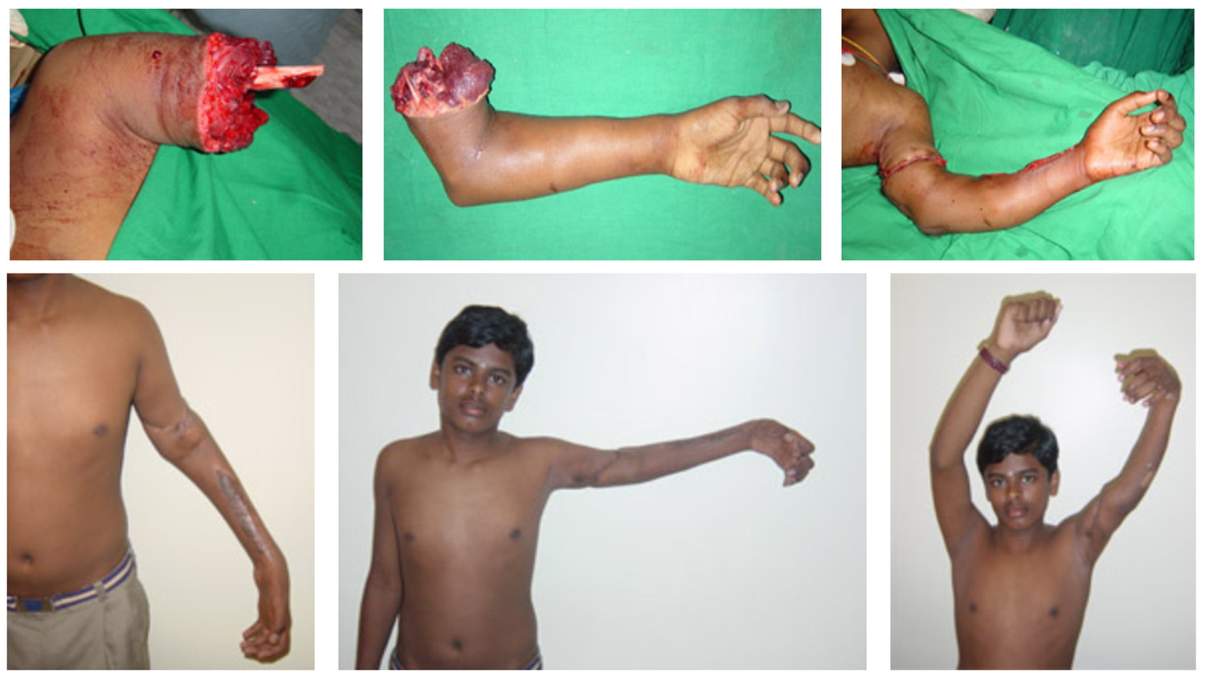
Traumatic amputation and replantation
http://www.gangahospital.com/plasticsurgery/microsurgeryandreplantation/MajorLimbReplantation.php

Slide 51
Borderline cases
Material Entity
Fiat Object Part
Object
Object Aggregate
?
?
?
Hurricane
Sand storm
Flame
Ocean wave
…

Slide 52
Immaterial Entity
Immaterial Entity
Continuant Fiat
Boundary
Site
Spatial Region
0-d SR
3-d SR
0-d CFB
2-d CFB
Fiat Point
Fiat Surface
1-d SR
2-d SR
1-d CFB
Fiat Line
Arp, R., B. Smith, and A.D. Spear,
Building ontologies with basic formal ontology. 2015,
The MIT Press,: Cambridge, Massachusetts. p. 1 online resource (245 p).
  ISO/IEC PRF 21838-2:2020(E)

Slide 53
Continuant Fiat Boundary
Elucidation:
b is a continuant fiat boundary means:
  b is an immaterial entity that is of zero, one or two dimensions,
  is such that there is no time t when b has a spatial region as continuant part at t,
  and whose location is determined in relation to some material entity.
  ISO/IEC PRF 21838-2:2020(E)

Slide 54
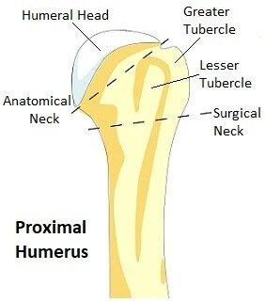
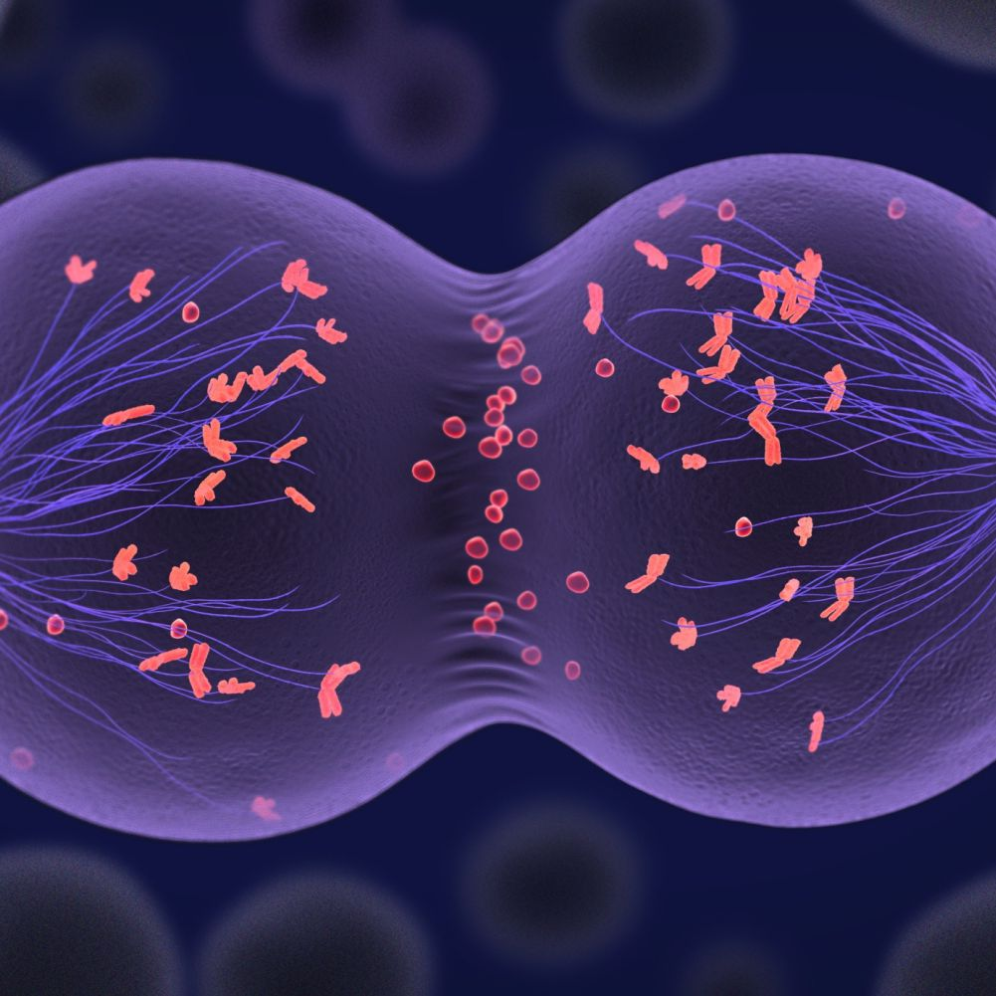
Continuant Fiat Boundary
https://www.thoughtco.com/meiosis-study-guide-373508
https://www.shoulder-pain-explained.com/proximal-humerus-fracture.html

Slide 55
It can get crazy with fiat boundaries
The community Baarle-Hertog in Belgium.
The ‘butter-night’ of Elten.

Slide 56
Fiat Surface
Elucidation: a fiat surface is a two-dimensional continuant fiat boundary that is self-connected.
Examples:
  the surface of the Earth,
  the plane separating the smoking from the non-smoking zone in a restaurant,
  the surface of the moon,
  the boundary between the upper and lower hemisphere of the moon,
  the surface of a tennis ball,
  the surface of a tabletop.
  ISO/IEC PRF 21838-2:2020(E)

Slide 57
Fiat Object Part ←→ Fiat Surface
Independent Continuant
Material Entity
Immaterial Entity
Fiat Object Part
Fiat Surface

Slide 58
Note on Continuant Fiat Boundaries
Not well worked out yet.
For some issues, see:
  Rabenberg M, Ceusters W.
  Fiat Surfaces in Basic Formal Ontology.
  14th International Conference on Formal Ontology in Information Systems ((FOIS 2024),
  July 08 - 09, 2024 online, and
  July 15 – 19, 2024, Enschede, The Netherlands.

Slide 59

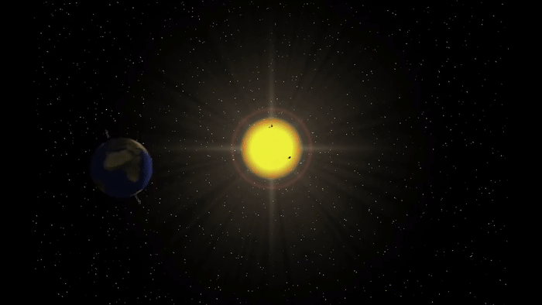
Spatial regions: that what certain other entities are located in at a time

Slide 60
Site
Elucidation: b is a site means: b is a 3-D immaterial entity whose boundaries either
  (1) (partially or wholly) coincide with the boundaries of one or more material entities or
  (2) have locations determined in relation to some material entity.
Examples: A hole in a portion of cheese, a rabbit hole, the Grand Canyon, the Piazza San Marco, the kangaroo-joey-containing hole of a kangaroo pouch, your left nostril (a fiat part – the opening – of your left nasal cavity), the lumen of your gut, the hold of a ship, the interior of the trunk of your car, a hole in an engineered floor joist.
  ISO/IEC PRF 21838-2:2020(E)

Slide 61
Specifically Dependent Continuant
Specifically Dependent Continuant
Quality
Realizable
Entity
Relational
Quality
Disposition
Role
Function
Arp, R., B. Smith, and A.D. Spear,
Building ontologies with basic formal ontology. 2015,
The MIT Press,: Cambridge, Massachusetts. p. 1 online resource (245 p).

Slide 62
Specifically Dependent Continuant
Specifically Dependent Continuant
Quality
Realizable
Entity
Elucidation: a quality is a specifically dependent continuant that, in contrast to roles and dispositions, does not require any further process in order to be realized.
Elucidation: b is a realizable entity means: b is a specifically dependent continuant that inheres in some independent continuant which is not a spatial region and is of a type some instances of which are realized in processes of a correlated type.
  ISO/IEC PRF 21838-2:2020(E)

Slide 63
Realizables and realizations
Continuant
Occurrent
Realizable entity
Process
Fragility of a glass
Skill of a craftsman
Role of a student
Function of a heart
Breaking
Constructing
Studying
Beating

Slide 64
Some realization axioms (1)
(cl:comment "realizes has domain process and range realizable-entity [oot-1]"
(forall (a b)
(if (realizes a b)
(and (exists (t) (instance-of a process t))
(exists (t) (instance-of b realizable-entity t))))))
(cl:comment "When a role is realized the bearer of the role participates in the realization process [grx-1]"
(forall (r p b)
(if (and (realizes p r) (inheres-in r b))
(exists (t) (participates-in b p t)))))
(cl:comment "A realizable entity exists at least at the beginning of the realization process [vhg-1]“
(forall (r p)
(if (realizes p r)
(exists (proct first)
(and (occupies-temporal-region p proct)
(has-first-instant proct first)
(exists-at r first))))))

Slide 65
Some realization axioms (2)
(cl:comment "has-material-basis is time indexed and has domain: disposition and range: material-entity [cfs-1]“
(forall (a b t)
(if (has-material-basis a b t)
(and (instance-of a disposition t)
(instance-of b material-entity t)
(instance-of t temporal-region t)))))
(cl:comment "The material basis of a disposition is part of the bearer of the disposition [uxo-1]“
(forall (m d b)
(if (and (exists (t) (instance-of m material-entity t))
(exists (t) (instance-of d disposition t))
(exists (t) (instance-of b material-entity t))
(inheres-in d b))
(forall (t)
(if (has-material-basis d m t)
(continuant-part-of m b t))))))

Slide 66
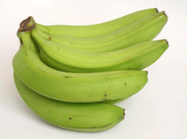
Quality
Object
Quality
isa
isa
Banana
isa
Color
isa
Green
instance
of at t₁
isa
instance of at t₁
Yellow
isa
Brown
Black

Slide 67
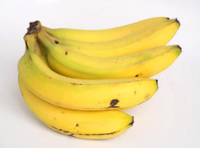
Quality
Object
Quality
isa
isa
Banana
isa
Color
isa
Green
instance
of at t₂
isa
instance of at t₂
Yellow
isa
Brown
Black

Slide 68
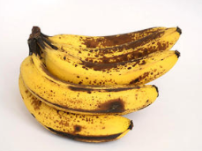
Quality
Object
Quality
isa
isa
Banana
isa
Color
isa
Green
instance
of at t₃
isa
Yellow
isa
Brown
instance of at t₃
Black

Slide 69
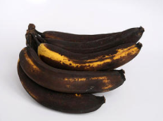
Quality
Object
Quality
isa
isa
Banana
isa
Color
isa
Green
instance
of at t₄
isa
Yellow
isa
Brown
Black
instance of at t₄

Slide 70
Inheres-in
(cl:comment "a inheres_in b =Def. a is a specifically dependent continuant and b is an independent continuant that is not a spatial region and a s-depends_on b. [tht-1]"
(forall (a b)
(iff (inheres-in a b)
(and (specifically-depends-on a b)
(exists (t)
(and (instance-of a specifically-dependent-continuant t)
(instance-of b independent-continuant t)
(not (instance-of b spatial-region t))))))))

Slide 71
S-dependence
(cl:comment "if s s-depends-on c then s and c never share common parts (s,c continuants) [nfe-1]“
(forall (s c)
(if (specifically-depends-on s c)
(not (exists (w t)
(and (continuant-part-of w s t)
(continuant-part-of w c t)))))))
(cl:comment "If s s-depends-on c then there's at least one time when they both exist and whenever s exists, c must also exist [iyu-1]“
(forall (s c)
(if (specifically-depends-on s c)
(and (exists (t) (and (exists-at s t)
(exists-at c t)))
(forall (t) (if (exists-at s t)
(exists-at c t)))))))

Slide 72
Relational Quality
Definition: b is a relational quality =Def. b is a quality and there exists c and d such that c and d are not identical, & b s-depends on c & b s-depends on d.
Quality
Relational
Quality
Instance of at t
isa
Instance
of at t
John’s love
for Mary
Instance
of at t
Mary’s love
for John
s-depends on
Mary
s-depends on
s-depends on
The love between
Mary and John
John
s-depends on

Slide 73
Relational quality definition
(cl:comment "DEFINITION: b is a relational quality = Def. b is a quality and there exists distinct c and d such that at all times t, b inheres in c if and only b specifically-depends-on. [dbp-1]"
(forall (b)
(iff (exists (t) (instance-of b relational-quality t))
(and (exists (c d)
(and (not (= c d))
(inheres-in b c )
(specifically-depends-on b d)))
(exists (t) (instance-of b quality t))))))

Slide 74
Realizable Entity
Realizable Entity
Disposition
Role
Elucidation: b is a disposition means:
b is a realizable entity
& this realization occurs
in virtue of the bearer’s physical make-up, and when and because this bearer is in some special physical circumstances,
& b is such that if it ceases to exist, then its bearer is physically changed.
Elucidation: b is a role means:
b is a realizable entity
& b exists because there is some single bearer that is in some special physical, social, or institutional set of circumstances in which this bearer does not have to be,
& b is not such that, if it ceases to exist, then the physical make-up of the bearer is thereby changed
  ISO/IEC PRF 21838-2:2020(E)

Slide 75
Function
Elucidation: A function is a disposition that exists in virtue of the bearer’s physical make-up and this physical make-up is something the bearer possesses because it came into being, either through evolution (in the case of natural biological entities) or through intentional design (in the case of artefacts), in order to realize processes of a certain sort.
Examples:
  The function of a hammer to drive in nails,
  the function of a heart pacemaker to regulate the beating of a heart through electricity.
  ISO/IEC PRF 21838-2:2020(E)

Slide 76
Function / role
Object #1 is designed to do y-type processes:
  → ‘to do y-type processes’ is #1’s function.
Object #1 is bought by somebody to do only z-type processes:
  → ‘to do y-type processes’ is still its function
  → ‘to do z-type processes’ is an acquired role.
Object #1 is then bought by somebody to do only w-type processes:
  → ‘to do y-type processes’ is still its function,
  → ‘to do w-type processes’ is an acquired role,
  → the role ‘to do z-type processes’ is lost.
Somebody is only interested in z-type processes, knows that object #1 can be used for that and creates object #2 exactly similar to object #1 to do z-type process:
  → ‘to do z-type processes’ is %2’s function
  → ‘to do y-type processes’ is not %2’s function

Slide 77
!!!!
You do not need to know all these details by heart
but
You must be able to correctly apply them!

