Slide 1
16th International Conference on Biological and Biomedical Ontology (ICBO 2025) Online: 9-11 November 2025 History in the Basic Formal Ontology
Werner CEUSTERS ^{1,2,3} and Alan RUTTENBERG ³
¹ Department of Biomedical Informatics, University at Buffalo, USA
² Department of Psychiatry, University at Buffalo, USA
³ National Center for Ontological Research

Slide 2
Problem: the definition of ‘history’ in the BFO2020
A History is ‘a Process that is the sum of the totality of Processes taking place in the Spatiotemporal Region occupied by the material part of a Material Entity [138-BFO]. Example: the life of an organism from the beginning to the end of its existence.’ [capitalization and underline ours]
From: International Standards Organisation. ISO/IEC 21838-2:2021 - Information technology — Top-level ontologies (TLO) — Part 2: Basic Formal Ontology (BFO). 2021.

Slide 3
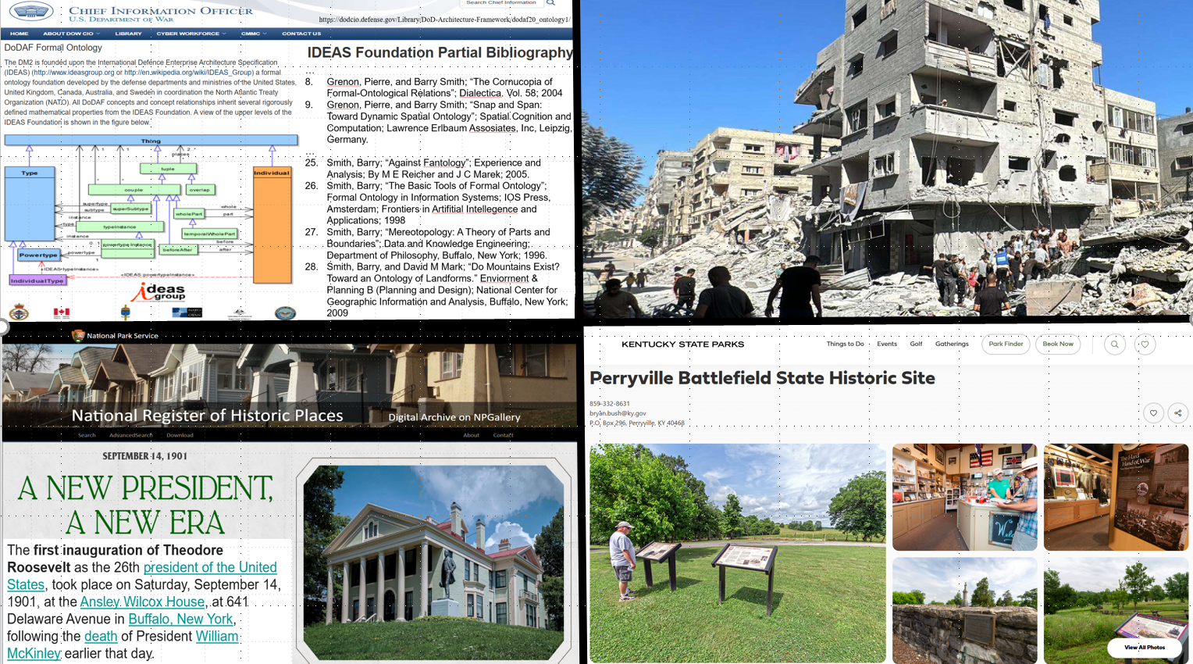
Basis of BFO used in NATO ontology
https://dodcio.defense.gov/Library/DoD-Architecture-Framework/dodaf20_ontology1/
3

Slide 4
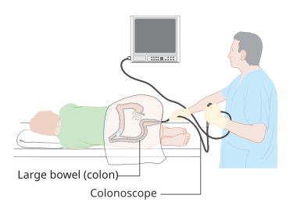
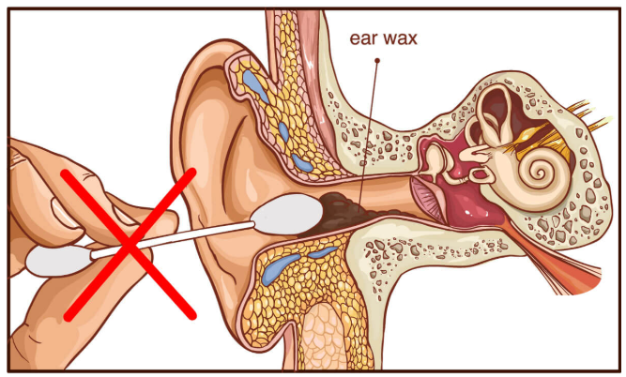
Colonoscopy or ear wax removal: not part of your history!
https://www.happyearshearing.com/safely-remove-ear-wax/
Image has been released as part of an open knowledge project by Cancer Research UK
4

Slide 5
The problem with BFO:history in a nutshell
Not all Processes a Material Entity participates in are parts of its History, though many should be;
The ‘histories’ of other sorts of entities, e.g. Sites, are not Histories.
The term ‘history’ has no face-value.
A History is ‘a Process that is the sum of the totality of Processes taking place in the Spatiotemporal Region occupied by the material part of a Material Entity [138-BFO]. Example: the life of an organism from the beginning to the end of its existence.’ [capitalization and underline ours]
From: International Standards Organisation. ISO/IEC 21838-2:2021 - Information technology — Top-level ontologies (TLO) — Part 2: Basic Formal Ontology (BFO). 2021.

Slide 6
Presentation overview
Distinctions between BFO Theory and BFO renderings;
The history of History in the BFO literature;
Use of ‘history’ and BFO:history in the BioPortal’s representational artifacts;
Points of critique;
Potential solutions.

Slide 7
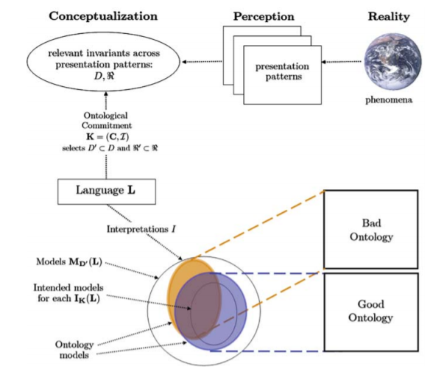
Standard ontology development framework
Ontological principles
Logical principles
What Is an Ontology? Nicola Guarino, Daniel Oberle, and Steffen Staab, S. Staab and R. Studer (eds.), Handbook on Ontologies, International Handbooks 1 on Information Systems, DOI 10.1007/978-3-540-92673-3, Springer-Verlag Berlin Heidelberg 2009. [Highlights and colored text added]

Slide 8
BFO framework
BFO Theory
BFO ontologies
axioms
vocabulary
OWL FOL
Ontological principles
Logical principles
Representational
Drift / burden
What Is an Ontology? Nicola Guarino, Daniel Oberle, and Steffen Staab, S. Staab and R. Studer (eds.), Handbook on Ontologies, International Handbooks 1 on Information Systems, DOI 10.1007/978-3-540-92673-3, Springer-Verlag Berlin Heidelberg 2009.

Slide 9
Presentation overview
Distinctions between BFO Theory and BFO renderings;
The history of History in the BFO;
Use of ‘history’ and BFO:history in the BioPortal’s representational artifacts;
Points of critique;
Potential solutions.

Slide 10
The history of ‘history’ in (the making of) the BFO (1)
‘We can define the life of a Continuant as the aggregate of the Occurrents in which it participates’ [2, p44].
[2] P. Grenon, B. Smith. Persistence and Ontological Pluralism. In: C Kanzian, editor. Persistence. Boston: De Gruyter; 2007.
‘a history is a Process that is the sum of the totality of Processes taking place in the Spatiotemporal Region occupied by a Material Entity or Site, including Processes on the surface of the entity or within the cavities to which it serves as host [138-001]’ [4, p70].
[4] Barry Smith, Mauricio Almeida, Jonathan Bona, Mathias Brochhausen, et al. Basic Formal Ontology 2.0 - Specification and user's guide.2015 June 26, 2015.
Motivation
‘participation’ is too vaguely elucidated;
‘process aggregate’ was removed as type-term;
How would specifically and generically dependent continuants occupy spatiotemporal regions?

Slide 11
The history of ‘history’ in (the making of) the BFO (2)
‘We can define the life of a Continuant as the aggregate of the Occurrents in which it participates’ [2, p44].
[2] P. Grenon, B. Smith. Persistence and Ontological Pluralism. In: C Kanzian, editor. Persistence. Boston: De Gruyter; 2007.
‘a history is a Process that is the sum of the totality of Processes taking place in the Spatiotemporal Region occupied by a Material Entity or Site, including Processes on the surface of the entity or within the cavities to which it serves as host [138-001]’ [4, p70].
[4] Barry Smith, Mauricio Almeida, Jonathan Bona, Mathias Brochhausen, et al. Basic Formal Ontology 2.0 - Specification and user's guide.2015 June 26, 2015.
‘The relation between a Material Entity and its History is one-to-one. Histories are thus very special kinds of Processes, since not only is it the case that, for any Material Entity or Site, there is exactly one Process which is its history, it is also the case that (by definition of BFO: history) there is for every history exactly one Material Entity or Site that it is the history of’ [4, p71].
Motivation
‘participation’ is too vaguely elucidated;
‘process aggregate’ was removed as type-term;
How would specifically and generically dependent continuants occupy spatiotemporal regions?
‘Dictate’ enforced because of the limitations of OWL.

Slide 12
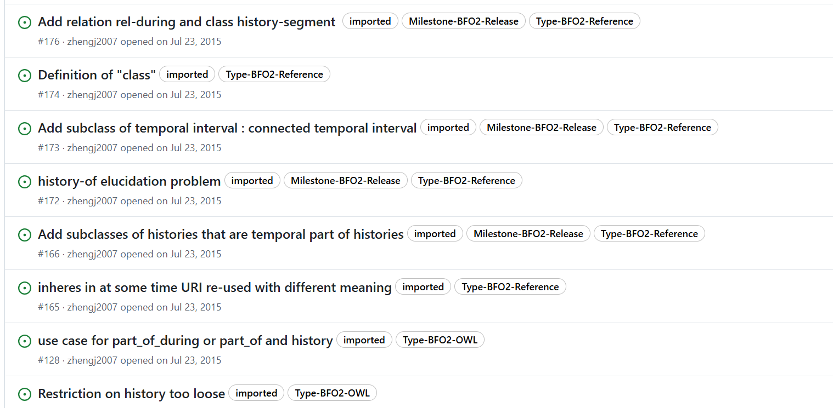
Basis of the 1:1 correspondence requirement: desire to represent ‘history-segments’ in OWL
https://github.com/BFO-ontology/BFO/issues?q=is%3Aissue%20history

Slide 13
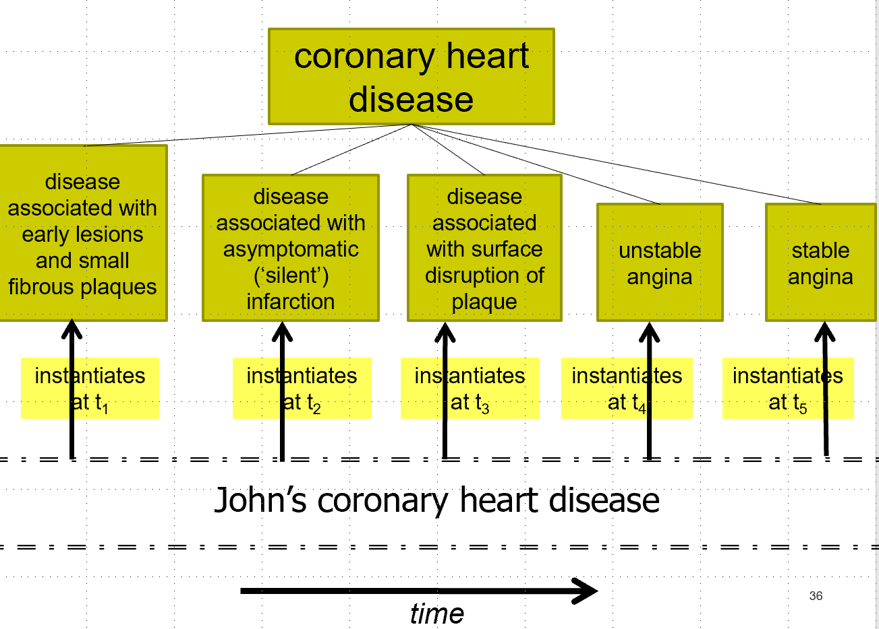
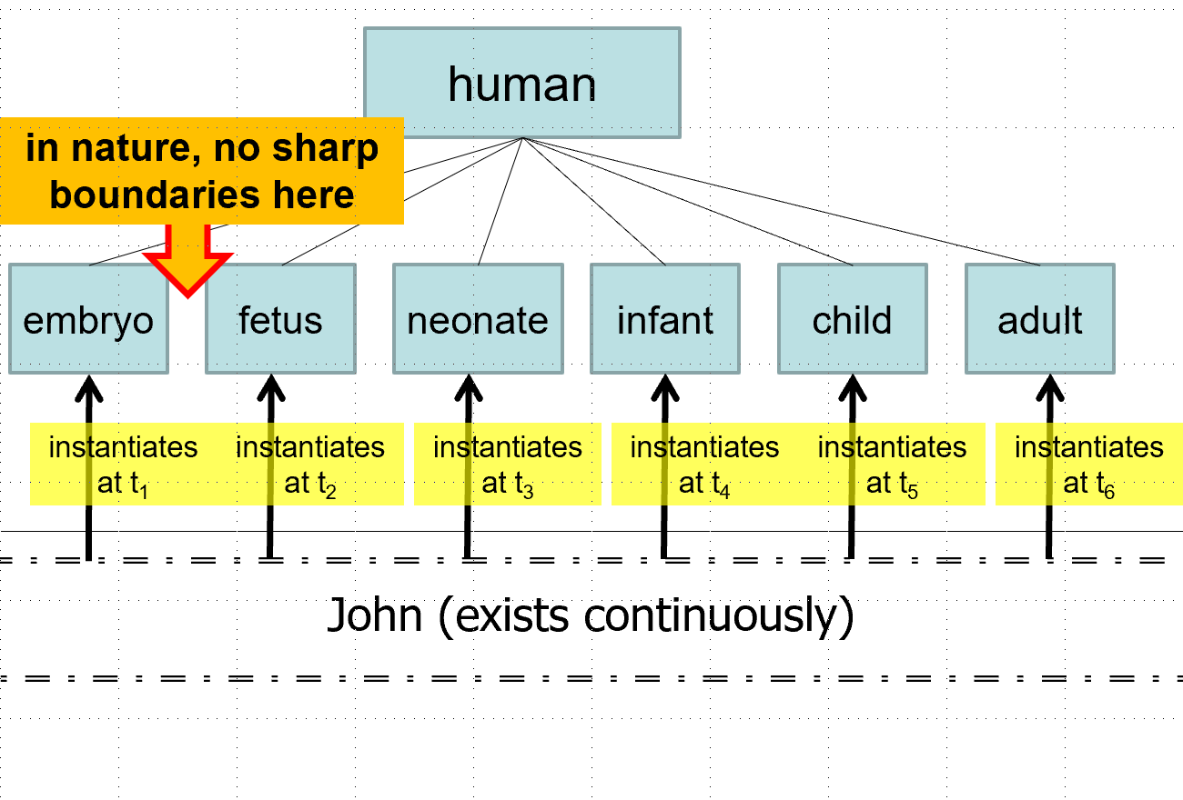

‘History’-segments and ‘development’-stages
Slides from B. Smith, ‘The Ontology for General Medical Science’, 11/5/2012
Available from: https://www.slideserve.com/clove/the-ontology-for-general-medical-science#google_vignette

Slide 14
Would there be a 1:1 correspondence between a continuant and a history ?
1 continuant → 1 history: follows from the definition
any Spatiotemporal Region in which Processes take place can have only one sum of these processes;
if such Spatiotemporal Region is ‘occupied by’ a continuant, only then is such sum a history;
1 history → 1 continuant: not guaranteed
no BFO axioms prevent a site and a material entity to spatially occupy the same spatial region.

Slide 15
The history of ‘history’ in (the making of) the BFO (3)
‘a history is a Process that is the sum of the totality of Processes taking place in the Spatiotemporal Region occupied by a Material Entity or Site, including Processes on the surface of the entity or within the cavities to which it serves as host [138-001]’ [4, p70].
‘The relation between a Material Entity and its History is one-to-one.
‘a history is a Process that is the sum of the totality of Processes taking place in the Spatiotemporal Region occupied by the material part of a Material Entity [138-BFO].
‘The relation between a Material Entity and its History is one-to-one.

Slide 16
Current axiomatization of history in BFO2020-FOL
[gki-1] history is a universal
[zuj-1] history is subclass of process
[lga-1] a material entity participates in its history
[okt-1] every material-entity has a history
[rph-1] history-of has domain history and range material-entity
[uzz-1] material entity and its history exist at exactly the same times
[vvy-1] every history is the history of something
‘Hard-coding’ of the 1:1 correspondence between an entity and its history
[woe-1] history-of is functional on first argument (forall (p q r) (if (and (history-of p q) (history-of r q)) (= p r)))
[zek-1] history-of is functional on second argument (forall (p q r) (if (and (history-of p q) (history-of p r)) (= q r)))

Slide 17
Presentation overview
Distinctions between BFO Theory and BFO renderings;
The history of History in the BFO;
Use of ‘history’ and BFO:history in the BioPortal’s representational artifacts;
Points of critique;
Potential solutions.

Slide 18
Use of ‘history’ in BioPortal Ontologies (November, 30 2023)
1,169 artifacts
124 include ‘history’ as a class
42 of these ‘history’ classes are not BFO’s history
18 do not define ‘history’
18 other define it in a way what would make it in BFO
- a process (but not history)
- a generically dependent continuant
- an independent continuant
6 define it so as to conflate occurrents and continuants
82 import BFO’s history ( 80 BFO 2.0 ; 2 BFO 2020 )
10 have subtypes of BFO history
9 defined 8 history subtypes incompatible with BFO’s history definition
1 has it trivially right but is at risk for a combinatorial explosion

Slide 19
Inappropriate subtypes of BFO:History in the BioPortal
disease course: ‘the totality of all processes through which a given disease instance is realized’
experience: ‘to conscious events in general, more specifically to perceptions, or to the practical knowledge and familiarity that is produced by these conscious processes’
kidney transplant status: ‘used to specify conditions like chronic kidey [sic] disease’
life course: ‘a processual entity which has as parts all the processes in which a given organism is participant’
life cycle: ‘an entire span of an organism's life, commencing with the zygote stage and ending in the death of the organism’
life history: ‘a history which includes all the processes during which resources are used by an organism to grow, survive, and reproduce over its lifetime’
provenance: ‘the process history leading to the creation and current condition of an artifact’
radiation attenuation: ‘the reduction of radiation intensity upon passage of radiation through matter’

Slide 20
Inappropriate subtypes of BFO:History in the BioPortal
History subclasses as documented | Critique
disease course: ‘the totality of all processes through which a given disease instance is realized’ | some of the material entities that participate in such processes surely exist prior to these processes
experience: ‘to conscious events in general, more specifically to perceptions, or to the practical knowledge and familiarity that is produced by these conscious processes’ | mixes processes with continuants that are the output of such processes, and such union cannot be a process
kidney transplant status: ‘used to specify conditions like chronic kidey [sic] disease’ | such a status is not a Process, hence not a History
life course: ‘a processual entity which has as parts all the processes in which a given organism is participant’ | participation is not time-indexed in this definition, and includes processes outside the material parts of the organism.
life cycle: ‘an entire span of an organism's life, commencing with the zygote stage and ending in the death of the organism’ | assumes that an organism ceases to exist when death, otherwise it would be only part of a history and a part of history cannot be another history of the same entity
life history: ‘a history which includes all the processes during which resources are used by an organism to grow, survive, and reproduce over its lifetime’ | assumes (1) that such processes are the only processes that an organism o can participate in, and (2) that o ceases to exist when it stops being alive.
provenance: ‘the process history leading to the creation and current condition of an artifact’ | includes processes prior to the existence of the artifact and excludes processes that occur after the current condition.
radiation attenuation: ‘the reduction of radiation intensity upon passage of radiation through matter’ | the ‘matter’ surely existed before the passage of radiation; the attenuation is thus at best only part of the matter’s history.

Slide 21
Presentation overview
Distinctions between BFO Theory and BFO renderings;
The history of History in the BFO;
Use of ‘history’ and BFO:history in the BioPortal’s representational artifacts;
Points of critique;
Potential solutions.

Slide 22
Some points of critique
Methodological:
the limitations of OWL drove the decision to impose the restrictions without providing metaphysical arguments.
Terminological:
it doesn’t seem right to use the term ‘history’ when it means ‘history of the material parts of a material entity’.
Content-wise:
Incomplete axiomatization;
If the term ‘history’ is indeed a misnomer, then BFO is currently silent about whether other continuants can have ‘histories’ too.
→ opportunity to address some current shortcomings in future version.

Slide 23
Presentation overview
Distinctions between BFO Theory and BFO renderings;
The history of History in the BFO;
Use of ‘history’ and BFO:history in the BioPortal’s representational artifacts;
Points of critique;
Potential solutions.

Slide 24
Conservative corrections (1)
Change the label:
History → History of the material part of a Material Entity
Axiomatize the existing definition by specifying:
what ‘occupied by’ means, e.g. Spatiotemporal Region str is ‘occupied by’ Continuant c iff:
str temporally-projects-onto some Temporal Region mtr,
str spatially-projects-onto some Spatial Region msr at mtr,
at any temporal part t of mtr, str spatially-projects-onto some continuant part msr(t) of Spatial Region msr,
c only exists-at Temporal Regions which are temporal parts of mtr, and
at any Temporal Region t that c exists at, c occupies-spatial-region msr(t).
that every Process that spatiotemporally-occupies a Spatiotemporal Region which is an occurrent-part-of the Spatiotemporal Region spatiotemporally-occupied-by a History h is an occurrent-part-of h.

Slide 25
Conservative corrections (2)
Remove the hard-coded 1:1 correspondence (axioms [woe-1] and [zek-1]).
Expand the definition for history:
A history* is a Process that is the sum of the totality of Processes taking place in the Spatiotemporal Region occupied by an Independent Continuant.
‘History of the material part of a material entity’ would then be one of its subtypes.
Replace ‘material entity’ in the existing history axioms by ‘independent continuant’.
What do we win:
Although Sites can overlap Material Entities, it is hardly conceivable that non-fiat Sites can have a History identical with the History of a Material Entity.
One can leave it to BFO-OWL renderings to include a subtype of history whose instances exhibit 1:1.

Slide 26
Substantive ‘local’ improvement
More inclusive definition of history:
A history* is a process that is the sum of the totality of (1) Processes P1 taking place in the Spatiotemporal Region ‘occupied by’ at least one Independent Continuant, and (2) Processes P2 ‘suitably related’ to Processes P1.
‘Suitably related’ examples of P2 processes:
Occurring in Sites that are continuant-part-of a Material Entity or in Sites that are boundary dependent on a Material Entity;
Occurring in Sites in which the Independent Continuant is located and that bring about some changes in parts of that Independent Continuant;
…

Slide 27
Expansive improvement: adopting (parts of / modifications of) an explicit change theory
Werner Ceusters, A. Ruttenberg. Towards Representing Change in the BFO. Formal Ontology In Information systems (FOIS 2025); Catania, Italy 2025
https://pubmed.ncbi.nlm.nih.gov/40949106/

Slide 28
Definition of change
D1. A change is an Occurrent that happens
(1) to at least one Continuant that is not a Spatial Region and
(2) in a Process p such that in the course of p some particular comes in or goes out of existence or exhibits a difference in some relation to another entity, including differences in instantiation.
E1+: A history+ is a Process that is the sum of the totality of temporal parts of Processes in which a change happens to some instance of Continuant.
→ What we win: specifically and generically dependent continuants can have histories without being bothered by spatial considerations.
Werner Ceusters, A. Ruttenberg. Towards Representing Change in the BFO. Formal Ontology In Information systems (FOIS 2025); Catania, Italy 2025 https://pubmed.ncbi.nlm.nih.gov/40949106/
Minimally expansive history definition

Slide 29
Relevant subtypes of change (1)
D2. mono-sequential change: a change c all whose occurrent parts that are changes stand in the temporal-layer-of relation to c
Werner Ceusters, A. Ruttenberg. Towards Representing Change in the BFO. Formal Ontology In Information systems (FOIS 2025); Catania, Italy 2025 https://pubmed.ncbi.nlm.nih.gov/40949106/

Slide 30
Mono-sequential change
cch is a change whose occurrent parts that are changes are temporal layers of cch.
t₁
t₂
(forall (a b)
(iff (temporal-layer-of a b)
(exists (t)
(and (occurrent-part-of a b)
(not (instance-of a temporal-region t))
(exists-throughout a t)
(exists-throughout b t))))))
(forall (cch t)
(if (and (instance-of cch mono-sequential-change t)
(happens-throughout cch t))
(forall (ch)
(iff (temporal-layer-of ch cch)
(and (instance-of ch change t)
(happens-throughout ch t)))))))
t: temporal region
happens-throughout
h: spatial change of head
n: spatial change of nose
c: spatial change of ear
l: spatial change of earlobe
Werner Ceusters, A. Ruttenberg. Towards Representing Change in the BFO. Formal Ontology In Information systems (FOIS 2025); Catania, Italy 2025 https://pubmed.ncbi.nlm.nih.gov/40949106/
temporal-layer-of

Slide 31
Relevant subtypes of change
D2. mono-sequential change: a change c all whose occurrent parts that are changes stand in the temporal-layer-of relation to c
D3. simple change: a mono-sequential change that happens to precisely one Continuant and has no change as proper occurrent part
D4. change sequence: a change whose proper-temporal parts that are mono-sequential changes are temporally ordered
D5. change profile: change sequence whose sequence parts are mono-sequential changes all of which are simple changes that happen to the same Continuant
Werner Ceusters, A. Ruttenberg. Towards Representing Change in the BFO. Formal Ontology In Information systems (FOIS 2025); Catania, Italy 2025 https://pubmed.ncbi.nlm.nih.gov/40949106/

Slide 32
Maximally expansive history definition
D2. mono-sequential change: a change c all whose occurrent parts that are changes stand in the temporal-layer-of relation to c
D3. simple change: a mono-sequential change that happens to precisely one Continuant and has no change as proper occurrent part
D4. change sequence: a change whose proper-temporal parts that are mono-sequential changes are temporally ordered
D5. change profile: change sequence whose sequence parts are mono-sequential changes all of which are simple changes that happen to the same Continuant
E1+* A history+* is a change sequence comprised of all changes that happen-to, or are suitably related to what happens-to, a continuant.

Slide 33
Major advantages of E1+*
E1+* A history+* is a change sequence comprised of all changes that happen-to, or are suitably related to what happens-to, a continuant.
Advantages:
Applicable to all sorts of continuants
Automatic preservation of the desired 1:1 correspondence
Example:
the Nobel Committee decides on the nominees for economy. At the moment of that decision each nominee undergoes a change in that they acquire a role: nominee for Nobel prize. The decision and the role acquisition are suitably related, and would constitute a change sequence, which would be part of the History+* of the nominees.

Slide 34
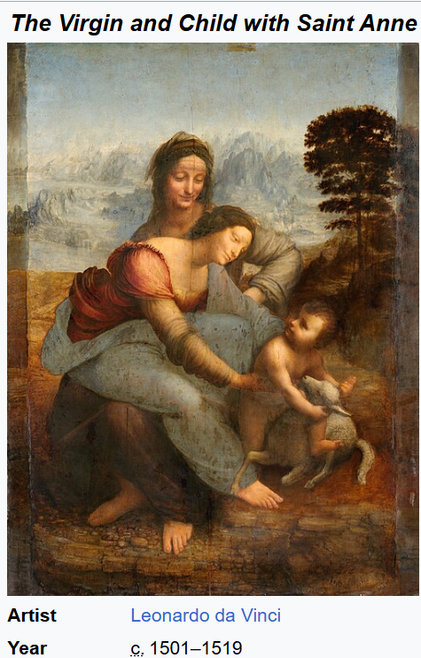
Disadvantage?
Image has been released as part of an open knowledge project by Cancer Research UK
34

Slide 35
Conclusion and take-away messages
The type ‘history’ is in BFO2020 too restrictively defined compared to what scholars closely involved in the development of the BFO have published about it over the past 25 years.
Correcting it in future versions has barely impact on existing representational artifacts (RAs):
Several publicly published RAs not dependent on the BFO use ‘history’ in a variety of meanings, predominantly not related to BFO’s type.
Most RAs that include BFO:history don’t use the type.
Of the few RAs that do use BFO:history, only one uses it correctly.
There are some easy fixes that bring clarity but keep most of the restrictions, while a comprehensive solution requires other parts of the BFO to be expanded.

